Slide 1
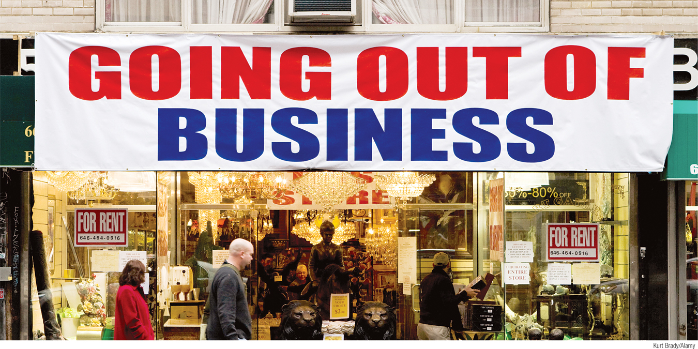
Explain the difference between short-run and long-run macroeconomic equilibrium
Describe the causes and effects of demand shocks and supply shocks
Determine if an economy is experiencing a recessionary or an inflationary gap and explain how to calculate the size of an output gap
What You Will Learn in this Module
Section 4 | Module 19

Slide 2
The AS–AD Model
The AS-AD model uses the aggregate supply curve and the aggregate demand curve together to analyze economic fluctuations.
Section 4 | Module 19

Slide 3
Short-Run Macroeconomic Equilibrium
The economy is in short-run macroeconomic equilibrium when the quantity of aggregate output supplied is equal to the quantity demanded.
The short-run equilibrium aggregate price level is the aggregate price level in the short-run macroeconomic equilibrium.
Short-run equilibrium aggregate output is the quantity of aggregate output produced in the short-run macroeconomic equilibrium.
Section 4 | Module 19

Slide 4
The AS–AD Model
Aggregate price
level
S
R
AS
Short-run macroeconomic equilibrium
P
E
E
SR
AD
Y
E
Real GDP
Section 4 | Module 19

Slide 5
Demand Shocks
(a) A Negative Demand Shock
(b) A Positive Demand Shock
Aggregate
price level
Aggregate
price level
A positive
demand shock...
A negative
demand shock...
S
R
AS
S
R
AS
P
1
E
P
E
...leads to a higher
aggregate price
level and higher
aggregate output.
1
2
2
...leads to a lower aggregate price level and lower aggregate output.
P
2
E
P
E
2
1
1
AD
1
AD
2
AD
2
AD
1
Y
2
Y
1
Real GDP
Y
1
Y
2
Real GDP
Section 4 | Module 19

Slide 6
Supply Shocks
(a) A Negative Supply Shock
(b) A Positive Supply Shock
Aggregate
price level
Aggregate
price level
A negative
supply shock...
A positive supply shock...
SRAS
SRAS
2
SRAS
1
SRAS
E
1
E
2
2
1
P
2
P
1
…leads to a lower aggregate output and a higher aggregate price level.
...leads to a higher
aggregate output and lower aggregate price level.
P
E
1
P
E
2
1
2
AD
AD
Y
2
Y
1
Real GDP
Y
1
Y
2
Real GDP
Section 4 | Module 19

Slide 7
Negative Supply Shocks
Stagflation is the combination of inflation and stagnating (or falling) aggregate output.
“Stagnation plus inflation”
Section 4 | Module 19

Slide 8
Long-Run Macroeconomic Equilibrium
The economy is in long-run macroeconomic equilibrium when the point of short-run macroeconomic equilibrium is on the long-run aggregate supply curve.
Section 4 | Module 19

Slide 9
Long-Run Macroeconomic Equilibrium
Aggregate
price level
L
R
AS
S
R
AS
P
E
Long-run
Macroeconomic
equilibrium
E
LR
AD
Y
P
Real GDP
Potential output
Section 4 | Module 19

Slide 10
Short-Run Versus Long-Run Effects of a Negative Demand Shock
Aggregate
price level
2. …reduces the aggregate
price level and aggregate
output and leads to higher
unemployment in the short run…
L
R
AS
S
R
AS
1
SRAS
2
P
1
E
1. An initial
negative
demand shock…
1
P
2
3. …until an eventual
fall in nominal wages
in the long run increases
short-run aggregate supply and moves the economy back to potential output.
E
2
P
3
E
3
AD
1
AD
2
Y
2
Y
1
Potential
output
Real GDP
Recessionary gap
Section 4 | Module 19

Slide 11
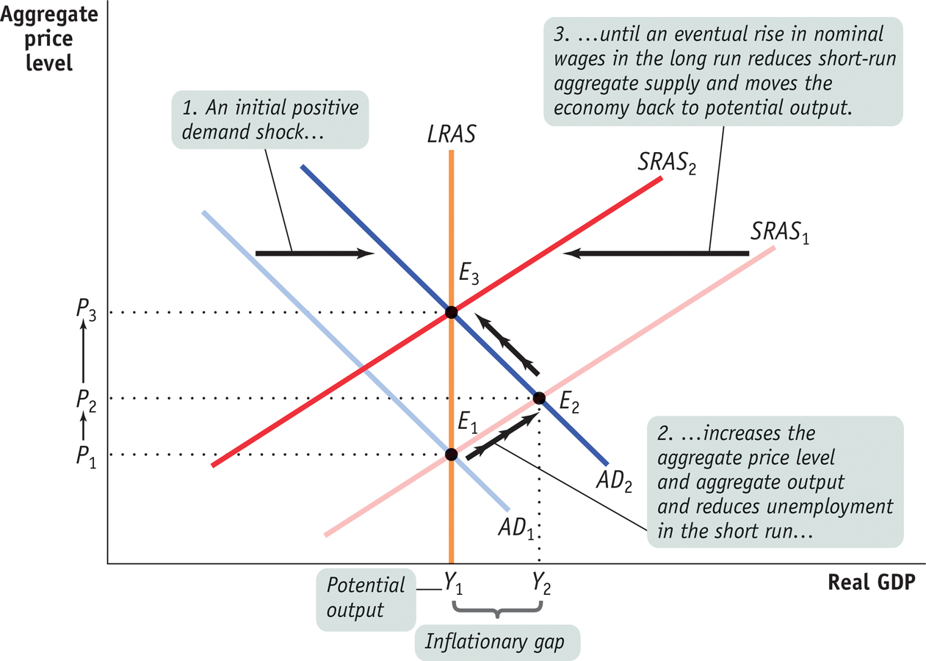
Short-Run Versus Long-Run Effects of a Positive Demand Shock
Section 4 | Module 19

Slide 12
Long-Run Macroeconomic Equilibrium
There is a recessionary gap when aggregate output is below potential output.
There is an inflationary gap when aggregate output is above potential output.
The output gap is the percentage difference between actual aggregate output and potential output.
Section 4 | Module 19

Slide 13
Long-Run Macroeconomic Equilibrium
The economy is self-correcting when shocks to aggregate demand affect aggregate output in the short run, but not the long run.
Section 4 | Module 19

Slide 14
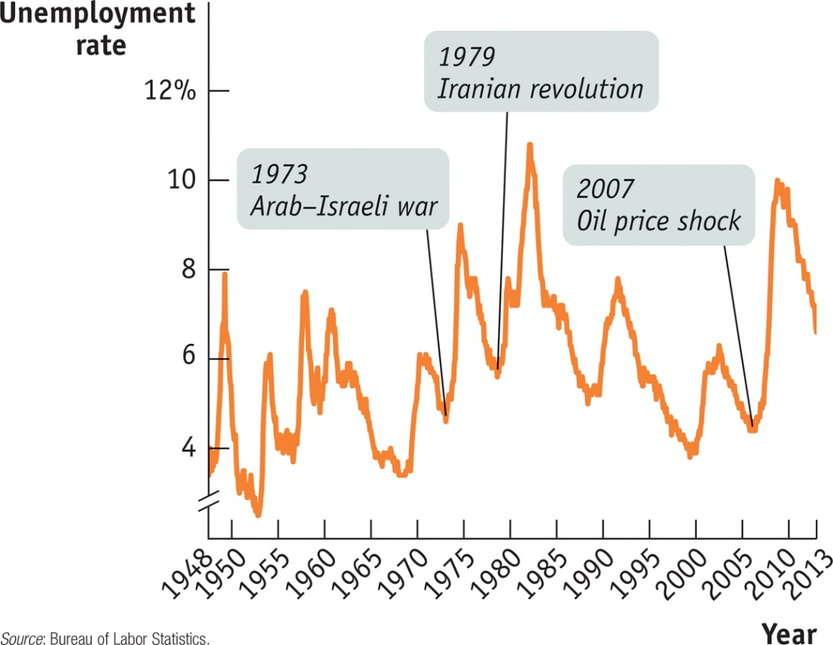
F Y I
Supply Shocks versus Demand Shocks in Practice
Recessions are mainly caused by demand shocks. But when a negative supply shock does happen, the resulting recession tends to be particularly severe.
There’s a reason the aftermath of a supply shock tends to be particularly severe for the economy: macroeconomic policy has a much harder time dealing with supply shocks than with demand shocks.
Section 4 | Module 19

Slide 15
Summary
In the AD–AS model, the intersection of the short-run aggregate supply curve and the aggregate demand curve is the point of short-run macroeconomic equilibrium. It determines the short-run equilibrium aggregate price level and the level of short-run equilibrium aggregate output.
A demand shock causes the aggregate price level and aggregate output to move in the same direction as the economy moves a long the short-run aggregate supply curve.
A supply shock causes them to move in opposite directions as the economy moves along the aggregate demand curve.
Stagflation is inflation and falling aggregate output and is caused by a negative supply shock.
Section 4 | Module 19

Slide 16
Summary
Demand shocks have only short-run effects on aggregate output because the economy is self-correcting in the long run.
In a recessionary gap, an eventual fall in nominal wages moves the economy to long-run macroeconomic equilibrium, where aggregate output is equal to potential output.
In an inflationary gap, an eventual rise in nominal wages moves the economy to long-run macroeconomic equilibrium.
The output gap is the percentage difference between actual aggregate output and potential output
Section 4 | Module 19

Slide 17
Practice
An increase in investment leads to _______ in the price level and _______ in real GDP in the short run. Include a correctly drawn AD/AS graph to support your answer. A. an increase; no change
B. A decrease; no change
C. no change; no change
D. an increase; an increase
E. a decrease; a decrease
Expectations of a lower rate of inflation shift the _________ to the _________. Include a correctly drawn AD/AS graph to support your answer.
A. long-run aggregate supply curve; left B. aggregate demand curve; left
C. short-run aggregate supply curve; right
D. aggregate demand curve; right E. short-run aggregate supply curve; left
Inflationary and recessionary gaps are closed by self-correcting adjustments that shift
A. the SRAS curve. B. The AD curve. And the SRAS curce C. The LRAS curve.
D. both the SRAS curve and the LRAS curve.
E. both the AD curve and LRAS curve.

Slide 18
Further practice (answer key will be posted soon)
Use AD/AS graphs to show the SR effects of each of the following shocks on the PL and RGDP
The price of copper, steel and other commodities has risen in global markets
A weak auto industry has prompted less investment spending by many firms that manufacture auto parts
Congress lowers taxes and increases spending
More and more students graduating from high school and receiving college degrees
Newspapers report housing sales have decreased for the third month in a row

Slide 19
Even More!
Draw a graph that shows the economy currently in LR equilibrium
Suppose household wealth has been falling for several months. Given this, adjust your graph to show both the SR change in PL and RDGP
Describe how the economy will adjust in the LR. Using the graph you drew in part a, show this adjustment to LR equilibrium

