Slide 1
Use the aggregate demand curve to illustrate the relationship between the aggregate price level and the quantity of aggregate output demanded in the economy
Explain how the wealth effect and interest rate effect give the aggregate demand curve a negative slope
Identify the factors that can shift the aggregate demand curve
What You Will Learn in this Module
Section 4 | Module 17

Slide 2
Aggregate Demand
The aggregate demand curve shows the relationship between the aggregate price level and the quantity of aggregate output demanded by households, businesses, the government and the rest of the world.
Section 4 | Module 17

Slide 3
The Aggregate Demand Curve
Aggregate price
level (GDP deflator,
2005 = 100)
A movement down the
AD curve leads to a lower
aggregate price level and
higher aggregate output.
1933
7.9
5.0
Aggregate demand
curve, AD
0
$716
950
Real GDP (billions of 2005 dollars)
Section 4 | Module 17

Slide 4
Why Is the Aggregate Demand Curve Downward Sloping?
When considering the aggregate demand curve, we consider a simultaneous change in the prices of all final goods and services.
It is downward-sloping for two reasons:
The first is the wealth effect of a change in the aggregate price level—a higher aggregate price level reduces the purchasing power of households’ wealth and reduces consumer spending.
The second is the interest rate effect of a change in aggregate the price level—a higher aggregate price level reduces the purchasing power of households’ money holdings, leading to a rise in interest rates and a fall in investment spending and consumer spending.
Section 4 | Module 17

Slide 5
Shifts of the Aggregate Demand Curve
The aggregate demand curve shifts because of:
changes in expectations
wealth
the stock of physical capital
government policies
fiscal policy
monetary policy
Section 4 | Module 17

Slide 6
Shifts of the Aggregate Demand Curve
(a) Rightward Shift
(b) Leftward Shift
Decrease in Aggregate Demand
Aggregate price level
Aggregate price level
Increase in
Aggregate Demand
AD
AD
AD
2
AD
1
1
2
Real GDP
Real GDP
Section 4 | Module 17

Slide 7
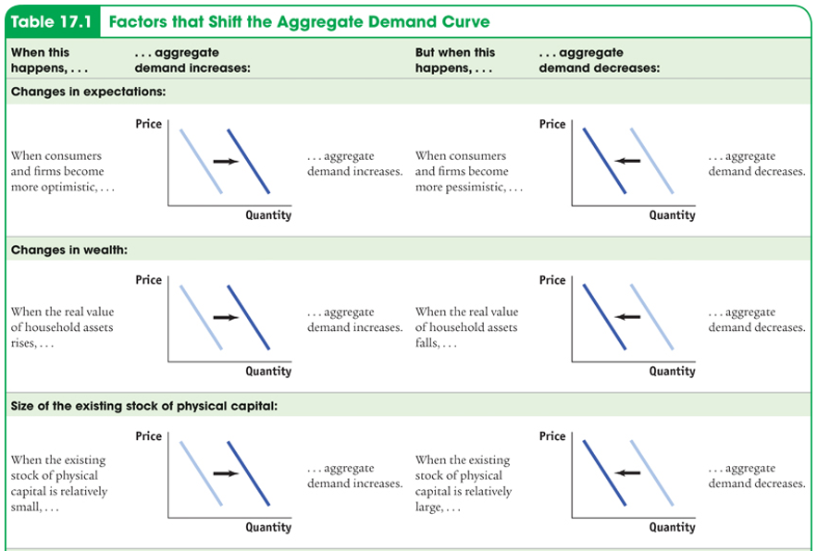
Factors that Shifts the Aggregate Demand Curve
Section 4 | Module 17

Slide 8
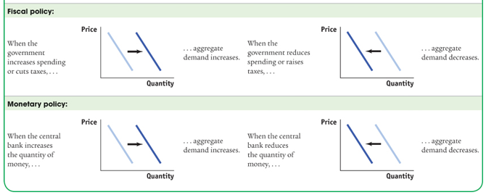
Factors that Shifts the Aggregate Demand Curve
Section 4 | Module 17

Slide 9
Practice
1. The interest rate effect is the tendency for changes in the price level to affect
A. the quantity of investment demanded and thus affect interest rates.
B. export demand and thus affect aggregate demand.
C. interest rates and thus affect the quantity of investment and consumption
^{demanded.}
D. real incomes and lead to shifts in potential output.
E. interest rates and thus affect the productivity of existing capital equipment.
2. Draw a correctly labeled graph to show the impact of an increase in taxes on aggregate demand.
3. When the aggregate price level rises, this will, other things equal,
A. lead to a rightward shift in the AD curve.
B. Lead to a leftward shift in the AD curve.
C. result in a decrease in the quantity of aggregate output demanded.
D. result in an increase in the quantity of aggregate output demanded.
E. result in a decrease in the quantity of aggregate output supplied.

Slide 10
Summary
The aggregate demand curve shows the relationship between the aggregate price level and the quantity of aggregate output demanded.
The aggregate demand curve is downward sloping for two reasons: the wealth effect of a change in the aggregate price level and the interest rate effect of a change in the aggregate price level.
The aggregate demand curve shifts because of changes in expectations, changes in wealth not due to changes in the aggregate price level, and the effect of the size of the existing stock of physical capital.
Policy makers can use fiscal policy and monetary policy to shift the aggregate demand curve.
Section 4 | Module 17

