Slide 1
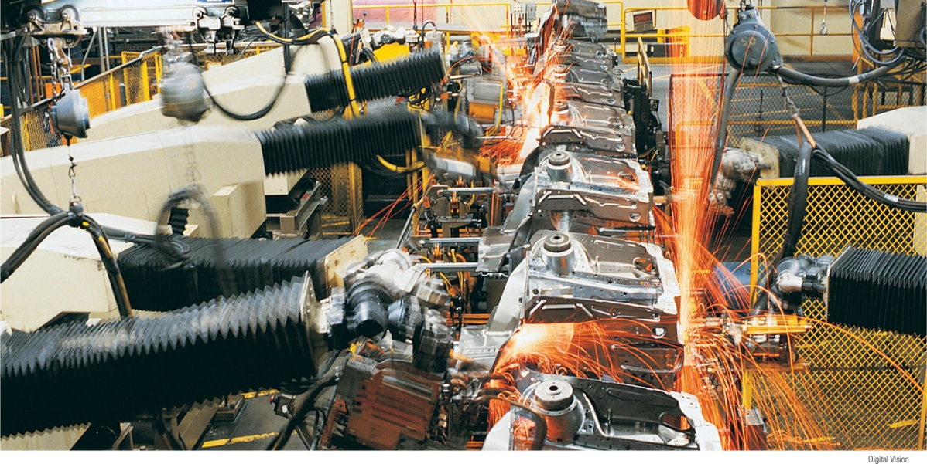
Use the aggregate supply curve to illustrate the relationship between the aggregate price level and the quantity of aggregate output supplied in the economy
Identify the factors can shift the aggregate supply curve
Explain why the aggregate supply curve is different in the short run from in the long run
What You Will Learn in this Module
Section 4 | Module 18

Slide 2
Todays Agenda
Quaaaz!
Self-grade worksheet
Aggregate Supply

Slide 3
Aggregate Supply
The aggregate supply curve shows the relationship between the aggregate price level and the quantity of aggregate output in the economy.
Section 4 | Module 18

Slide 4
The Short-Run Aggregate Supply Curve
The short-run aggregate supply curve is upward-sloping because nominal wages are sticky in the short run:
a higher aggregate price level leads to higher profits and increased aggregate output in the short run.
The nominal wage is the dollar amount of the wage paid.
Sticky wages are nominal wages that are slow to fall even in the face of high unemployment and slow to rise even in the face of labor shortages.
Section 4 | Module 18

Slide 5
The Short-Run Aggregate Supply Curve
[Insert Content Here]
Aggregate price
level (GDP deflator,
2005 = 100)
Short-run aggregate
supply curve, SRAS
10.6
1929
7.9
A movement down
the SRAS curve leads
to deflation and lower
aggregate output.
1933
0
$716
977
Real GDP (billions of
2005 dollars)
Section 4 | Module 18

Slide 6
Shifts of the Short-Run Aggregate Supply Curve
[Insert Content Here]
(a) Leftward Shift
(b) Rightward Shift
Aggregate price level
Aggregate
price level
SRAS
2
SRAS
1
SRAS
1
SRAS
2
Decrease in Short-Run Aggregate Supply
Increase in Short-Run
Aggregate Supply
Real GDP
Real GDP
Section 4 | Module 18

Slide 7
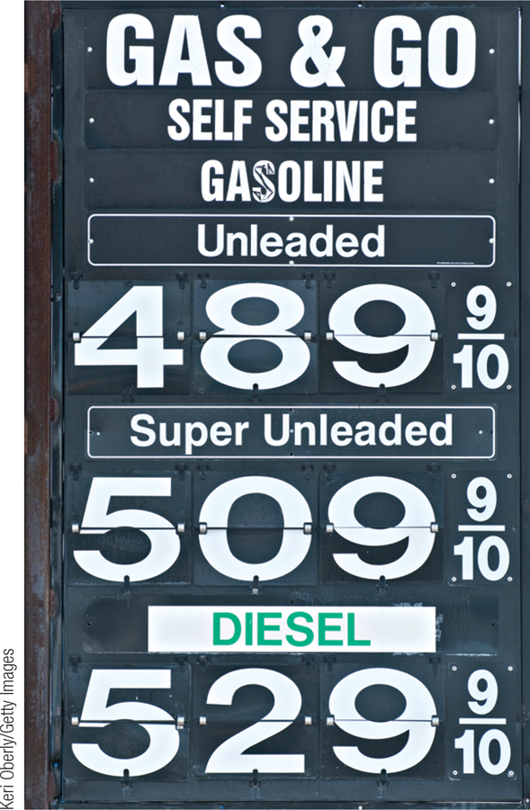
Shifts of the Short-Run Aggregate Supply Curve
Changes in expected inflation, commodity prices, nominal wages, or productivity lead to changes in producers’ profits and shift the short-run aggregate supply curve.
A commodity is a standardized input bought and sold in bulk quantities, such as oil, coffee, or copper.
Section 4 | Module 18

Slide 8
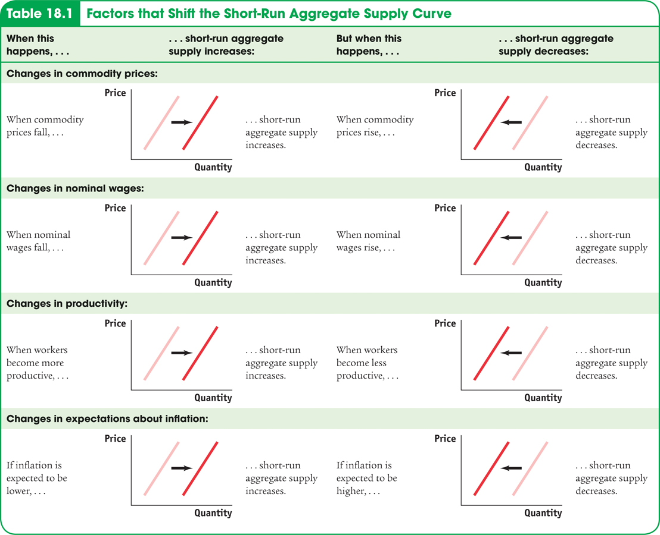
Factors that Shift Short-Run Aggregate Supply
Section 4 | Module 18

Slide 9
Long-Run Aggregate Supply Curve
The long-run aggregate supply curve shows the relationship between the aggregate price level and the quantity of aggregate output supplied that would exist if all prices, including nominal wages, were fully flexible.
Section 4 | Module 18

Slide 10
Long-Run Aggregate Supply Curve
[Insert Content Here]
Aggregate price
level (GDP deflator,
2005 = 100)
Long-run aggregate
supply curve, LRAS
15.0
…leaves the quantity
of aggregate output
supplied unchanged
in the long run.
A fall in the aggregate price level
7.5
0
Potential output, YP
$800
Real GDP (billions of
2005 dollars)
Section 4 | Module 18

Slide 11
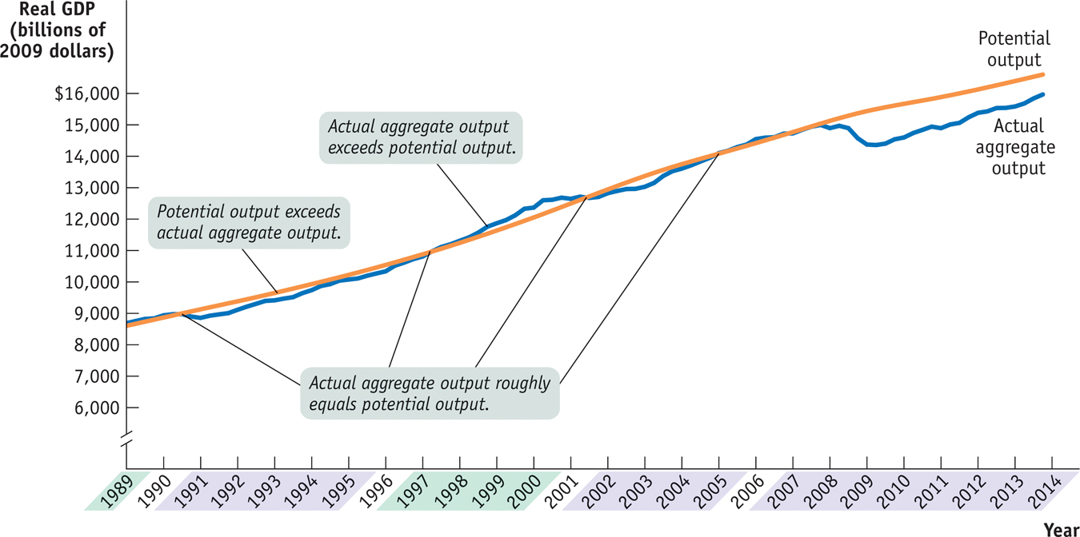
Actual and Potential Output from 1989 to 2013
Section 4 | Module 18

Slide 12
From the Short Run to the Long Run
(a) Leftward Shift of the Short-Run
Aggregate Supply Curve
(b) Rightward Shift of the Short-Run
Aggregate Supply Curve
Aggregate
price level
L
R
AS
Aggregate
price level
L
R
AS
S
R
AS
1
S
R
AS
2
S
R
AS
2
S
R
AS
1
A fall in nominal wages shifts SRAS rightward.
P
A₁
A₁
1
P
1
A rise in nominal
wages shifts SRAS
leftward.
Y
P
Y
1
Real GDP
Y
1
Y
P
Real GDP
Section 4 | Module 18

Slide 13
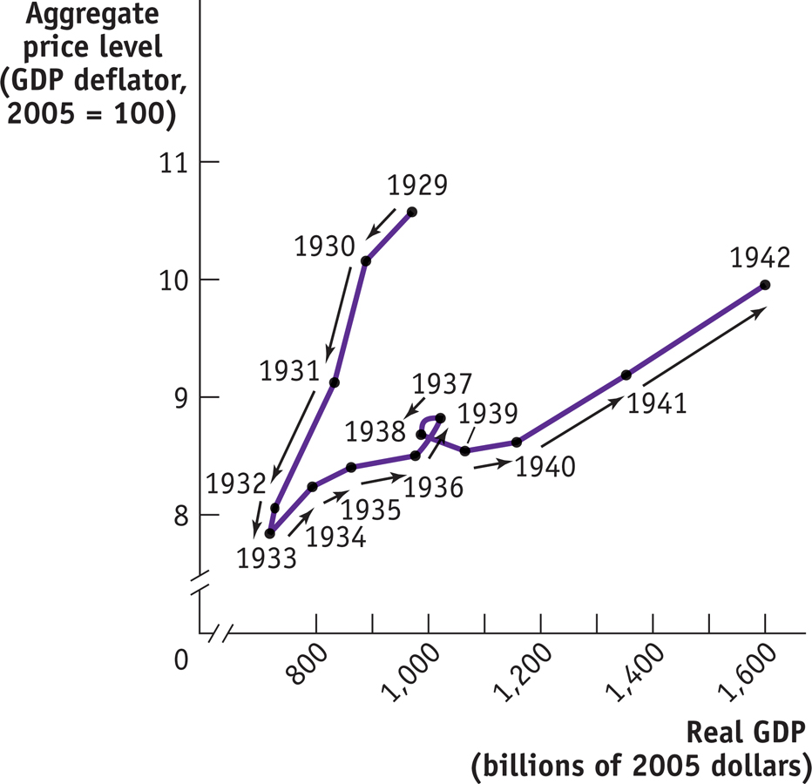
F Y I
Prices and Output During the Great Depression
Section 4 | Module 18

Slide 14
Summary
The aggregate supply curve shows the relationship between the aggregate price level and the quantity of aggregate output supplied.
The short-run aggregate supply curve is upward sloping because nominal wages are sticky in the short run.
Changes in commodity prices, nominal wages, and productivity lead to changes in producers’ profits and shift the short-run aggregate supply curve.
In the long run, all prices are flexible and the economy produces at its potential output, and the long-run aggregate supply curve is vertical at potential output.
Section 4 | Module 18

Slide 15
Practice
Which of the following will cause short-run aggregate supply to increase? A. a law that requires employers to provide health insurance for all employees.
B. An increase in the aggregate price level. C. A decrease in the price of oil. D. an increase in the minimum wage. E. a decrease in government transfer payments.
In the long run, the aggregate price level has A. no effect on the quantity of aggregate output. B. a positive effect on the quantity of aggregate output. C. a negative effect on the quantity of aggregate output. D. A positive impact on aggregate output, but no impact on employment.
E. a positive impact on employment, but no impact on aggregate output.

