Slide 1
What You Will Learn in this Module
Use macroeconomic models to conduct policy analysis
Improve your approach to free-response macroeconomic questions
Section 8 | Module 45

Slide 2
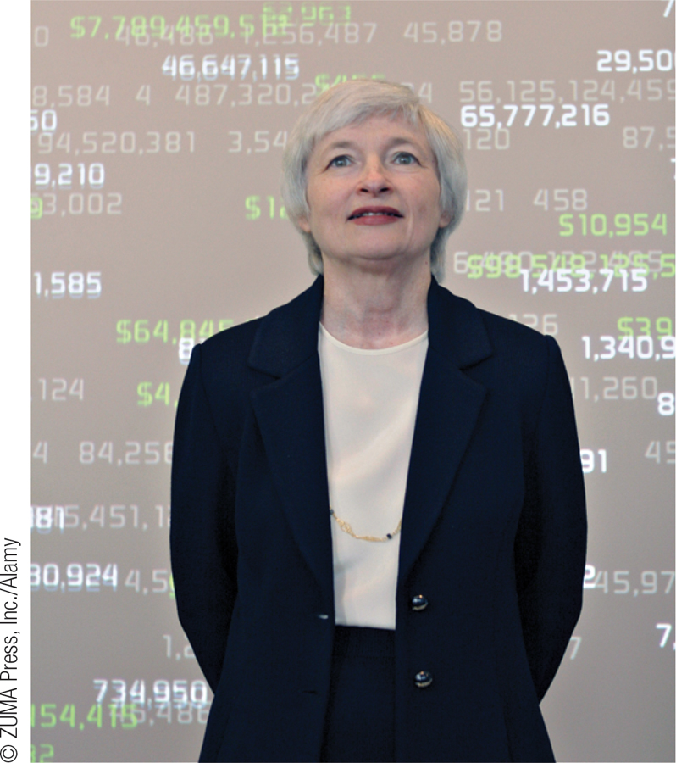
A Structure for Macroeconomic Analysis
Most macroeconomic problems have the following components:
A starting point
A pivotal event
Initial effects of the event
Secondary and long-run effects of the event
How will the Fed’s monetary policy change nominal interest rates?
Section 8 | Module 45

Slide 3
A Structure for Macroeconomic Analysis
For example:
Assume the U.S. economy is currently operating at an aggregate output level above potential output.
Draw a correctly labeled graph showing aggregate demand, short-run supply, long-run aggregate supply, equilibrium output, and the aggregate price level.
Now assume that the Federal Reserve conducts contractionary monetary policy.
Identify the open-market operation the Fed would conduct, and draw a correctly labeled graph of the money market to show the effect of the monetary policy on the nominal interest rate.
Section 8 | Module 45

Slide 4
A Structure for Macroeconomic Analysis
Show and explain how the Fed’s actions will affect equilibrium in the aggregate demand and supply graph you drew previously. Indicate the new aggregate price level on your graph.
Assume Canada is the largest trading partner of the United States. Draw a correctly labeled graph of the foreign exchange market for the U.S. dollar showing how the change in the aggregate price level you indicate on your graph above will affect the foreign exchange market. What will happen to the value of the U.S. dollar relative to the Canadian dollar?
How will the Federal Reserve’s contractionary monetary policy affect the real interest rate in the United States? Explain.
Section 8 | Module 45

Slide 5
The Starting Point
Assume the U.S. economy is currently operating at an aggregate output level above potential output.
Draw a correctly labeled graph showing aggregate demand, short-run supply, long-run aggregate supply, equilibrium output, and the aggregate price level.
Section 8 | Module 45

Slide 6
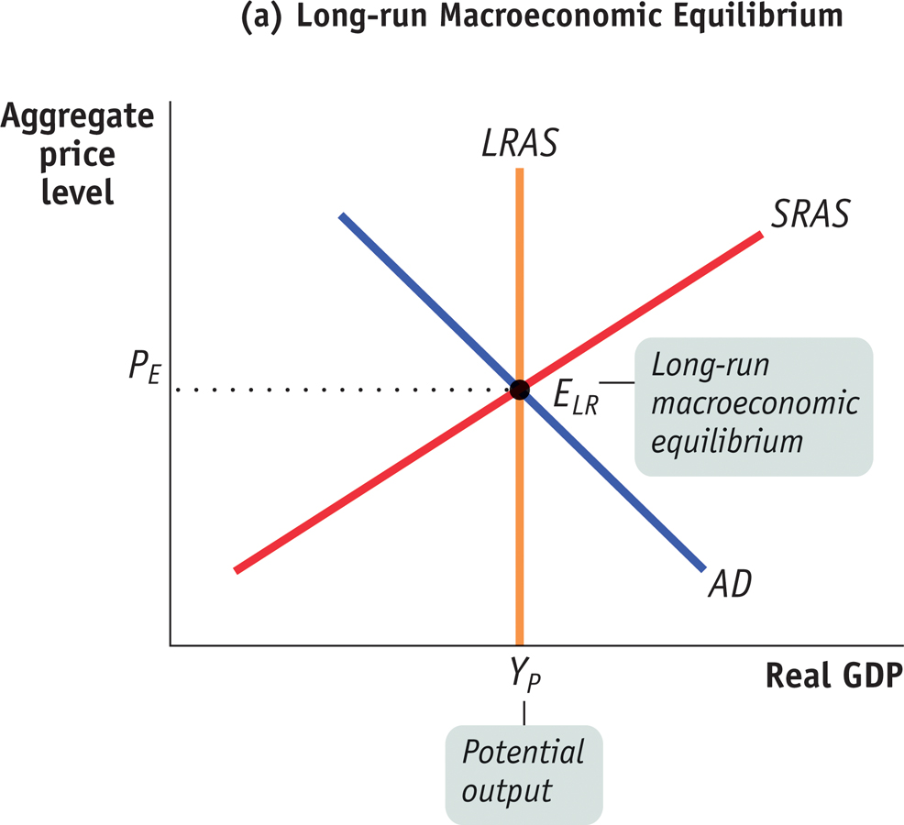
Analysis Starting Points
Section 8 | Module 45
Notes:
Figure caption: Figure 45.1. Panels (a, (b), and © represent the three basic starting points for analysis using the aggregate demand-aggregate supply model.

Slide 7
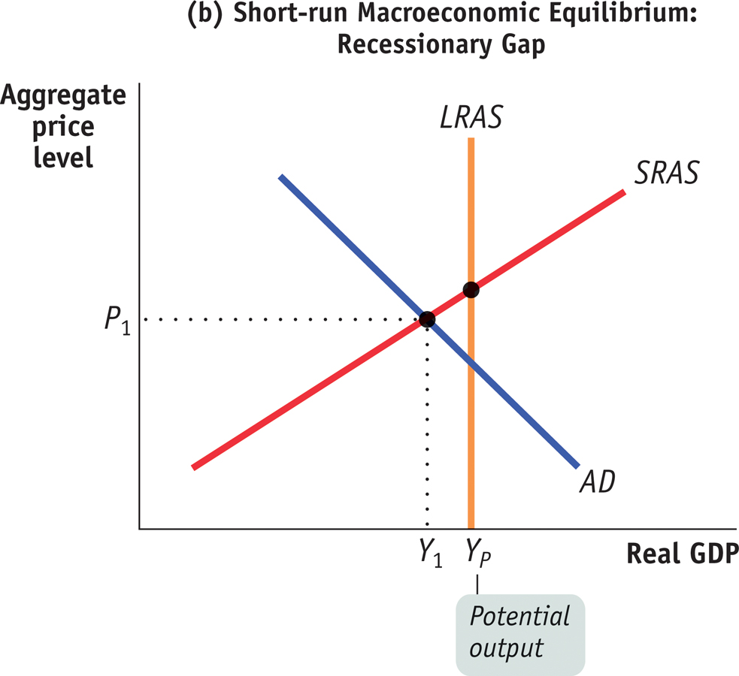
Analysis Starting Points
Section 8 | Module 45
Notes:
Figure caption: Figure 45.1. Panels (a, (b), and © represent the three basic starting points for analysis using the aggregate demand-aggregate supply model.

Slide 8
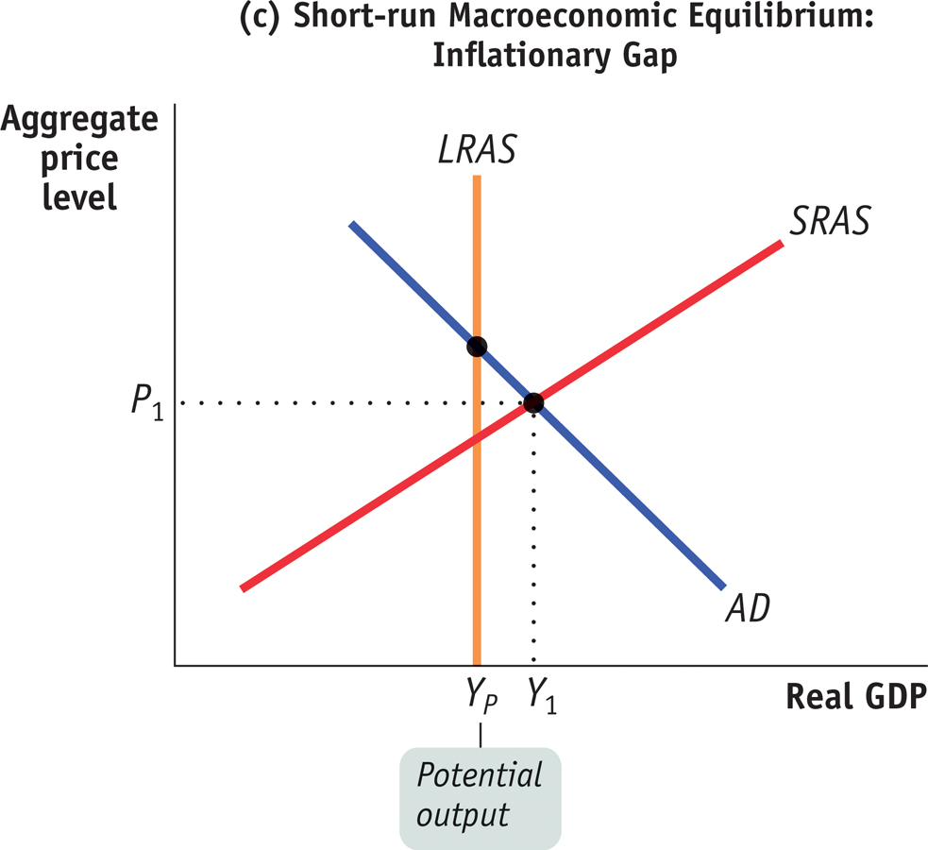
The Balance of Payments
Section 8 | Module 45
Notes:
Figure caption: Figure 45.1. Panels (a, (b), and © represent the three basic starting points for analysis using the aggregate demand-aggregate supply model.

Slide 9
The Pivotal Event
Now assume that the Federal Reserve conducts contractionary monetary policy.
Section 8 | Module 45

Slide 10
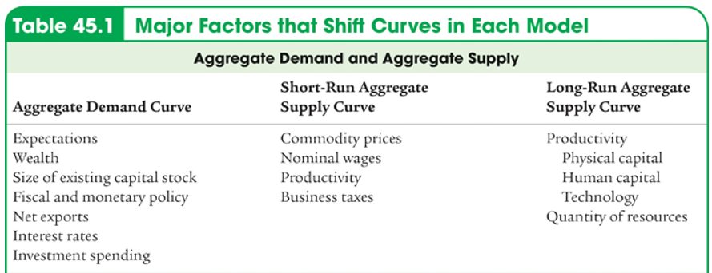
The Pivotal Event
Section 8 | Module 45

Slide 11
The Pivotal Event
Section 8 | Module 45

Slide 12
The Pivotal Event
Section 8 | Module 45

Slide 13
The Pivotal Event
Section 8 | Module 45

Slide 14
The Pivotal Event
Section 8 | Module 45

Slide 15
The Initial Effect of the Event
Show and explain how the Fed’s actions will affect equilibrium.
Section 8 | Module 45

Slide 16
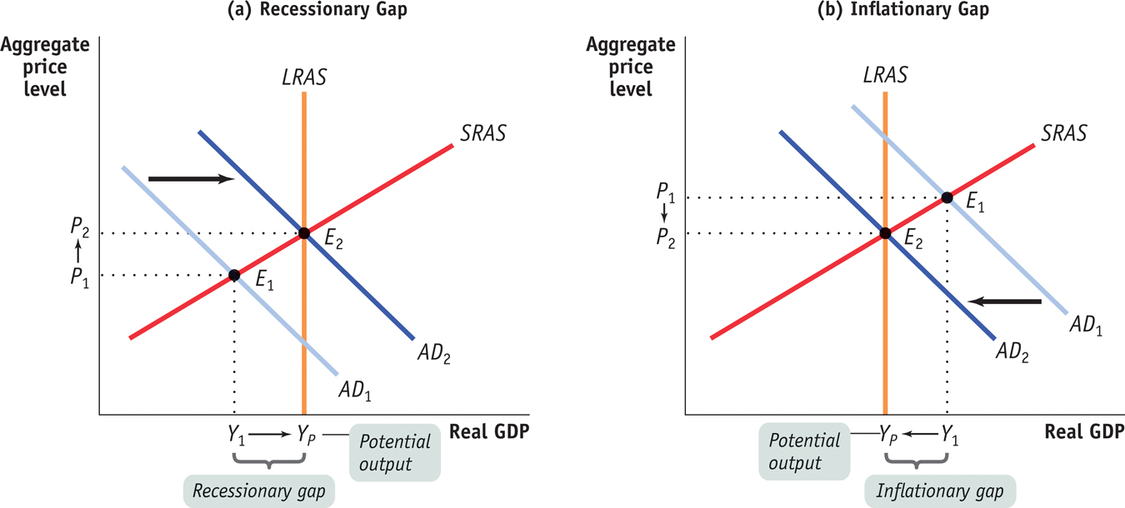
Monetary and Fiscal Policy Close Output Gaps
Section 8 | Module 45
Notes:
Figure Caption: Figure 45.2. By shifting the aggregate demand curve, monetary and fiscal policy can close output gaps in the economy as shown in panel (a) for a recessionary gap and panel (b) for an inflationary gap.

Slide 17
Secondary and Long-Run Effects of the Event
Assume Canada is the largest trading partner of the United States. What will happen to the value of the U.S. dollar relative to the Canadian dollar?
How will the Federal Reserve’s contractionary monetary policy affect the real interest rate in the United States?
Section 8 | Module 45

Slide 18
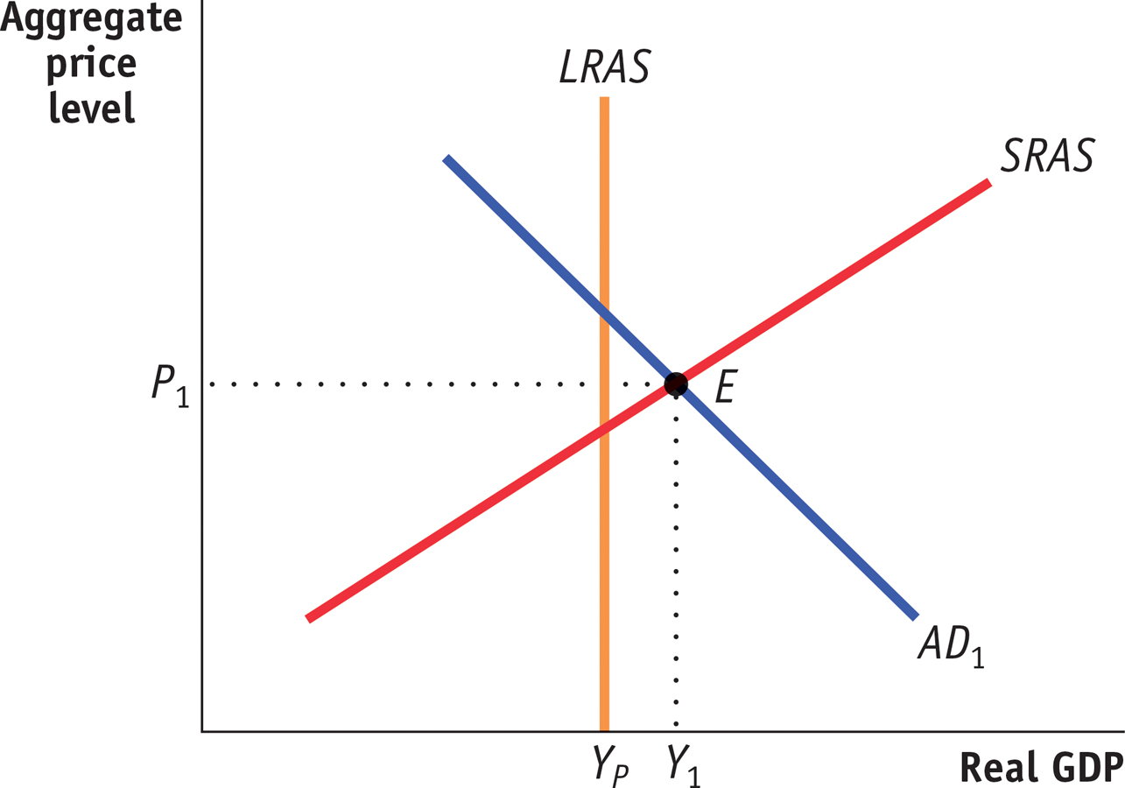
Analyzing Our Scenario
Section 8 | Module 45

Slide 19
Analyzing Our Scenario
Identify the open-market operation the Fed would conduct
The Fed would sell U.S. Treasury securities (bonds, bills, or notes).
Section 8 | Module 45

Slide 20
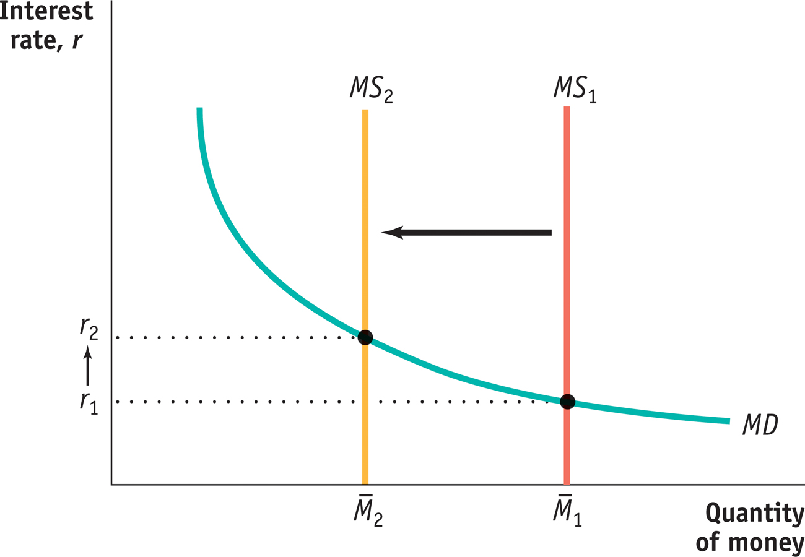
Analyzing Our Scenario
Draw a correctly labeled graph of the money market to show the effect of the monetary policy on the nominal interest rate.
Section 8 | Module 45

Slide 21
Analyzing Our Scenario
Show and explain how the Fed’s actions will affect equilibrium in the aggregate demand and supply graph you drew previously. Indicate the new aggregate price level on your graph.
A higher interest rate will lead to decreased investment and consumer spending, decreasing aggregate demand. The equilibrium price level and real GDP will fall.
Section 8 | Module 45

Slide 22
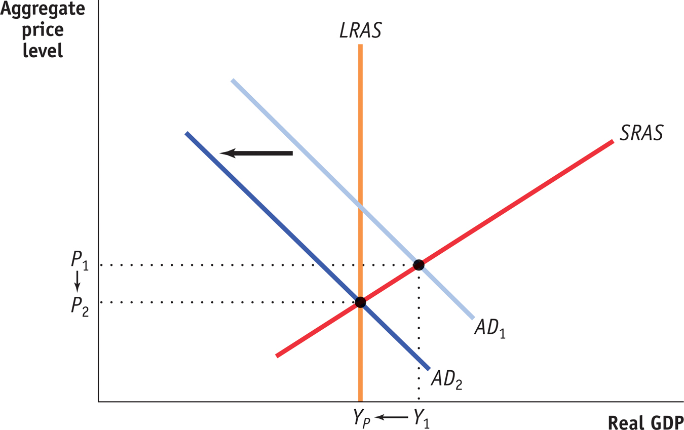
Analyzing Our Scenario
Section 8 | Module 45

Slide 23
Analyzing Our Scenario
Draw a correctly labeled graph of the foreign exchange market for the U.S. dollar showing how the change in the aggregate price level you indicate on your graph above will affect the foreign exchange market.
The decrease in the U.S. price level will make U.S. exports relatively inexpensive for Canadians to purchase and lead to an increase in demand for U.S. dollars with which to purchase those exports.
Section 8 | Module 45

Slide 24
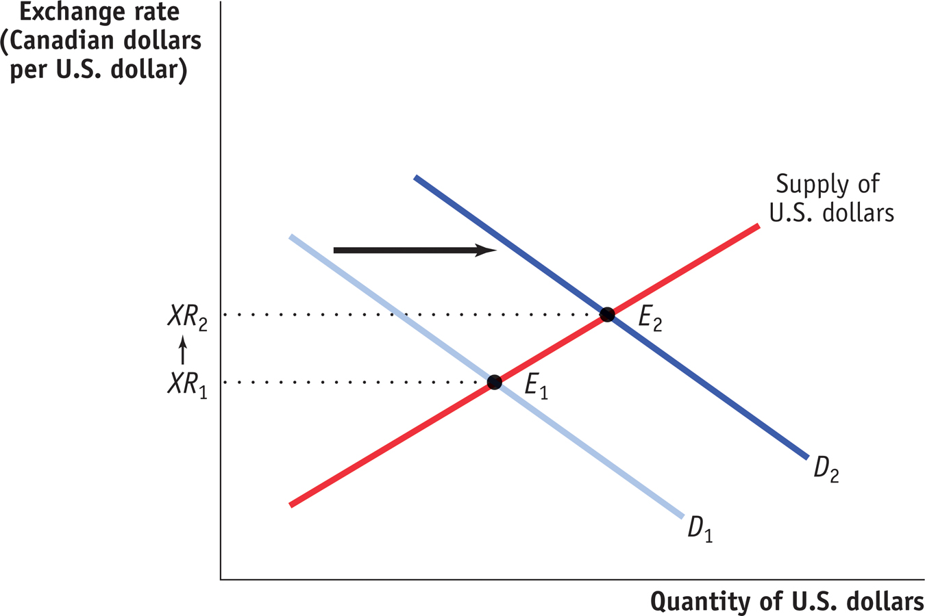
Analyzing Our Scenario
Section 8 | Module 45

Slide 25
Analyzing Our Scenario
What will happen to the value of the U.S. dollar relative to the Canadian dollar?
The U.S. dollar will appreciate.
How will the Federal Reserve’s contractionary monetary policy affect the real interest rate in the United States? Explain.
There will be no effect on the real interest rate in the long run because, due to the neutrality of money, changes in the money supply do not affect values in the long run.
Section 8 | Module 45

Slide 26
Summary
Most macroeconomic problems have the following components:
A starting point
A pivotal event
Initial effects of the event
Secondary and long-run effects of the event
We can use the basic macroeconomic models to analyze scenarios and evaluate policy recommendations.
Section 8 | Module 45

