Slide 1
Todays Agenda
Practice questions – Module 1
Practice test: 30 minutes
Opportunity cost

Slide 2
Scarcity in economics means: A. the market does not provide an efficient quantity of goods and services. B. the wants of people are limited. C. there must be poor people in rich countries. D. economists are clearly not doing their jobs. E. not having sufficient resources to produce all the goods and services we want.
Khalil is offered a free ticket to the opera. His opportunity cost of going to the opera is:
A. zero—the tickets were free. B. the price listed on the ticket. C. whatever Khalil would have done had he not gone to the opera.
D. the price listed on the ticket plus whatever Khalil would have done had he not gone to the opera.
E. the price listed on the ticket minus whatever Khalil could have received by selling it to another person in the parking lot.

Slide 3
Which of the following is an example of a normative statement?
A. A low rate of unemployment is good for the economy.
B. A high rate of economic growth creates more jobs for the country.
C. Everyone in America deserves to be covered by national health insurance.
D. The federal government spends half of its budget on national defense.
E. The Interstate Highway System in the U.S. is an essential part of the transportation infrastructure.

Slide 4
Video Questions
What is scarcity?
What is opportunity cost?
What is the PPC?
What is an inefficiency?

Slide 5
Scarcity and Opportunity Cost - Zoo
You will build a zoo.
The grid sheet is set up with squares that represent 1⁄2 acre each.
Each group has 20 acres to use.
Each exhibit takes up a certain number of acres as noted on the handout.
Each group will decide what animals and areas will be used to set up their zoo.

Slide 6
Today’s Agenda
Briefly review PPF lecture, practice questions
Gains from Trade
PPC worksheet – if not finished in class, worksheet due as homework
https://www.youtube.com/watch?v=kmjzgB_tUJ8 (helpful review video)

Slide 7
What You Will Learn in this Module
The importance of trade-offs in economic analysis
When the production possibilities curve model tells us about efficiency, opportunity cost, and economic growth
The two sources of economic growth—increases in the availability of resources and improvements in technology
Section 1 | Module 3

Slide 8
Trade-offs: The Production Possibility Frontier
Someone makes a trade-off when they give up something to get something else.
The production possibility frontier (PPF)
Illustrates the trade-offs facing an economy that produces only two goods.
Shows the maximum quantity of one good that can be produced for any given production of the other.
Section 1 | Module 3

Slide 9
The Production Possibility Frontier
Figure 3.1
Quantity of coconuts
30
D
Feasible and
efficient
in production
Not feasible
15
A
9
Feasible but
not efficient
B
C
Production possibility frontier
PPF
0
20
28
40
Quantity of fish
Section 1 | Module 3

Slide 10
Efficiency
The PPF illustrates efficiency.
An economy is efficient if there is no way to make anyone better off without making at least one person worse off.
An economy is efficient in production if it produces at a point on its PPF.
An economy is efficient in allocation if it allocates its resources so that consumers are as well off as possible.
The PPF is a reminder that the true cost of any good is everything, in addition to money, that must be given up to get that good – the opportunity cost.
Section 1 | Module 3

Slide 11
Opportunity Cost
The PPF is a reminder that the true cost of any good is everything, in addition to money, that must be given up to get that good – the opportunity cost.
Section 1 | Module 3

Slide 12
Increasing Opportunity Cost
Figure 3.2
Quantity of coconuts
Producing the first
20 fish . . .
…requires giving up
5 coconuts
35
30
But producing
20 more fish . . .
A
25
20
…requires giving up
25 more coconuts…
15
10
5
PPF
0
10
20
30
40
50
Quantity of fish
Section 1 | Module 3

Slide 13
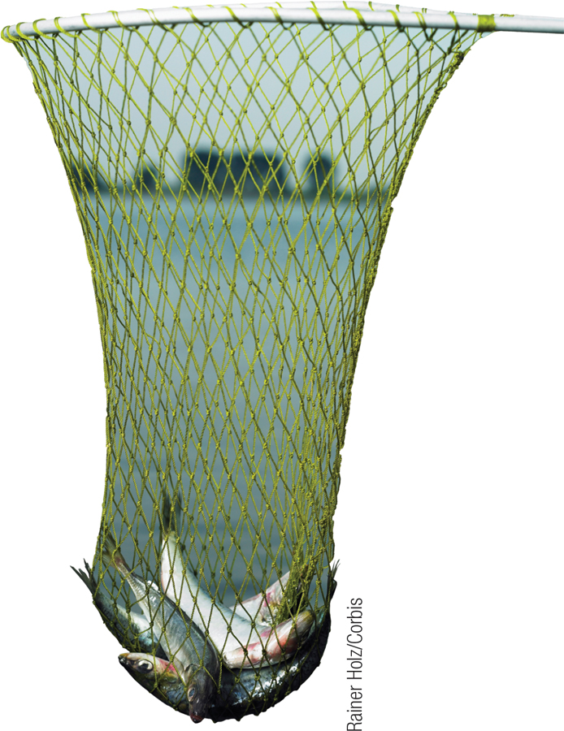
Economic Growth
Economic growth allows a sustained rise in aggregate output.
Economic growth is shown as an outward shift of the PPF.
There are two general sources of economic growth.
An increase in an economy’s resources.
Progress in technology.
Section 1 | Module 3

Slide 14
Economic Growth
Figure 3.3
Quantity of coconuts
Economic growth results in an outward shift of the PPF because production possibilities are expanded.
The economy can now produce more of everything.
Production is initially at point A (20 fish and 25 coconuts), → it can move to point E (25 fish and 30 coconuts).
35
30
E
25
A
20
15
10
5
Original
New
PPF
PPF
0
10
20
25
30
40
50
Quantity of fish
Section 1 | Module 3

Slide 15
Summary
One important economic model is the production possibility frontier.
The PPF illustrates: opportunity cost, efficiency, and economic growth.
There are two basic sources of growth: an increase in factors of production, and improved technology.
Section 1 | Module 3

Slide 16
Practice Questions
Technological improvements will A. leave the production possibility curve unchanged. B. shift the production possibility curve inward. C. shift the production possibility curve outward. D. necessarily lead to increase unemployment. E. increase the slope of the production possibility curve.
Efficient production exists when the economy is A. operating underneath its production possibility curve. B. operating on its production possibility curve. C. operating outside its production possibility curve. D. moving beyond its production possibility curve. E. in a recession.
The process through which an economy’s production possibility curve is shifted outward is
A. comparative advantage.
B. economicgrowth.
C. fullemployment.
D. specialization. E. free trade.

Slide 17
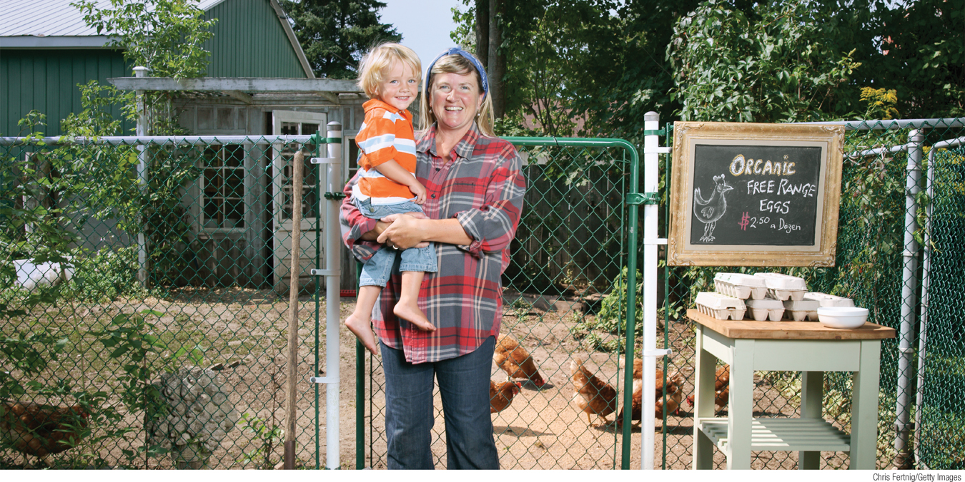
How trade leads to gains for an individual or an economy
The difference between absolute advantage and comparative advantage
How comparative advantage leads to gains from trade in the global marketplace
What You Will Learn in this Module
Section 1 | Module 4

Slide 18
Gains from Trade
The key to a much better standard of living for everyone is trade.
The reason we have an economy is that there are gains from trade.
Gains from trade arise from specialization.
Section 1 | Module 4

Slide 19
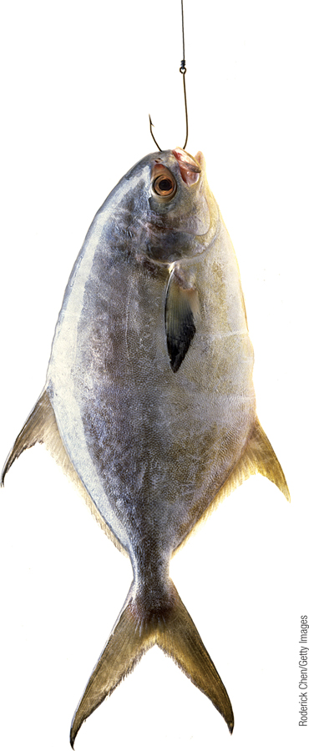
Production Possibilities for Two Castaways
Figure 4.1
(a) Tom’s Production Possibilities
Quantity of coconuts
30
Tom’s consumption without trade
9
Tom’s PPF
0
28
40
Quantity of fish
Section 1 | Module 4

Slide 20
Production Possibilities for Two Castaways
Quantity of coconuts
20
Hank’s consumption without trade
8
Hank’s
PPF
0
6
10
Quantity of fish
Section 1 | Module 4

Slide 21
Tom and Hank’s Opportunity Costs
 | Tom’s Opportunity Cost | Hank’s Opportunity Cost
One fish | ¾ coconut | 2 coconuts
One coconut | 4/3 fish | ½ fish
Section 1 | Module 4

Slide 22
Comparative Advantage and Gains from Trade
Both castaways are better off when they each specialize in what they are good at and trade.
Tom should specialize in catching fish.
Hank should specialize in gathering coconuts.
Section 1 | Module 4

Slide 23
Comparative Advantage and Gains from Trade
(a) Tom’s Production and Consumption
(b) Hank’s Production and Consumption
Quantity of coconuts
Quantity of coconuts
30
Tom’s consumption without trade
Hank’s production with trade
Tom’s consumption with trade
20
Hank’s consumption with trade
10
Tom’s production with trade
10
Hank’s consumption without trade
9
8
T
o
m
's
Hank's
PPF
PPF
0
28
30
40
Quantity of fish
0
6
10
Quantity of fish
Section 1 | Module 4

Slide 24
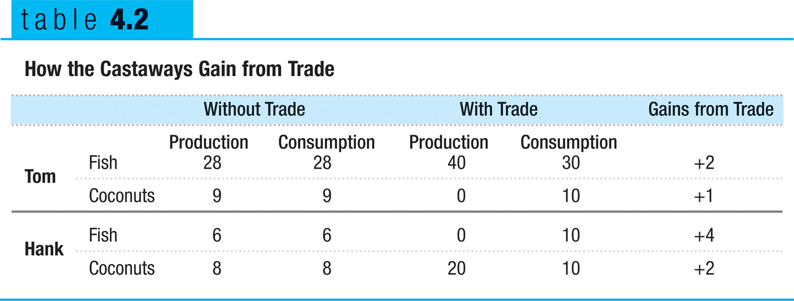
How the Castaways Gain from Trade
Both Tom and Hank experience gains from trade.
Section 1 | Module 4

Slide 25
Today’s Agenda
Go over worksheet from yesterday
Introduce Absolute and Comparative advantage
Practice questions
Worksheet 4.4

Slide 26
Comparative Advantage and Gains from Trade
An individual has a comparative advantage in producing a good or service if the opportunity cost of producing the good is lower for that individual than for other people.
An individual has an absolute advantage in an activity if he or she can do it better than other people. Having an absolute advantage is not the same thing as having a comparative advantage.
Section 1 | Module 4

Slide 27
Comparative Advantage and Gains from Trade
Comparative advantage is the basis for trade.
Trade can be beneficial to both even if one has an absolute advantage in the production of both goods.
The PPF teaches two important lessons.
By agreeing to specialize and trade, both traders can be better off.
Every has a comparative advantage in something.
Section 1 | Module 4

Slide 28
Comparative Advantage and International Trade
International trade results from comparative advantage.
If the U.S. concentrates on producing pork and ships some of its output to Canada, while Canada concentrates on aircraft and ships some of its output to the U.S., both countries can consume more than if they insisted on being self-sufficient.
Section 1 | Module 4

Slide 29
Comparative Advantage and International Trade
(a) The U.S. Production Possibilities Frontier
(b) Canadian Production Possibilities Frontier
Quantity of aircraft
Quantity of aircraft
3,000
Canadian production with trade
U.S. consumption without trade
U.S. consumption with trade
Canadian consumption without trade
2,000
1,500
1,500
Canadian consumption
with trade
U.S. production with trade
1,000
U
.S.
Canadian
PPF
PPF
0
1
2
3
0
0.5
1
1.5
Quantity of pork (millions of tons)
Quantity of pork (millions of tons)
Section 1 | Module 4

Slide 30
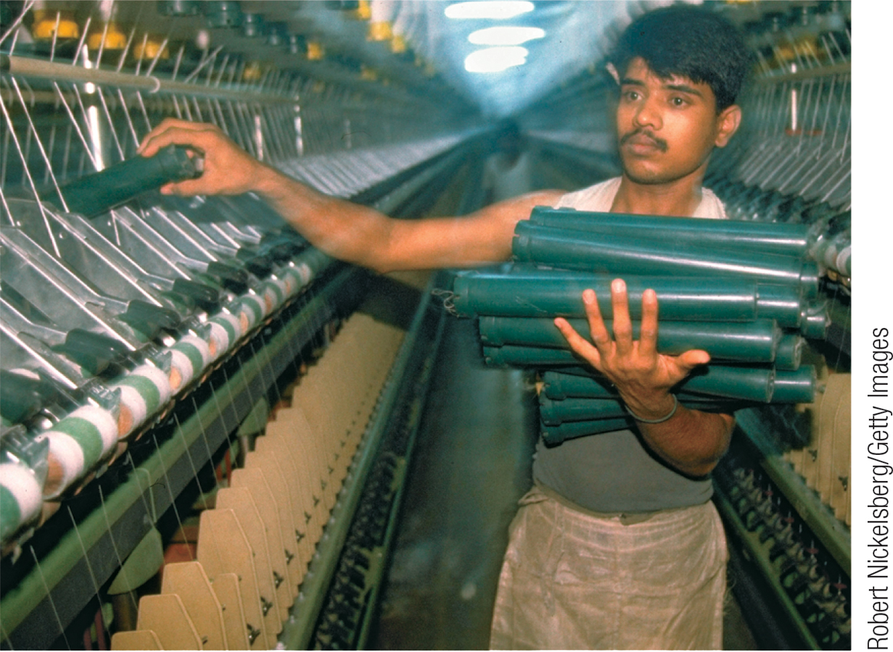
F Y I
Rich Nation, Poor Nation
Most clothing is made overseas in countries that are much poorer than the U.S.
The immediate reason for their poverty is that their economies are much less productive.
Even though these economies are much less productive, these countries hold a comparative advantage in clothing production.
Section 1 | Module 4

Slide 31
Summary
A higher standard of living comes from specialization and trade.
Comparative advantage explains the source of gains from trade between individuals and countries.
Everyone has a comparative advantage in something.
Absolute advantage is the ability to produce a particular good or service better than anyone else.
Section 1 | Module 4

Slide 32
Practice
If they spend all night writing computer programs, Laurence can write 10 programs while Carrie Anne can write 5. If they spend all night making sunglasses, Laurence can make 6 while Carrie Anne can make 4. We know that:
Laurence's opportunity cost of writing programs is less than that of Carrie Anne.
Laurence's opportunity cost of writing programs and of making sunglasses is less than that of Carrie Anne.
Carrie Anne's opportunity cost of writing programs and of making sunglasses is less than that of Laurence.
Carrie Anne's opportunity cost of writing programs is less than that of Laurence.
Laurence’s opportunity cost of making sunglasses is less than that of Carrie Anne.
France and England both produce wine and cloth under conditions of constant opportunity costs. France will have a comparative advantage in wine production if:
A. it can produce more wine than England. B. its labor productivity in wine production is greater than England's. C. the absolute cost of producing wine is lower in France than in England. D. the opportunity cost of wine production is lower in France than in England.
E. it can produce more cloth than England.
An economy that has the lowest opportunity cost for producing a particular good is said to have a(n):
A. absolute advantage. B. Comparative advantage. C. production possibility curve.
D. increasingopportunitycost.
E. free trade zone.

Slide 33
Suppose that one day of labor in each country produces the following quantities of fish and cheese:
Fish Country (tons)
Cheese (tons)
France 80 40 Japan 200 50
Does France have a comparative advantage in the production of fish, cheese, or neither? Explain.
Does Japan have a comparative advantage in the production of fish, cheese, or neither? Explain.
Suppose the countries decide to trade with each other—1 ton of cheese for 3 tons of fish. Would this trade be advantageous to both countries? Explain.

