Slide 1
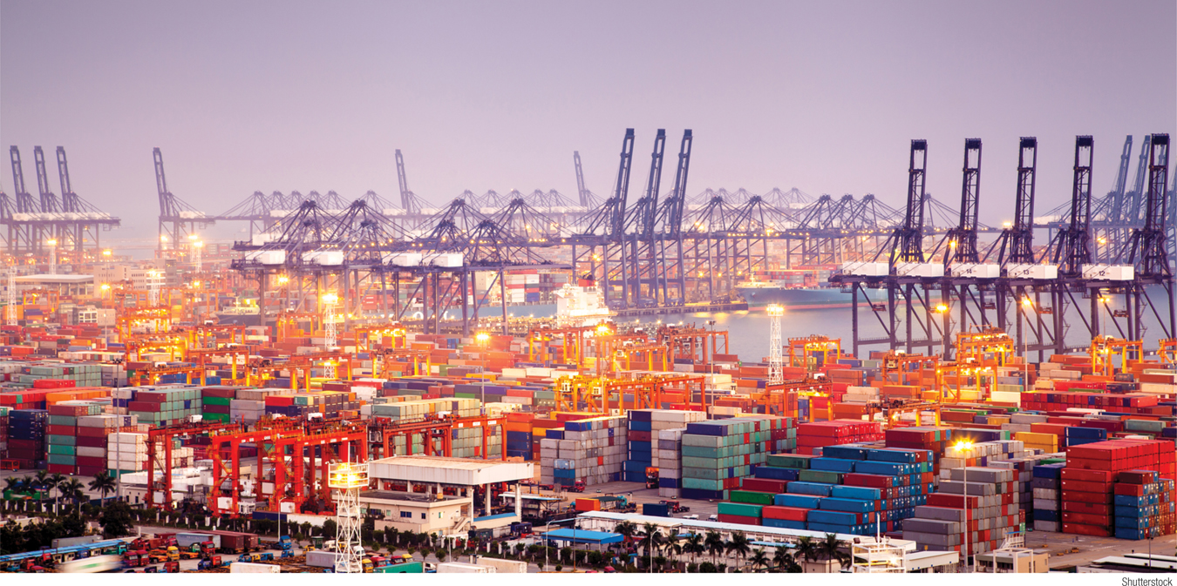
What You Will Learn in this Module
Explain the pros and cons of protectionism
Illustrate the effects of a tariff and an import quota
Section 8 | Module 44

Slide 2
Trade Restrictions
Remember, specialization and trade make larger quantities of goods and services available to consumers.
Every country now has an open economy, although some economies are more open than others.
Some factors that affect a country’s approach to trade:
Transportation costs
Fear of becoming reliant upon another country
National pride
Casualties of trade: lost jobs/increased structural unemployment
Section 8 | Module 44

Slide 3
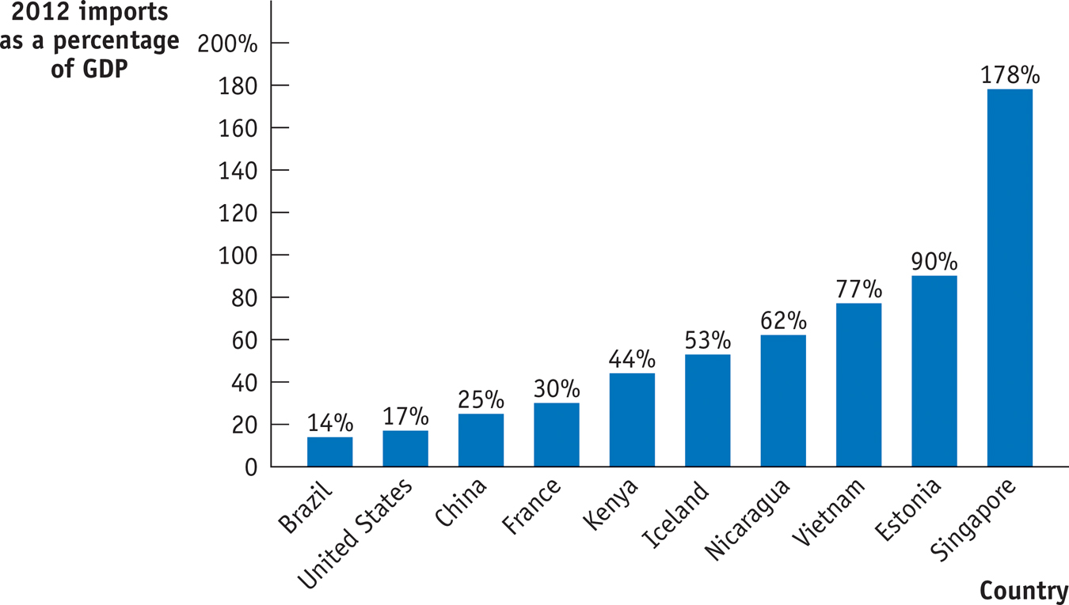
Trade Restrictions
Section 8 | Module 44

Slide 4
Trade Restrictions
Protectionism is the practice of limiting trade to protect domestic industries.
Primary tools of protectionism:
Tariffs
Import quotas
Section 8 | Module 44

Slide 5
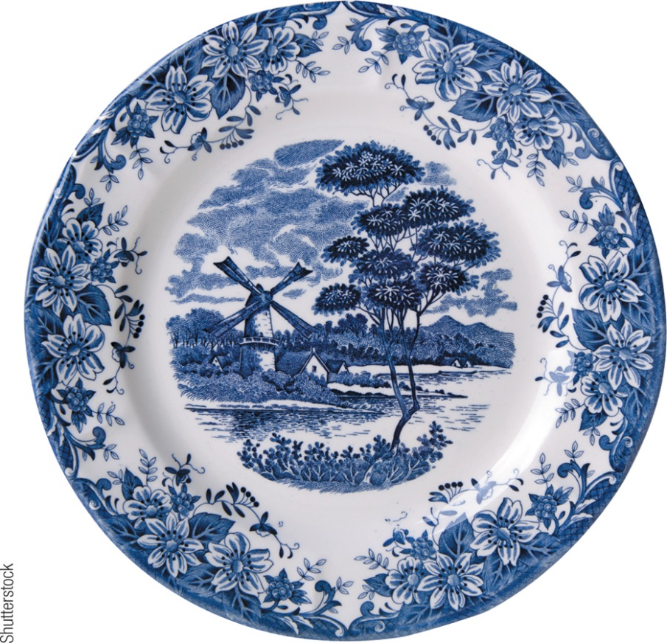
Tariffs
Tariffs are taxes on imports
Can make prices higher for domestic consumers
Can spark trade wars
In U.S., 1% of federal government revenue comes from tariffs
Consider hypothetical U.S. market for ceramic plates
Section 8 | Module 44

Slide 6
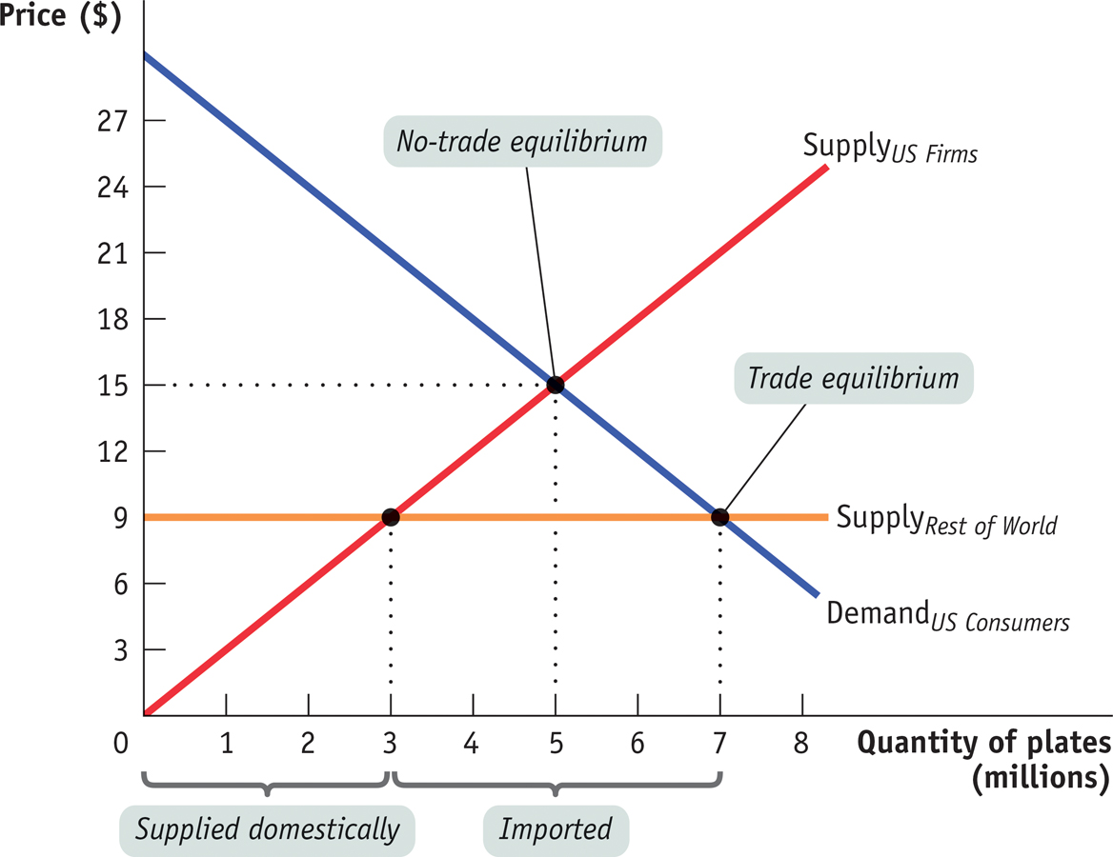
Tariffs
The U.S. Ceramic Plate Market with Imports
Section 8 | Module 44

Slide 7
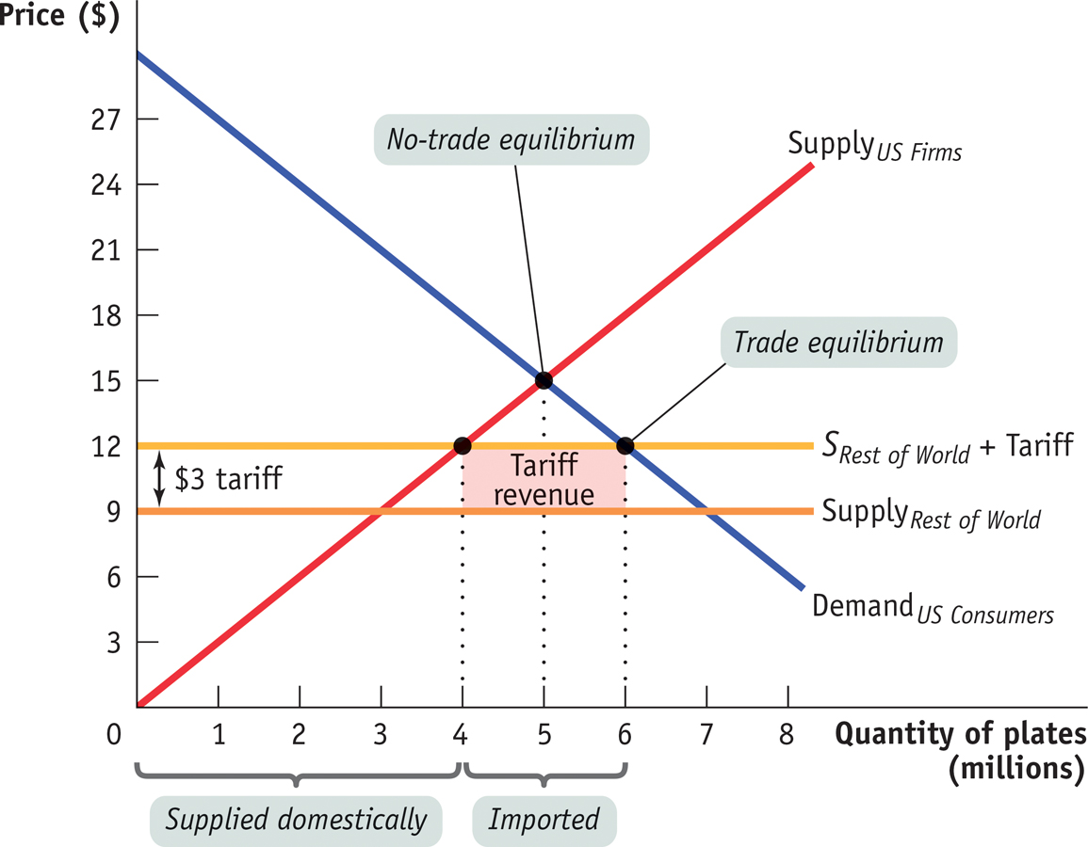
Tariffs
A Tariff on Ceramic Plates
Section 8 | Module 44

Slide 8
Quotas
An Import Quota is a limit on the quantity of a good that can be imported within a given period.
Restricting supplies, reduces equilibrium quantity and increases the equilibrium price.
Result is higher prices for domestic consumers
Consider, again, hypothetical U.S. market for ceramic plates
Section 8 | Module 44

Slide 9
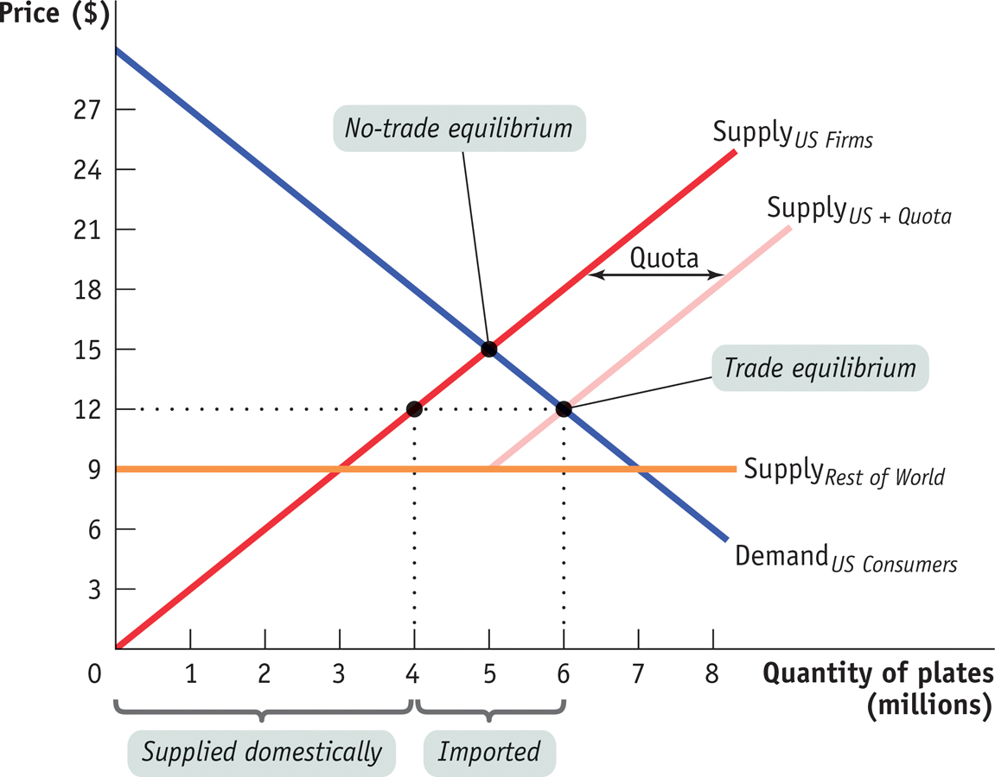
Quotas
A Ceramic Plates Quota
Section 8 | Module 44

Slide 10
F Y I
Bringing Down the Walls
Section 8 | Module 43

Slide 11
Summary
Protectionism is the practice of limiting trade to protect domestic industries.
Tariffs are taxes on imports. While helping domestic industry, they provide a revenue for the government.
Import quota is a limit on the quantity of a good that can be imported within a given period.
Section 8 | Module 44

