Slide 1
Explain the meaning of the balance of payments accounts
Identify the determinants of international capital flows
What You Will Learn in this Module
Section 8 | Module 41

Slide 2
Capital Flows and The Balance of Payments
A country’s balance of payments accounts summarize its transactions with the rest of the world.
The balance of payments on current account, or current account, includes the balance of payments on goods and services together with balances on factor income and transfers.
The merchandise trade balance is a frequently-cited component of the balance of payments on goods and services.
Section 8 | Module 41

Slide 3
Capital Flows and The Balance of Payments
A country’s balance of payments on financial account, or simply its financial account, is the difference between its sales of assets to foreigners and its purchases of assets from foreigners during a given period.
Section 8 | Module 41

Slide 4
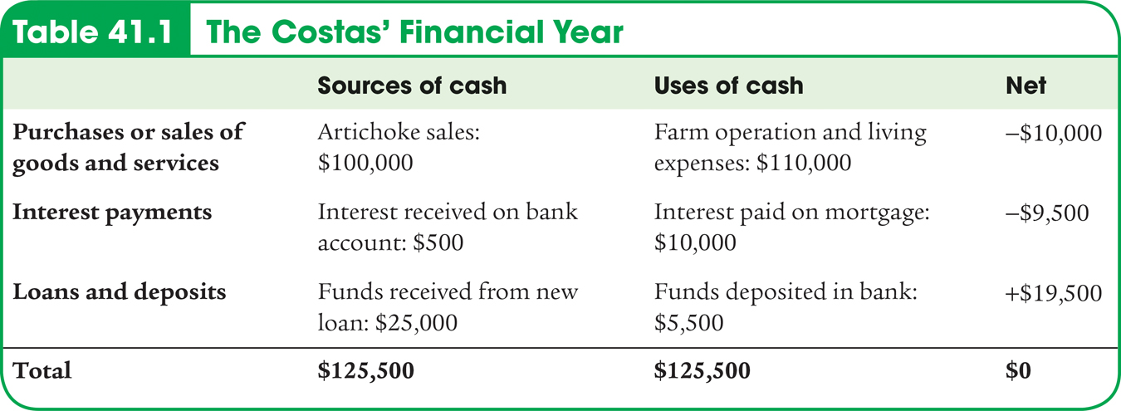
Capital Flows and The Balance of Payments
Section 8 | Module 41

Slide 5
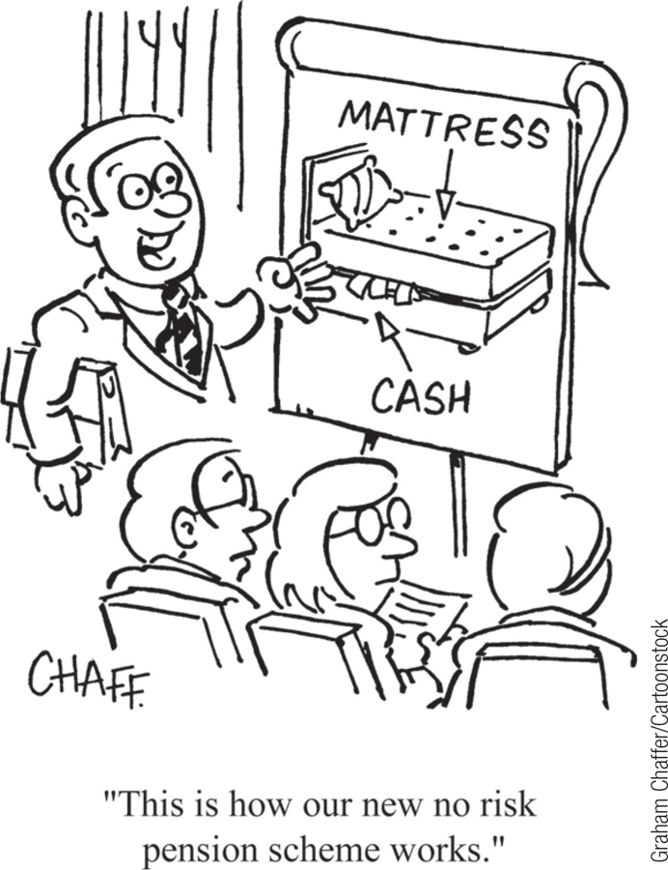
Capital Flows and The Balance of Payments
The current account and the financial account must sum to zero.
Money flows into the U.S. from the rest of the world as payment for U.S. exports of goods and services, as payment for the use of U.S.-owned factors of production, and as transfer payments.
Money flows out of the U.S. to the rest of the world as payment for the U.S. imports of goods and services, as payment for the use of foreign-owned factors of production, and as transfer payments.
Section 8 | Module 41

Slide 6
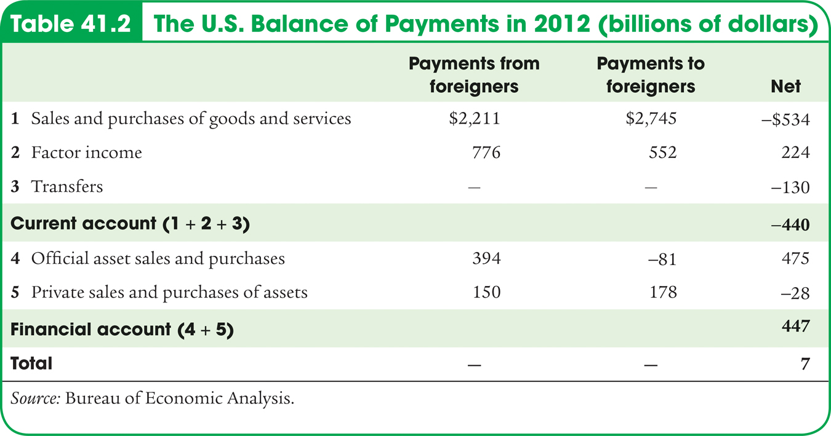
The U.S. Balance of Payments, 2012
Section 8 | Module 41

Slide 7
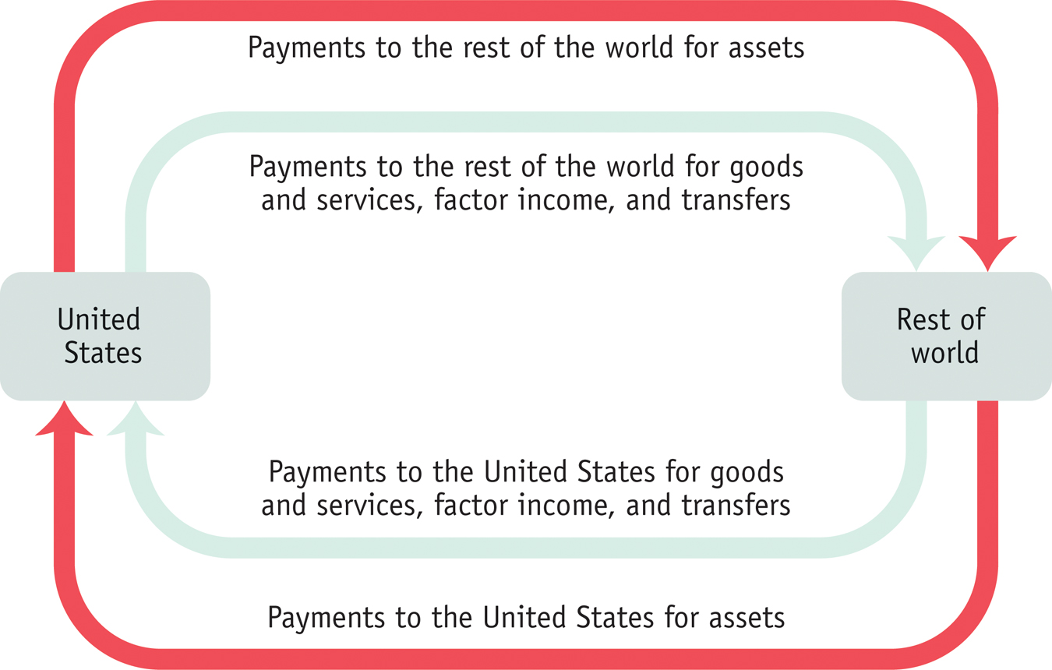
The Balance of Payments
Section 8 | Module 41
Notes:
Figure Caption: Figure 41.1: The Balance of Payments
The green arrows represent payments that are counted in the balance of payments on current account. The red arrows represent payments that are counted in the balance of payments on financial account. Because the total flow into the United States must equal the total flow out of the United States, the sum of the balance of payments on current account plus the balance of payments on financial account is zero.

Slide 8
F Y I
GDP, GNP, and the Current Account
Why doesn’t the national income equation use the current account as a whole?
Gross domestic product, which is the value of goods and services produced in a country, doesn’t include two sources of income that are included in calculating the current account balance: international factor income and international transfers.
For example, the profits of Ford Motors U.K. aren’t included in America’s GDP and the funds Latin American immigrants send home to their families aren’t subtracted from GDP.
Gross national product does include international factor income.
Section 8 | Module 41

Slide 9
F Y I
GDP, GNP, and the Current Account
Estimates of U.S. GNP differ slightly from estimates of GDP.
GNP adds in items such as the earnings of U.S. companies abroad and subtracts items such as the interest payments on bonds owned by residents of China and Japan.
Economists use GDP rather than a broader measure because:
The original purpose of the national accounts was to track production rather than income.
Data on international factor income and transfer payments are generally considered somewhat unreliable.
Y=C+I+G-IM
Section 8 | Module 41

Slide 10
FRQ
a. i. 3 points b. 2 points c. 2 points
ii. 3 points
Iii 3 points
Iv 3 points
2. a. 6 points b I 4 points c 6 points
ii 4 points
iii 4 points

Slide 11
Modeling the Financial Account
We can gain insight into the motivations for capital inflows that are the result of private decisions using the loanable funds model.
Section 8 | Module 41

Slide 12
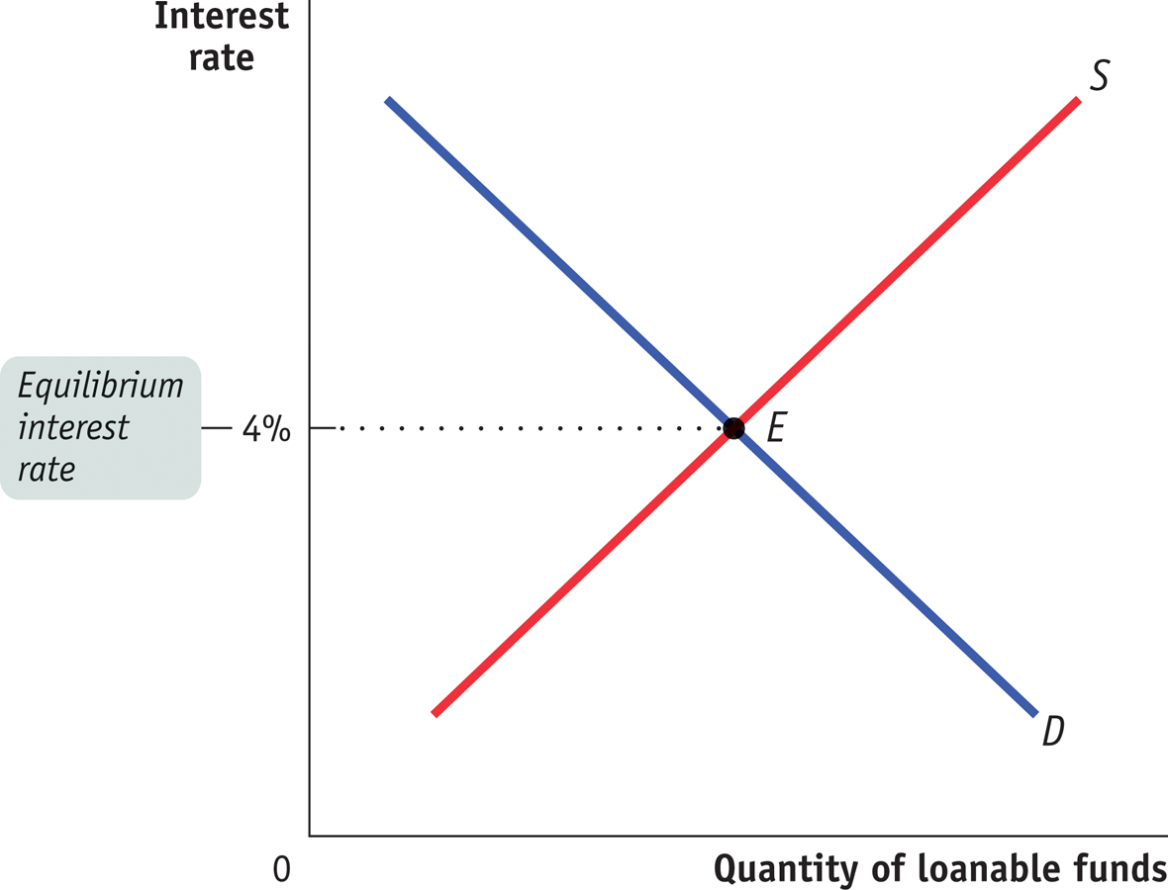
The Loanable Funds Model Revisited
Section 8 | Module 41
Notes:
Figure Caption: Figure 41.2: The Loanable Funds Model – Revisited
According to the loanable funds model of the interest rate, the equilibrium interest rate is determined by the intersection of the supply of loanable funds, S, and the demand for loanable funds, D. At point E, the equilibrium interest rate is 4%.
The Loanable Funds Market is typically labeled “Real Interest Rate” by the AP program.

Slide 13
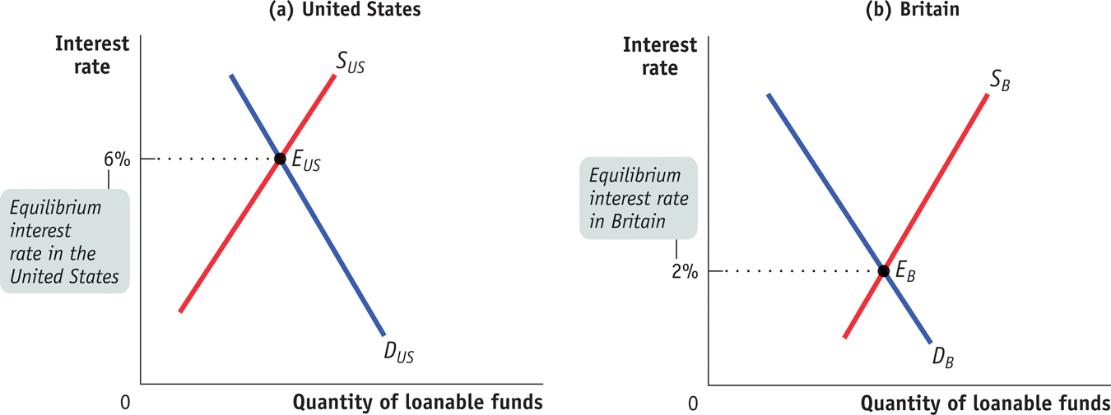
Loanable Funds Markets in Two Countries
Section 8 | Module 41
Notes:
Figure Caption: Figure 41.3: Loanable Funds Markets in Two Countries
Here we show two countries, the United States and Britain, each with its own loanable funds market. The equilibrium interest rate is 6% in the U.S. market but only 2% in the British market. This creates an incentive for capital to flow from Britain to the United States.

Slide 14
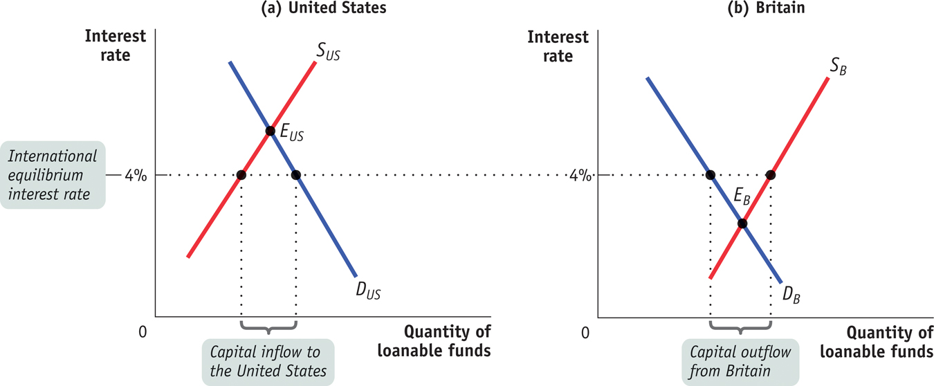
International Capital Flows
Section 8 | Module 41
Notes:
Figure Caption: Figure 41.3: Loanable Funds Markets in Two Countries
Here we show two countries, the United States and Britain, each with its own loanable funds market. The equilibrium interest rate is 6% in the U.S. market but only 2% in the British market. This creates an incentive for capital to flow from Britain to the United States.

Slide 15
Underlying Determinants of International Capital Flows
International differences in the demand for funds reflect underling differences in investment opportunities.
A country with rapidly growing economy tends to offer more investment opportunities than a country with a more slowly growing economy, other things equal.
Section 8 | Module 41

Slide 16
F Y I
A Global Savings Glut?
In 2005, Ben Bernanke said that the “principal causes of the U.S. current account deficit” were from outside the country. He argued that special factors had created a “global savings glut” that had pushed down interest rates worldwide.
What caused this global savings glut?
According to Bernanke, the main cause was the series of financial crises that began in Thailand in 1997; moved across much of Asia; then hit Russia in 1998, Brazil in 1999, and Argentina in 2002.
As a result, a number of these countries experienced large capital outflows.
Section 8 | Module 41

Slide 17
Two-way Capital Flows
The loanable funds model helps us understand the direction of net capital flows – the excess of inflows into a country over outflows, or vice versa.
Why does capital move in both directions?
Diversification
Business strategy
Moving to international banking centers
Section 8 | Module 41

Slide 18
Summary
A country’s balance of payments accounts summarize its transactions with the rest of the world.
The balance of payments on current account, or current account, includes the balance of payments on goods and services together with balances on factor income and transfers.
The merchandise trade balance, or trade balance, is a frequently cited component of the balance of payments on goods and services.
The balance of payments on financial account, or financial account, measures capital flows. By definition, the balance of payments on current account plus the balance of payments on financial account is zero.
Section 8 | Module 41

Slide 19
Summary
Capital flows respond to international differences in interest rates and other rates of return; they can be usefully analyzed using an international version of the loanable funds model, which shows how a country where the interest rate would be low in the absence of capital flows sends funds to a country where the interest rate would be high in the absence of capital flows.
The underlying determinants of capital flows are international differences in savings and opportunities for investment spending.
Section 8 | Module 41

