Slide 1
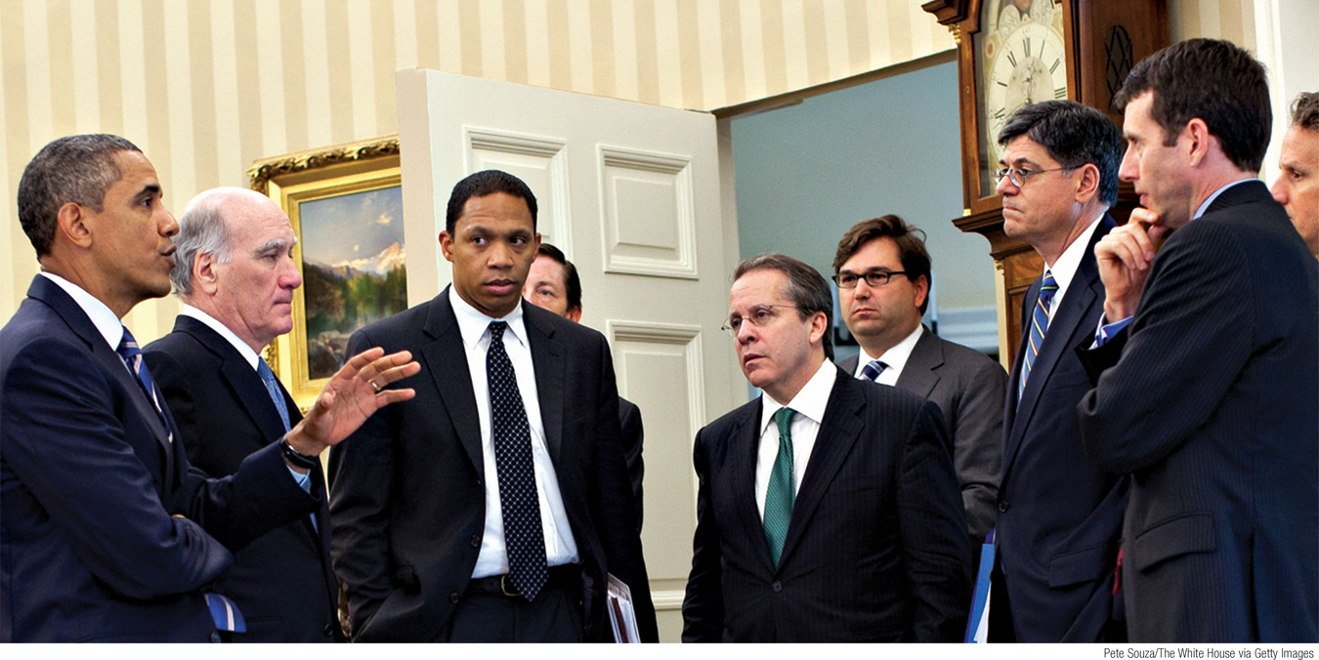
List and describe the elements of the modern macroeconomic consensus
Explain the main remaining disputes
What You Will Learn in this Module
Section 6 | Module 36

Slide 2
Five Key Questions About Macroeconomic Policy
 | Classical macroeconomics | Keynesian macroeconomics | Monetarism | Modern consensus
Is expansionary monetary policy helpful in fighting recessions? | No | Not very | Yes | Yes, except in special circumstances
Is expansionary fiscal policy effective in fighting recessions? | No | Yes | No | Yes
Can monetary and/or fiscal policy reduce unemployment in the long run? | No | Yes | No | No
Should fiscal policy be used in a discretionary way? | No | Yes | No | No, except in special circumstances
Should monetary policy be used in a discretionary way? | No | Yes | No | Still in dispute
Section 6 | Module 36

Slide 3
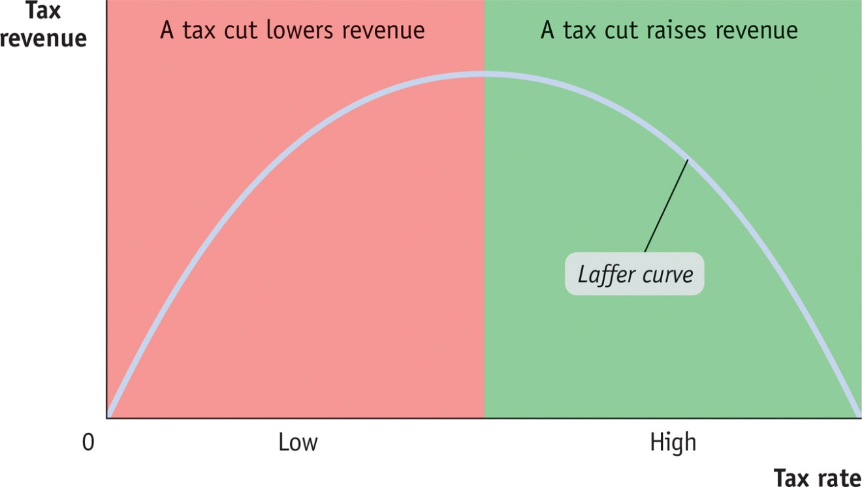
F Y I
Supply-Side Economics
The core of the “supply-side economics” view of economic policy was the belief that reducing tax rates, and so increasing the incentives to work and invest, would have a powerful positive effect on the growth rate of potential output.
Almost all economists agree that tax cuts increase incentives to work and invest. However, attempts to estimate these incentive effects indicate that, at current U.S. tax levels, they aren’t nearly strong enough to support the strong claims made by supply-siders.
Section 6 | Module 36

Slide 4
Should Monetary Policy Be Used in a Discretionary Way?
There is a broad consensus among macroeconomists on these points:
Monetary policy should play the main role in stabilization policy.
The central bank should be independent.
Discretionary fiscal policy should be used sparingly.
Section 6 | Module 36

Slide 5
Should Monetary Policy Be Used in a Discretionary Way?
However, there are debates over how the central bank should set its policy.
The questions:
Should the central bank be given a defined target or the discretion to manage the economy?
Should the central bank manage asset prices?
What should the central bank do when conventional policy has reached it limits?
Section 6 | Module 36

Slide 6
The Clean Little Secret of Macroeconomics
The clean little secret of modern macroeconomics is how much consensus economists have reached over the past 70 years.
Section 6 | Module 36

Slide 7
Summary
The modern consensus is that monetary and fiscal policy are both effective in the short run but that neither can reduce the unemployment rate in the long run.
Discretionary fiscal policy is considered generally unadvisable, except in special circumstances.
There are continuing debates about the appropriate role of monetary policy.
Section 6 | Module 36

