Slide 1
Describe the role of banks in the economy
Identify the reasons for and types of banking regulation
Explain how banks create money
What You Will Learn in this Module
Section 5 | Module 25

Slide 2
The Monetary Role of Banks
A bank is a financial intermediary that uses liquid assets in the form of bank deposits to finance the illiquid investments of borrowers.
A T-account is a tool for analyzing a business’s financial position by showing, in a single table, the business’s assets (on the left) and liabilities (on the right).
A T-Account for Samantha’s Smoothies
Section 5 | Module 25

Slide 3
The Monetary Role of Banks
Bank reserves are the currency banks hold in their vaults plus their deposits at the Federal Reserve.
The reserve ratio is the fraction of bank deposits that a bank holds as reserves.
The Federal Reserve sets the required reserve ratio, which is smallest fraction of deposits that the Federal Reserve allows banks to hold.
Section 5 | Module 25

Slide 4
Assets and Liabilities of First Street Bank
A T-account summarizes a bank’s financial position. The bank’s assets, $900,000 in outstanding loans to borrowers and reserves of $100,000, are entered on the left side. Its liabilities, $1,000,000 in bank deposits held for depositors, are entered on the right side.
Assets and Liabilities of First street Bank
Section 5 | Module 25

Slide 5
The Problem of Bank Runs
A bank run is a phenomenon in which many of a bank’s depositors try to withdraw their funds due to fears of a bank failure.
Historically, they have often proved contagious, with a run on one bank leading to a loss of faith in other banks, causing additional bank runs.
Section 5 | Module 25

Slide 6
F Y I
It’s a Wonderful Banking System
There was a wave of bank runs in the early 1930s. To bring the panic to an end Franklin Delano Roosevelt declared a national “bank holiday,” closing all banks for a week to give bank regulators time to close unhealthy banks and certify healthy ones.
Since then, regulation has protected the United States and other wealthy countries against most bank runs.
There are some limits on deposit insurance; in particular, currently only the first $250,000 of any bank account is insured. As a result, there can still be a rush out of a bank perceived as troubled.
Section 5 | Module 25

Slide 7
Bank Regulations
Deposit Insurance guarantees that a bank’s depositors will be paid even if the bank can’t come up with the funds, up to a maximum amount per account.
The FDIC currently guarantees the first $250,000 of each account.
Section 5 | Module 25

Slide 8
Bank Regulations
Capital Requirements - regulators require that the owners of banks hold substantially more assets than the value of bank deposits.
In practice, banks’ capital is equal to 7% or more of their assets.
Section 5 | Module 25

Slide 9
Bank Regulations
Reserve Requirements - rules set by the Federal Reserve that determine the minimum reserve ratio for a bank. For example, in the United States, the minimum reserve ratio for checkable bank deposits is 10%.
The discount window is an arrangement in which the Federal Reserve stands ready to lend money to banks in trouble.
Section 5 | Module 25

Slide 10
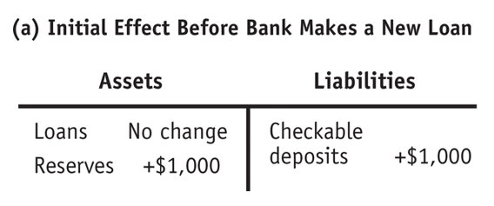
Determining the Money Supply
Effect on the Money Supply of a Deposit at First Street Bank Initial Effect Before Bank Makes New Loans:
Section 5 | Module 25

Slide 11
Determining the Money Supply
Effect on the Money Supply of a Deposit at First Street Bank Effect After Bank Makes New Loans:
Section 5 | Module 25

Slide 12
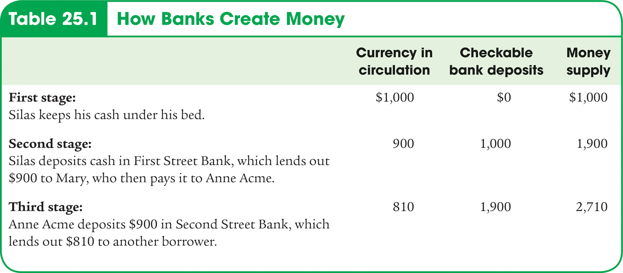
How Banks Create Money
Section 5 | Module 25

Slide 13
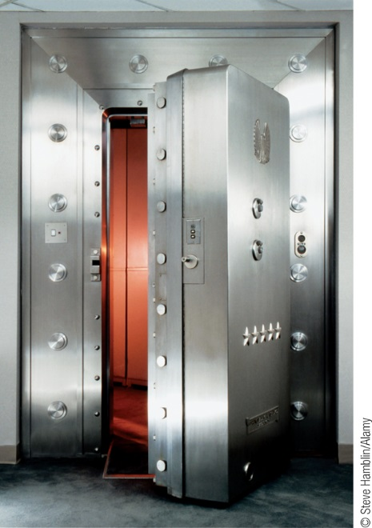
Reserves, Bank Deposits, and the Money Multiplier
Excess reserves are bank reserves over and above its required reserves.
Increase in bank deposits from $1,000 in excess reserves = $1,000 + $1,000 × (1 − rr) + $1,000 × (1 − rr)2 + $1,000 × (1 − rr)3 + . . .
This can be simplified to:
Increase in bank deposits from $1,000 in excess reserves = $1,000/rr
Section 5 | Module 25

Slide 14
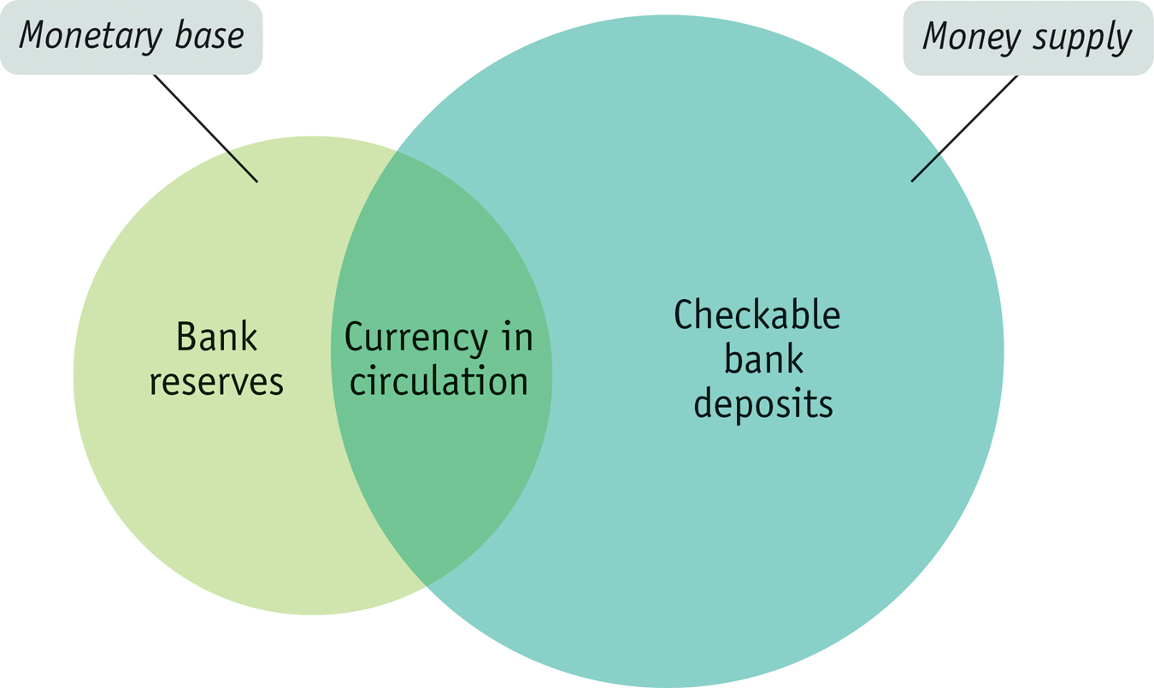
The Money Multiplier in Reality
The monetary base is the sum of currency in circulation and bank reserves.
The money multiplier is the ratio of the money supply to the monetary base.
Section 5 | Module 25

Slide 15
Practice
1. Which of the following would be the initial effect of an individual making a $10,000 cash deposit in a bank?
A. The money supply would rise by $10,000.
B. The money supply would fall by $10,000.
C. The money supply is not be affected by the deposit.
D. The money supply would fall, but by less than the $10,000 deposit.
E. The money supply would rise by more than $10,000.

Slide 16
Practice
2. First National Bank has $80 million in checkable deposits, $15 million in deposits with the Federal Reserve, $5 million cash in the bank vault and $5 million in government bonds. Consider the information for First National Bank. If the reserve ratio is 20%, what are the excess reserves available for the bank to lend?
A. $76 million
B. $55 million
C. $68 million
D. $20 million
E. $16 million

Slide 17
Practice
3. Suppose your grandma sends you $100 for your birthday and you deposit $100 into your checking account at the local bank. The reserve ratio is 10%. Based upon this deposit, the bank's excess reserves have increased by _____ and, if the bank lends all excess reserves, the money supply could eventually grow by as much as _____.
A. $90; $1000
B. $100; $900
C. $90; $900
D. $100; $1000

Slide 18
Summary
Banks allow depositors immediate access to their funds, but they also lend out most of the funds deposited in their care.
To meet demands for cash, they maintain bank reserves composed of both currency held in vaults and deposits at the Federal Reserve.
The reserve ratio is the ratio of bank reserves to bank deposits.
A T-account summarizes a bank’s financial position.
Banks have sometimes been subject to bank runs, most notably in the early 1930s.
Section 5 | Module 25

Slide 19
Summary
Depositors are now protected by deposit insurance, bank owners face capital requirements that reduce the incentive to make overly risky loans with depositors’ funds, and banks must satisfy reserve requirements.
When currency is deposited in a bank, it starts a multiplier process in which banks lend out excess reserves, leading to an increase in the money supply—so banks create money.
The money multiplier is the ratio of the money supply to the monetary base.
Section 5 | Module 25

