Slide 1
Today's Agenda
Go over homework – have it out so I can see you did it
Begin Module 5 – Demand and the Demand curve
Quiz tomorrow on Modules 1-4

Slide 2
What a competitive market is and how it is described by the supply and demand model
What the demand curve is
The difference between movements along the demand curve and changes in demand
The factors that shift the demand curve
What You Will Learn in this Module
Section 2 | Module 5

Slide 3
Supply and Demand: A Model of a Competitive Market
A competitive market:
Many buyers and sellers
Identical good or service
The supply and demand model is a model of how a competitive market works.
Five key elements:
Demand curve
Supply curve
Demand and supply curve shifts
Market equilibrium
Changes in the market equilibrium
Section 2 | Module 5

Slide 4
The Demand Schedule and the Demand Curve
A demand schedule shows how much of a good or service consumers will want to buy at different prices.
Demand Schedule for Cotton
Price of cotton
(per pound)
Quantity of cotton beans demanded (billions of pounds)
$2.00
7.1
1.75
7.5
1.50
8.1
1.25
8.9
1.00
10.0
0.75
11.5
0.50
14.2
Section 2 | Module 5

Slide 5
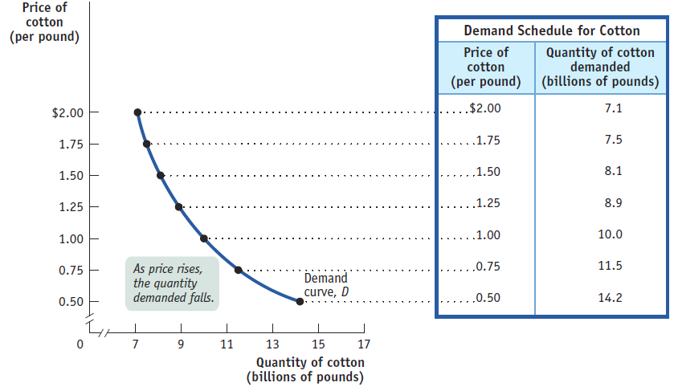
The Demand Schedule and the Demand Curve
A demand curve is the graphical representation of the demand schedule; it shows how much of a good or service consumers want to buy at any given price.
Section 2 | Module 5

Slide 6
Shifts of the Demand Curve
Demand Schedules for Cotton
Quantity of cotton demanded
(billions of pounds)
Price of cotton
(per pound)
An increase in the population and other factors generate an increase in demand – a rise in the quantity demanded at any given price.
in 2012
in 2013
$2.00
7.1
8.5
1.75
7.5
9.0
1.50
8.1
9.7
1.25
8.9
10.7
1.00
10.0
12.0
0.75
11.5
13.8
0.50
14.2
17.0
Section 2 | Module 5

Slide 7
Shifts of the Demand Curve
This is represented by the two demand schedules:
One showing demand in 2012, before the rise in population.
The other showing demand in 2013, after the rise in population.
Demand Schedules for Cotton
Quantity of cotton demanded
(billions of pounds)
Price of cotton
(per pound)
in 2012
in 2013
$2.00
7.1
8.5
1.75
7.5
9.0
1.50
8.1
9.7
1.25
8.9
10.7
1.00
10.0
12.0
0.75
11.5
13.8
0.50
14.2
17.0
Section 2 | Module 5

Slide 8
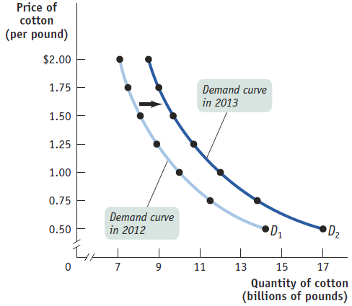
Shifts of the Demand Curve
A shift of the demand curve is a change in the quantity demanded at any given price, represented by the change of the original demand curve to a new position, denoted by a new demand curve.
Section 2 | Module 5

Slide 9
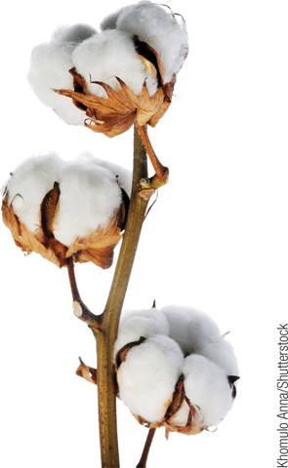
Movement Along the Demand Curve
A movement along the demand curve is a change in the quantity demanded of a good that is the result of a change in that good’s price.
Price of cotton (per pound)
A shift of the demand curve…
$2.00
1.75
A
C
… is not the same thing as a movement along the demand curve
1.50
1.25
1.00
B
0.75
0.50
D
1
D
2
0
7
8.1
9.7
10
13
15
17
Quantity of cotton (billions of pounds)
Section 2 | Module 5

Slide 10
Shifts of the Demand Curve
An “increase in demand” means a rightward shift of the demand curve: at any given price, consumers demand a larger quantity than before. (D1→D2)
Price
Increase in demand
Decrease in demand
D
3
D
1
D
2
Quantity
Section 2 | Module 5

Slide 11
Understanding Shifts of the Demand Curve
Changes in the Prices of Related Goods
Substitutes: Two goods are substitutes if a fall in the price of one of the goods makes consumers less willing to buy the other good.
Complements: Two goods are complements if a fall in the price of one good makes people more willing to buy the other good.
Section 2 | Module 5

Slide 12
Understanding Shifts of the Demand Curve
Changes in Income
Normal Goods: When a rise in income increases the demand for a good - the normal case - we say that the good is a normal good.
Inferior Goods: When a rise in income decreases the demand for a good, it is an inferior good.
Section 2 | Module 5

Slide 13
Understanding Shifts of the Demand Curve
Changes in Tastes
Economists usually lump together changes in demand due to fads, beliefs, cultural shifts, and so on under the heading of changes in tastes, or preferences.
Changes in Expectations
Expectations of a future drop in price lead to a decrease in demand today.
Expectations of a future rise in price are likely to cause an increase in demand today.
Section 2 | Module 5

Slide 14
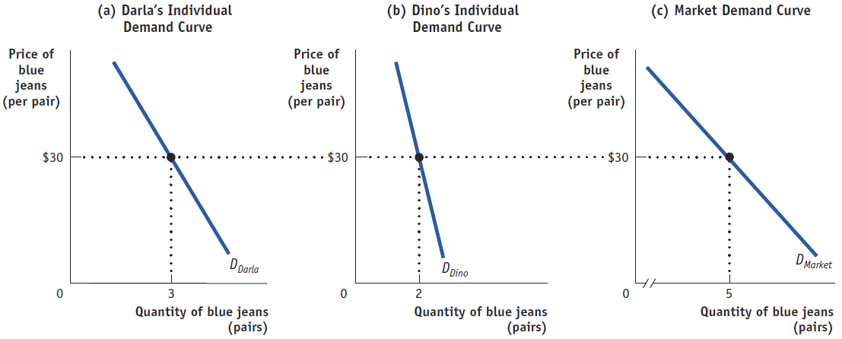
Individual Demand Curve and the Market Demand Curve
The market demand curve is the horizontal sum of the individual demand curves of all consumers in that market.
Section 2 | Module 5

Slide 15
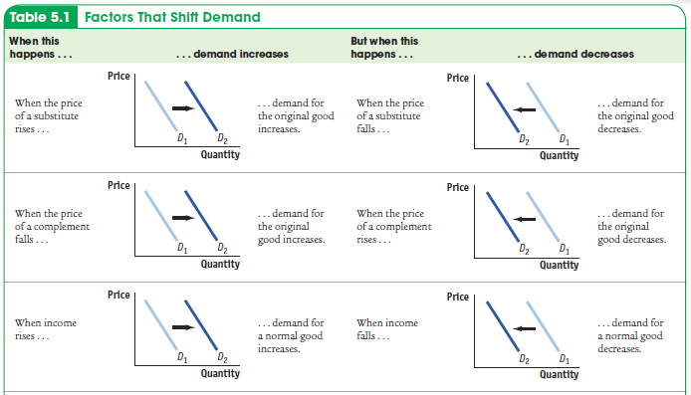
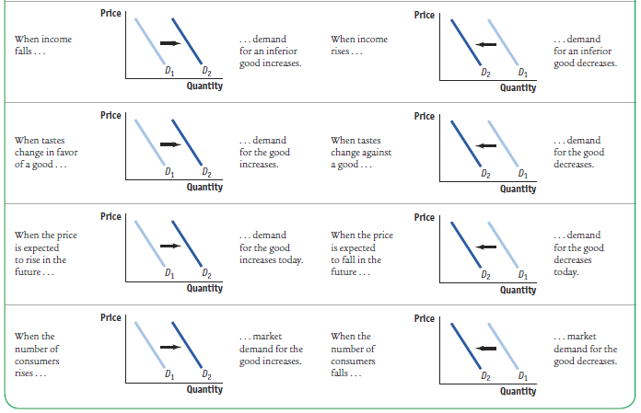
Factors That Shift Demand
Section 2 | Module 5

Slide 16
F Y I
Beating the Traffic
All big cities have traffic problems.
Cities can develop strategies to reduce the demand for auto trips .
London has imposed a “congestion charge” on all cars entering the city— currently about £8 ($13).
Three years later traffic in central London was about 10 percent lower than before the charge.
Section 2 | Module 5

Slide 17
Summary
The supply and demand model illustrates how a competitive market works.
The demand schedule shows the quantity demanded at each price and is represented graphically by a demand curve.
The law of demand says that demand curves slope downward.
A movement along the demand curve occurs when a price change leads to a change in the quantity demanded. When economists talk of increasing or decreasing demand, they mean shifts of the demand curve—a change in the quantity demanded at any given price
Section 2 | Module 5

Slide 18
Summary
There are five main factors that shift the demand curve:
A change in the prices of related goods or services
A change in income
A change in tastes
A change in expectations
A change in the number of consumers
The market demand curve for a good or service is the horizontal sum of the individual demand curves of all consumers in the market.
Section 2 | Module 5

Slide 19
The law of demand and downward sloping demand curve tell us which of the following:
A. There is a direct relationship between price and quantity supplied B. There is a direct relationship between price and quantity demanded C. There is a direct relationship between price and demand
D. There is an inverse relationship between price and quantity demanded
E. There is an inverse relationship between price and supply
2. What causes a change in quantity demanded?
A. Income
B. The price of other goods in the marketplace
C. Price of the good D. Interest rates E. Expectations
3. An increase in demand is shown on a graph by
A. Movement up the same demand curve B. Shifting of the demand curve to the left
C. Movement down the same demand curve
D. Shifting of the demand curve to the right
E. Shifting of the supply curve to the right

Slide 20
1. All of the following would decrease demand for the latest style furry boots except:
A. The price of shoes goes down
B. People prefer boots without fur C. The price of the furry boots goes up D. People expect the boots to go out of style soon
E. The weather forecast is for a very warm winter
2. A decrease in the price of toothpaste in a tube can lead to a decrease in the purchases of toothpaste in a pump. This means
A. Toothpaste in a tube and in a pump are substitute goods and the demand curve for toothpaste in a tube will shift right.
B. Toothpaste in a tube and in a pump are complementary goods and the demand curve for toothpaste in a tube will shift right.
C. Toothpaste in a tube and in a pump are substitute goods and the demand curve for toothpaste in a pump will shift left.
D. Toothpaste in a tube and in a pump are complementary goods and the demand curve for toothpaste in a pump will shift left.
E. Toothpaste in a tube and in a pump are complementary goods and the demand curve for both toothpastes will shift left.
3. Suppose that the Food and Drug Administration has written an article stating green tea reduces heart disease and many illnesses. What might be the immediate effect seen in the economy?
A. The demand for green tea would increase, forcing the price to go up. B. The quantity demanded for green tea would increase, forcing the price to go up.
C. The quantity supplied of green tea would increase, forcing the price to go up.
D. The supply of green tea would increase, forcing the price to go down. E. The quantity supplied for green tea would go down, forcing the price to go up.

