Slide 1
Today's Agenda
No Quiz! No time
Finish demand – practice questions
Supply – very briefly
Equilibrium

Slide 2
What a competitive market is and how it is described by the supply and demand model
What the demand curve is
The difference between movements along the demand curve and changes in demand
The factors that shift the demand curve
What You Will Learn in this Module
Section 2 | Module 5

Slide 3
Supply and Demand: A Model of a Competitive Market
A competitive market:
Many buyers and sellers
Identical good or service
The supply and demand model is a model of how a competitive market works.
Five key elements:
Demand curve
Supply curve
Demand and supply curve shifts
Market equilibrium
Changes in the market equilibrium
Section 2 | Module 5

Slide 4
The Demand Schedule and the Demand Curve
A demand schedule shows how much of a good or service consumers will want to buy at different prices.
Demand Schedule for Cotton
Price of cotton
(per pound)
Quantity of cotton beans demanded (billions of pounds)
$2.00
7.1
1.75
7.5
1.50
8.1
1.25
8.9
1.00
10.0
0.75
11.5
0.50
14.2
Section 2 | Module 5

Slide 5
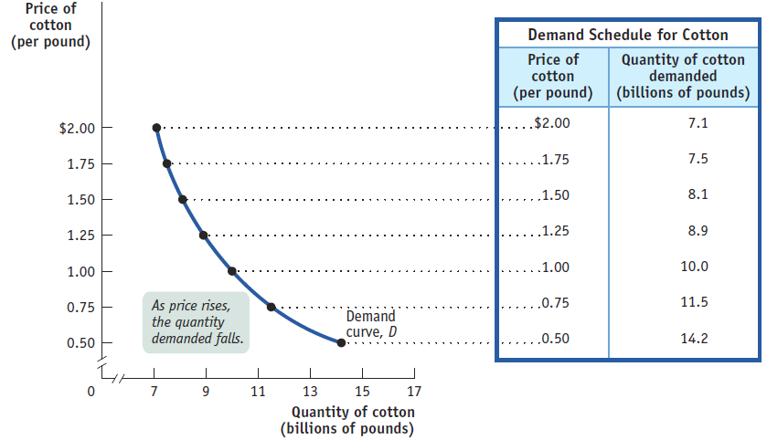
The Demand Schedule and the Demand Curve
A demand curve is the graphical representation of the demand schedule; it shows how much of a good or service consumers want to buy at any given price.
Section 2 | Module 5

Slide 6
Shifts of the Demand Curve
Demand Schedules for Cotton
Quantity of cotton demanded
(billions of pounds)
Price of cotton
(per pound)
An increase in the population and other factors generate an increase in demand – a rise in the quantity demanded at any given price.
in 2012
in 2013
$2.00
7.1
8.5
1.75
7.5
9.0
1.50
8.1
9.7
1.25
8.9
10.7
1.00
10.0
12.0
0.75
11.5
13.8
0.50
14.2
17.0
Section 2 | Module 5

Slide 7
Shifts of the Demand Curve
This is represented by the two demand schedules:
One showing demand in 2012, before the rise in population.
The other showing demand in 2013, after the rise in population.
Demand Schedules for Cotton
Quantity of cotton demanded
(billions of pounds)
Price of cotton
(per pound)
in 2012
in 2013
$2.00
7.1
8.5
1.75
7.5
9.0
1.50
8.1
9.7
1.25
8.9
10.7
1.00
10.0
12.0
0.75
11.5
13.8
0.50
14.2
17.0
Section 2 | Module 5

Slide 8
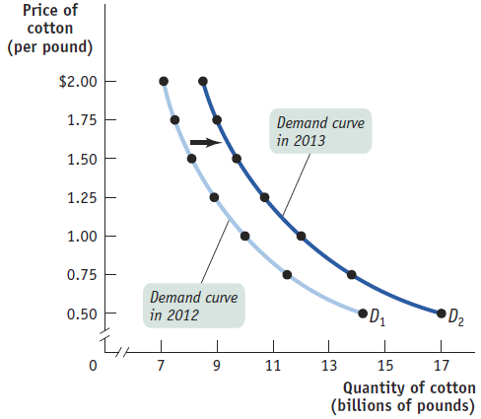
Shifts of the Demand Curve
A shift of the demand curve is a change in the quantity demanded at any given price, represented by the change of the original demand curve to a new position, denoted by a new demand curve.
Section 2 | Module 5

Slide 9
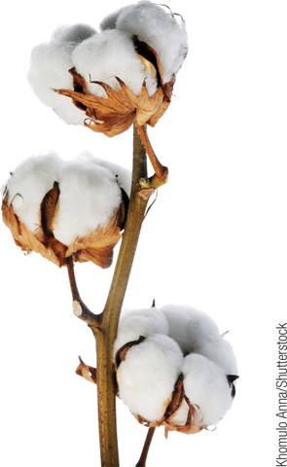
Movement Along the Demand Curve
A movement along the demand curve is a change in the quantity demanded of a good that is the result of a change in that good’s price.
Price of cotton (per pound)
A shift of the demand curve…
$2.00
1.75
A
C
… is not the same thing as a movement along the demand curve
1.50
1.25
1.00
B
0.75
0.50
D
1
D
2
0
7
8.1
9.7
10
13
15
17
Quantity of cotton (billions of pounds)
Section 2 | Module 5

Slide 10
Shifts of the Demand Curve
An “increase in demand” means a rightward shift of the demand curve: at any given price, consumers demand a larger quantity than before. (D1→D2)
Price
Increase in demand
Decrease in demand
D
3
D
1
D
2
Quantity
Section 2 | Module 5

Slide 11
Understanding Shifts of the Demand Curve
Changes in the Prices of Related Goods
Substitutes: Two goods are substitutes if a fall in the price of one of the goods makes consumers less willing to buy the other good.
Complements: Two goods are complements if a fall in the price of one good makes people more willing to buy the other good.
Section 2 | Module 5

Slide 12
Understanding Shifts of the Demand Curve
Changes in Income
Normal Goods: When a rise in income increases the demand for a good - the normal case - we say that the good is a normal good.
Inferior Goods: When a rise in income decreases the demand for a good, it is an inferior good.
Section 2 | Module 5

Slide 13
Understanding Shifts of the Demand Curve
Changes in Tastes
Economists usually lump together changes in demand due to fads, beliefs, cultural shifts, and so on under the heading of changes in tastes, or preferences.
Changes in Expectations
Expectations of a future drop in price lead to a decrease in demand today.
Expectations of a future rise in price are likely to cause an increase in demand today.
Section 2 | Module 5

Slide 14
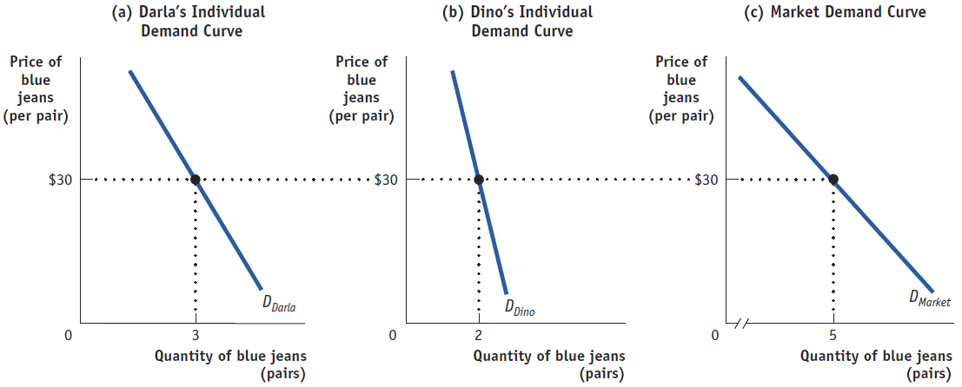
Individual Demand Curve and the Market Demand Curve
The market demand curve is the horizontal sum of the individual demand curves of all consumers in that market.
Section 2 | Module 5

Slide 15
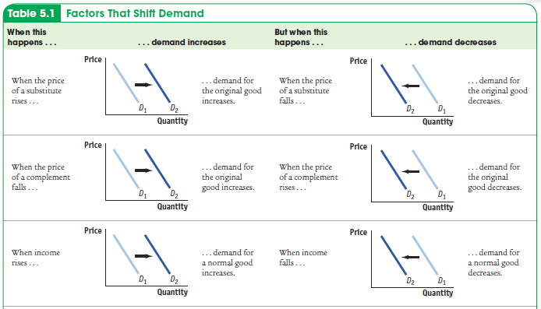
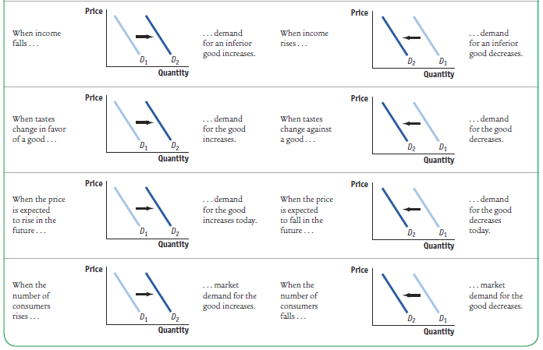
Factors That Shift Demand
Section 2 | Module 5

Slide 16
F Y I
Beating the Traffic
All big cities have traffic problems.
Cities can develop strategies to reduce the demand for auto trips .
London has imposed a “congestion charge” on all cars entering the city— currently about £8 ($13).
Three years later traffic in central London was about 10 percent lower than before the charge.
Section 2 | Module 5

Slide 17
Summary
The supply and demand model illustrates how a competitive market works.
The demand schedule shows the quantity demanded at each price and is represented graphically by a demand curve.
The law of demand says that demand curves slope downward.
A movement along the demand curve occurs when a price change leads to a change in the quantity demanded. When economists talk of increasing or decreasing demand, they mean shifts of the demand curve—a change in the quantity demanded at any given price
Section 2 | Module 5

Slide 18
Summary
There are five main factors that shift the demand curve:
A change in the prices of related goods or services
A change in income
A change in tastes
A change in expectations
A change in the number of consumers
The market demand curve for a good or service is the horizontal sum of the individual demand curves of all consumers in the market.
Section 2 | Module 5

Slide 19
The law of demand and downward sloping demand curve tell us which of the following:
A. There is a direct relationship between price and quantity supplied B. There is a direct relationship between price and quantity demanded C. There is a direct relationship between price and demand
D. There is an inverse relationship between price and quantity demanded
E. There is an inverse relationship between price and supply
2. What causes a change in quantity demanded?
A. Income
B. The price of other goods in the marketplace
C. Price of the good D. Interest rates E. Expectations
3. An increase in demand is shown on a graph by
A. Movement up the same demand curve B. Shifting of the demand curve to the left
C. Movement down the same demand curve
D. Shifting of the demand curve to the right
E. Shifting of the supply curve to the right

Slide 20
1. All of the following would decrease demand for the latest style furry boots except:
A. The price of shoes goes down
B. People prefer boots without fur C. The price of the furry boots goes up D. People expect the boots to go out of style soon
E. The weather forecast is for a very warm winter
2. A decrease in the price of toothpaste in a tube can lead to a decrease in the purchases of toothpaste in a pump. This means
A. Toothpaste in a tube and in a pump are substitute goods and the demand curve for toothpaste in a tube will shift right.
B. Toothpaste in a tube and in a pump are complementary goods and the demand curve for toothpaste in a tube will shift right.
C. Toothpaste in a tube and in a pump are substitute goods and the demand curve for toothpaste in a pump will shift left.
D. Toothpaste in a tube and in a pump are complementary goods and the demand curve for toothpaste in a pump will shift left.
E. Toothpaste in a tube and in a pump are complementary goods and the demand curve for both toothpastes will shift left.
3. Suppose that the Food and Drug Administration has written an article stating green tea reduces heart disease and many illnesses. What might be the immediate effect seen in the economy?
A. The demand for green tea would increase, forcing the price to go up. B. The quantity demanded for green tea would increase, forcing the price to go up.
C. The quantity supplied of green tea would increase, forcing the price to go up.
D. The supply of green tea would increase, forcing the price to go down. E. The quantity supplied for green tea would go down, forcing the price to go up.

Slide 21
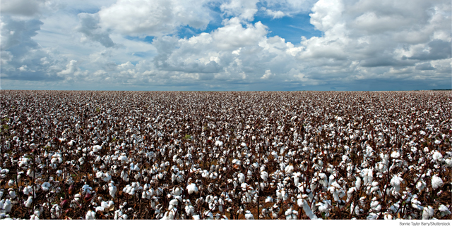
Draw a supply curve and interpret its meaning
Discuss the difference between movements along the supply curve and changes in supply
List the factors that shift the supply curve
What You Will Learn in this Module
Section 2 | Module 6

Slide 22
The Supply Schedule
A supply schedule shows how much of a good or service would be supplied at different prices.
Supply Schedule for Cotton
Price of cotton (per pound) | Quantity of cotton supplied (billions of pounds)
$2.00 | 11.6
1.75 | 11.5
1.50 | 11.2
1.25 | 10.7
1.00 | 10.0
0.75 | 9.1
0.50 | 8.0
Section 2 | Module 6

Slide 23
The Supply Curve
A supply curve shows graphically how much of a good or service people are willing to sell at any given price.
Price of cotton (per pound)
Supply curve, S
$2.00
1.75
1.50
As price rises, the quantity supplied rises.
1.25
1.00
0.75
0.50
0
7
9
11
13
15
17
Quantity of cotton
(billions of pounds)
Section 2 | Module 6

Slide 24
The Law of Supply
The Law of Supply says that, other things being equal, the price and quantity supplied of a good are positively related.
Section 2 | Module 6

Slide 25
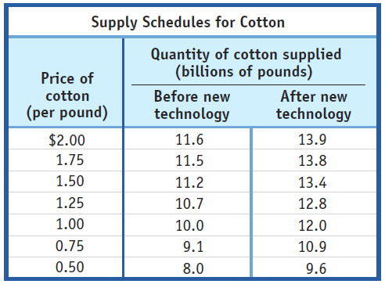
An Increase in Supply
The adoption of improved cotton-growing technology generated an increase in supply—a rise in the quantity supplied at any given price.
This event is represented by the two supply schedules—one showing supply before the new technology was adopted, the other showing supply after the new technology was adopted—and their corresponding supply curves. The increase in supply shifts the supply curve to the right.
Section 2 | Module 6

Slide 26
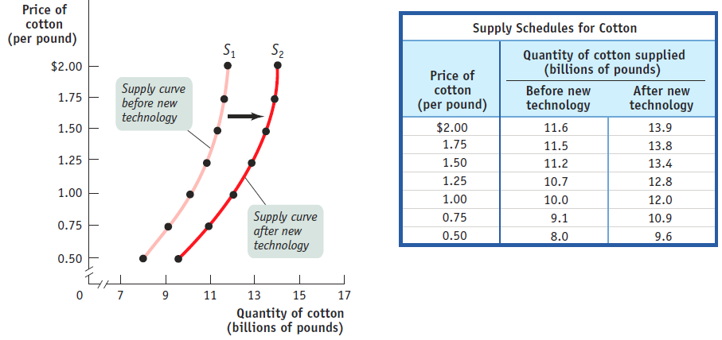
An Increase in Supply
A shift of the supply curve is a change in the quantity supplied of a good at any given price, or a change in supply.
Section 2 | Module 6

Slide 27
Movement Along the Supply Curve
Price of cotton (per pound)
A movement along the supply curve…
S
1
S
2
$2.00
1.75
1.50
B
1.25
1.00
A
C
0.75
… is not the same thing as a shift of the supply curve.
0.50
0
7
10
11.2
12
15
17
Quantity of cotton (billions of pounds)
A movement along the supply curve is a change in the quantity supplied of a good that is the result of a change in that good’s price.
Section 2 | Module 6

Slide 28
Shifts of the Supply Curve
Price
Any “increase in supply” means a rightward shift of the supply curve: at any given price, there is an increase in the quantity supplied. (S1→ S2)
Any “decrease in supply” means a leftward shift of the supply curve: at any given price, there is a decrease in the quantity supplied. (S1→ S3)
S
3
S
1
S
2
Increase in supply
Decrease in supply
Quantity
Section 2 | Module 6

Slide 29
Understanding Shifts of the Supply Curve
Changes in input prices
An input is a good that is used to produce another good.
Changes in the prices of related goods and services
Changes in technology
Technology is the method people use to turn inputs into useful goods and services.
Changes in expectations
Changes in the expected future price of a good can lead a supplier to supply less or more of the good today.
Changes in the number of producers
Section 2 | Module 6

Slide 30
Individual Supply Curve and the Market Supply Curve
The market supply curve is the horizontal sum of
the individual supply curves of all firms in that market.
(a) Mr. Silva’s Individual Supply Curve
(b) Mr. Liu’s Individual
Supply Curve
(c) Market Supply Curve
Price of cotton
(per pound)
Price of cotton
(per pound)
Price of cotton (per pound)
S
Silva
S
Liu
S
Market
$2
$2
$2
1
1
1
0
1
2
3
0
1
2
0
1
2
3
4
5
Quantity of cotton (thousands of pounds)
Quantity of cotton (thousands of pounds)
Quantity of cotton (thousands of pounds)
Section 2 | Module 6

Slide 31
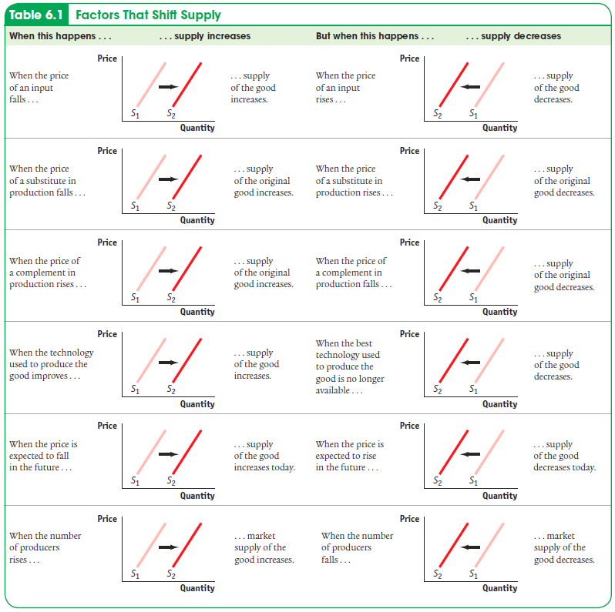
Factors That Shift Supply
Section 2 | Module 6

Slide 32
F Y I
Only Creatures Small and Pampered
According to a 2007 article in the New York Times, the U.S. has experienced a severe decline in the number of farm veterinarians over the past two decades.
The source of the problem is the higher demand for pet veterinarians.
Farm veterinary services and pet veterinary services are substitutes in production.
Section 2 | Module 6

Slide 33
Practice
Which of the following is correct regarding supply? A An increase in technology will lead to a decrease in supply causing the supply curve to shift left.
B A decrease in the number of sellers in the market will lead to an increase in supply
leading to a shift of the supply curve to the right.
C . A change in price will lead to a change in quantity supplied and a movement along
the existing supply curve.
D An increase in price will lead to a decrease in supply causing a shift of the supply
curve to the left.
E A decrease in price of a good will lead to an increase in supply causing a shift of the
supply curve to the right.

Slide 34
Practice
An increase in technology, a decrease in input prices, and an increase in the number of sellers in the marketplace will lead to which of the following?
An increase in the quantity supplied
B. A decrease in the quantity supplied
C. An increase in demand D. An increase in supply
E. A decrease in supply

Slide 35
Practice
A decrease in technology, a decrease in input prices, and a decrease in the number of sellers in the marketplace will lead to which of the following?
An increase in the quantity supplied
B. A decrease in the quantity supplied
C. An increase in demand D. An increase in supply
E. A decrease in supply

Slide 36
Practice
When oil prices fall, what happens to supply of plastics?
A. Supply shifts to the right as price of inputs decreases. B. Supply shifts left as more drivers demand gasoline. C. Supply shifts as the number of suppliers of plastic declines.
D. Supply shifts to the right as price of inputs increases.
E. Supply shifts as consumers demand more plastic products.

Slide 37
Practice
On the way to the supermarket, the tractor trailer carrying peaches tips over and spills peaches all over the highway. The result will be
The quantity supplied of peaches goes down and the price of peaches goes down.
B. The quantity demanded of peaches goes up and the price of peaches goes down.
C. The supply of peaches goes down and the price of peaches goes up. D. The supply of peaches goes down and the price of peaches goes down.
E. The demand for peaches goes up and the price of peaches goes up.

Slide 38
Practice
Draw a graph representing the market for groceries in Kingtown and show what happens when a new supermarket opens in town. Draw a second graph that shows what happens when the cost of hiring workers for this supermarket doubles.

Slide 39
Summary
The supply schedule shows the quantity supplied at each price and is represented graphically by a supply curve. Supply curves usually slope upward.
A movement along the supply curve occurs when price changes.
A change in the quantity supplied at any given price is a shifts of the supply curve.
There are five main factors that shift the supply curve:
A change in input prices
A change in the prices of related goods and services
A change in technology
A change in expectations
A change in the number of producers
The market supply curve for a good or service is the horizontal sum of the individual supply curves of all producers in the market.
Section 2 | Module 6

Slide 40
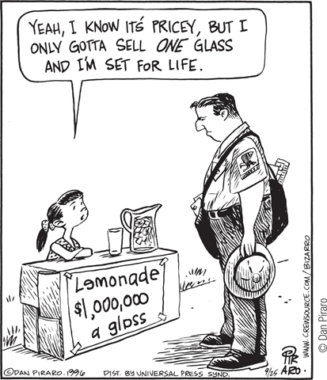
Supply, Demand and Equilibrium
Equilibrium in a competitive market: when the quantity demanded of a good equals the quantity supplied of that good.
The price at which this takes place is the equilibrium price (a.k.a. market-clearing price):
Every buyer finds a seller and vice versa.
The quantity of the good bought and sold at that price is the equilibrium quantity.
Section 2 | Module 7

Slide 41
Finding the Equilibrium Price and Quantity
Price of cotton
(per pound)
Market equilibrium occurs at point E, where the supply curve and the demand curve intersect.
Supply
$2.00
1.75
1.50
1.25
Equilibrium price
1.00
E
Equilibrium
0.75
0.50
Demand
0
7
10
13
15
17
Quantity of cotton
(billions of pounds)
Equilibrium quantity
Section 2 | Module 7

Slide 42
Price Above Its Equilibrium Level Creates a Surplus
Price of cotton
(per pound)
There is a surplus of a good when the quantity supplied exceeds the quantity demanded. Surpluses occur when the price is above its equilibrium level.
Supply
$2.00
1.75
Surplus
1.50
1.25
1.00
E
0.75
0.50
Demand
0
7
8.1
10
11.2
13
15
17
Quantity of cotton (billions of pounds)
Quantity demanded
Quantity supplied
Section 2 | Module 7

Slide 43
Price Below Its Equilibrium Level Creates a Shortage
Price of cotton
(per pound)
There is a shortage of a good when the quantity demanded exceeds the quantity supplied. Shortages occur when the price is below its equilibrium level.
Supply
$2.00
1.75
1.50
1.25
1.00
E
0.75
0.50
Shortage
Demand
0
7
9.1
10
11.5
13
15
17
Quantity of cotton (billions of pounds)
Quantity supplied
Quantity demanded
Section 2 | Module 7

Slide 44
F Y I
The Price of Admission
The competitive market model determines the price you pay for concert tickets.
Section 2 | Module 7

Slide 45
Equilibrium and Shifts of the Demand Curve
Price
of cotton
An increase in demand…
Supply
… leads to a movement along the supply curve due to a higher equilibrium price and higher equilibrium quantity.
E
2
P
2
Price rises
E
1
P
1
D
2
D
1
Q
1
Q
2
Quantity of cotton
Section 2 | Module 7

Slide 46
Equilibrium and Shifts of the Supply Curve
Price of
cotton
S
2
S
A decrease in supply…
1
E
2
P
2
Price rises
… leads to a movement along the demand curve due to a higher equilibrium price and lower equilibrium quantity.
P
1
E
1
Demand
Q
Q
Quantity of cotton
2
1
Quantity falls
Section 2 | Module 7

Slide 47
Simultaneous Shifts of Supply and Demand Curves
(a) One possible outcome: Price Rises, Quantity Rises
Price of cotton
Small decrease
in supply
S
2
S
1
Two opposing forces determining the equilibrium quantity.
E
The increase in demand dominates the decrease in supply.
2
P
2
E
1
P
1
D
2
D
1
Large increase
in demand
Q
1
Q
2
Quantity of cotton
Section 2 | Module 7

Slide 48
Simultaneous Shifts of Supply and Demand Curves
(b) Another Possibility Outcome: Price Rises, Quantity Falls
Price of cotton
Two opposing forces determining the equilibrium quantity.
Large decrease in supply
S
2
S
1
E
2
P
2
E
1
Small increase in demand
P
1
D
2
D
1
Q
Q
Quantity of cotton
Section 2 | Module 7

Slide 49
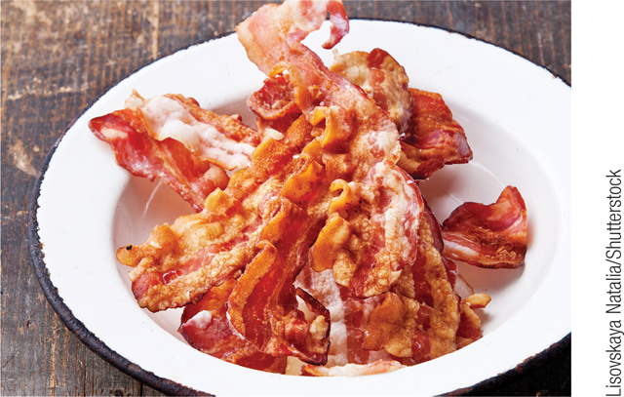
F Y I
Makin’ Bacon?
A decrease in the supply of bacon may cause consumers to squeal, but it won’t cause a lasting shortage, because higher bacon prices will decrease the quantity demanded and increase the quantity supplied.
Section 2 | Module 7

Slide 50
Summary
Simultaneous Shifts of Supply and Demand | Supply Increases | Supply Decreases
Demand Increases | Price: cannot be determined Quantity: up | Price: up Quantity: cannot be determined
Demand Decreases | Price: down Quantity: cannot be determined | Price: cannot be determined Quantity: down
Section 2 | Module 7

Slide 51
Summary
The equilibrium price, or market-clearing price, is the price at which the quantity demanded is equal to the quantity supplied.
When quantity supplied is equal to quantity demanded, this is the equilibrium quantity.
When the price is above its market-clearing level, there is a surplus that pushes the price down.
When the price is below its market-clearing level, there is a shortage that pushes the price up.
Section 2 | Module 7

