Slide 1
How scarcity and choice are central to the study of economics
The importance of opportunity cost in individual choice and decision making
The difference between positive economics and normative economics
When Economists agree and why they sometimes disagree
What makes macroeconomics different from microeconomics
What You Will Learn in this Module
Section 1 | Module 1

Slide 2
Todays Agenda
Economic Way of Thinking lecture
Partner practice – Macro vs Micro and Positive vs Normative
Extra practice/review: reffnomics.com
Davidson project edx
mjm foodie

Slide 3
How scarcity and choice are central to the study of economics
The importance of opportunity cost in individual choice and decision making
The difference between positive economics and normative economics
When Economists agree and why they sometimes disagree
What makes macroeconomics different from microeconomics
What You Will Learn in this Module
Section 1 | Module 1

Slide 4
Individual Choice: The Core of Economics
Individual choice is the decision by an individual of what to do, which necessarily involves a decision of what not to do.
Basic principles behind the individual choices include:
Resources are scarce.
The real cost of something is what you must give up to get it.
“How much?” is a decision at the margin.
People usually take advantage of opportunities to make themselves better off.
Section 1 | Module 1

Slide 5
Resources Are Scarce
A resource is anything that can be used to produce something else.
Ex.: Land, labor, capital, entrepreneurship
Resources are scarce – the quantity available isn’t large enough to satisfy all productive uses.
Ex.: Petroleum, lumber, intelligence
Section 1 | Module 1

Slide 6
Opportunity Cost: The Real Cost of Something Is What You Must Give Up to Get It
The real cost of an item is its opportunity cost: what you must give up in order to get it.
Opportunity cost is crucial to understanding individual choice.
Section 1 | Module 1

Slide 7
Macroeconomics vs. Microeconomics
Let’s begin by looking more carefully at the difference between microeconomic and macroeconomic questions.
MICROECONOMIC QUESTIONS
MACROECONOMIC QUESTIONS
Go to business school or take a job?
How many people are employed in the economy as a whole?
What determines the salary offered by Citibank to Cherie Camajo, a new Columbia MBA?
What determines the overall salary levels paid to workers in a given year?
Section 1 | Module 1

Slide 8
Macroeconomics vs. Microeconomics
MICROECONOMIC QUESTIONS
MACROECONOMIC QUESTIONS
What determines the cost to a university or college of offering a new course?
What determines the overall level of prices in the economy as a whole?
What government policies should be adopted to make it easier for low-income students to attend college?
What government policies should be adopted to promote full employment and growth in the economy as a whole?
What determines the overall trade in goods, services and financial assets between the U.S. and the rest of the world?
What determines whether Citibank opens a new office in Shanghai?
Section 1 | Module 1

Slide 9
Macroeconomics vs. Microeconomics
Microeconomics focuses on how decisions are made by individuals and firms and the consequences of those decisions.
Macroeconomics examines the aggregate behavior of the economy.
Macroeconomics examines how the actions of all the individuals and firms in the economy interact to produce a particular level of economic performance as a whole.
In macroeconomics, the behavior of the whole macroeconomy is, indeed, greater than the sum of individual actions and market outcomes.
Section 1 | Module 1

Slide 10
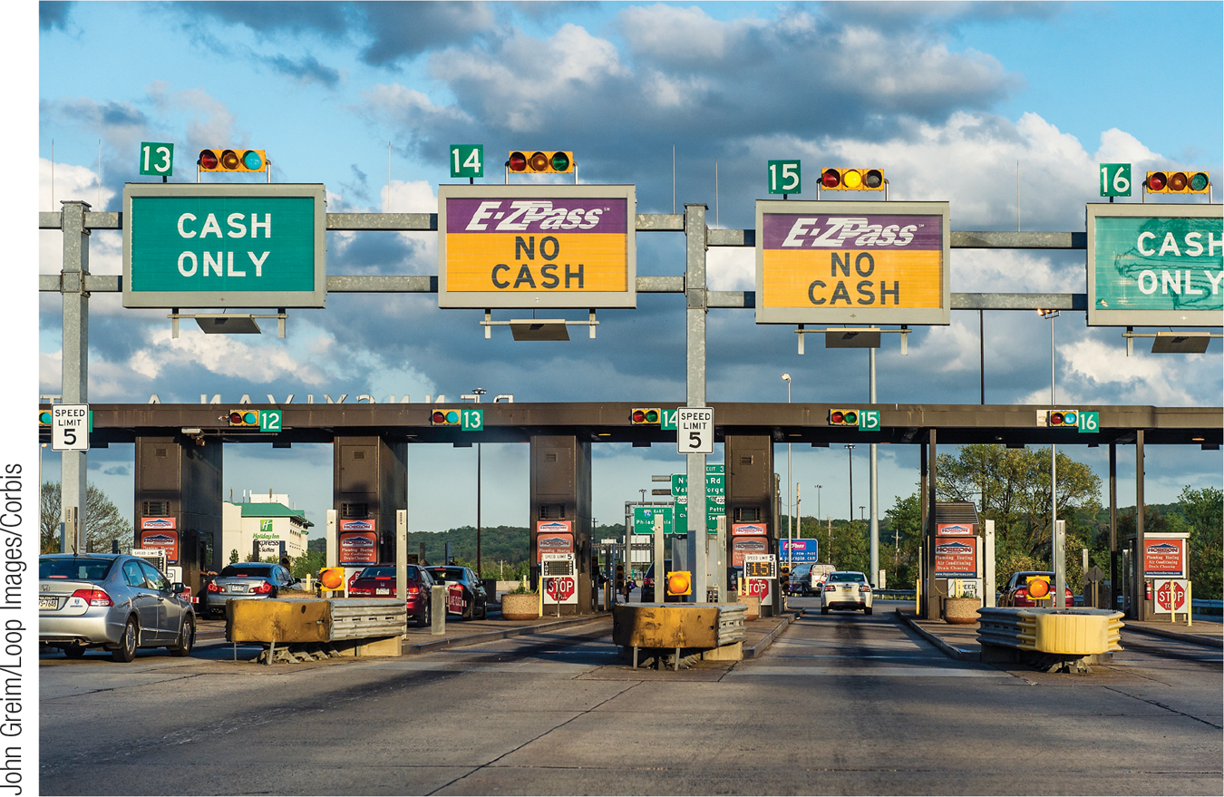
Positive v. Normative Economics
Positive economics is the branch of economic analysis that describes the way the economy actually works.
Normative economics makes prescriptions about the way the economy should work.
Section 1 | Module 1

Slide 11
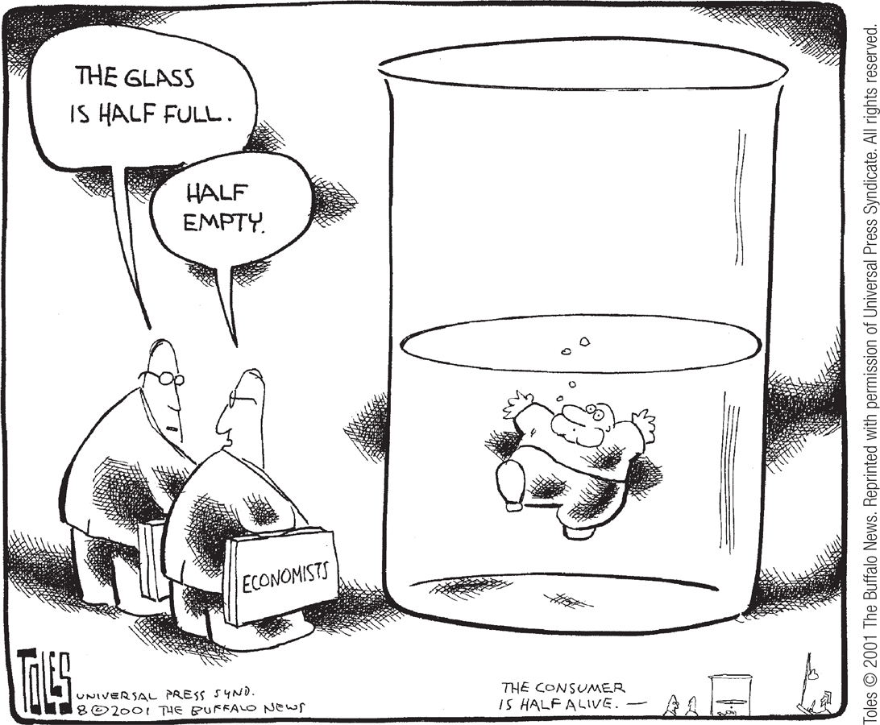
When and Why Economists Disagree
There are two main reasons economists disagree:
Which simplifications to make in a model
Values
Section 1 | Module 1

Slide 12
F Y I
When Economists Agree
Many economists agreed on their responses to statements such as: “Tariffs and import quotas usually reduce general economic welfare,” and “A ceiling on rents reduces the quantity and quality of housing available.”
What is interesting is that many non-economists disagree with economists on these statements.
Section 1 | Module 1

Slide 13
Summary
Everyone has to make choices about what to do and what not to do. Individual choice is the basis of economics.
The reason choices must be made is that resources—anything that can be used to produce something else—are scarce.
Because you must choose among limited alternatives, the true cost of anything is what you must give up to get it— all costs are opportunity costs.
Macroeconomics is the study of the behavior of the economy as a whole. Macroeconomics differs from microeconomics in the type of questions it tries to answer and in its strong policy focus.
Section 1 | Module 1

Slide 14
Summary
Economists use economic models both for positive economics, which describes how the economy works, and for normative economics, which prescribes how the economy should work.
There are two main reasons economists disagree. One, they may disagree about which simplifications to make in a model. Two, economists may disagree—like everyone else—about values.
Section 1 | Module 1

Slide 15
Questions for Thought – Work as Partners
For each of the following statements, identify if it refers to a macroeconomics or a microeconomics concept.
The unemployment rate is holding steady at 7.2%.
Congress should lower taxes to allow consumers to keep more of their income.
Colleges should lower the tuition for freshmen and sophomores.
The price of cars is rising in spite of a recent recession.
Increases in personal tax rates hurts middleclass workers.
Microsoft will be sending one million tablets to Germany.

Slide 16
Answers
The unemployment rate is holding steady at 7.2%. MACRO
Congress should lower taxes to allow consumers to keep more of their income. MACRO
Colleges should lower the tuition for freshmen and sophomores. MICRO
The price of cars is rising in spite of a recent recession. MICRO
Increases in personal tax rates hurts middleclass workers. MACRO
Microsoft will be sending one million tablets to Germany. MICRO

Slide 17
Continued
For each of the following statements, identify if it refers to a positive or a normative economics statement.
The high school should allocate more parking spaces to seniors.
The unemployment rate is holding steady at 7.2%
Colleges should lower the tuition for freshmen and sophomores.
Generally, if stores lowered product prices, more people would buy the products.
Movie prices should increase by 5% this year.
College athletes should be paid for their participation.
How much should colleges pay athletes for their participation?
An average electric bill for a family of 4 is $325/month.
More people should vote in local elections.
High schools should begin classes later in the day.

Slide 18
Answers
The high school should allocate more parking spaces to seniors. Normative
The unemployment rate is holding steady at 7.2% Positive
Colleges should lower the tuition for freshmen and sophomores. Normative
Generally, if stores lowered product prices, more people would buy the products. Positive
Movie prices should increase by 5% this year.Positive
College athletes should be paid for their participation. Normative
How much should colleges pay athletes for their participation? Normative
An average electric bill for a family of 4 is $325/month. Positive
More people should vote in local elections. Normative
High schools should begin classes later in the day. Normative

