Slide 1
What You Will Learn in this Module
Explain how long-run economic growth is represented in macroeconomic models
Model the effects of economic growth policies
Section 7 | Module 40

Slide 2
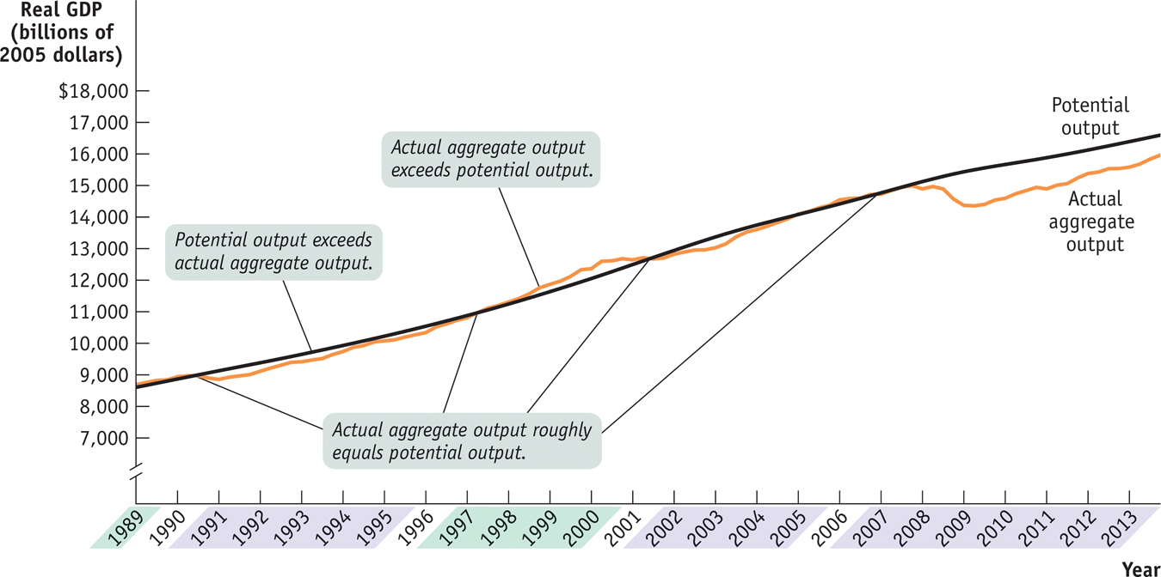
Actual and Potential Output from 1989 to 2013
Section 7 | Module 40
Notes:
Figure Caption: Figure 40-1: Actual and Potential Output from 1989 to 2009
This figure shows the performance of actual and potential output in the United States from 1989 to 2009. The black line shows estimates of U.S. potential output, produced by the Congressional Budget Office, and the blue line shows actual aggregate output. The purple-shaded years are periods in which actual aggregate output fell below potential output, and the green-shaded years are periods in which actual aggregate output exceeded potential output. As shown, significant shortfalls occurred in the recessions of the early 1990s and after 2000. Actual aggregate output was significantly above potential output in the boom of the late 1990s.
Source: Congressional Budget Office; Bureau of Economic Analysis

Slide 3
Long-run Economic Growth and the Production Possibilities Curve
Economic growth can be shown on a production possibility curve as a shift outward of the curve.
There is a trade-off between investment and consumer goods.
Depreciation is a loss in the value of physical capital due to wear, age or obsolescence.
Some investment is needed to counteract depreciation.
Section 7 | Module 40

Slide 4
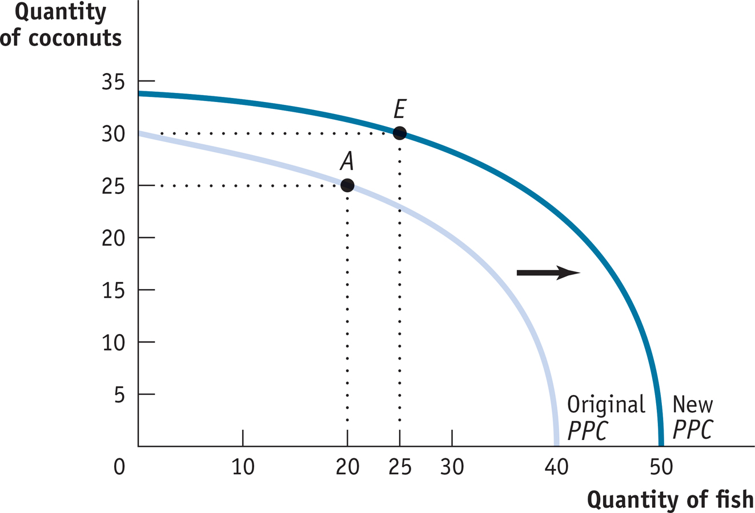
Economic Growth
Section 7 | Module 40
Notes:
Figure Caption: Figure 40.2: Economic growth results in an outward shift of the production possibility frontier because production possibilities are expanded. The economy can now produce more of everything. For example, if production is initially at point A (20 fish and 25 coconuts), it could move to point E (25 fish and 30 coconuts).

Slide 5
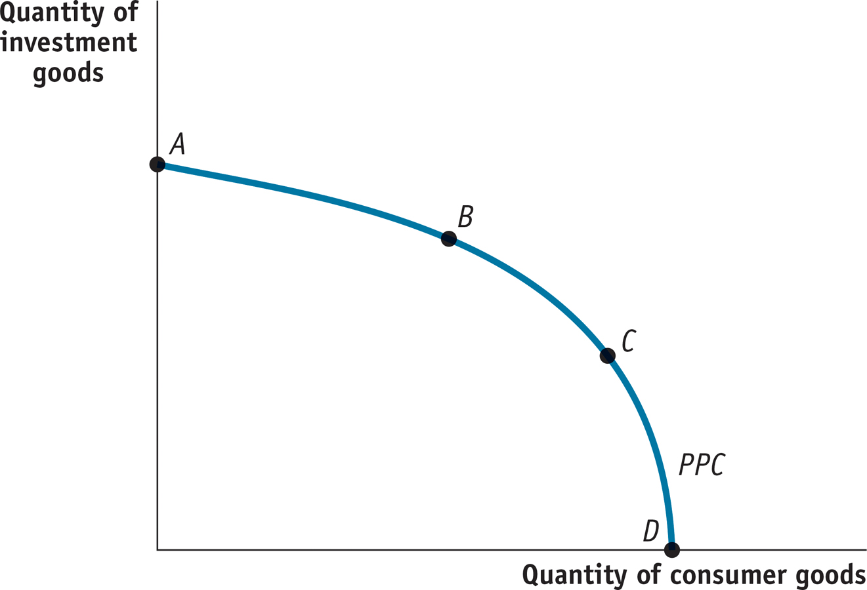
The Trade-off Between Investment and Consumer Goods
Section 7 | Module 40
Notes:
Figure Caption: Figure 40.3: The Trade-off Between Investment and Consumer Goods.

Slide 6
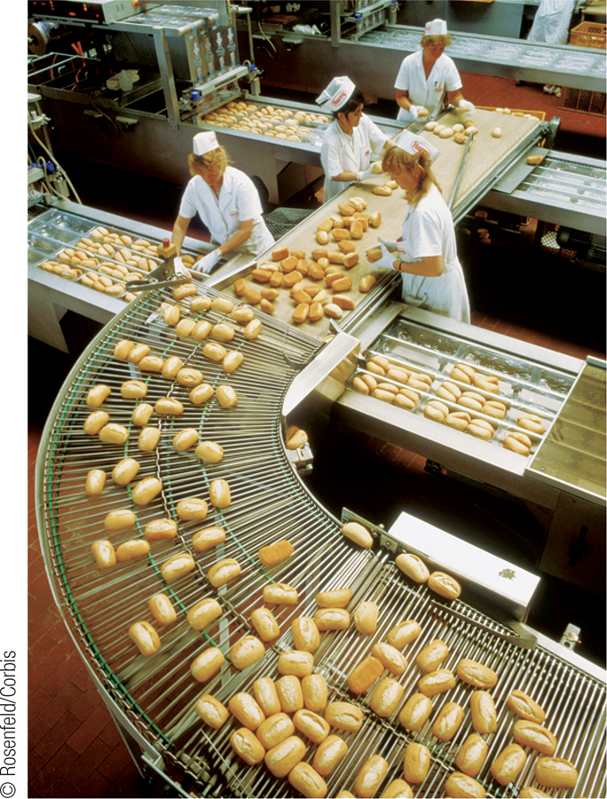
Long-run Economic Growth and the Aggregate Demand - Aggregate Supply Model
Recall that in the aggregate demand-aggregate supply model, the long-run aggregate supply curve shows the relationship between the aggregate price level and the quantity of aggregate output supplied when all prices are flexible.
Increases in potential output are reflected in a rightward shift of the LRAS curve.
Decreases in potential output are reflected in a leftward shift of the LRAS curve.
Section 7 | Module 40

Slide 7
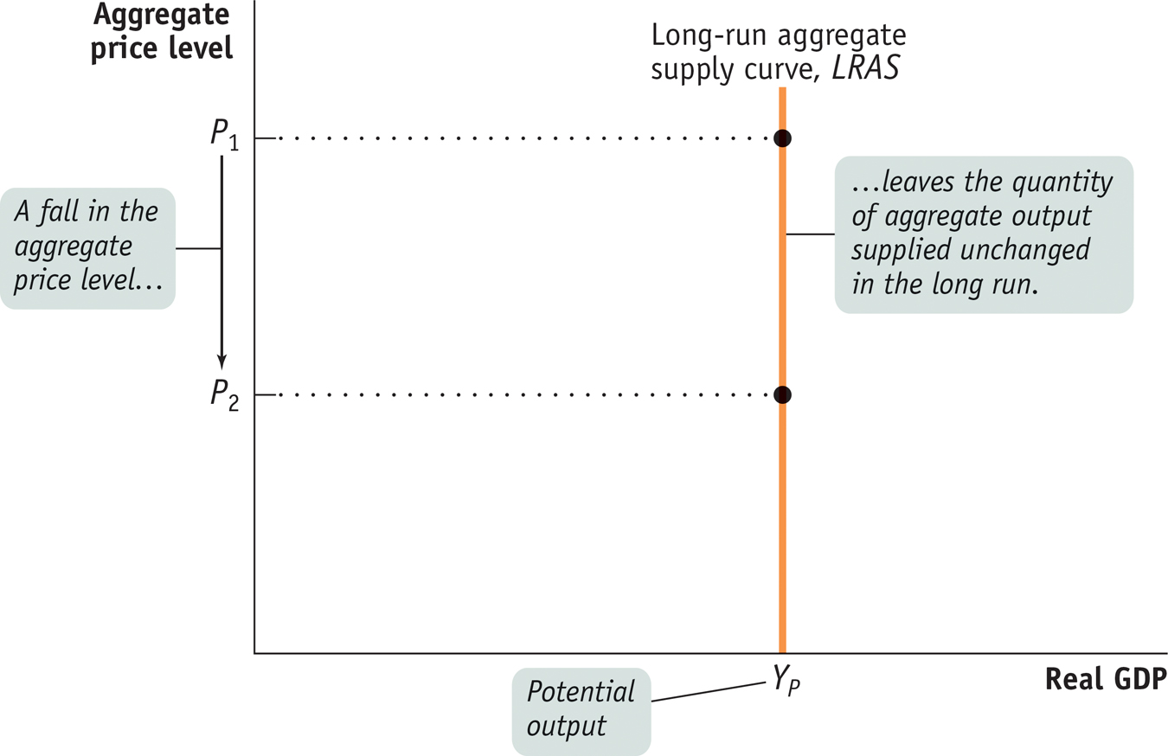
The Long-Run Aggregate Supply Curve
Section 7 | Module 40
Notes:
Figure Caption: Figure 40.4: Long-Run Aggregate Supply Curve
The long-run aggregate supply curve shows the quantity of aggregate output supplied when all prices, including nominal wages, are flexible. It is vertical at potential output, Y_{P} , because in the long run an increase in the aggregate price level has no effect on the quantity of aggregate output supplied.

Slide 8
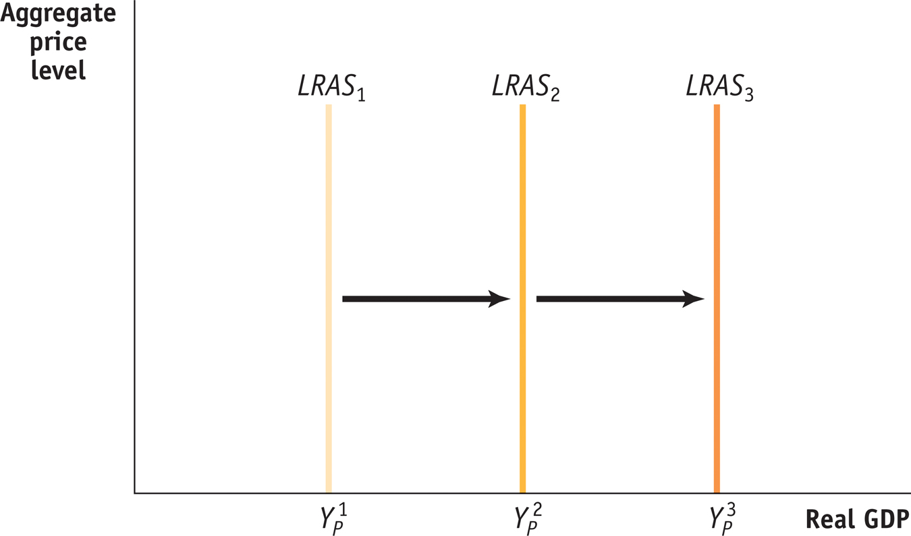
Long Run Growth and the LRAS Curve
Section 7 | Module 40
Notes:
Figure Caption: Figure 40.5: Long-run Growth and the LRAS Curve. The growth in potential output over time can be shown as a rightward shift of the long-run aggregate supply curve.

Slide 9
Distinguishing Between Long-Run Growth and Short-Run Fluctuations
The points along a production possibility curve are achievable if all of an economy’s resources are used efficiently.
If the economy experiences macroeconomic fluctuations due to a recession, production falls to a point inside the production possibility curve.
Long-run growth will appear as an outward shift of the production possibility curve.
Section 7 | Module 40

Slide 10
Distinguishing Between Long-Run Growth and Short-Run Fluctuations
In the aggregate demand-aggregate supply model, fluctuations of actual aggregate output around potential output are illustrated by shifts in aggregate demand or short-run aggregate supply.
Long-run economic growth is illustrated by a shift of the LRAS curve.
The LRAS curve demonstrates NO relationship with price level and RGDP because society adjusts or “gets used to” the prices.
The SRAS curve has a positive relationship between price level and RGDP—producers are responsive to price level.
Section 7 | Module 40

Slide 11
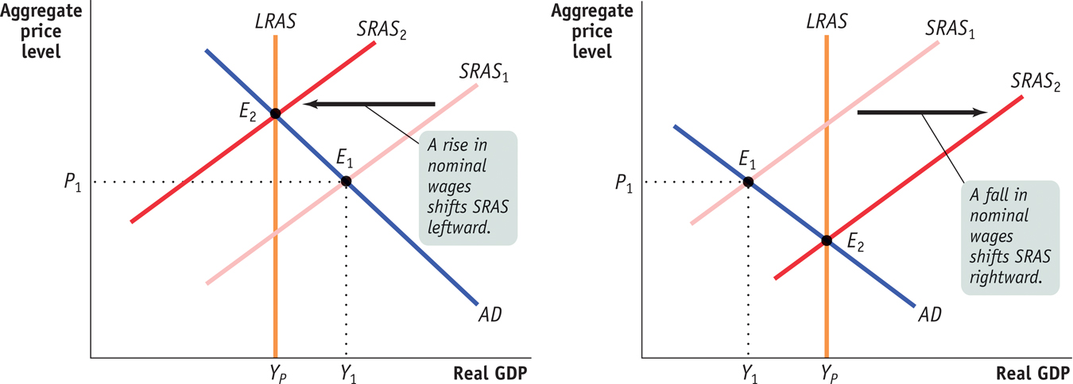
From the Short Run to the Long Run
Section 7 | Module 40
Notes:
Figure Caption: Figure 40.6: From the Short Run to the Long Run
Panel (a): The initial short-run aggregate supply curve is SRAS₁. At the aggregate price level, P₁, the quantity of aggregate output supplied, Y₁, exceeds potential output, Y_{P}. Eventually, low unemployment will cause nominal wages to rise, leading to a leftward shift of the short-run aggregate supply curve from SRAS₁ to SRAS₂.
Panel (b): At the aggregate price level, P₁, the quantity of aggregate output supplied is less than potential output. This reflects the fact that the short-run aggregate supply curve has shifted to the right, due to both the short-run adjustment process in the economy and to a rightward shift of the long-run aggregate supply curve.

Slide 12
Summary
Long-run economic growth can be seen on the production possibility curve as a shift outward of the curve.
An economy must have some investment in capital goods to counteract depreciation.
Long-run economic growth can be seen on the aggregate demand-aggregate supply model in the LRAS curve.
Short-run fluctuations can be seen in the production possibility curve in a movement inside the curve.
Short-run fluctuations can be seen in the aggregate demand-aggregate supply model as movements of the aggregate demand curve or the short-run aggregate supply curve.
Section 7 | Module 40

