Slide 1
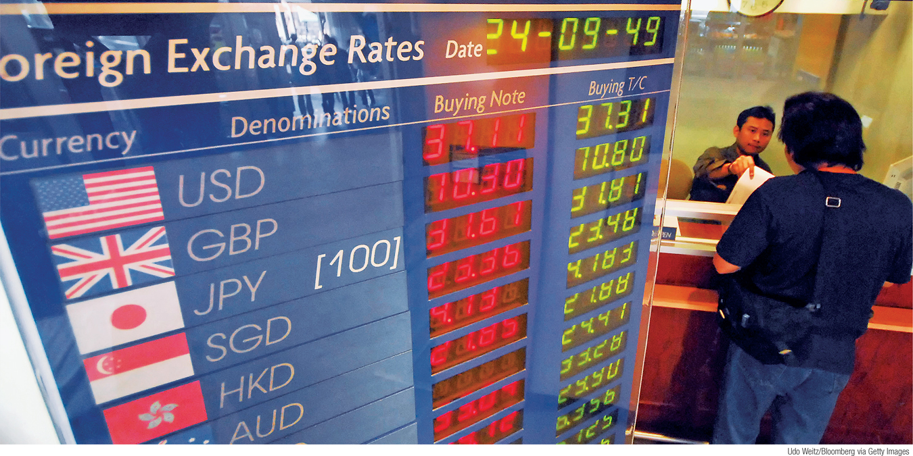
What You Will Learn in this Module
Explain the role of the foreign exchange market and the exchange rate
Discuss the importance of real exchange rates and their role in the current account
Section 8 | Module 42

Slide 2
The Role of The Exchange Rate
Currencies are traded in the foreign exchange market.
The prices at which currencies trade are known as exchange rates.
When a currency becomes more valuable in terms of other currencies, it appreciates.
When a currency becomes less valuable in terms of other currencies, it depreciates.
Section 8 | Module 42

Slide 3
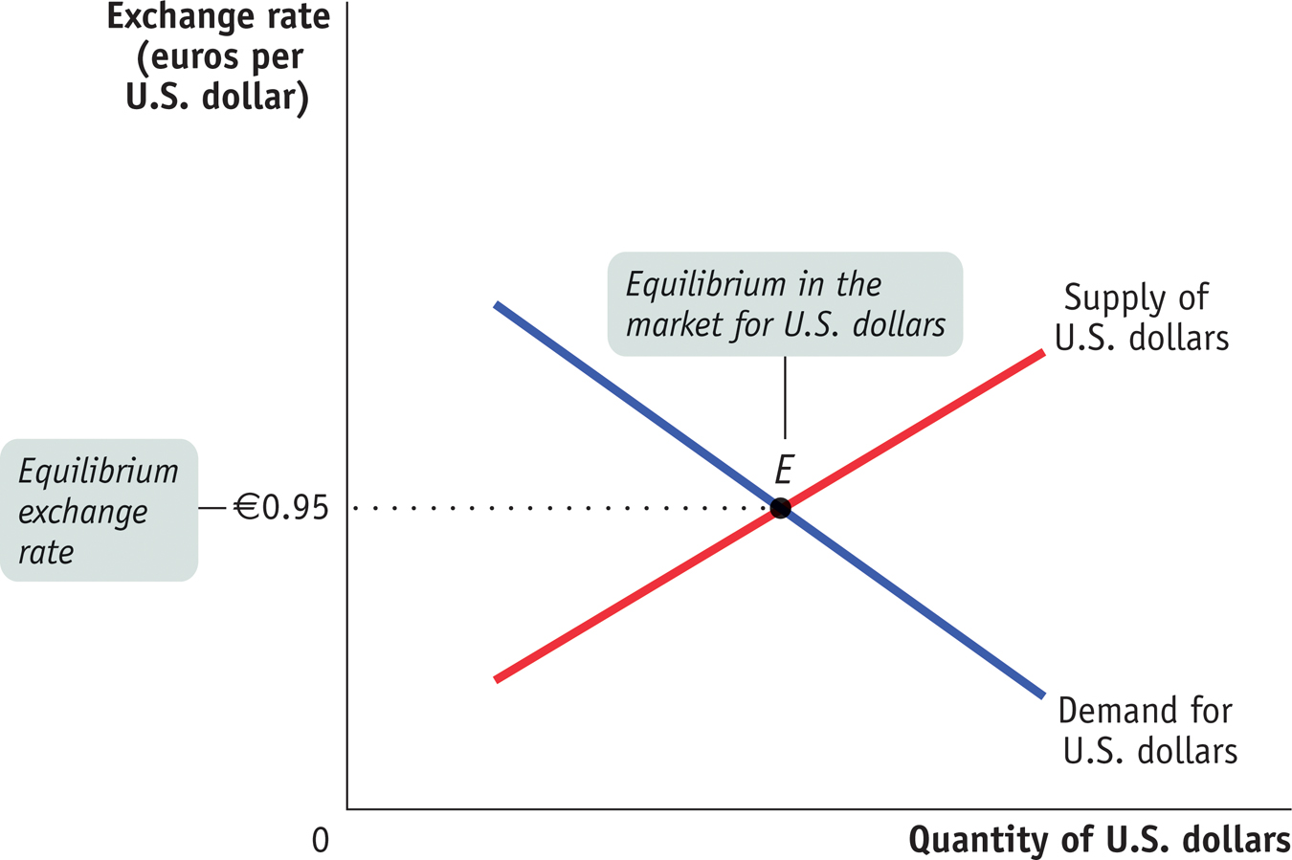
The Foreign Exchange Market
Section 8 | Module 42
Notes:
Figure Caption: Figure 42.1: The Foreign Exchange Market
The foreign exchange market matches up the demand for a currency from foreigners who want to buy domestic goods, services, and assets with the supply of a currency from domestic residents who want to buy foreign goods, services, and assets. Here, the equilibrium in the market for dollars is at point E, corresponding to an equilibrium exchange rate of † 0.95 per $1.00. The equilibrium exchange rate is the exchange rate at which the quantity of a currency demanded in the foreign exchange market is equal to the quantity supplied.

Slide 4
Equilibrium Exchange Rate
The equilibrium exchange rate is the exchange rate at which the quantity of a currency demanded in the foreign exchange market is equal to the quantity supplied.
Section 8 | Module 42

Slide 5
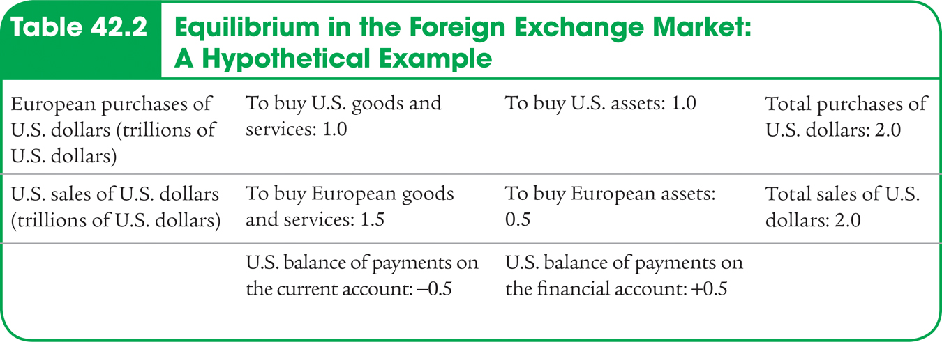
Equilibrium in the Foreign Exchange Market:
A Hypothetical Example
Section 8 | Module 42

Slide 6
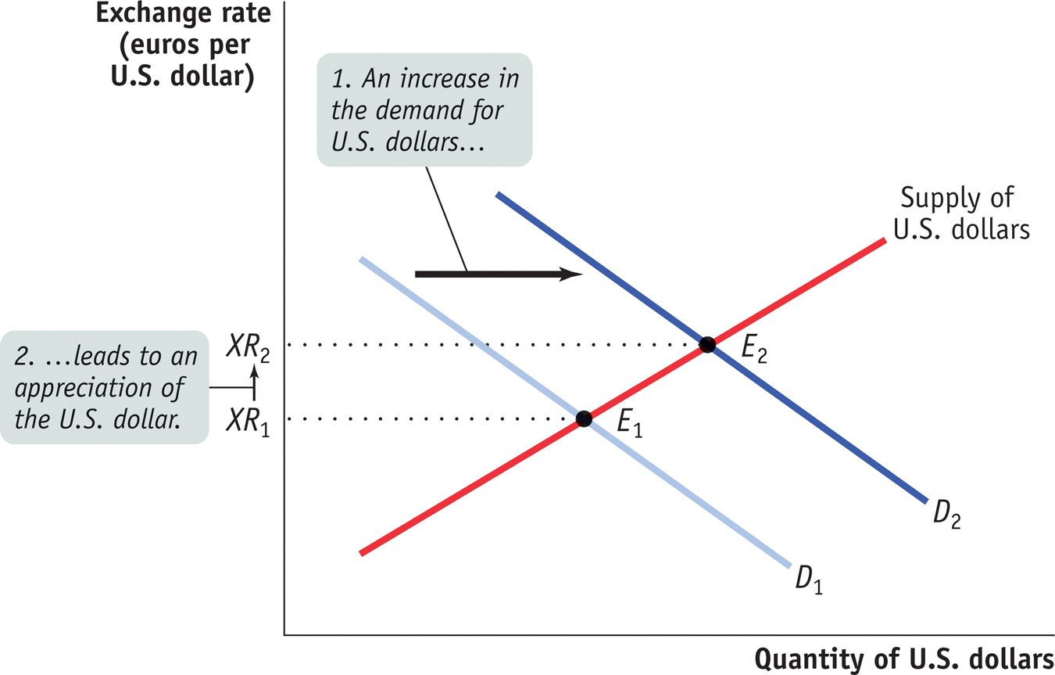
An Increase in the Demand for U.S. Dollars
Section 8 | Module 42
Notes:
Figure Caption: Figure 42.2: An Increase in the Demand for U.S. Dollars
An increase in the demand for U.S. dollars might result from a higher rate of return available in the United States. The demand curve for U.S. dollars shifts from D₁ to D₂. So the equilibrium number of euros per U.S. dollar rises—the dollar appreciates. As a result, the balance of payments on current account falls as the balance of payments on financial account rises.

Slide 7
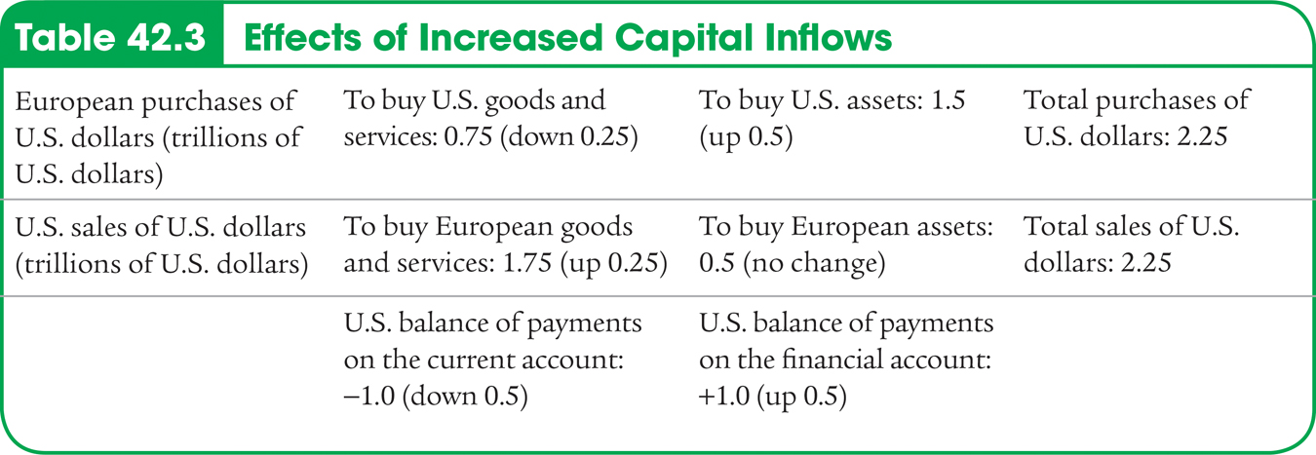
Effects of Increased Capital Inflows
Section 8 | Module 42

Slide 8
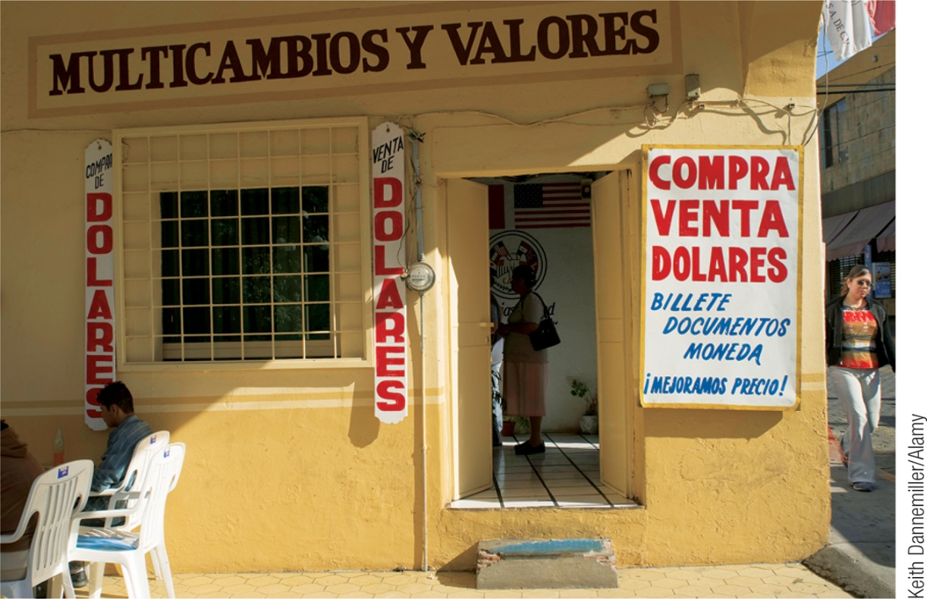
Inflation and Real Exchange Rates
Real exchange rates are exchange rates adjusted for international differences in aggregate price levels.
Real exchange rate = Mexican pesos per U.S. dollars × P_{US} /P_{Mex}
Section 8 | Module 42

Slide 9
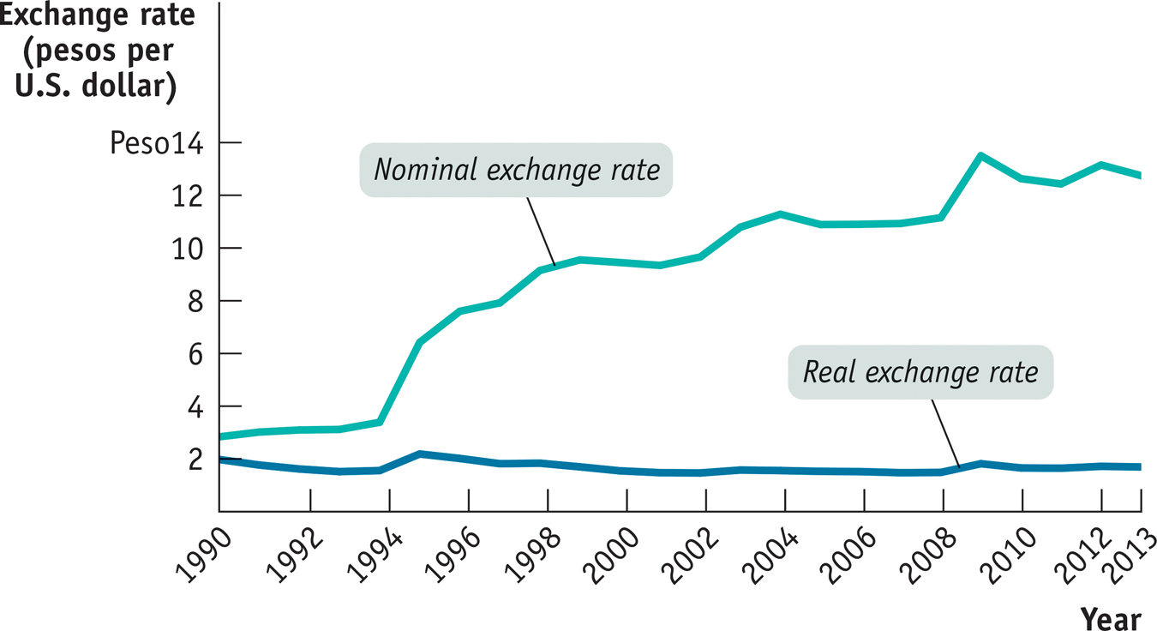
Real versus Nominal Exchange Rates
Section 8 | Module 42
Notes:
Figure Caption: Figure 42.3: Real versus Nominal Exchange Rates, 1990-2009
Between 1990 and 2009, the price of a dollar in Mexican pesos increased dramatically. But because Mexico had higher inflation than the United States, the real exchange rate, which measures the relative price of Mexican goods and services, ended up roughly where it started.

Slide 10
Purchasing Power Parity
The purchasing power parity between two countries’ currencies is the nominal exchange rate at which a given basket of goods and services would cost the same amount in each country.
Section 8 | Module 42

Slide 11
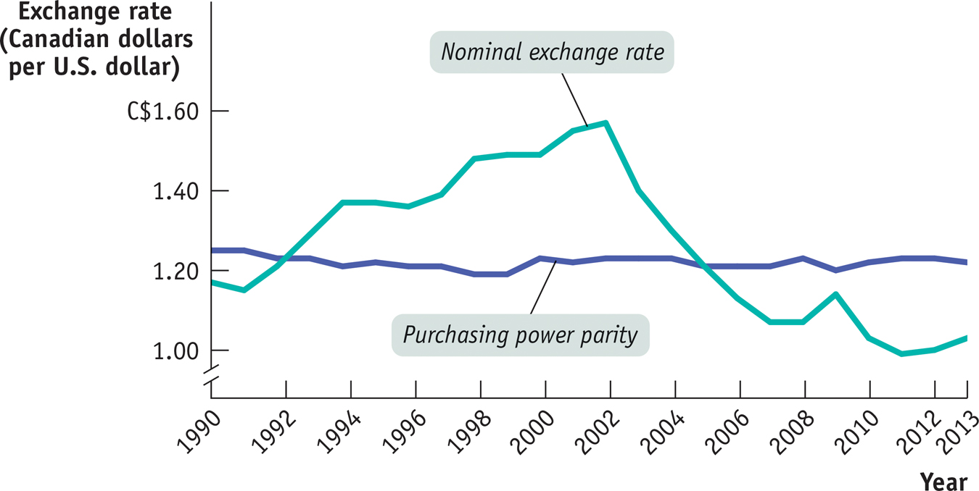
Purchasing Power Parity
Section 8 | Module 42
Notes:
Figure Caption: Figure 42.4: Purchasing Power Parity versus the Nominal Exchange Rate, 1990–2008
The purchasing power parity between U.S. and Canada—the exchange rate at which a basket of goods and services would have cost the same amount in both countries—changed very little over the period shown, staying near C$1.20 per US$1. But the nominal exchange rate fluctuated widely.

Slide 12
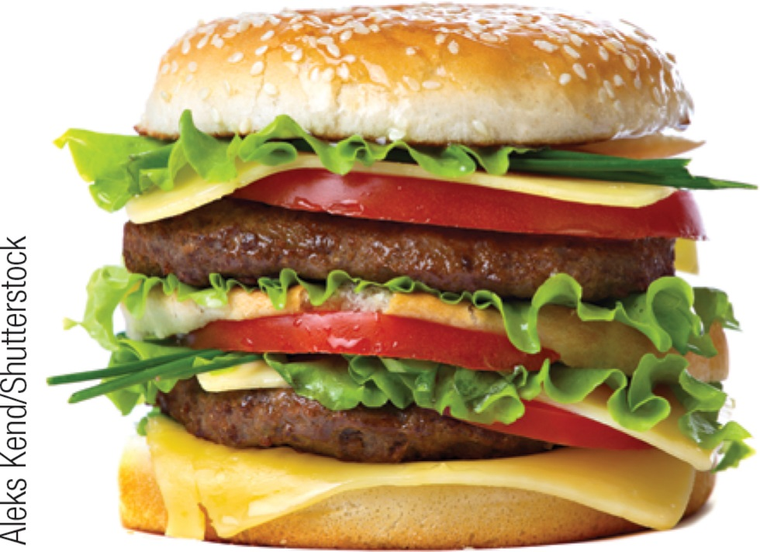
F Y I
Burgernomics
The Economist’s Big Mac index looks at the price of a Big Mac in local currency and computes the following:
The price of a Big Mac in U.S. dollars using the prevailing exchange rate.
The exchange rate at which the price of a Big Mac would equal the U.S. price.
If purchasing power parity held, the dollar price of a Big Mac would be the same everywhere.
Estimates of purchasing power parity based on the Big Mac index are relatively consistent with more elaborate measures.
Section 8 | Module 42

Slide 13
F Y I
Low-Cost America
Why were European automakers, such as Volvo and BMW, flocking to America?
To some extent because they were being offered special incentives.
But the big factor was the exchange rate.
In the early 2000s one euro was, on average, worth less than a dollar; by the summer of 2008 the exchange rate was around €1 = $1.50.
This change in the exchange rate made it substantially cheaper for European car manufacturers to produce in the United States than at home.
Section 8 | Module 42

Slide 14
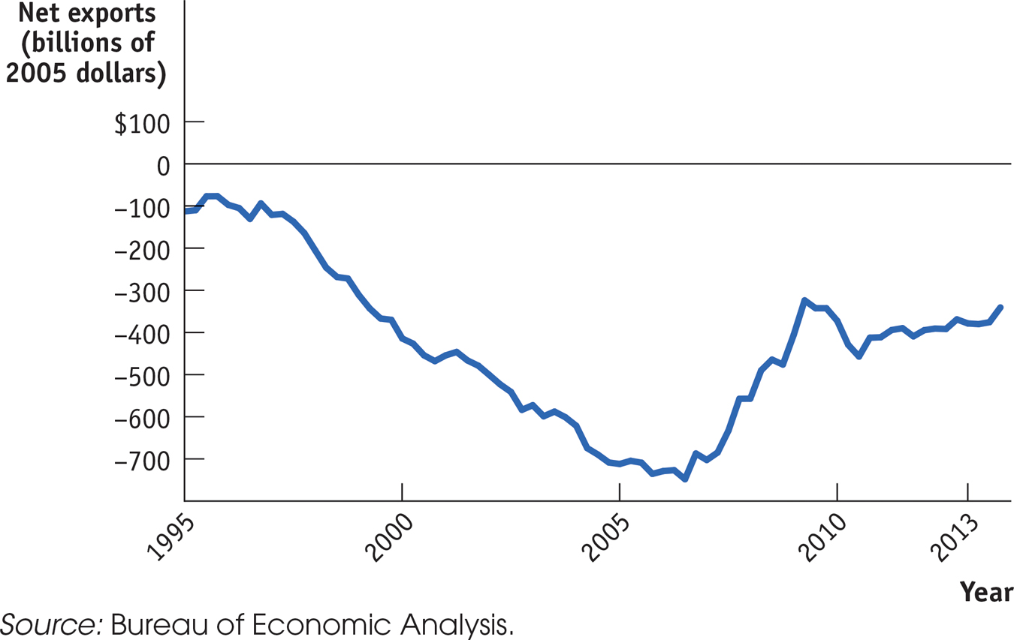
F Y I
Low-Cost America
Section 8 | Module 42
Notes:
Figure Caption: U.S. Net Exports, 1947-2008
After a long period of decline, U.S. net exports—exports minus imports—increased sharply after 2006 as the dollar depreciated against other major currencies, making U.S.-produced goods more attractive to foreign buyers.

Slide 15
Summary
Currencies are traded in the foreign exchange market; the prices at which they are traded are exchange rates.
When a currency rises against another currency, it appreciates; when it falls, it depreciates.
The equilibrium exchange rate matches the quantity of that currency supplied to the foreign exchange market to the quantity demanded.
To correct for international differences in inflation rates, economists calculate real exchange rates, which multiply the exchange rate between two countries’ currencies by the ratio of the countries’ price levels.
Section 8 | Module 42

Slide 16
Summary
The current account responds only to changes in the real exchange rate, not the nominal exchange rate.
Purchasing power parity is the exchange rate that makes the cost of a basket of goods and services equal in two countries. It is a good predictor of actual changes in the nominal exchange rate.
Section 8 | Module 42

