Slide 1
What You Will Learn in this Module
Explain the difference between fixed exchange rates and floating exchange rates
Discuss the considerations that lead countries to choose different exchange rate regimes
Describe the effects of currency devaluation and revaluation under a fixed exchange rate regime
Explain how macroeconomic policy affects exchange rates under a floating exchange rate regime
Section 8 | Module 43

Slide 2
Exchange Rate Policy
An exchange rate regime is a rule governing policy toward the exchange rate.
A country has a fixed exchange rate when the government keeps the exchange rate against some other currency at or near a particular target.
A country has a floating exchange rate when the government lets the exchange rate go wherever the market takes it.
Section 8 | Module 43

Slide 3
How Can an Exchange Rate Be Held Fixed?
Government purchases or sales of currency in the foreign exchange market are exchange market interventions.
Foreign exchange reserves are stocks of foreign currency that governments maintain to buy their own currency on the foreign exchange market.
Foreign exchange controls are licensing systems that limit the right of individuals to buy foreign currency.
Section 8 | Module 43

Slide 4
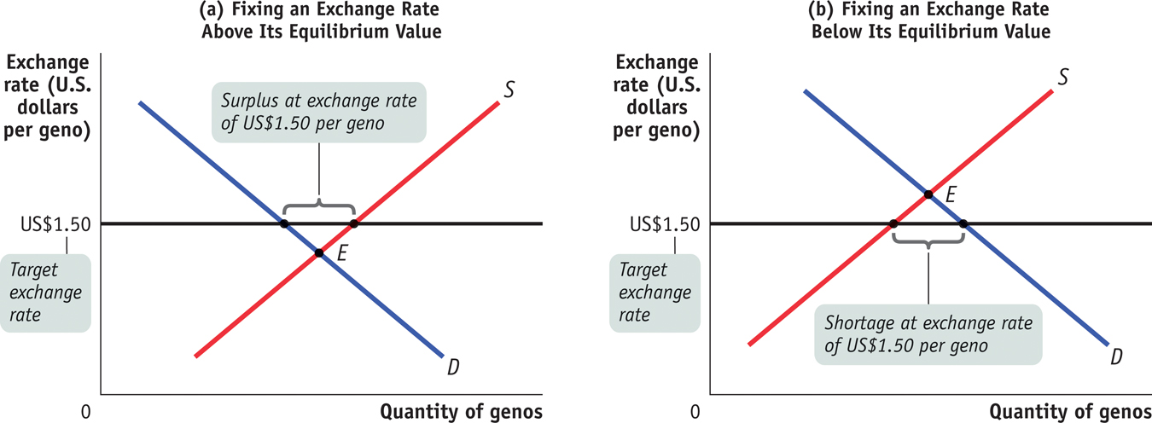
Exchange Market Intervention
Section 8 | Module 43
Notes:
Figure Caption: Figure 43.1: Exchange Market Intervention
In both panels the imaginary country of Genovia is trying to keep the value of its currency, the geno, fixed at US$1.50.
In panel (a), there is a surplus of genos on the foreign exchange market. To keep the geno from falling, the Genovian government can buy genos and sell U.S. dollars. In panel (b), there is a shortage of genos. To keep the geno from rising, the Genovian government can sell genos and buy U.S. dollars.

Slide 5
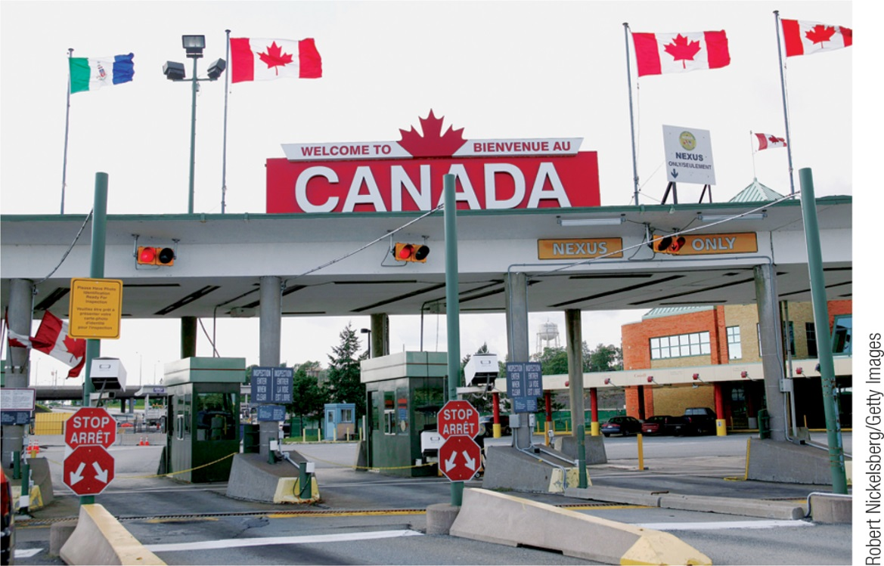
The Exchange Rate Regime Dilemma
Exchange rate policy poses a dilemma: there are economic payoffs to stable exchange rates, but the policies used to fix the exchange rate have costs.
Exchange market intervention requires large reserves, and exchange controls distort incentives.
If monetary policy is used to help fix the exchange rate, it isn’t available to use for domestic policy.
Section 8 | Module 43

Slide 6
F Y I
China Pegs the Yuan
China’s spectacular success as an exporter led to a rising surplus on current account.
Non-Chinese private investors became increasingly eager to shift funds into China, to take advantage of its growing domestic economy.
As a result, at the target exchange rate, the demand for yuan exceeded the supply.
To keep the rate fixed, China had to engage in large-scale exchange market intervention—selling yuan, buying up other countries’ currencies (mainly U.S. dollars) on the foreign exchange market, and adding them to its reserves.
Section 8 | Module 43

Slide 7
Exchange Rates And Macroeconomic Policy
A devaluation is a reduction in the value of a currency that previously had a fixed exchange rate.
A revaluation is an increase in the value of a currency that previously had a fixed exchange rate.
Section 8 | Module 43

Slide 8
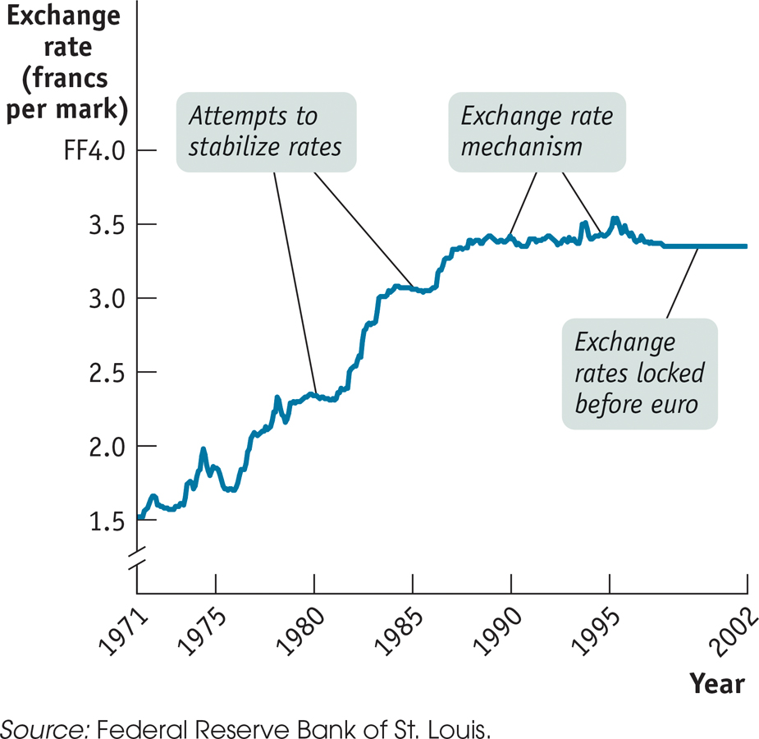
F Y I
From Bretton Woods to the Euro
In 1944, representatives of the Allied nations met to establish a postwar system of fixed exchange rates among major currencies.
By 1973, most economically advanced countries had moved to floating exchange rates.
In Europe, a “target zone” mechanism, known as the Exchange Rate Mechanism, was created to reduce uncertainty for business.
In 1991, the countries agreed to move to a common European currency.
Section 8 | Module 43

Slide 9
Monetary Policy Under Floating Exchange Rates
Under floating exchange rates, expansionary monetary policy works through:
the exchange rate - cutting domestic interest rates leads to a depreciation
increase in exports and decrease in imports, which increases aggregate demand
Contractionary monetary policy has the reverse effect.
Section 8 | Module 43

Slide 10
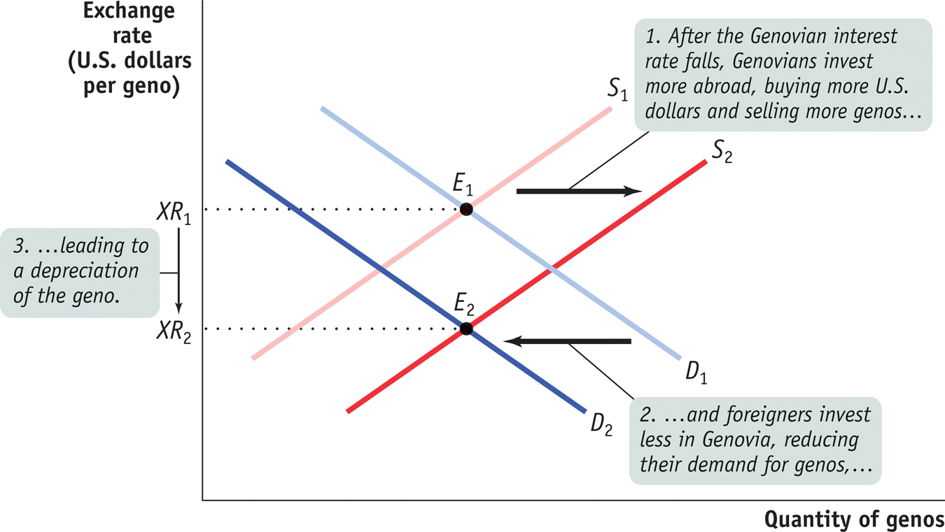
Monetary Policy and the Exchange Rate
Section 8 | Module 43
Notes:
Figure Caption: Figure 44.1: Monetary Policy and the Exchange Rate
Here we show what happens in the foreign exchange market if Genovia cuts its interest rate.
Residents of Genovia have a reduced incentive to keep their funds at home, so they invest more abroad. As a result, the supply of genos shifts rightward from S₁ to S₂. Meanwhile, foreigners have less incentive to put funds into Genovia, so the demand for genos shifts leftward from D₁ to D₂. The geno depreciates: the equilibrium exchange rate falls from X₁ to X₂.

Slide 11
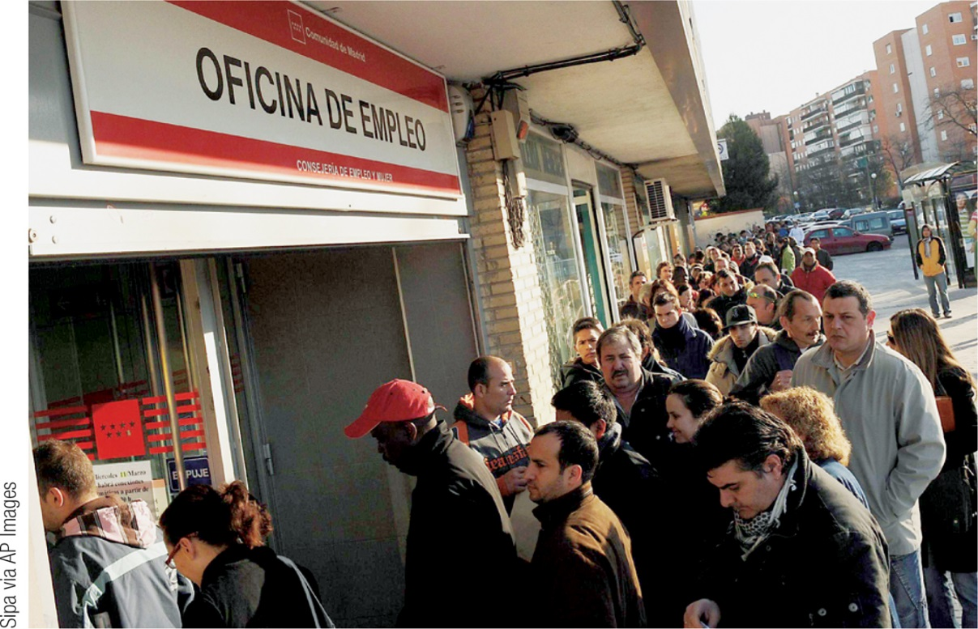
International Business Cycles
The fact that one country’s imports are another country’s exports creates a link between the business cycle in different countries.
Floating exchange rates, however, may reduce the strength of that link.
Section 8 | Module 43

Slide 12
F Y I
The Joy of a Devalued Pound
On September 16, 1992, Britain abandoned its fixed exchange rate policy.
The pound promptly dropped 20% against the German mark, the most important European currency at the time.
The British government would no longer have to engage in large-scale exchange market intervention to support the pound’s value.
The devaluation would increase aggregate demand, so the pound’s fall would help reduce British unemployment.
Because Britain no longer had a fixed exchange rate, it was free to pursue an expansionary monetary policy to fight its slump.
Section 8 | Module 43

Slide 13
Summary
Countries adopt different exchange rate regimes, rules governing exchange rate policy.
The main types are fixed exchange rates, where the government takes action to keep the exchange rate at a target level, and floating exchange rates, where the exchange rate is free to fluctuate.
Countries can fix exchange rates using exchange market intervention, which requires them to hold foreign exchange reserves that they use to buy any surplus of their currency.
Section 8 | Module 43

Slide 14
Summary
Alternatively, they can change domestic policies, especially monetary policy, to shift the demand and supply curves in the foreign exchange market. Finally, they can use foreign exchange controls.
Exchange rate policy poses a dilemma: there are economic payoffs to stable exchange rates, but the policies used to fix the exchange rate have costs.
Exchange market intervention requires large reserves, and exchange controls distort incentives. If monetary policy is used to help fix the exchange rate, it isn’t available to use for domestic policy.
Section 8 | Module 43

Slide 15
Summary
Fixed exchange rates aren’t always permanent commitments: countries with a fixed exchange rate sometimes engage in devaluations or revaluations.
Under floating exchange rates, expansionary monetary policy works in part through the exchange rate: cutting domestic interest rates leads to a depreciation, and through that to higher exports and lower imports, which increases aggregate demand. Contractionary monetary policy has the reverse effect.
The fact that one country’s imports are another country’s exports creates a link between the business cycle in different countries. Floating exchange rates, however, may reduce the strength of that link.
Section 8 | Module 43

