Slide 1
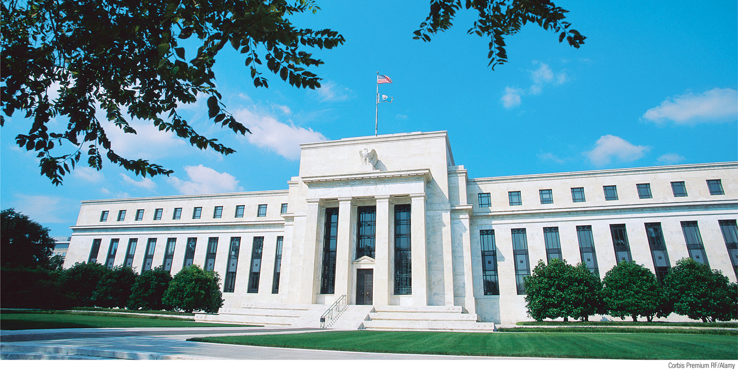
Discuss the history of the Federal Reserve System
Describe the structure of the Federal Reserve System
Explain how the Federal Reserve has responded to major financial crises
What You Will Learn in this Module
Section 5 | Module 26

Slide 2
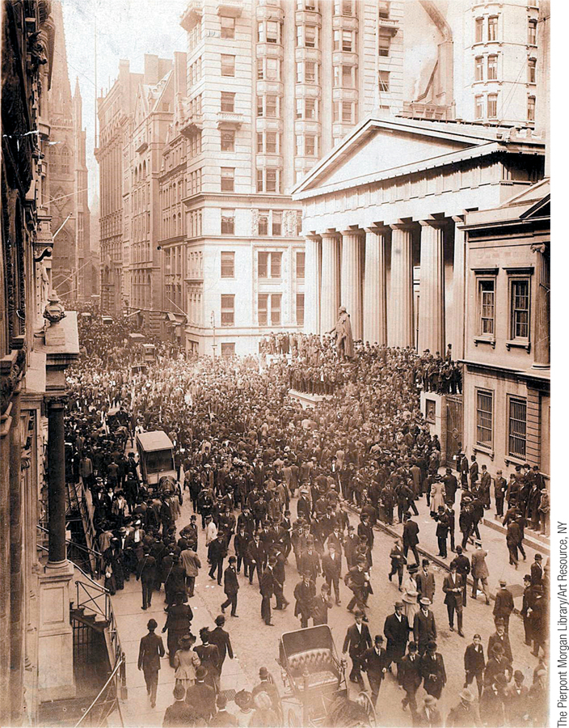
The Federal Reserve System
A central bank is an institution that oversees and regulates the banking system and controls the monetary base.
The Federal Reserve is a central bank—an institution that oversees and regulates the banking system, and controls the monetary base.
The Federal Reserve Bank was created in 1913 in response to frequent banking crises at the turn of the century.
Refer to: http://www.federalreserve.gov/
or http://www.federalreserve.gov/otherfrb.htm.
Section 5 | Module 26

Slide 3
The Structure of the Fed
The Federal Reserve system consists of the Board of Governors in Washington, D.C., plus regional Federal Reserve Banks.
The Federal Reserve Banks serve each of the 12 Federal Reserve districts.
Section 5 | Module 26

Slide 4
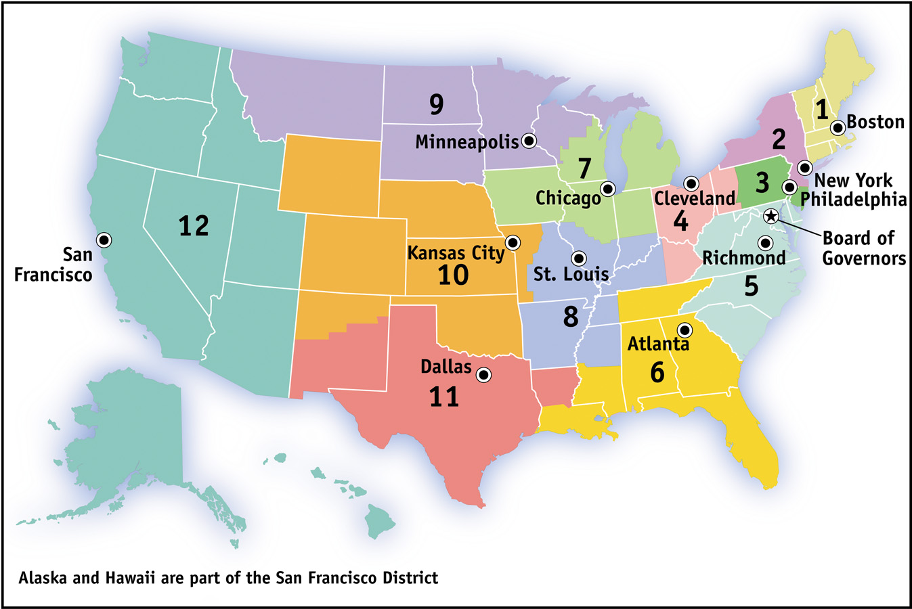
The Structure of the Fed
Section 5 | Module 26

Slide 5
The Effectiveness of the Federal Reserve System
The Great Depression sparked widespread bank runs in the early 1930s, which greatly worsened and lengthened the depth of the Depression.
Federal deposit insurance was created, and the government recapitalized banks by lending to them and by buying shares of banks.
By 1933, banks had been separated into two categories: commercial (covered by deposit insurance) and investment (not covered).
Public acceptance of deposit insurance finally stopped the bank runs of the Great Depression.
Section 5 | Module 26

Slide 6
The Savings and Loan Crisis of the 1980s
The savings and loan (thrift) crisis of the 1980s arose because insufficiently regulated S&Ls engaged in overly risky speculation and incurred huge losses.
Depositors in failed S&Ls were compensated with taxpayer funds because they were covered by deposit insurance.
The crisis caused steep losses in the financial and real estate sectors, resulting in a recession in the early 1990s.
Section 5 | Module 26

Slide 7
Back to the Future: The Financial Crisis of 2008
Subprime lending during the U.S. housing bubble of the mid-2000s spread through the financial system via securitization.
When the bubble burst, massive losses by banks and nonbank financial institutions led to widespread collapse in the financial system.
To prevent another Great Depression, the Fed and the U.S. Treasury expanded lending to bank and nonbank institutions, provided capital through the purchase of bank shares, and purchased private debt.
Section 5 | Module 26

Slide 8
Back to the Future: The Financial Crisis of 2008
Because much of the crisis originated in nontraditional bank institutions, the crisis of 2008 indicated that a wider safety net and broader regulation are needed in the financial sector.
Section 5 | Module 26

Slide 9
F Y I
Regulation After the 2008 Crisis
Section 5 | Module 26

Slide 10
Summary
The monetary base is controlled by the Federal Reserve, the central bank of the United States.
In response to the Panic of 1907, the Fed was created to centralize holding of reserves, inspect banks’ books, and make the money supply sufficiently responsive to varying economic conditions.
The Great Depression sparked widespread bank runs in the early 1930s, which greatly worsened and lengthened the depth of the Depression.
Section 5 | Module 26

Slide 11
Summary
By 1933, banks had been separated into two categories: commercial (covered by deposit insurance) and investment (not covered). Public acceptance of deposit insurance finally stopped the bank runs of the Great Depression.
The savings and loan (thrift) crisis of the 1980s arose because insufficiently regulated S&Ls engaged in overly risky speculation and incurred huge losses. The crisis caused steep losses in the financial and real estate sectors, resulting in a recession in the early 1990s.
Subprime lending during the U.S. housing bubble of the mid-2000s spread through the financial system via securitization. When the bubble burst, massive losses by banks and nonbank financial institutions led to widespread collapse in the financial system.
Section 5 | Module 26

