Slide 1
Describe the functions of the Federal Reserve System
Explain the primary tools the Federal Reserve uses to influence the economy
What You Will Learn in this Module
Section 5 | Module 27

Slide 2
The Functions of the Federal Reserve System
Provide financial services
Supervise and regulate banking institutions
Maintain the stability of the financial system
Conduct monetary policy
Section 5 | Module 27

Slide 3
What the Fed Does
Sets reserve requirements - rules set by the Federal Reserve that determine the minimum reserve ratio for a bank.
For example, in the United States, the minimum reserve ratio for checkable bank deposits is 10%.
The federal funds market allows banks that fall short of the reserve requirement to borrow funds from banks with excess reserves.
The federal funds rate is the interest rate determined in the federal funds market.
Section 5 | Module 27

Slide 4
Reserve Requirements and the Discount Rate
Operates the discount window – an arrangement in which the Federal Reserve stands ready to lend money to banks in trouble.
The discount rate is the rate of interest the Fed charges on loans to banks.
Section 5 | Module 27

Slide 5
Open-Market Operations
Conducts open-market operations – the principal tool of monetary policy.
The Fed can increase or reduce the monetary base by buying government debt (U.S. Treasury Bills) from banks or selling government debt to banks.
The Federal Reserve’s Assets and Liabilities:
Section 5 | Module 27

Slide 6
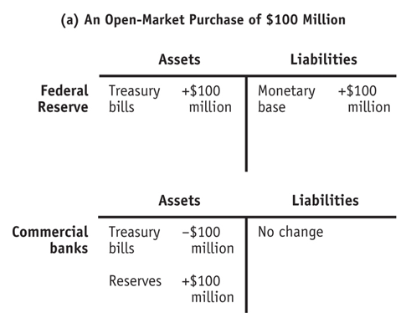
Open-Market Operations by the Federal Reserve
Section 5 | Module 27

Slide 7
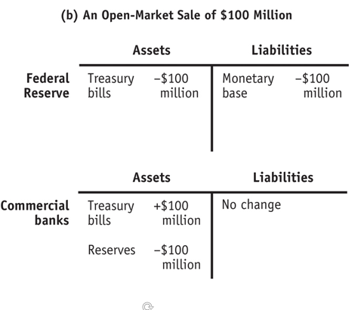
Open-Market Operations by the Federal Reserve
Section 5 | Module 27

Slide 8
F Y I
Who Gets the Interest on the Fed’s Assets?
Who gets the profits? U.S. taxpayers do.
The Fed keeps some of the interest it receives to finance its operations, but turns most of it over to the U.S. Treasury.
For example, in 2013 the Federal Reserve system received $79.5 billion in interest on its holdings of Treasury bills, of which $77.7 billion was returned to the Treasury.
The Fed decides on the size of the monetary base based on economic considerations—in particular, the Fed doesn’t let the monetary base get too large, because that can cause inflation.
Section 5 | Module 27

Slide 9
Practice
Suppose the Federal Reserve were to engage in open-market operations by buying $100 million of U.S. Treasury bills. Which of the following would be the end result of such an action?
A. The money supply would stay the same.
B. The money supply would decrease by $100 million.
C. The money supply would increase by $100 million.
D. The money supply would increase by more than $100 million.
E. The money supply would increase, but by less than $100 million.

Slide 10
When a bank borrows from the Federal Reserve, it pays the
required reserve ratio.
discount rate.
federal funds rate.
prime rate.
mortgage rate.

Slide 11
Summary
The Federal Reserve System provides financial services, supervises and regulates banking institutions, maintains the stability of the financial system, conducts monetary policy.
The monetary base is controlled by the Federal Reserve, the central bank of the United States.
The Fed regulates banks and sets reserve requirements. To meet those requirements, banks borrow and lend reserves in the federal funds market at the federal funds rate.
Through the discount window facility, banks can borrow from the Fed at the discount rate.
Section 5 | Module 27

Slide 12
Summary
Open-market operations by the Fed are the principal tool of monetary policy: the Fed can increase or reduce the monetary base by buying U.S. Treasury bills from banks or selling U.S. Treasury bills to banks.
Section 5 | Module 27

