Slide 1
Discuss how the AS–AD model is used to formulate macroeconomic policy
Explain the rationale for stabilization policy
Describe the importance of fiscal policy as a tool for managing economic fluctuations
Identify the policies that constitute expansionary fiscal policy and those that constitute contractionary fiscal policy
What You Will Learn in this Module
Section 4 | Module 20

Slide 2
Question…
If there is a $500 million recessionary gap, and MPC is .8,
How much would the government have to change spending by to fix the gap?
How much would the government have to change taxes by to fix the gap?

Slide 3
Video
https://www.youtube.com/watch?v=oGQBvDt3BqI
1. What are the two types of fiscal policy that Congress and the President can use?
2. Distinguish between discretionary and non-discretionary fiscal policy
3. What two specific fiscal policies could help an economy suffering from recession?
4. Draw a correctly labeled AD/AS graph to show an economy suffering from recession and then amend the graph to show the effect of your answer in question 3

Slide 4
Video – apologies, this is trying to “sell” the 2009 recovery act
video

Slide 5
Macroeconomic Policy
Economy is self-correcting in the long run.
Stabilization policy is the use of government policy to reduce the severity of recessions and rein in excessively strong expansions.
Section 4 | Module 20

Slide 6
Macroeconomic Policy
Policy in the Face of Demand Shocks
If policy were able to perfectly anticipate shifts of the aggregate demand curve and counteract them, the period of low aggregate output and falling prices could be avoided.
Price stability is generally regarded as a desirable goal.
Section 4 | Module 20

Slide 7
Macroeconomic Policy
Responding to supply shocks:
There are no easy policies to shift the short-run aggregate supply curve.
Policy dilemma: a policy that counteracts the fall in aggregate output by increasing aggregate demand will lead to higher inflation, but a policy that counteracts inflation by reducing aggregate demand will deepen the output slump.
Section 4 | Module 20

Slide 8
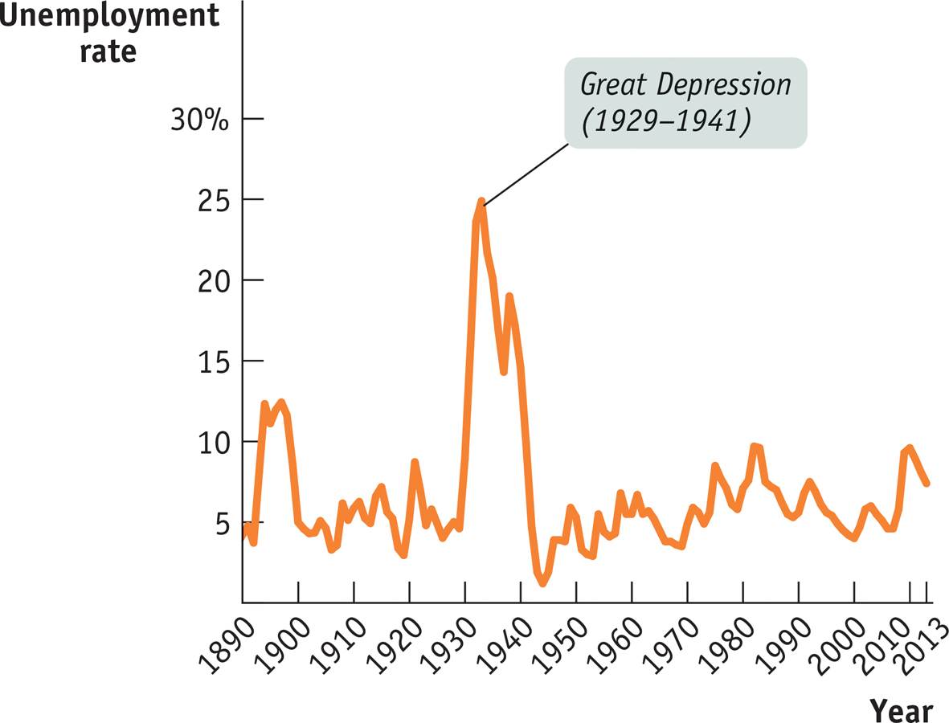
F Y I
Is Stabilization Policy Stabilizing?
Has the economy actually become more stable since the government began trying to stabilize it?
Yes. Data from the pre–World War II era are less reliable than more modern data, but there still seems to be a clear reduction in the size of economic fluctuations.
It’s possible that the greater stability of the economy reflects good luck rather than policy.
But on the face of it, the evidence suggests that stabilization policy is indeed stabilizing.
Section 4 | Module 20

Slide 9
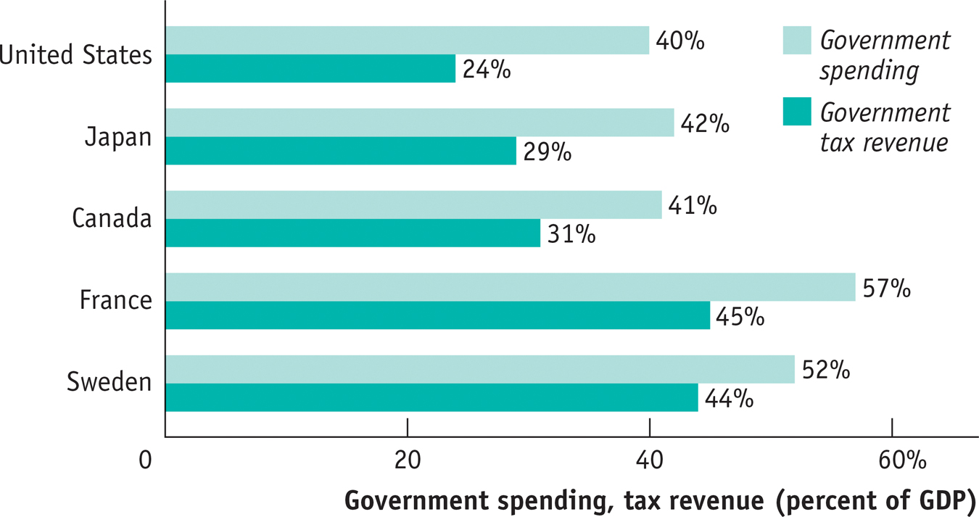
Government Spending and Tax Revenue for Some
High-Income Countries in 2012
Section 4 | Module 20

Slide 10
Taxes, Government Purchases of Goods and Services, Transfers, and Borrowing
Funds flow into the government in the form of taxes and government borrowing
Funds flow out of the government in the form of government purchases of goods and services and government transfers to households
Section 4 | Module 20

Slide 11
The Government Budget and Total Spending
Fiscal policy is the use of taxes, government transfers, or government purchases of goods and services to shift the aggregate demand curve.
Section 4 | Module 20

Slide 12
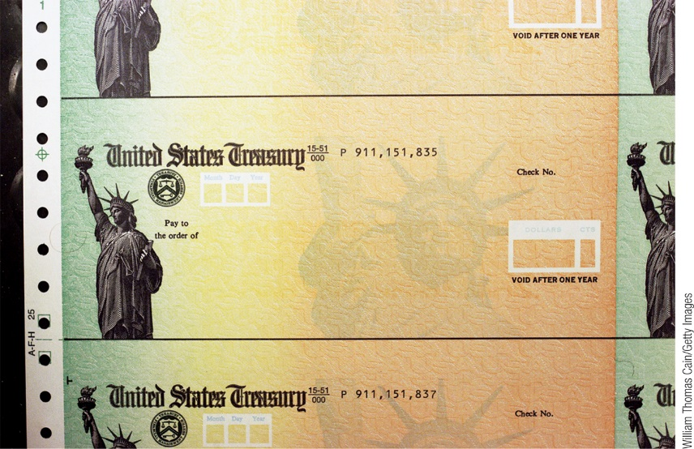
Expansionary and Contractionary Fiscal Policy
Expansionary fiscal policy increases aggregate demand and can take one of three forms:
an increase in government purchases of goods and services
a cut in taxes
an increase in government transfers
Contractionary fiscal policy reduces aggregate demand and can take one of three forms:
a reduction in government purchases of goods and services
an increase in taxes
a reduction in government transfers
Section 4 | Module 20

Slide 13
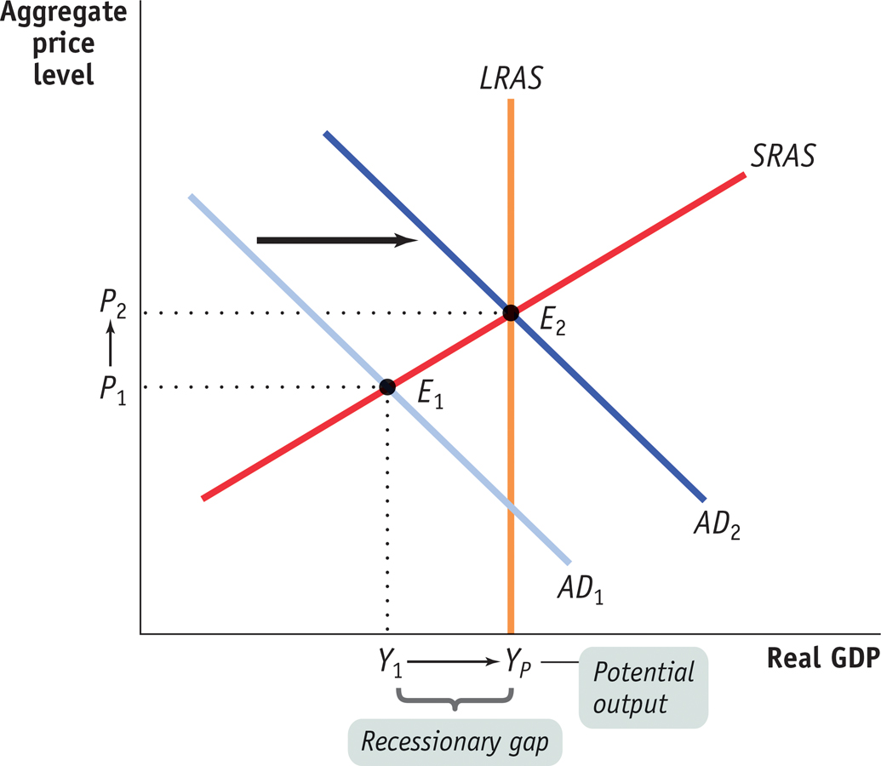
Expansionary and Contractionary Fiscal Policy
Expansionary Fiscal Policy Can Close a Recessionary Gap
Section 4 | Module 20

Slide 14
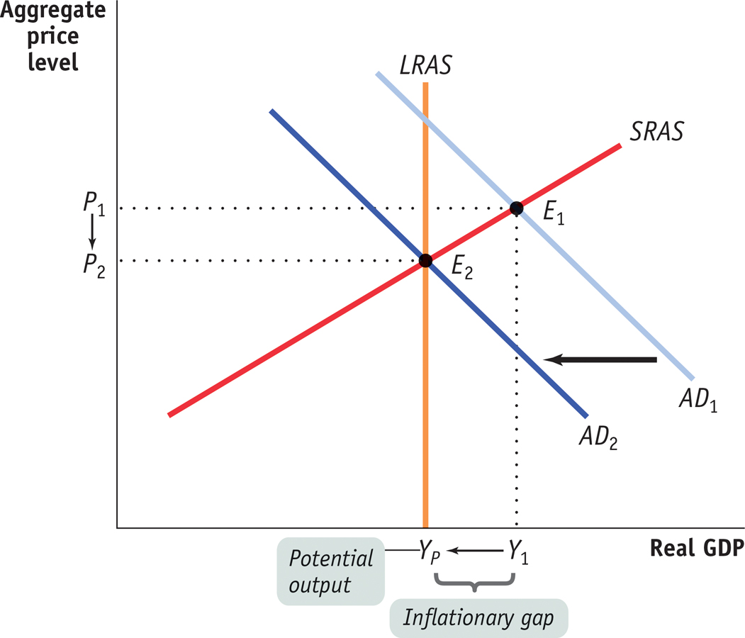
Expansionary and Contractionary Fiscal Policy
Contractionary Fiscal Policy Can Eliminate an Inflationary Gap
14 of 17
Section 4 | Module 20

Slide 15
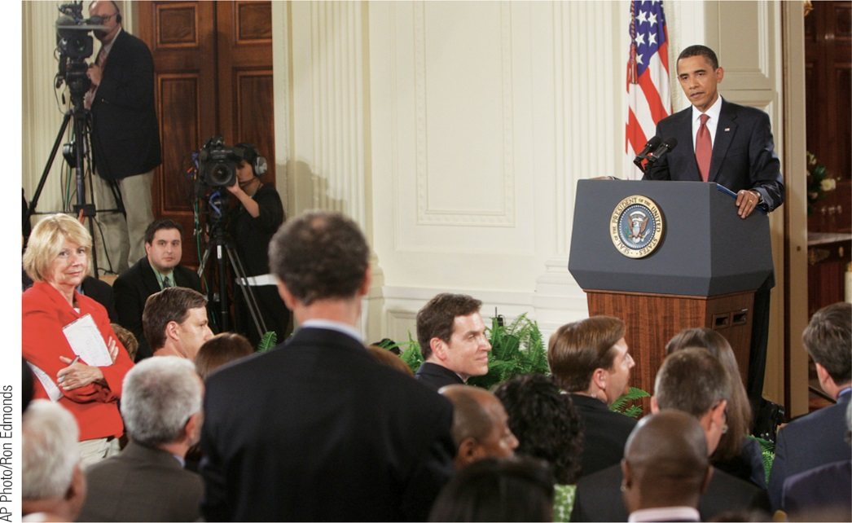
A Cautionary Note: Lags in Fiscal Policy
In the case of fiscal policy, there is an important reason for caution: there are significant lags in its use.
Realize the recessionary/inflationary gap by collecting and analyzing economic data → takes time
Government develops a spending plan→ takes time
Implementation of the action plan (spending the money → takes time)
Will the stimulus come in time to be worthwhile? President Barack Obama listens to a question during a news conference in the East Room of the White House in Washington, D.C.
Section 4 | Module 20

Slide 16
Practice
The current level of real GDP lies below potential GDP. An appropriate fiscal policy would be to _____. Include an appropriate graph showing the initial condition and impact of the fiscal policy action with your answer.
A. increase the money supply.
B. decrease transfer payments.
C. increase tax rates.
D. increase government purchases
E. decrease government purchases.

Slide 17
Practice
Contractionary fiscal policy causes the aggregate demand curve to shift to the _______ and is used to close a(n) _______ gap.
A. right; inflationary
B. right; recessionary
C. left; inflationary
D. left; recessionary
E. left; trade

Slide 18
Transfer payments are payments which
A. government makes to households who meet entitlement criteria set by Congress.
B. government makes to households when government receives a good or service.
C. erode the purchasing power of households and businesses.
D. are essentially tax refunds.
E. undermine consumption in the economy.

Slide 19
Summary
Many economists advocate active stabilization policy: using fiscal or monetary policy to offset demand shocks.
Negative supply shocks pose a policy dilemma: a policy that counteracts the fall in aggregate output by increasing aggregate demand will lead to higher inflation, but a policy that counteracts inflation by reducing aggregate demand will deepen the output slump.
Fiscal policy is the use of taxes, government transfers, or government purchases of goods and services to shift the aggregate demand curve.
Expansionary fiscal policy shifts the aggregate demand curve rightward.
Contractionary fiscal policy shifts the aggregate demand curve leftward.
Section 4 | Module 20

Slide 20
Front: Increase AS Back: Increase AD Windows: Decrease AD Door: Decrease AS
1. Congress increases taxes on the rich.
2. Congress cuts taxes on the middle class.
3. Oil prices fall amid rumors of a new discovery in Alaska.
4. Productivity increases.
5. Productivity falls for the third quarter in a row.
6. Congress decreases unemployment benefits.
7. Baby boomers retire in greater numbers.
8. Wages rise due to labor union contracts.
9. Producers and consumers are pessimistic about the future.
10. Producers and consumers are optimistic about the future.

Slide 21
Front: Increase AS Back: Increase AD Windows: Decrease AD Door: Decrease AS
11. More people are graduating from college with a 4 year degree or a technical degree.
12. More people are dropping out of school.
13. Commodity prices drop.
14. Commodity prices increase.
15. Congress raises taxes on businesses.
16. Congress lowers taxes on businesses.
17. Exports rise to an all-time high.
18. Imports rise to an all-time high.
19. Congress increases spending on health care.
20. Congress decreases spending on the space program.

