Slide 1
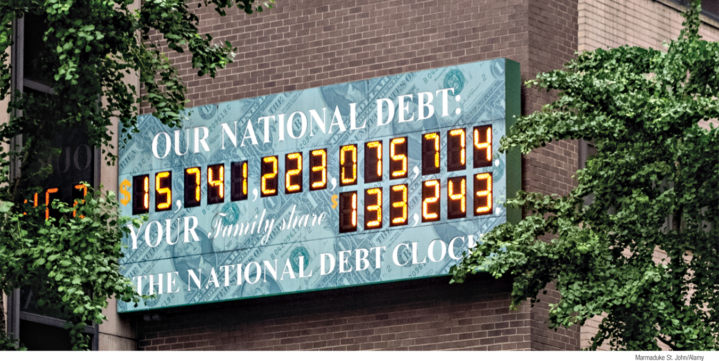
Explain why governments calculate the cyclically adjusted budget balance
Identify problems posed by a large public debt
Discuss why implicit liabilities of the government are also a cause for concern
What You Will Learn in this Module
Section 6 | Module 30

Slide 2
Debt and Deficit – Voter
What is your opinion about America running a budget deficit?
Should America have a national debt?
Should the government actively work to reduce the national debt? If so, what should they do? If not, why not?
What is your reaction to your interview based on what you have learned thus far in the course?

Slide 3
The Budget Balance
The budget balance is the difference between the government’s tax revenue and its spending both on goods and services and on government transfers.
Other things equal, discretionary expansionary fiscal policies—increased government purchases of goods and services, higher government transfers, or lower taxes—reduce the budget balance for that year.
Savings by government = value of tax revenues – government purchases of goods and services – value of government transfers
Section 6 | Module 30

Slide 4
The Budget Balance
That is, expansionary fiscal policies make a budget surplus smaller or a budget deficit bigger.
Conversely, contractionary fiscal policies—smaller government purchases of goods and services, smaller government transfers, or higher taxes—increase the budget balance for that year, making a budget surplus bigger or a budget deficit smaller.
Section 6 | Module 30

Slide 5
The Budget Balance
Some of the fluctuations in the budget balance are due to the effects of the business cycle.
In order to separate the effects of the business cycle from the effects of discretionary fiscal policy, governments estimate the cyclically adjusted budget balance.
The cyclically adjusted budget balance is an estimate of the budget balance if the economy were at potential output.
Section 6 | Module 30

Slide 6
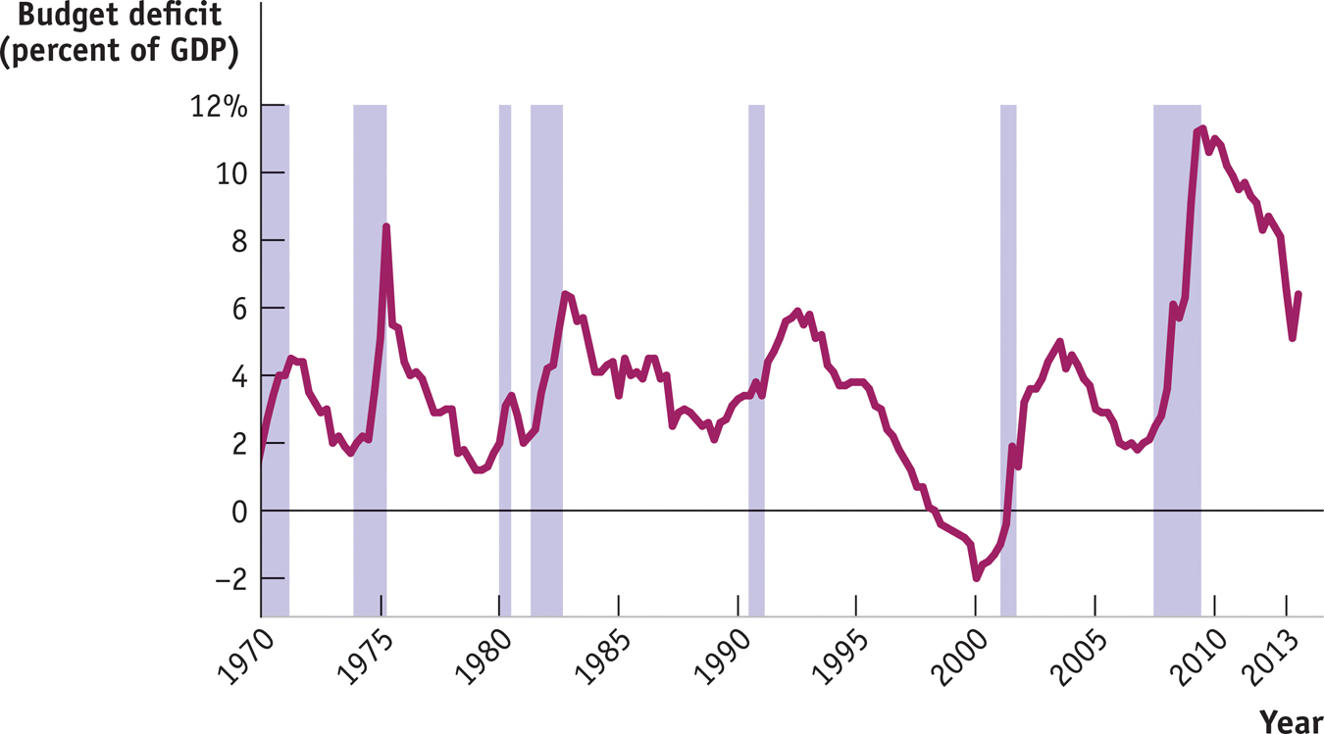
The Budget Balance
The U.S. Federal Budget Deficit and the Business Cycle
Section 6 | Module 30

Slide 7
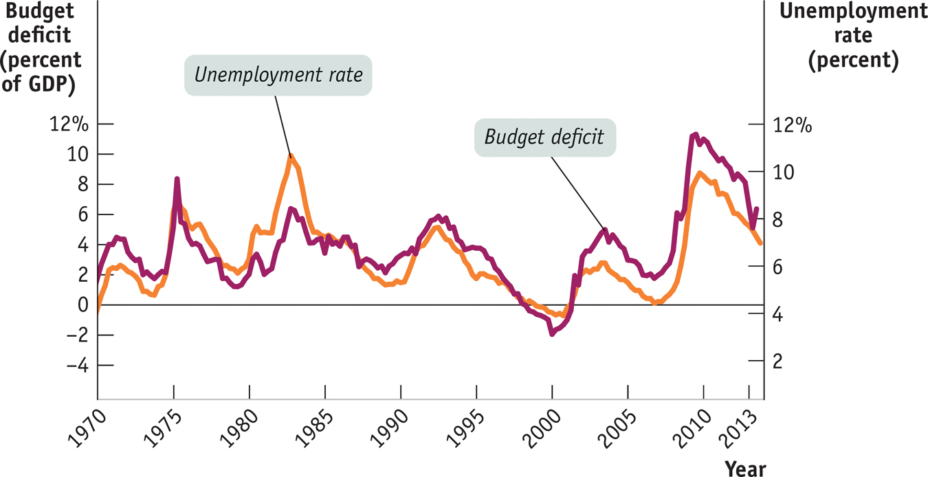
The Budget Balance
The U.S. federal Budget Deficit and the Unemployment Rate
Section 6 | Module 30

Slide 8
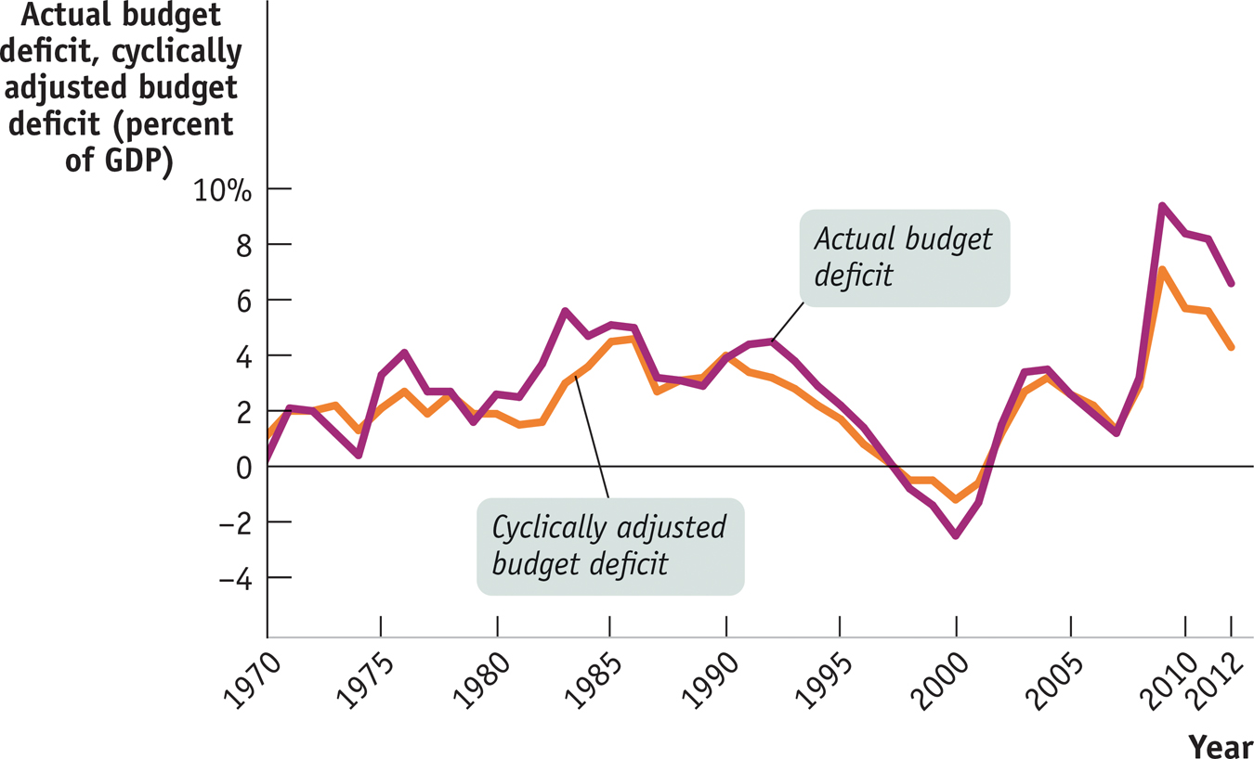
The Budget Balance
The Actual Budget Deficit Versus the Cyclically Adjusted Budget Deficit
Section 6 | Module 30

Slide 9
Should the Budget Be Balanced?
Most economists don’t believe the government should be forced to run a balanced budget every year because this would undermine the role of taxes and transfers as automatic stabilizers.
Yet policy makers concerned about excessive deficits sometimes feel that rigid rules prohibiting—or at least setting an upper limit on—deficits are necessary.
Section 6 | Module 30

Slide 10
Long-Run Implications of Fiscal Policy
U.S. government budget accounting is calculated on the basis of fiscal years.
A fiscal year runs from October 1 to September 30 and is labeled according to the calendar year in which it ends.
Persistent budget deficits have long-run consequences because they lead to an increase in public debt.
Section 6 | Module 30

Slide 11
Problems Posed by Rising Government Debt
Public debt may “crowd out” investment spending, which reduces long-run economic growth.
And in extreme cases, rising debt may lead to government default, resulting in economic and financial turmoil.
Can’t a government that has trouble borrowing just print money to pay its bills?
Yes, it can, but this leads to another problem: inflation.
Lautario Palacios, 7, holds a sign that calls for politicians to stop robbing, during a January 9, 2002 demonstration in Buenos Aires, Argentina.
Section 6 | Module 30

Slide 12
Deficits and Debt in Practice
A widely used measure of fiscal health is the debt–GDP ratio.
This number can remain stable or fall even in the face of moderate budget deficits if GDP rises over time.
Section 6 | Module 30

Slide 13
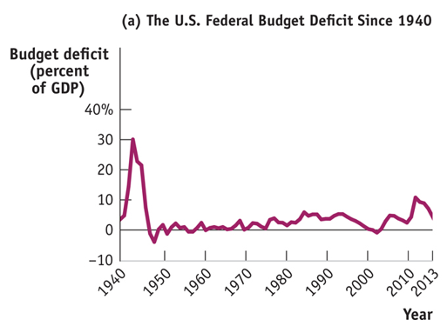
U.S. Federal Deficits and Debt
Section 6 | Module 30

Slide 14
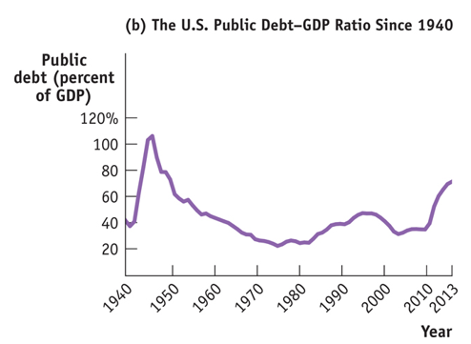
U.S. Federal Deficits and Debt
Section 6 | Module 30

Slide 15
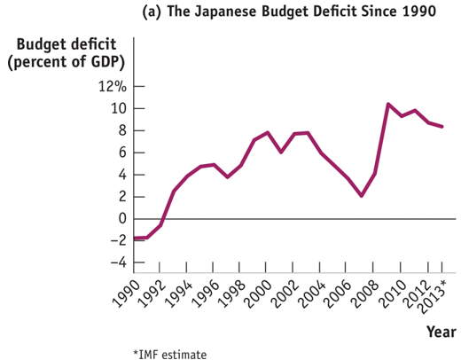
Japanese Deficits and Debt
Section 6 | Module 30

Slide 16
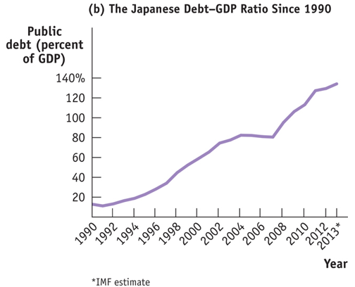
Japanese Deficits and Debt
Section 6 | Module 30

Slide 17
F Y I
What Happened to the Debt from World War II?
The government paid for World War II by borrowing on a huge scale. By the war’s end, the public debt was more than 100% of GDP, and many people worried about how it could ever be paid off.
The truth is that it never was paid off.
By 1962 the public debt was back up to $248 billion.
Vigorous economic growth, plus mild inflation, had led to a rapid rise in GDP. The experience was a clear lesson in the peculiar fact that modern governments can run deficits forever, as long as they aren’t too large.
Section 6 | Module 30

Slide 18
Implicit Liabilities
Implicit liabilities are spending promises made by governments that are effectively a debt despite the fact that they are not included in the usual debt statistics.
Section 6 | Module 30

Slide 19
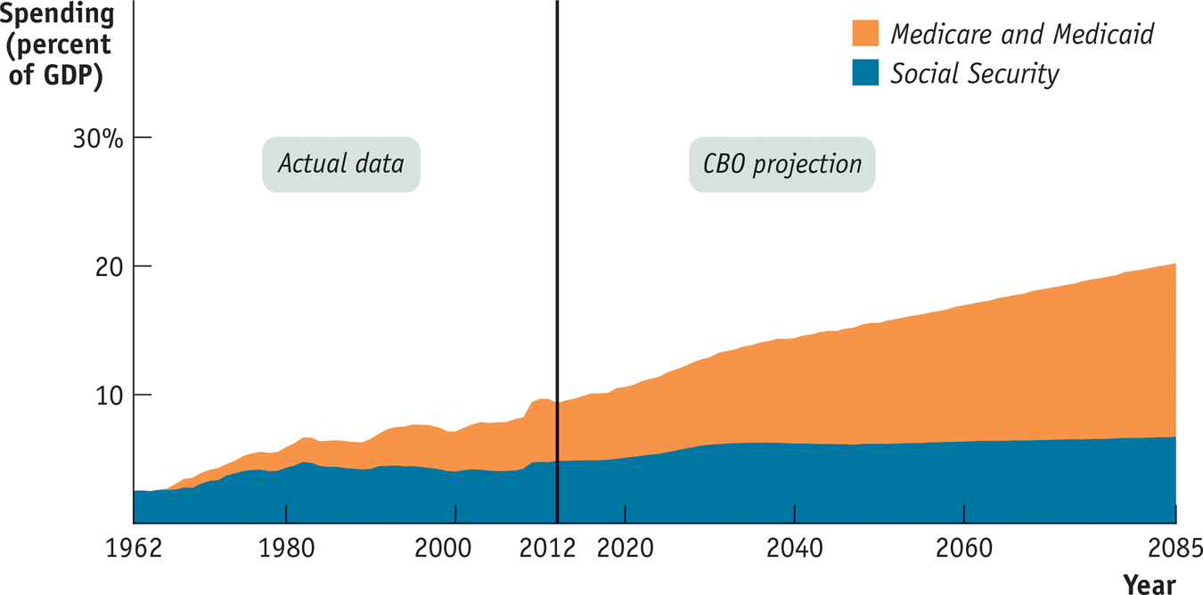
Future Demands on the Federal Budget
Section 6 | Module 30

Slide 20
Summary
Expansionary fiscal policies reduce the budget balance, while contractionary fiscal policies increase the budget balance.
In order to separate the effects of the business cycle from the effects of discretionary fiscal policy, governments estimate the cyclically adjusted budget balance.
U.S. government budget accounting is calculated on the basis of fiscal years.
Persistent budget deficits have long-run consequences because they lead to an increase in public debt.
Section 6 | Module 30

Slide 21
Summary
Public debt may crowd out investment spending, which reduces long-run economic growth.
Rising debt may lead to government default, resulting in economic and financial turmoil.
The debt–GDP ratio can remain stable or fall even in the face of moderate budget deficits if GDP rises over time.
A stable debt–GDP ratio may give a misleading impression that all is well because modern governments often have large implicit liabilities.
Section 6 | Module 30

