Slide 1
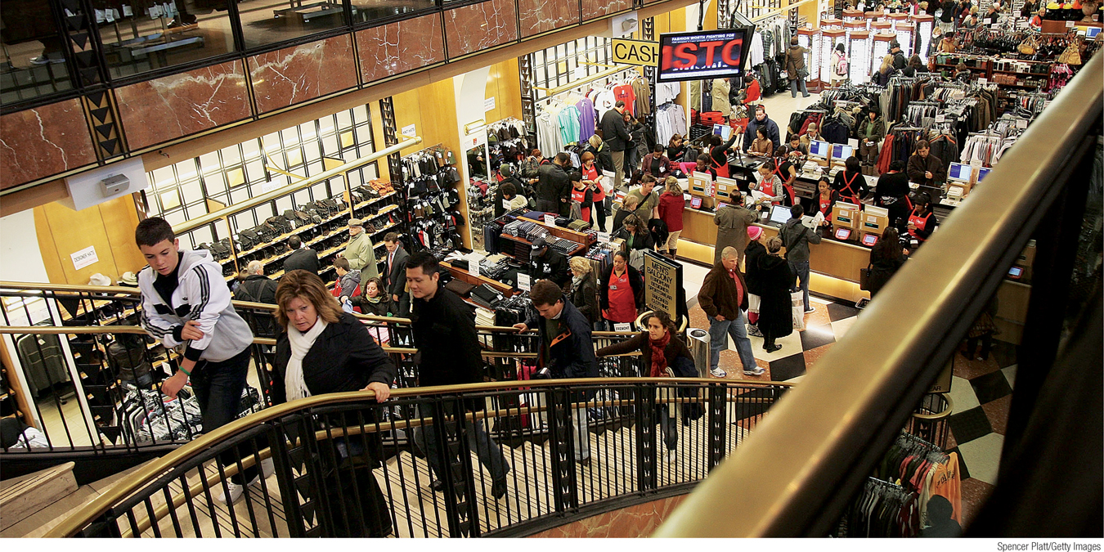
The National Accounts
Almost all countries calculate a set of numbers known as the national income and product accounts.
The national income and product accounts, or national accounts, keep track of the flows of money between different parts of the economy.
Section 3 | Module 10

Slide 2
GDP = C + I + G + X - IM

Slide 3
The Simple Circular-Flow Diagram
The simplest circular-flow diagram illustrates an economy that contains only two inhabitants: households and firms.
A household consists of either an individual or group of people who share their income.
A firm is an organization that produces goods and services for sale—and that employs members of households.
Section 3 | Module 10

Slide 4
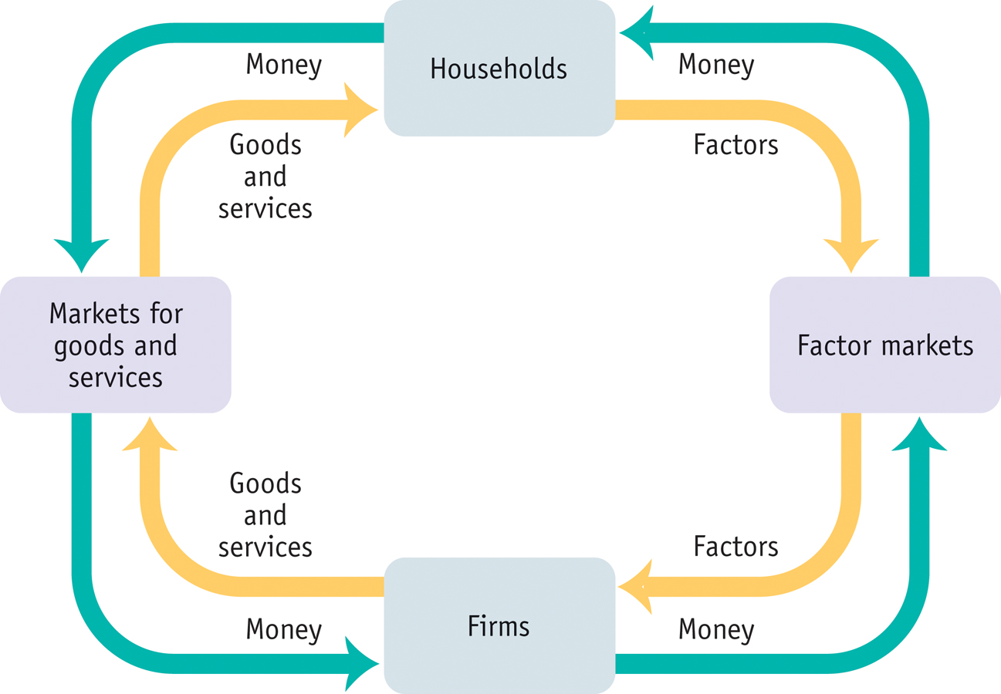
The Circular-Flow Diagram
Section 3 | Module 10

Slide 5
An Expanded Circular-Flow Diagram
Government purchases of goods and services
Government borrowing
Government
Consumer spending
Taxes
Government transfers
Private savings
Households
Wages, profit, interest, rent
Markets for goods and services
Factor Markets
Financial Markets
Borrowing and
stock issues
by firms
GDP
Wages, profit, interest, rent
Foreign lending and purchases of stock
Firms
Foreign borrowing and sales of stock
Exports
Rest of the world
Imports
Section 3 | Module 10

Slide 6
The National Accounts
Households engage in consumer spending.
Households own factors of production. They sell these factors to firms, receiving rent, wages, interest on bonds, dividends on stocks.
In addition, households receive government transfers from the government.
Disposable income, total household income minus taxes, is available to spend on consumption or to save.
Section 3 | Module 10

Slide 7
The National Accounts
Private savings, equal to disposable income minus consumer spending, is disposable income that is not spent on consumption.
The banking, stock, and bond markets, which channel private savings and foreign lending into investment spending, government borrowing, and foreign borrowing, are known as the financial markets.
Section 3 | Module 10

Slide 8
The National Accounts
Government purchases of goods and services (G) is paid for by tax receipts as well as by government borrowing.
Exports (X) generate an inflow of funds into the country from the rest of the world, while imports (IM) lead to an outflow of funds to the rest of the world.
Section 3 | Module 10

Slide 9
The National Accounts
Inventories are stocks of goods and raw materials held to facilitate business operations.
Investment spending is spending on productive physical capital, such as machinery and construction of structures, and on changes to inventories.
Section 3 | Module 10

Slide 10
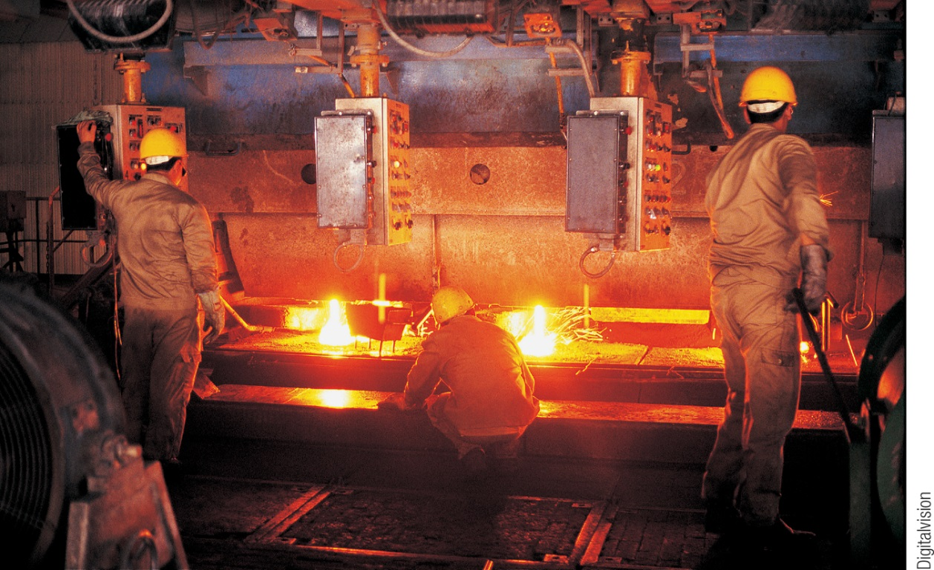
Gross Domestic Product
Final goods and services are goods and services sold to the final, or end, user.
Intermediate goods and services are goods and services—bought from one firm by another firm—that are inputs for production of final goods and services.
Gross domestic product or GDP measures the total value of all final goods and services produced in the economy during a given year.
GDP does not include the value of intermediate goods.
Section 3 | Module 10

Slide 11
Calculating Gross Domestic Product
GDP can be calculated three ways:
Add up the value added of all producers
Add up all aggregate spending on domestically-produced final goods and services. This results in the equation: GDP = C + I + G + X - IM
Add up all income paid to factors of production
Section 3 | Module 10

Slide 12
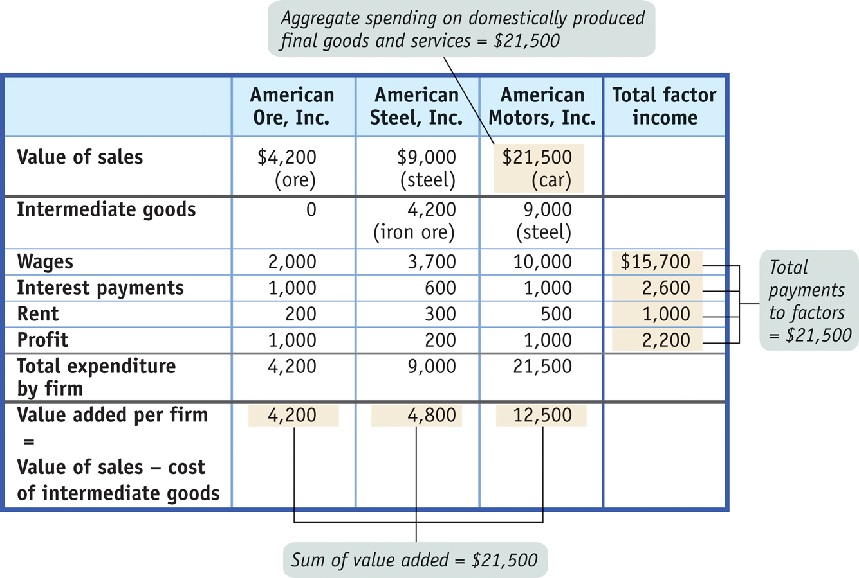
Calculating Gross Domestic Product
Section 3 | Module 10

Slide 13
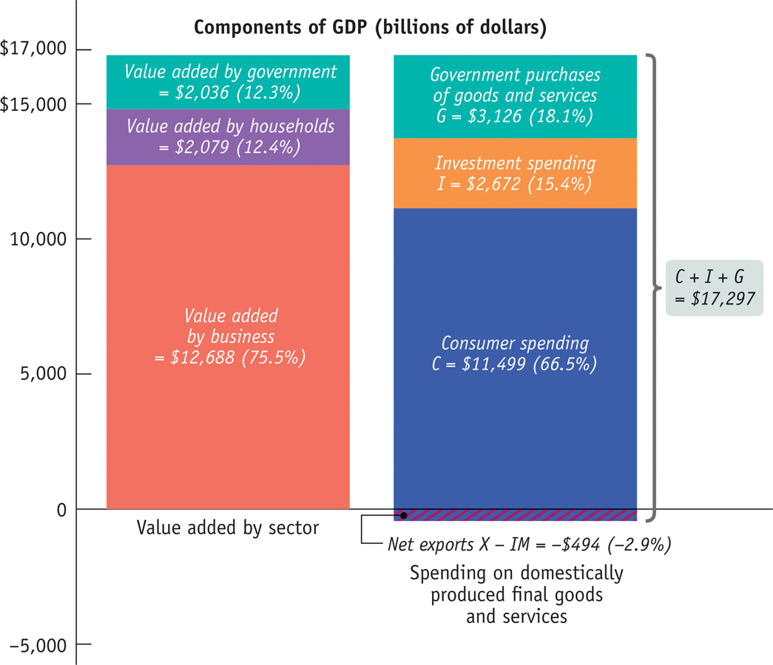
U.S. GDP in 2013:
Two Methods of Calculating GDP
Section 3 | Module 10

Slide 14
1. The simplest circular-flow model shows the interaction between households and firms. In this model:
A. only barter transactions take place.
B. households and firms interact in the market for goods and services, but firms are the
only participants in the factor markets.
C. firms supply goods and services to households, while households supply factors of
^{production to firms.}
D. attention is focused on ―real‖ flows of goods, services, and factors of production, but
money flows between households and firms are ignored for simplicity.
E. firms supply factors of production to households, which, in turn, supply goods and
^{services to the firms.}
2. Which of the following is false about the circular-flow diagram?
A. Households are the primary demanders of goods and services.
B. Firms are the primary suppliers of goods and services.
C. Money flows from households to firms as households offer factors of production for ^{sale.}
D. Money flows from firms to households as households offer factors of production for ^{sale.}
E. Firms are the primary demanders in the product market.
3. Construction of new homes is considered part of:
^{A. investment spending.}
^{B. consumption.}
^{C. government spending.}
^{D. private saving.}
^{E. the stock market.}

Slide 15
Summary
Economists keep track of the flows of money between sectors with the national income and product accounts, or national accounts.
Households earn income via the factor markets from wages.
Disposable income is allocated to consumer spending (C) and private savings.
Via the financial markets, private savings and foreign lending are channeled to investment spending (I), government borrowing, and foreign borrowing.
Government purchases of goods and services (G) are paid for by tax revenues and any government borrowing.
Section 3 | Module 10

Slide 16
Summary
Exports (X) generate an inflow of funds into the country from the rest of the world, but imports (IM) lead to an outflow of funds to the rest of the world.
Gross domestic product, or GDP, measures the value of all final goods and services produced in the economy.
GDP can be calculated in three ways:
add up the value added by all producers;
add up all spending on domestically produced final goods and services (GDP = C + I + G + X − IM); or
add up all the income paid by domestic firms to factors of production. These three methods are equivalent.
Section 3 | Module 10

