Slide 1
Discuss the factors that explain why long-run growth rates differ so much among countries
Explain the challenges to growth posed by scarcity of natural resources, environmental degradation, and efforts to make growth sustainable
What You Will Learn in this Module
Section 7 | Module 39

Slide 2
Why Growth Rates Differ
A number of factors influence differences among countries in their growth rates.
Some countries add to their physical capital more rapidly than others, through high rates of investment spending.
Some countries add to their human capital through education.
Some countries engage in or encourage research and development (R&D) spending to create new technologies and prepare them for practical use.
Section 7 | Module 39

Slide 3
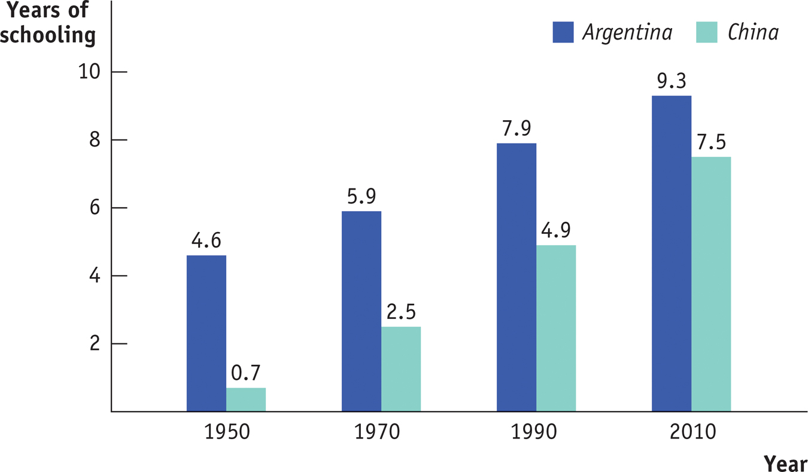
China’s Students Are Catching Up
Section 7 | Module 39
Notes:
Table 39.1: Human Capital in Latin America and East Asia
Source: Barro, Robert J. and Lee, Jong-Wha (2001) “International Data on Educational Attainment: Updates and Implications,” Oxford Economic Papers vol. 53(3), p. 541-563

Slide 4
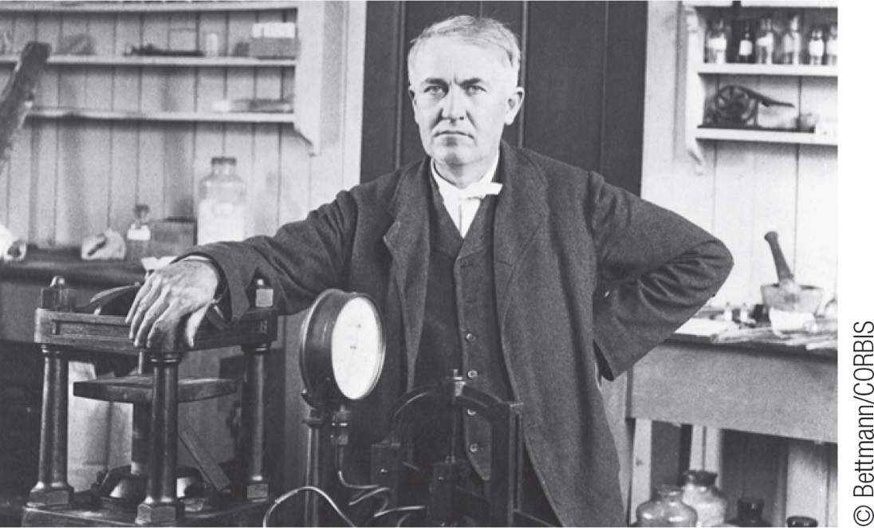
F Y I
Inventing R& D
Thomas Edison is best known as the inventor of the light bulb and the phonograph. But his biggest invention was “research and development”!
In 1875 Edison created something new: his Menlo Park, New Jersey laboratory employed 25 men full-time to generate new products and processes for business.
He created an organization whose purpose was to create new ideas year after year.
Section 7 | Module 39

Slide 5
The Role of Government in Promoting Economic Growth
Governments play a direct role in building infrastructure: roads, power lines, ports, information networks, and other parts of an economy’s physical capital.
Governments also play an important indirect role in making high rates of private investment spending possible.
Much of an economy’s human capital is the result of government spending on education.
Much important R&D is done by government agencies.
Section 7 | Module 39

Slide 6
The Role of Government in Promoting Economic Growth
Political stability and protection of property rights are crucial ingredients in long-run economic growth.
Even when governments aren’t corrupt, excessive government intervention can be a brake on economic growth.
If large parts of the economy are supported by government subsidies, protected from imports, or otherwise insulated from competition, productivity tends to suffer because of a lack of incentives.
Section 7 | Module 39

Slide 7
F Y I
The Brazilian Breadbasket
In recent years, Brazil’s economy has made a strong showing, especially in agriculture.
This success depends on exploiting a natural resource, the tropical savannah land known as the cerrado.
A combination of three factors changed this land into a useable resource:
Technological progress due to research and development
Improved economic policies
Addition of physical capital
Section 7 | Module 39

Slide 8
Is World Growth Sustainable?
Long-run economic growth is sustainable if it can continue in the face of the limited supply of natural resources and the impact of growth on the environment.
Differing views about the impact of limited natural resources on long-run economic growth turn on the answers to three questions:
How large are the supplies of key natural resources?
How effective will technology be at finding alternatives to natural resources?
Can long-run economic growth continue in the face of resource scarcity?
Section 7 | Module 39

Slide 9
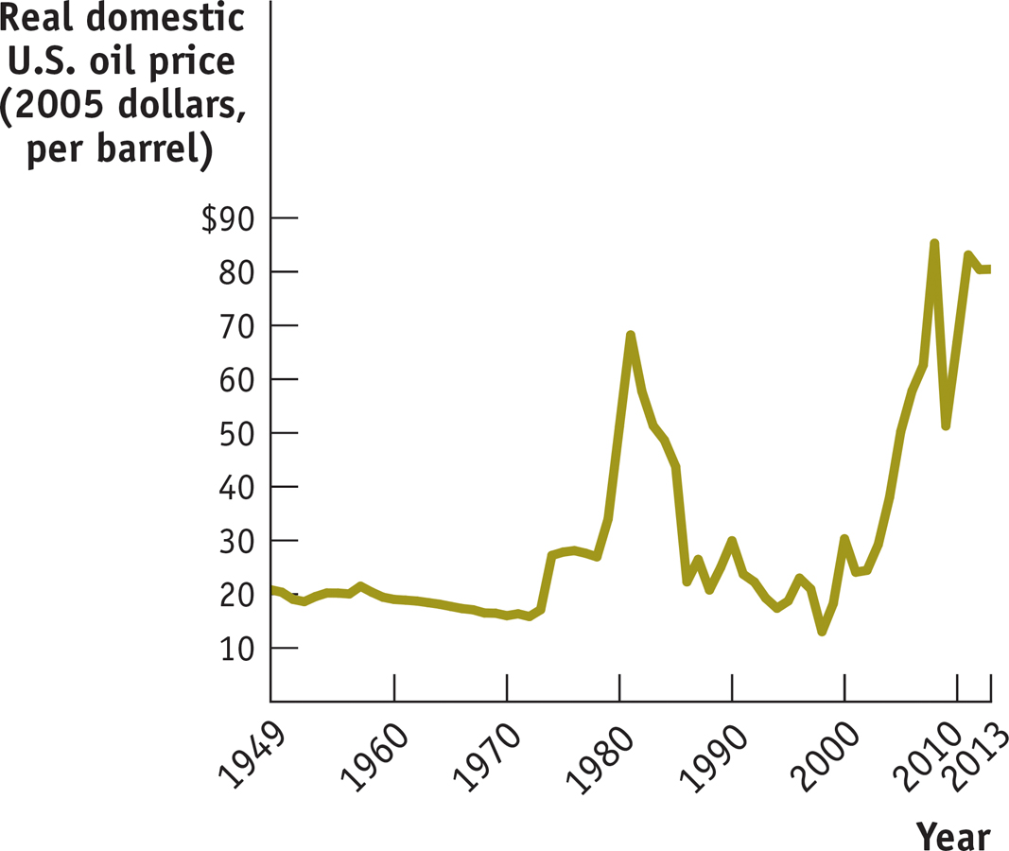
The Real Price of Oil, 1949-2013
Section 7 | Module 39
Notes:
Figure Caption: Figure 39.1: The Real Price of Oil, 1949–2008
The real price of natural resources, like oil, rose dramatically in the 1970s and then fell just as dramatically in the 1980s. Since 2005, however, the real prices of natural resources have soared.
Source: Energy Information Administration

Slide 10
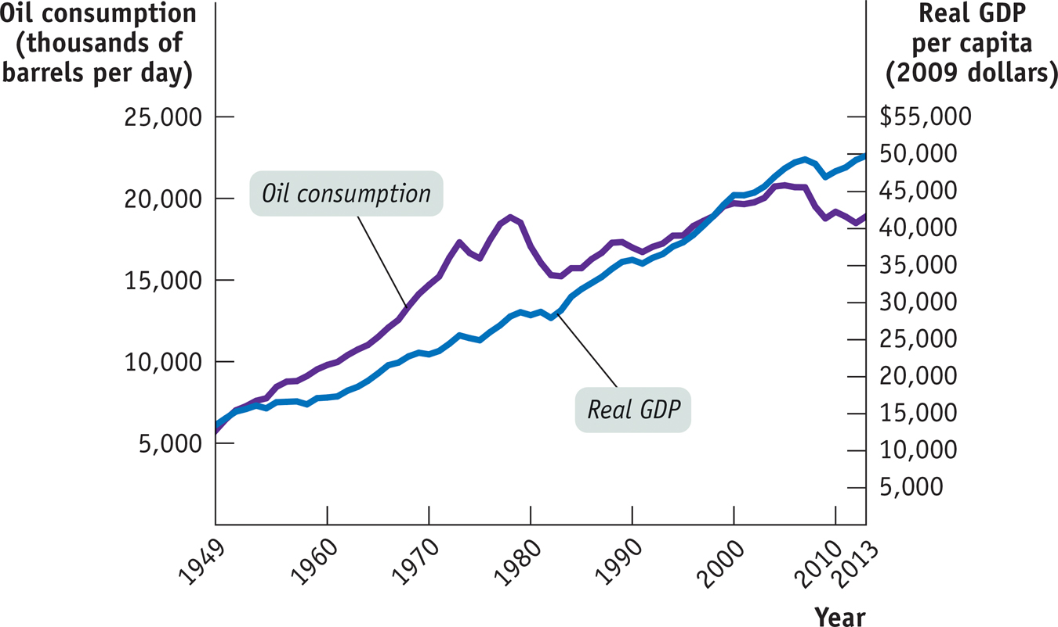
U.S. Oil Consumption and Growth over Time
Section 7 | Module 39
Notes:
Figure Caption: Figure 39.2: U.S. Oil Consumption and Growth over Time
Until 1973, the real price of oil was relatively cheap and there was a more or less one-to-one relationship between economic growth and oil consumption. Conservation efforts increased sharply after the spike in the real price of oil in the mid-1970s. Yet the U.S. economy was still able to deliver growth despite cutting back on oil consumption.
Source: Energy Information Administration; Bureau of Economic Analysis

Slide 11
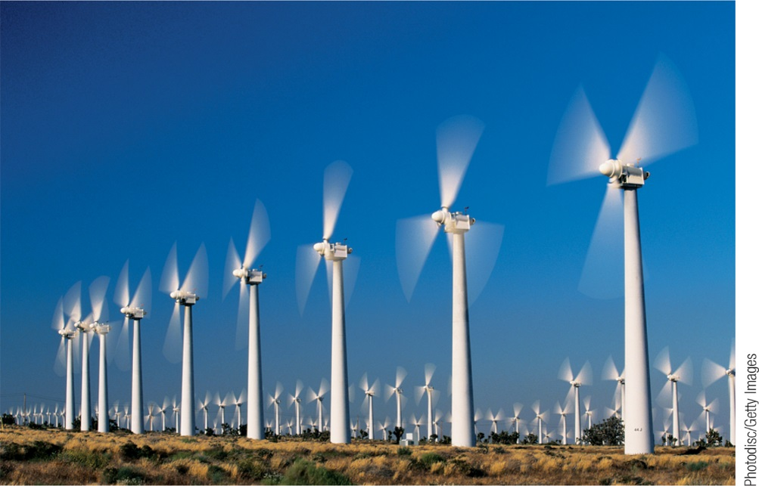
Economic Growth and the Environment
The limits to growth arising from environmental degradation are more difficult to overcome because overcoming them requires effective government intervention.
The emission of greenhouse gases is clearly linked to growth, and limiting them will require some reduction in growth.
However, the best available estimates suggest that a large reduction in emissions would require only a modest reduction in the growth rate.
Section 7 | Module 39

Slide 12
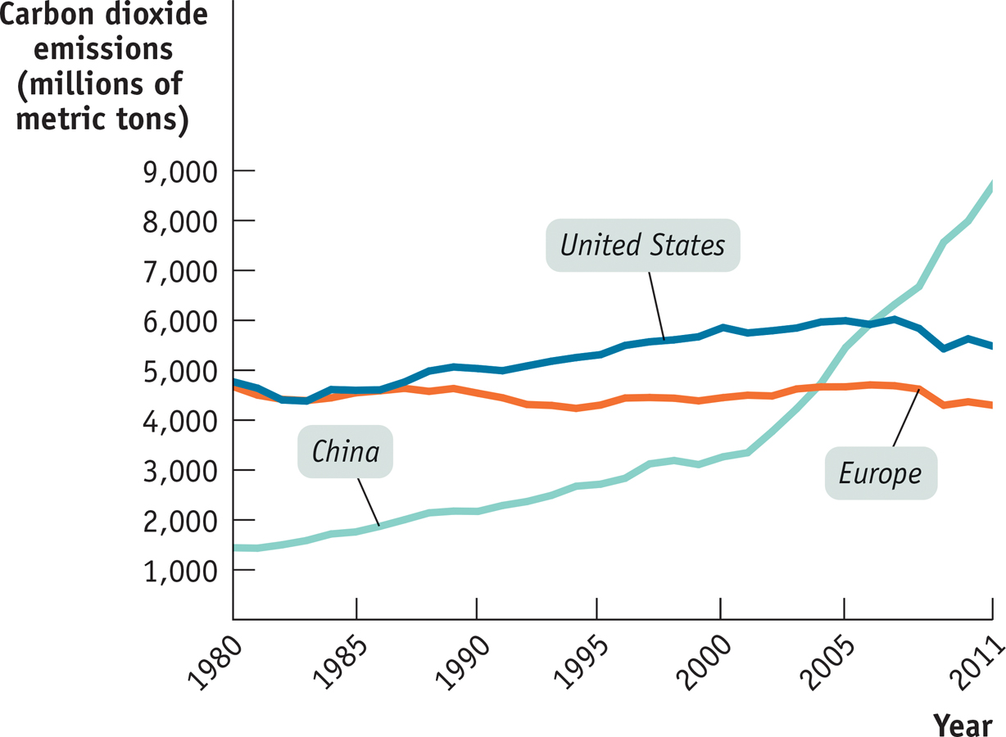
Climate Change and Growth
Section 7 | Module 39

Slide 13
Economic Growth and the Environment
There is broad consensus that government action to address climate change and greenhouse gases should be in the form of market-based incentives, like a carbon tax or a cap and trade system.
It will also require rich and poor countries to come to some agreement on how the cost of emissions reductions will be shared.
Section 7 | Module 39

Slide 14
Summary
The large differences in countries’ growth rates are largely due to differences in their rates of accumulation of physical and human capital as well as differences in technological progress.
A prime factor is differences in savings and investment rates.
Technological progress is largely a result of research and development, or R&D.
Government actions that help growth are the building of infrastructure.
Government actions that retard growth are political instability, the neglect or violation of property rights, corruption, and excessive government intervention.
Section 7 | Module 39

Slide 15
Summary
Economists generally believe that environmental degradation poses a greater problem for whether long-run economic growth is sustainable than natural resource scarcity.
Addressing environmental degradation requires effective governmental intervention, but the problem of natural resource scarcity is often well handled by the market price response.
Section 7 | Module 39

