Slide 1
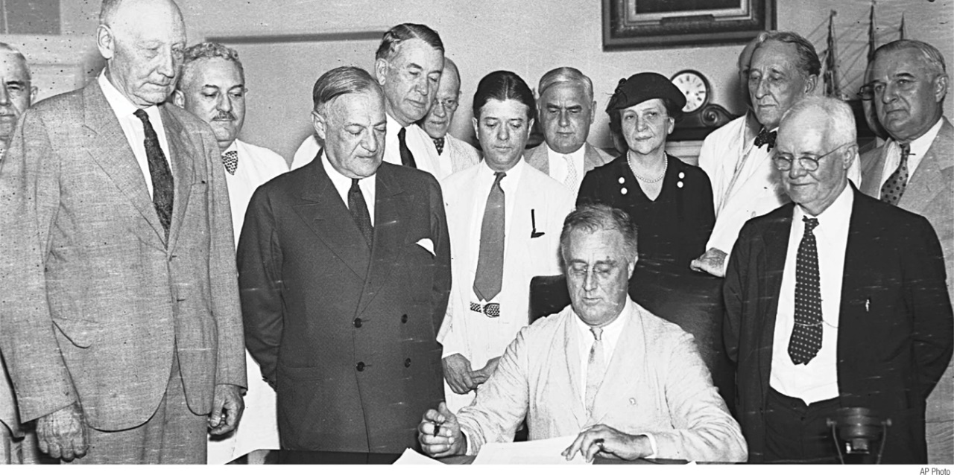
Explain why classical macroeconomics wasn’t adequate for the problems posed by the Great Depression
Discuss how Keynes and the experience of the Great Depression legitimized macroeconomic policy activism
Define monetarism and identify its views on the limits of discretionary monetary policy
Describe how challenges led to a revision of Keynesian ideas and the emergence of new classical macroeconomics
What You Will Learn in this Module
Section 6 | Module 35

Slide 2
Classical Macroeconomics
Classical macroeconomics asserted that monetary policy affected only the aggregate price level, not aggregate output.
Classical macroeconomics asserted that the short run was unimportant.
According to the classical model, prices are flexible, making the aggregate supply curve vertical even in the short run.
As a result, an increase in the money supply leads, other things equal, to an equal proportional rise in the aggregate price level, with no effect on aggregate output.
Increases in the money supply lead to inflation, and that’s all.
Section 6 | Module 35

Slide 3
Classical Macroeconomics
By the 1930s, measurement of business cycles was a well-established subject, but there was no widely accepted theory of business cycles.
Section 6 | Module 35

Slide 4
The Great Depression and the Keynesian Revolution
In 1936, Keynes presented his analysis of the Great Depression—his explanation of what was wrong with the economy’s alternator—in a book titled The General Theory of Employment, Interest, and Money.
The school of thought that emerged out of the works of John Maynard Keynes is known as Keynesian economics.
Section 6 | Module 35

Slide 5
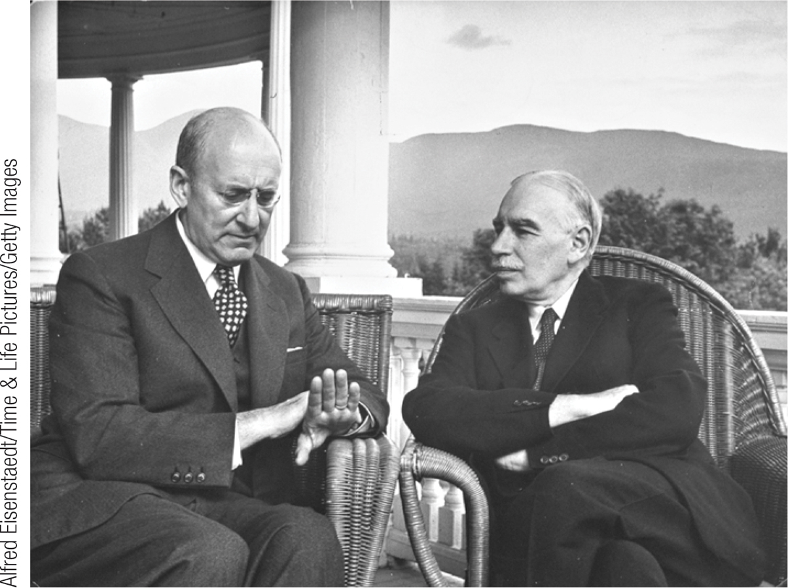
The Great Depression and the Keynesian Revolution
Keynesian economics reflected two innovations:
Short-run effects of shifts in aggregate demand on aggregate output.
Keynes argued that other factors than money are mainly responsible for business cycles.
Section 6 | Module 35

Slide 6
Classical versus Keynesian Macroeconomics
Section 6 | Module 35

Slide 7
Policy to Fight Recessions
The main practical consequence of Keynes’s work was that it legitimized macroeconomic policy activism—the use of monetary and fiscal policy to smooth out the business cycle.
Section 6 | Module 35

Slide 8
F Y I
The End of the Great Depression
The basic message many of the young economists who adopted Keynes’s ideas in the 1930s took from his work was that economic recovery requires aggressive fiscal expansion—deficit spending on a large scale to create jobs.
And that is what they eventually got, but it wasn’t because politicians were persuaded.
Instead, what happened was a very large and expensive war, World War II.
Section 6 | Module 35

Slide 9
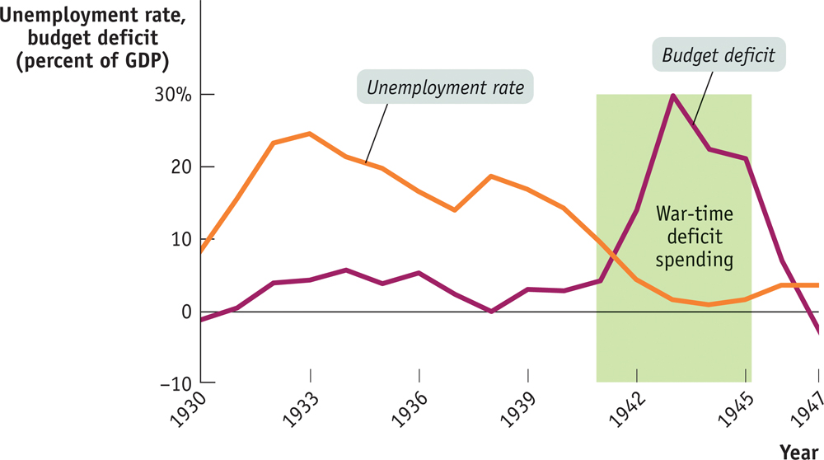
F Y I
The End of the Great Depression
Section 6 | Module 35

Slide 10
F Y I
The End of the Great Depression
The previous figure shows the U.S. unemployment rate and the federal budget deficit as a share of GDP from 1930 to 1947.
As you can see, deficit spending during the 1930s was on a modest scale.
In 1940, as the risk of war grew larger, the United States began a large military buildup, and the budget moved deep into deficit.
After the attack on Pearl Harbor on December 7, 1941, the country began deficit spending on an enormous scale.
Section 6 | Module 35

Slide 11
Challenges to Keynesian Economics
Monetarism asserted that GDP will grow steadily if the money supply grows steadily.
It called for a shift from monetary policy rule to that of a discretionary monetary policy.
It argued that GDP would grow steadily if the money supply grew steadily.
Monetarism was influential for a time, but was eventually rejected by many macroeconomists.
Section 6 | Module 35

Slide 12
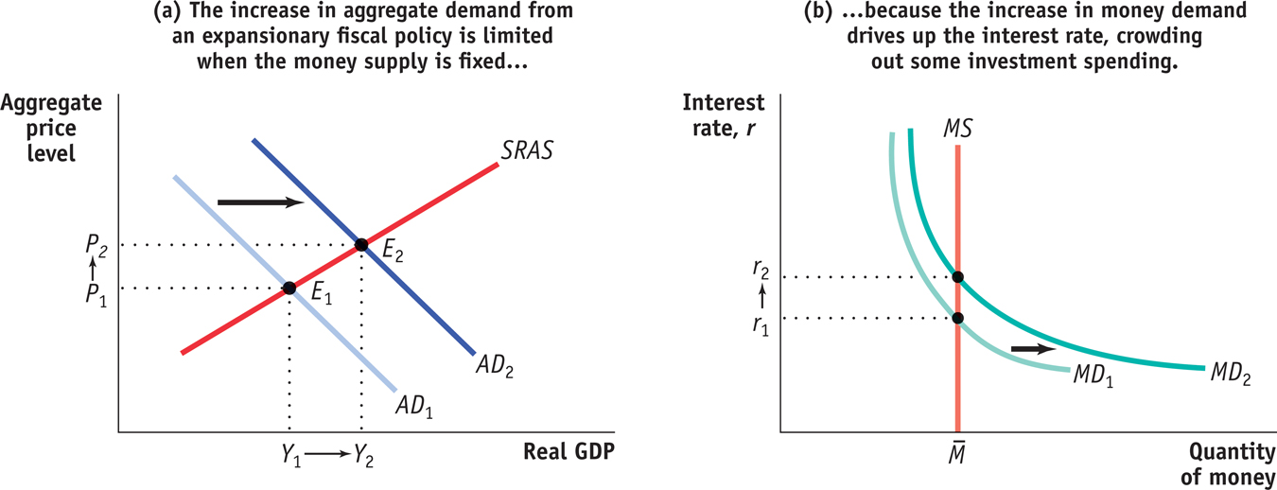
Fiscal Policy with a Fixed Money Supply
Section 6 | Module 35

Slide 13
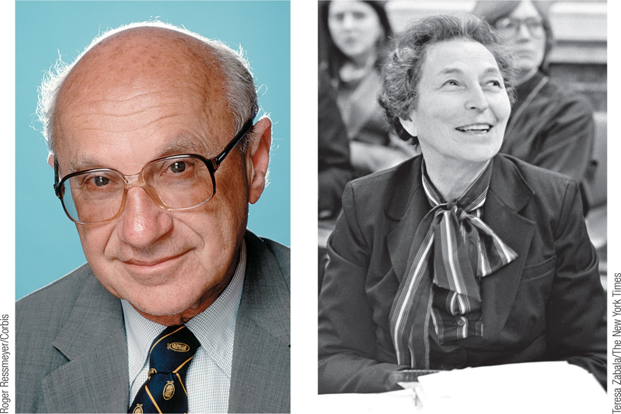
Monetarism
When the central bank changes interest rates or the money supply based on its assessment of the state of the economy, it is engaged in discretionary monetary policy.
A monetary policy rule is a formula that determines the central bank’s actions.
The velocity of money is the ratio of nominal GDP to the money supply.
The velocity equation: M × V = P × Y
Section 6 | Module 35

Slide 14
Monetarism
Monetarists believed that V was stable, so they believed that if the Federal Reserve kept M on a steady growth path, nominal GDP would also grow steadily.
Section 6 | Module 35

Slide 15
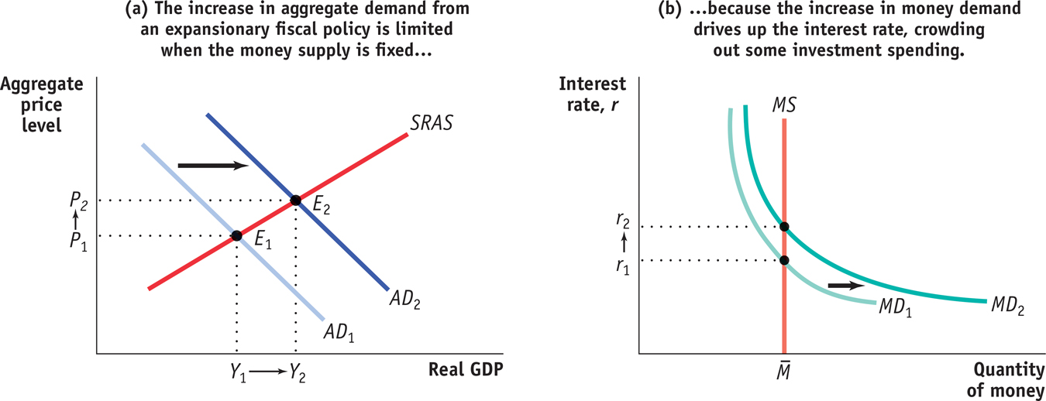
The Velocity of Money
Section 6 | Module 35

Slide 16
Inflation and the Natural Rate of Unemployment
The natural rate of unemployment is also the non-accelerating-inflation rate of unemployment, or NAIRU.
According to the natural rate hypothesis, because inflation is eventually embedded into expectations, to avoid accelerating inflation over time the unemployment rate must be high enough that the actual inflation rate equals the expected inflation rate.
Section 6 | Module 35

Slide 17
Inflation and the Natural Rate of Unemployment
The natural rate hypothesis limits the role of macroeconomic policy in stabilizing the economy.
The goal is not to seek a permanently lower unemployment rate, but to keep it stable
The natural rate hypothesis became almost universally accepted.
Section 6 | Module 35

Slide 18
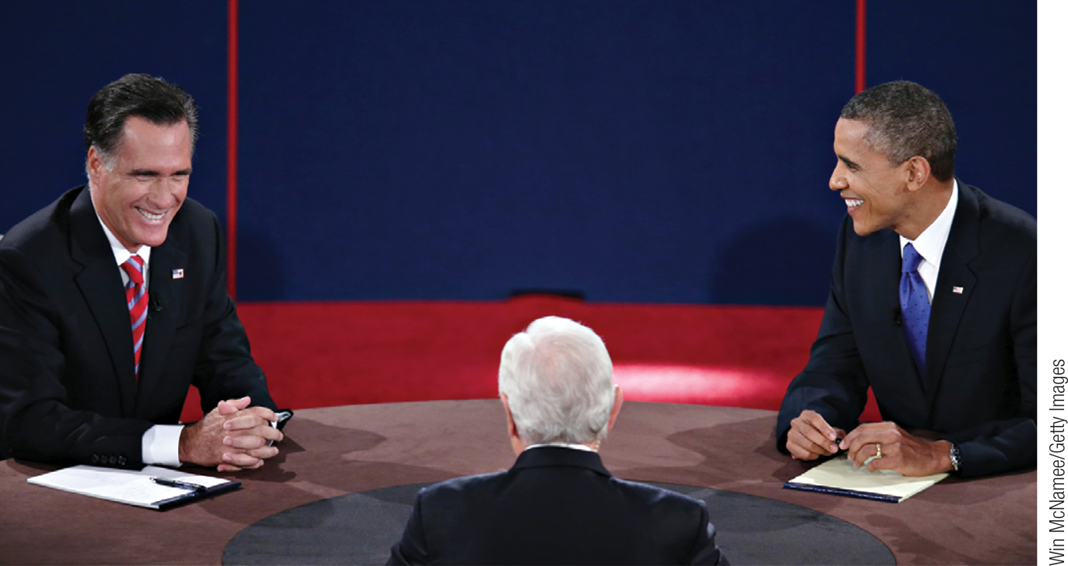
The Political Business Cycle
A political business cycle results when politicians use macroeconomic policy to serve political ends.
Fear of a political business cycle led to a consensus that monetary policy should be insulated from politics.
Section 6 | Module 35

Slide 19
Rational Expectations, Real Business Cycles, and New Classical Macroeconomics
New classical macroeconomics is an approach to the business cycle.
It returns to the classical view that shifts in the aggregate demand curve affect only the aggregate price level, not aggregate output.
Section 6 | Module 35

Slide 20
Rational Expectations
Rational expectations is the view that individuals and firms make decisions optimally, using all available information.
The idea of rational expectations did serve as a useful caution for macroeconomists who had become excessively optimistic about their ability to manage the economy.
Section 6 | Module 35

Slide 21
Real Business Cycle Theory
According to new Keynesian economics, market imperfections can lead to price stickiness for the economy as a whole.
Real business cycle theory says that fluctuations in the rate of growth of total factor productivity cause the business cycle.
Section 6 | Module 35

Slide 22
Summary
Classical macroeconomics asserted that monetary policy affected only the aggregate price level, not aggregate output, and that the short run was unimportant.
Keynesian economics attributed the business cycle to shifts of the aggregate demand curve, often the result of changes in business confidence. Keynesian economics also offered a rationale for macroeconomic policy activism.
Monetarism is a doctrine that called for a monetary policy rule as opposed to discretionary monetary policy, and which argued that GDP would grow steadily if the money supply grew steadily.
Section 6 | Module 35

Slide 23
Summary
The natural rate hypothesis says that the unemployment rate must be high enough to keep expected inflation and actual inflation equal.
Fears of a political business cycle led to a consensus that monetary policy should be insulated from politics.
Rational expectations suggests that even in the short run there might not be a trade-off between inflation and unemployment because expected inflation would change immediately in the face of expected changes in policy.
Section 6 | Module 35

Slide 24
Summary
Real business cycle theory claims that changes in the rate of growth of total factor productivity are the main cause of business cycles.
New Keynesian economics argues that market imperfections can lead to price stickiness, so that changes in aggregate demand have effects on aggregate output after all.
Section 6 | Module 35

