Slide 1
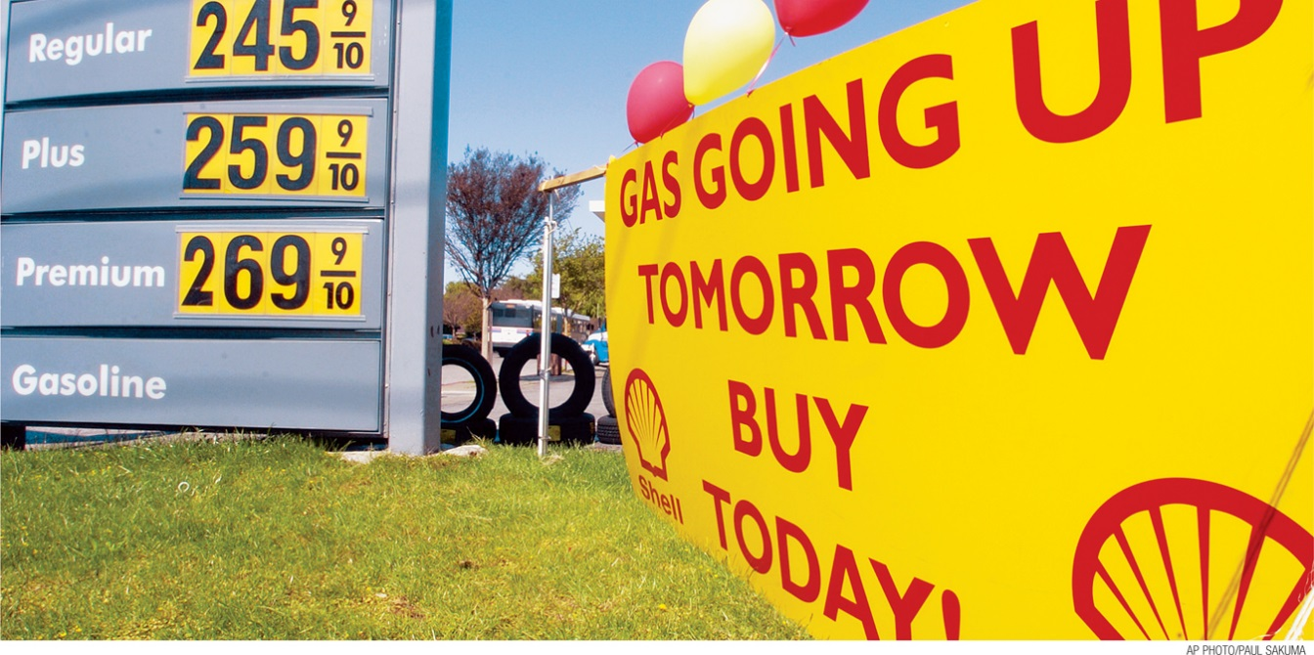
Calculate the rate of inflation
Specify the economic costs of inflation
Identify who is helped and who is hurt by inflation
Explain why policy makers try to maintain a stable rate of inflation
Differentiate between real and nominal values of income, wages, and interest rates
Discuss the problems of deflation and disinflation
What You Will Learn in this Module
Section 3 | Module 14

Slide 2
The Natural Rate of Unemployment
The real wage is the wage rate divided by the price level.
Real income is income divided by the price level.
The inflation rate is the percent increase in the overall level of prices per year.
Inflation rate = Price level in year 2 – Price level in year 1 x 100
Price level in year 1
Section 3 | Module 14

Slide 3
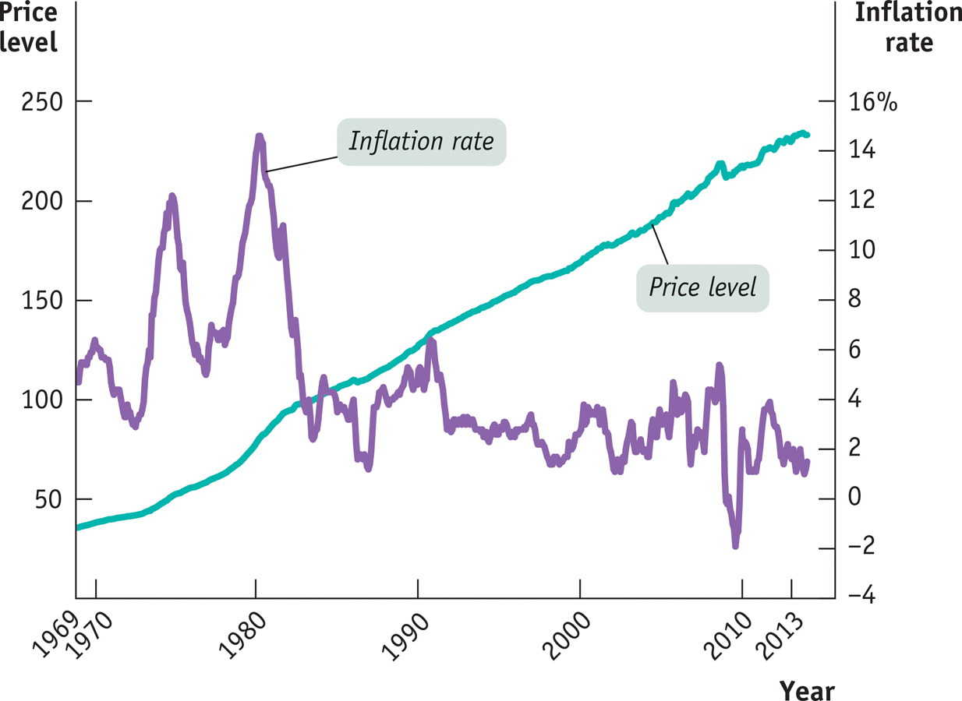
Inflation and Deflation
The Price Level Versus the Inflation Rate, 1969-2013
Section 3 | Module 14

Slide 4
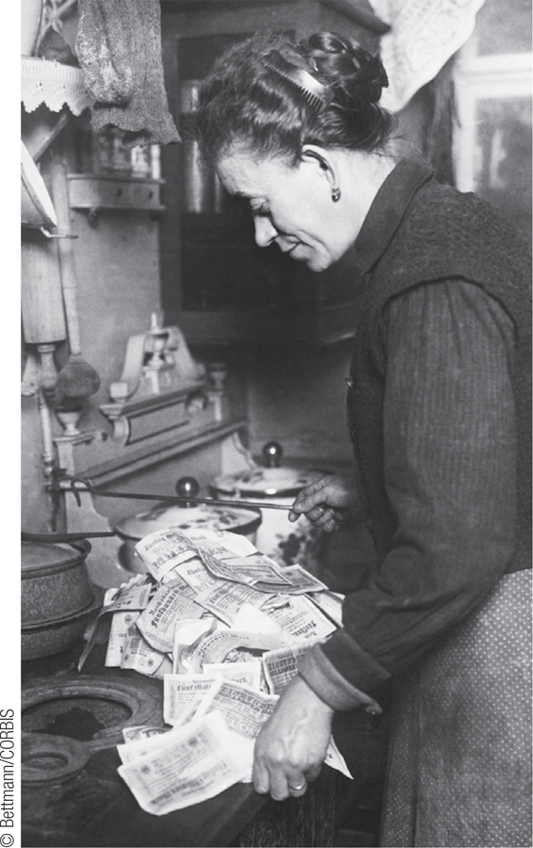
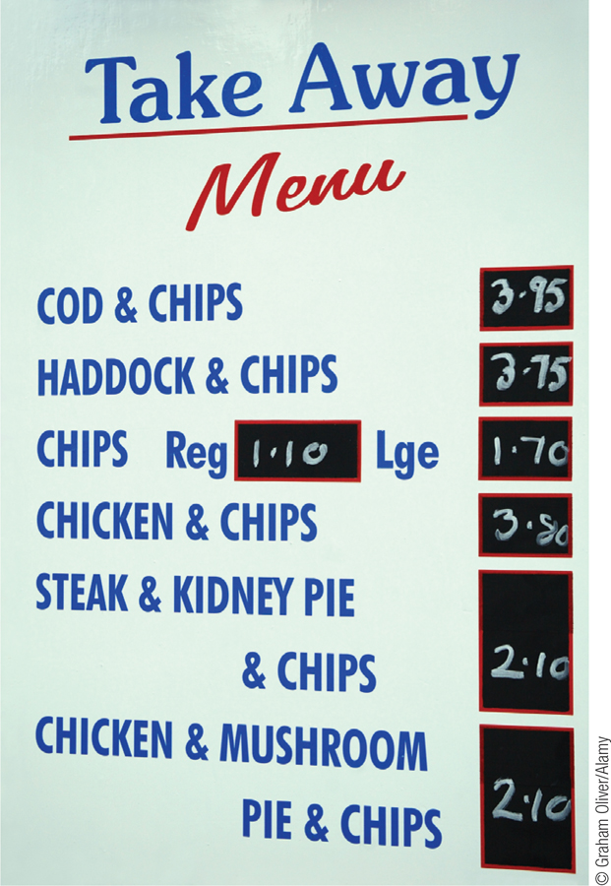
Inflation and Deflation
High rates of inflation impose significant economic costs.
Shoe-leather costs are the increased costs of transactions caused by inflation.
Menu cost is the real cost of changing a listed price.
Unit-of-account costs arise from the way inflation makes money a less reliable unit of measurement.
Section 3 | Module 14

Slide 5
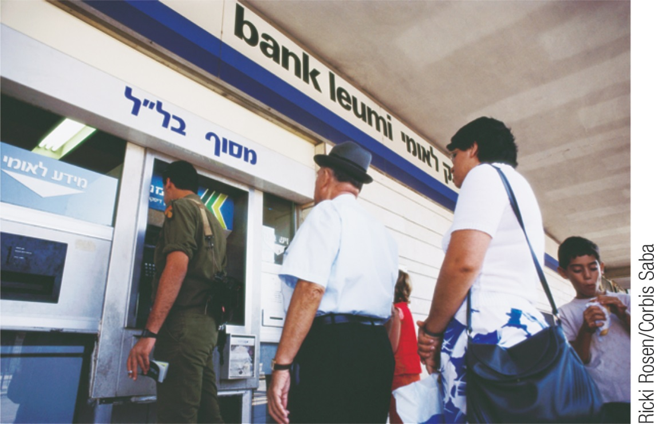
F Y I
Israel’s Experience with Inflation
In the mid-1980s, Israel experienced a “clean” inflation.
But policy errors led to very high inflation.
The shoe-leather costs of inflation were substantial. Israelis spent a lot of time moving money in and out of bank accounts that provided high enough interest rates to offset inflation.
Businesses made efforts to minimize menu costs. For example, restaurant menus often didn’t list prices.
It was hard for Israelis to make decisions because prices changed so much and so often.
Section 3 | Module 14

Slide 6
Winners and Losers from Inflation
Inflation changes the dollar repayment of a loan will be because the loan contract is stated in nominal terms.
The nominal interest rate is the interest rate expressed in dollar terms.
The real interest rate is the nominal interest rate minus the rate of inflation.
If inflation is higher than expected, borrowers gain at the expense of lenders.
If inflation is lower than expected, lenders gain at the expense of borrowers.
Disinflation is the process of bringing the inflation rate down.
Section 3 | Module 14

Slide 7
Practice – helped or hurt?
Jack retired five years ago and now lives on a fixed-income annuity and a small savings account that pays him 1% interest on the balance. The current inflation rate is 1.7%.
Jill has worked at her current position without a raise for 4 years. Because inflation has risen 5% over the course of the 4 years, she has struggled to pay day-to-day living expenses and her house payment. She asked her employer for a raise and he gave her a 6% raise because she is such a good worker.
Peter has been saving his money to buy his girlfriend an engagement ring. He decided to give the money to his mother to hold for him so he wouldn’t spend it rather than put it in a savings account at the bank. During the time he was saving, the price of the ring he picked out increased by 10%.
Wendy manages a bank in the local area. The previous manager made several fixed-rate loans to customers at low interest rates to bring in new depositors. Inflation is now rising at 3% per year.

Slide 8
Practice – helped or hurt cont’d
Luke works for a building contractor and is a member of the local iron workers union. The contractor is currently building 5 skyscrapers in the Chicago area. His union just negotiated a new 5-year contract that includes small annual raises and a cost of living adjustment (COLA).
Leia just read that the national debt owed by the federal government is at an all-time high. (Explain impact on federal government.)
Han works at the local tax agency. The county commissioners just voted to sell license tags at the same rate for the next 5 years. (Explain impact on county government.)
Lando signed a 4-year fixed rate lease for the condo he is going to live in while he attends college.

Slide 9
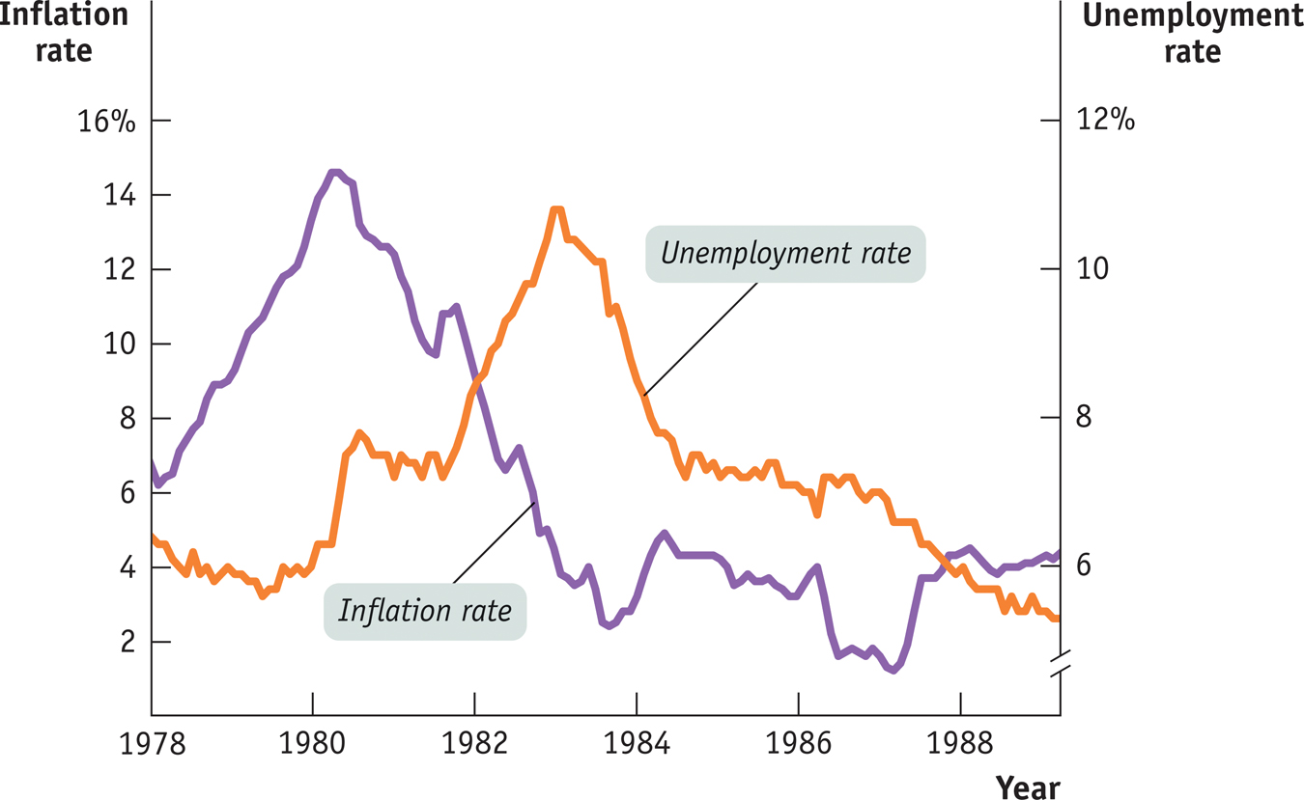
The Cost of Disinflation
Section 3 | Module 14

Slide 10
Summary
The rate of change of prices is important in the economy.
A high inflation rate imposes overall costs on the economy: shoe-leather costs, menu costs, and unit-of-account costs.
Inflation does not, as many assume, make everyone poorer by raising the level of prices because wages and incomes are adjusted to take into account a rising price level, leaving real wages and real income unaffected.
A higher-than-expected inflation rate is good for borrowers and bad for lenders. A lower-than expected inflation rate is good for lenders and bad for borrowers.
Disinflation is very costly, so policy makers try to prevent inflation from becoming excessive in the first place.
Section 3 | Module 14

