Slide 1
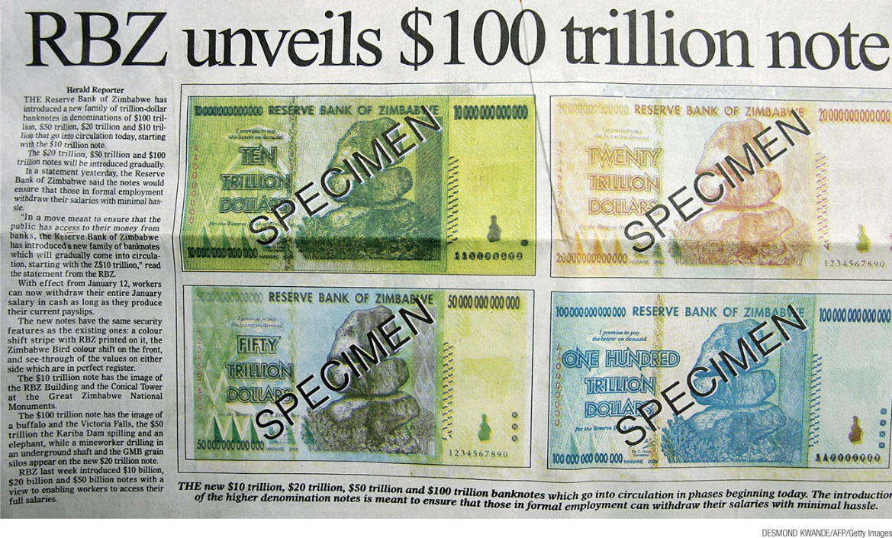
Use the classic model of the price level
Explain why efforts to collect an inflation tax by printing money can lead to high rates of inflation and even hyper inflation
Define the types of inflation: cost-push and demand-pull
What You Will Learn in this Module
Section 6 | Module 33

Slide 2
The long-run Phillips curve shows the relationship between:
a. potential aggregate output and the natural rate of unemployment at a given raze of expected inflation.
B the expected inflation and the actual inflation after the expectation becomes embedded in people's minds.
C unemployment and inflation after expectations of inflation have had time to adjust to experience.
D the aggregate output and the aggregate price level in the economy at a given rate of expected inflation.
E the real interest rate and investment spending.

Slide 3
If the economy is in a liquidity trap:
A both monetary and fiscal policies are effective.
B neither monetary nor fiscal policy can be effective.
C monetary policy can be effective, but fiscal policy is not.
D fiscal policy can be effective, but monetary policy is not.
E expansionary monetary policy can be effective, while contractionary monetary policy is not.

Slide 4
Money and Inflation
According to the classical model of the price level, the real quantity of money is always at its long-run equilibrium level.
The real quantity of money is M/P.
A change in the nominal money supply, M, leads in the long run to a change in the aggregate price level.
The Turkish currency is the lira. When Turkey made 1,000,000 “old” lira equivalentto 1 “new” lira, real GDP was unaffected because of the neutrality of money.
Section 6 | Module 33

Slide 5
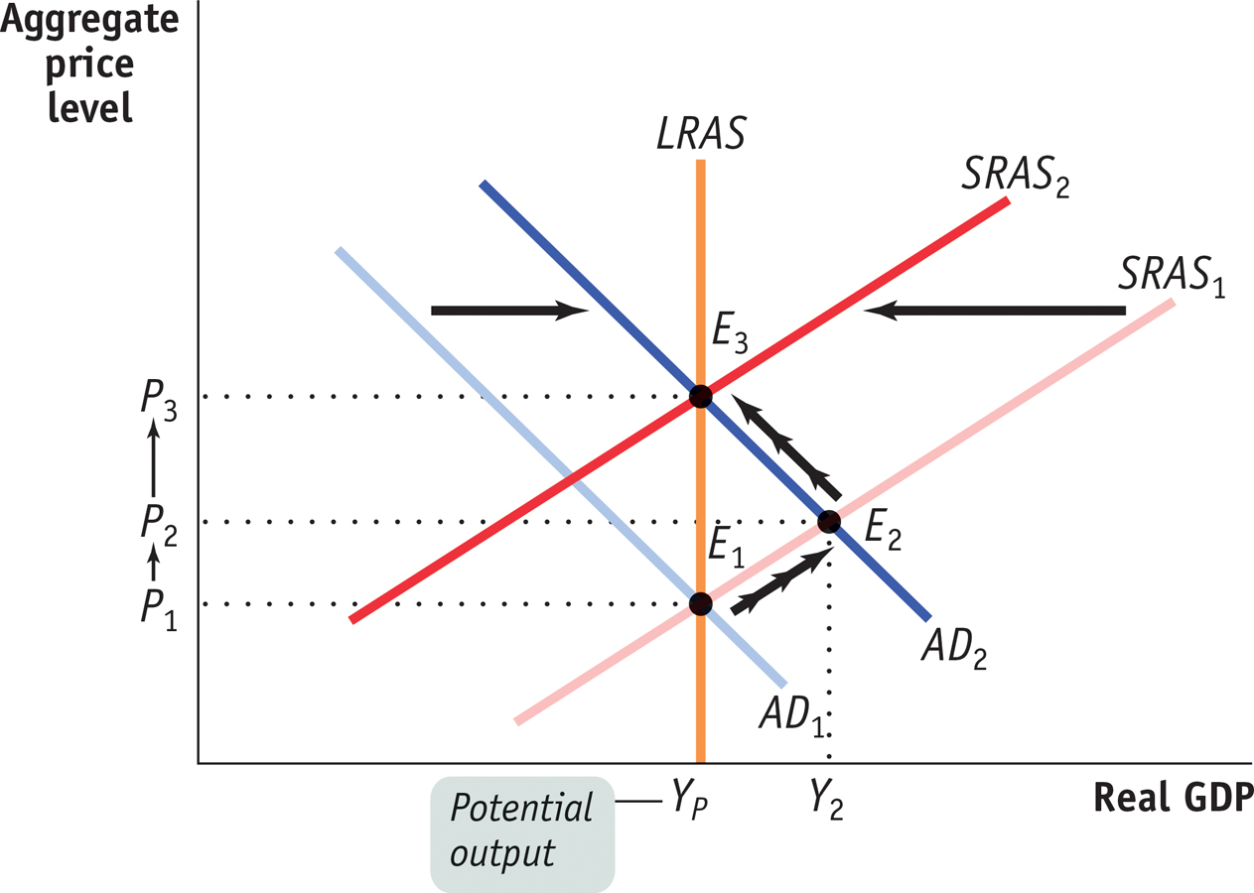
Money and Prices
Section 6 | Module 33

Slide 6
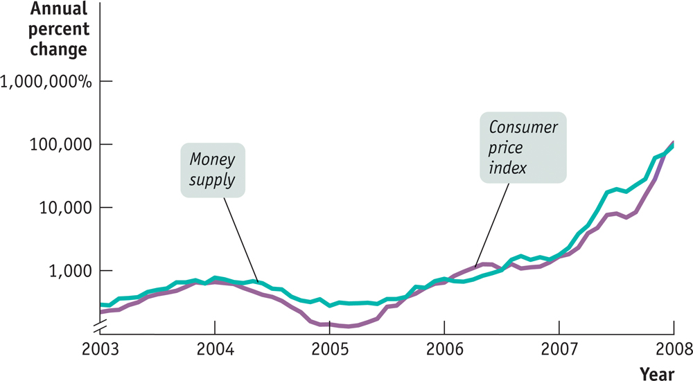
Money Supply Growth and Inflation in Zimbabwe
Section 6 | Module 33

Slide 7
The Inflation Tax
The inflation tax is the reduction in the real value of money held by the public caused by inflation, equal to the inflation rate times the money supply, on those who hold money.
The real value of resources captured by the government is reflected by the real inflation tax, the inflation rate times the real money supply.
Section 6 | Module 33

Slide 8
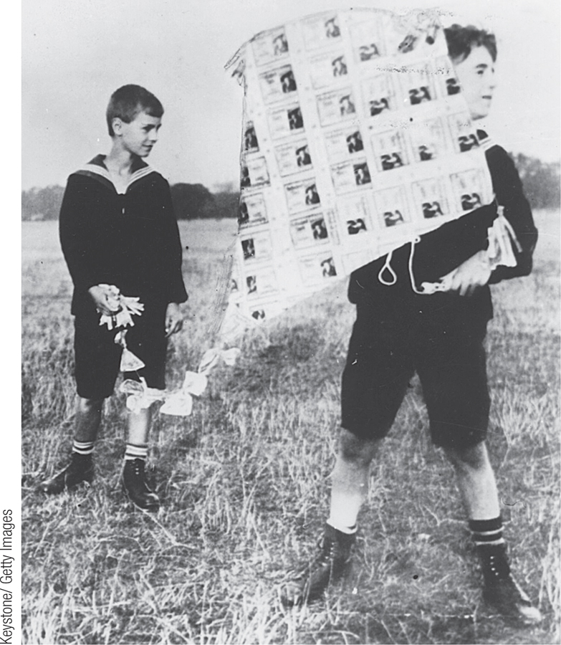
The Logic of Hyperinflation
In order to avoid paying the inflation tax, people reduce their real money holdings and force the government to increase inflation to capture the same amount of real inflation tax.
In some cases, this leads to a vicious circle of a shrinking real money supply and a rising rate of inflation.
This leads to hyperinflation and a fiscal crisis.
Section 6 | Module 33

Slide 9
The Logic of Hyperinflation
High inflation arises when the government must print a large quantity of money to cover a large budget deficit.
Seinorage = ∆M
Real Seinorage = ∆M
P
Real Seinorage = ∆M M
M P
Real Seinorage = Rate of growth of the money supply x Real money supply
Section 6 | Module 33

Slide 10
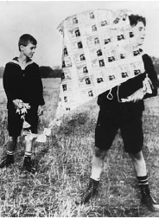
The Logic of Hyperinflation
In 1923, Germany’s money was worth so little that children used stacks of banknotes as building blocks or built kites with them.
Section 6 | Module 33

Slide 11
F Y I
Zimbabwe’s Inflation
Zimbabwe’s money supply growth was matched by almost simultaneous surges in its inflation rate. Why did Zimbabwe’s government pursue policies that led to runaway inflation?
The reason boils down to political instability, which in turn had its roots in Zimbabwe’s history.
Robert Mugabe, Zimbabwe’s president, tried to solidify his position by seizing farms and turning them over to his political supporters.
But because this seizure disrupted production, the result was to undermine the country’s economy and its tax base. It became impossible for the country’s government to balance its budget either by raising taxes or by cutting spending.
Section 6 | Module 33

Slide 12
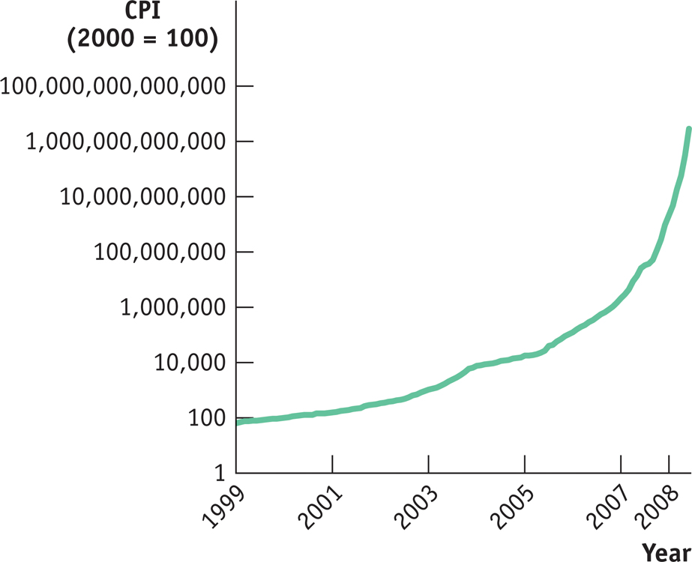
F Y I
Consumer Prices in Zimbabwe, 1999-2008
Section 6 | Module 33

Slide 13
Moderate Inflation and Disinflation
The governments of wealthy, politically stable countries like the United States and Britain don’t find themselves forced to print money to pay their bills.
Yet over the past 40 years both countries, along with a number of other nations, have experienced uncomfortable episodes of inflation.
In the United States, the inflation rate peaked at 13% at the beginning of the 1980s. In Britain, the inflation rate reached 26% in 1975.
Section 6 | Module 33

Slide 14
Moderate Inflation and Disinflation
A decrease in aggregate supply because of an increase in the price of an input is cost-push inflation.
An increase in aggregate demand that increases the price level is demand-pull inflation.
In the short run, policies that produce a booming economy also tend to lead to higher inflation, and policies that reduce inflation tend to depress the economy.
This creates both temptations and dilemmas for governments.
Section 6 | Module 33

Slide 15
The Output Gap and the Unemployment Rate
When actual aggregate output is equal to potential output, the actual unemployment rate is equal to the natural rate of unemployment.
When the output gap is positive (an inflationary gap), the unemployment rate is below the natural rate.
When the output gap is negative (a recessionary gap), the unemployment rate is above the natural rate.
Section 6 | Module 33

Slide 16
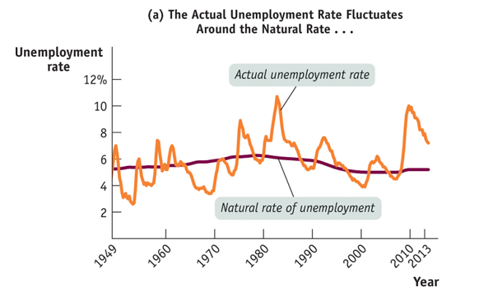
Cyclical Unemployment and the Output Gap
Section 6 | Module 33

Slide 17
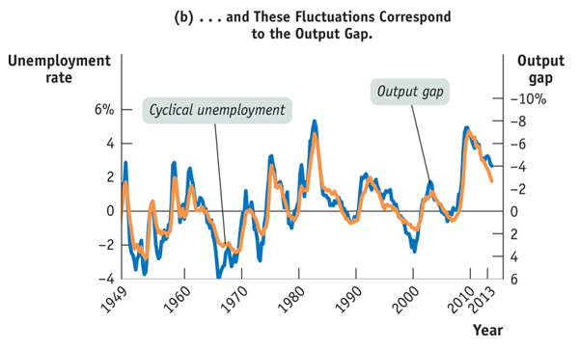
Cyclical Unemployment and the Output Gap
Section 6 | Module 33

Slide 18
Summary
In analyzing high inflation, economists use the classical model of the price level, which says that changes in the money supply lead to proportional changes in the aggregate price level even in the short run.
Governments sometimes print money in order to finance budget deficits. When they do, they impose an inflation tax on those who hold money.
The output gap is the percentage difference between the actual level of real GDP and potential output.
Section 6 | Module 33

