Slide 1
The Law & You
Law & Values

Slide 2
LAW
Is a product of the culture’s historical experience and its collective intelligence rather than simply an arbitrary and random product of individual lawmakers or judges.
--John Walsh

Slide 3
Remember:
1. Law never changes in exact harmony with the social institutions it reflects.
2. “Reality” is not what we see, rather what we interpret through our own cultural perspectives.
3. At any point and time, laws can inform you about a society or culture.
4. However, is the law reflecting a society or culture as it is, as it was, or the society as it is going to be.

Slide 4
Goals of the Legal System
Protect Basic Human Rights
Promote Fairness
Help Resolve Conflicts
Promote Order/Stability
Protect the Environment
Protect the Rights of Minorities

Slide 5
Basis for Law
Moral Values:
Deals with the fundamental questions of right and wrong
Ex: Laws against killing another promote a value “to protect life”
Self-Defense or war deaths are immoral but do not violate the law

Slide 6
Economic Values:
Deals with the accumulation, preservation, use, and distribution of wealth
Laws will encourage or discourage certain economic activities
Ex: homeownership is encouraged
Ex: shoplifting protects property and discourages it with criminal penalties

Slide 7
Social Values:
Circulates around issues important to society
Free public education thru high school
Like all values they change over time
Title 9 (girls vs. boys sports)

Slide 8
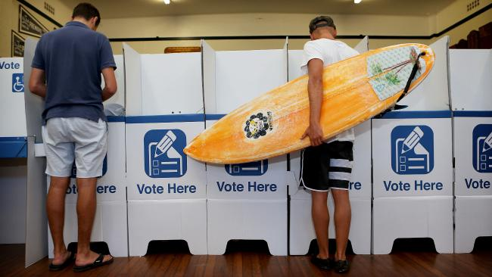
Political Values:
Reflects the relationship between the government and individuals
Voting promotes participation in the political process & the laws that protect that right is a basic American value

Slide 9
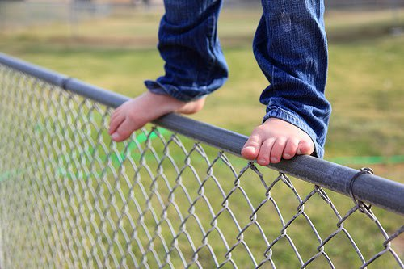
Basic American Political Thinking
Moderates:
Someone whose political opinions fall in between those of a liberal and a conservative depending on the individual and the topic
“Middle of the Roaders”
Sometimes referred as “fence riders” by the other two

Slide 10
Liberal(ism)
Idea that government should take an active role in promoting social and economic progress
Ideology usually associated with the Democratic Party
“Government has the responsibility to try and solve societal problems”
“Our government is not working well. We must change it.”
Political views are referred to being, “on the left.”

Slide 11
Conservative(ism)
Government’s role in society is to be strictly limited.
Ideology usually associated with the Republican Party
Views social programs with suspicion
Pro industry & business
Reduce government regulation of business
Political views are referred to being, “to the right.”

Slide 12
Wrap up
Our laws reflect society’s standards, values, and expectations.
They establish “the rules of the game” in our personal interactions.
It helps to ensure fairness.
Establishes our rights and our responsibilities
Assists in avoiding and resolving problems.

Slide 13
You Be the Judge
In groups of 3 – your own choosing: For each of the following situations determine whether they are moral, economic, political, or social values are involved. Explain the reasons for your answers.
Have 1 person be the “scribe” to write down your responses. We will share out a few

Slide 14
Laws and Values
All drivers must stop at stop signs.
Government officials may not accept gifts from people who want them to pass certain laws
Neil cheats on his tax returns.
All citizens may vote at age eighteen.
When driving you must wear a seatbelt.
The legal drinking age in Michigan is 21.
Special government programs lend money to minority owned businesses at low interest rates.

Slide 15
Laws and Values
Mike is married but has been seen with other women.
You explain to a little old lady that you found $2000 and are willing to share it with her if she gives you $200 to secure your silence about it. She agrees and gives you the $200 and you tell her you have to go get the money.
Alex is shopping at Best Buy and slips the new Apple headphones in his pocket.

Slide 16
Today’s Agenda
American legal system activity:
In your groups, you will create a small document illustrating the structure of the American legal system OR the “Bill of Rights”
First, you will brainstorm everything you know (without outside resources).
Then, you will create a small poster of this knowledge.
The group with the MOST complete, informational product will receive 3 pts EC on test.

Slide 17
The American System of Law
In your groups, brainstorm your knowledge of the American legal system. Categories are:
3 Branches of Government
Checks and Balances for each branch
Federalism
US Constitution
Types of Laws (federal, state…)
Sources of law (where laws can start)
Citizens and Lawmaking (what ordinary people can do)

Slide 18
Work Day for Planning, Global Context part II, ATL part II
TOMORROW: LIBRARY

