Slide 1
Describe how the loanable funds market matches savers and investors
Identify the determinants of supply and demand in the loanable funds market
Explain how the two models of interest rates can be reconciled
What You Will Learn in this Module
Section 5 | Module 29

Slide 2
Today’s agenda
Loanable funds market
Fisher effect
Crowding out

Slide 3
The Market for Loanable Funds
The loanable funds market is a hypothetical market that examines the market outcome of the demand for funds generated by borrowers and the supply of funds provided by lenders.
The interest rate is the price, calculated as a percentage of the amount borrowed, charged by the lender to a borrower for the use of their savings for one year.
Section 5 | Module 29

Slide 4
The Monetary Role of Banks The Market for Loanable Funds
The rate of return on a project is the profit earned on the project expressed as a percentage of its cost.
Section 5 | Module 29

Slide 5
The Demand for Loanable Funds
Interest rate
A
12%
B
4
Demand for loanable funds, D
0
$150
450
Quantity of loanable funds
(billions of dollars)
Section 5 | Module 29

Slide 6
The Supply for Loanable Funds
Interest rate
Supply of loanable funds, S
12%
Y
4
X
0
$150
450
Quantity of loanable funds
(billions of dollars)
Section 5 | Module 29

Slide 7
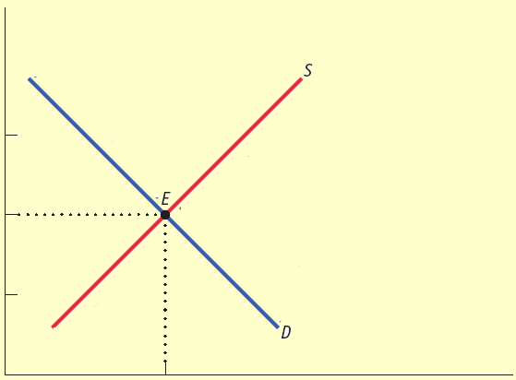
Equilibrium in the Loanable Funds Market
Interest rate
Projects with rate of return
8% or greater are funded.
12%
Offers not accepted from
lenders who demand interest
rate of more than 8%.
r*
8
Projects with rate of return
less than 8% are not funded.
4
Offers accepted from lenders willing to lend at interest rate of 8% or less.
0
$300
Quantity of loanable funds
(billions of dollars)
Q*
Section 5 | Module 29

Slide 8
Shifts of the Demand for Loanable Funds
Factors that can cause the demand curve for loanable funds to shift include:
Changes in perceived business opportunities
Changes in the government’s borrowing
Crowding out occurs when a government deficit drives up the interest rate and leads to reduced investment spending and consumption.
Section 5 | Module 29

Slide 9
An Increase in the Demand for Loanable Funds
Interest rate
S
An increase in the demand for loanable funds . . .
r
2
. . . leads to a rise in the equilibrium interest rate.
r
1
D
2
D
1
Quantity of loanable funds
Section 5 | Module 29

Slide 10
Shifts of the Supply of Loanable Funds
Factors that can cause the supply of loanable funds to shift include:
Changes in private savings behavior: Between 2000 and 2006 rising home prices in the United States made many homeowners feel richer, making them willing to spend more and save less. This shifted the supply of loanable funds to the left.
Changes in capital inflows: The U.S. has received large capital inflows in recent years, with much of the money coming from China and the Middle East. Those inflows helped fuel a big increase in residential investment spending from 2003 to 2006. As a result of the worldwide slump, those inflows began to trail off in 2008.
Section 5 | Module 29

Slide 11
An Increase in the Supply of Loanable Funds
Interest rate
S
1
S
2
… leads to a fall in equilibrium interest rate.
r
1
An increase in the supply for loanable funds . . .
r
2
D
Section 5 | Module 29

Slide 12
Inflation and Interest Rates
Anything that shifts either the supply of loanable funds curve or the demand for loanable funds curve changes the interest rate.
Historically, major changes in interest rates have been driven by many factors, including:
changes in government policy
technological innovations that created new investment opportunities
Section 5 | Module 29

Slide 13
Inflation and Interest Rates
However, arguably the most important factor affecting interest rates over time is changing expectations about future inflation.
This shifts both the supply and the demand for loanable funds.
This is the reason, for example, that interest rates today are much lower than they were in the late 1970s and early 1980s.
Section 5 | Module 29

Slide 14
Inflation and Interest Rates
Real interest rate = nominal interest rate - inflation rate
In the real world neither borrowers nor lenders know what the future inflation rate will be when they make a deal. Actual loan contracts, therefore, specify a nominal interest rate rather than a real interest rate.
Section 5 | Module 29

Slide 15
The Fisher Effect
According to the Fisher effect, an increase in expected future inflation drives up the nominal interest rate, leaving the expected real interest rate unchanged.
Section 5 | Module 29

Slide 16
The Fisher Effect
Nominal
Interest rate
Demand for loanable funds
at 10% expected inflation
Supply of loanable funds
at 10% expected inflation
S
10
E
10
14%
Supply of loanable
funds at 0%
expected inflation
D
10
Demand for loanable funds
at 0% expected inflation
S
0
4
E
0
D
0
0
Q*
Quantity of loanable funds
Section 5 | Module 29

Slide 17
Reconciling the Two Interest Rate Models
The Interest Rate in the Short Run
According to the liquidity preference model, a fall in the interest rate leads to a rise in investment spending, I, which leads to a rise in real GDP and consumer spending, C.
Increasing GDP also leads to an increase in Saving because of the savings-investment spending identity.
After a decrease in the interest rate, the quantity of savings supplied rises exactly enough to match the quantity of savings demanded.
Section 5 | Module 29

Slide 18
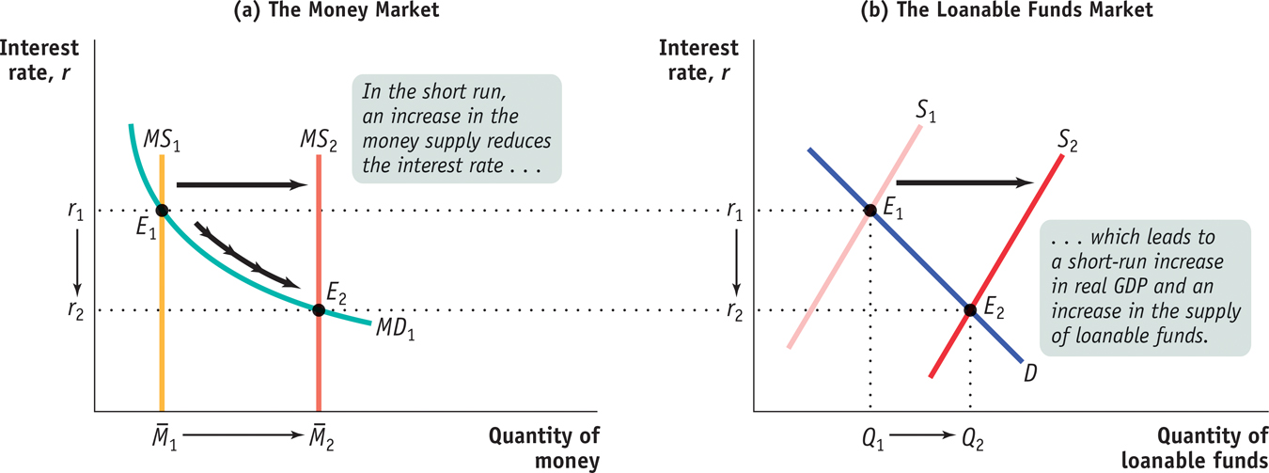
The Short-run Determination of the Interest Rate
Section 5 | Module 29

Slide 19
Reconciling the Two Interest Rate Models
The Interest Rate in the Long Run
In the long run, changes in the money supply don’t affect the interest rate.
Section 5 | Module 29

Slide 20
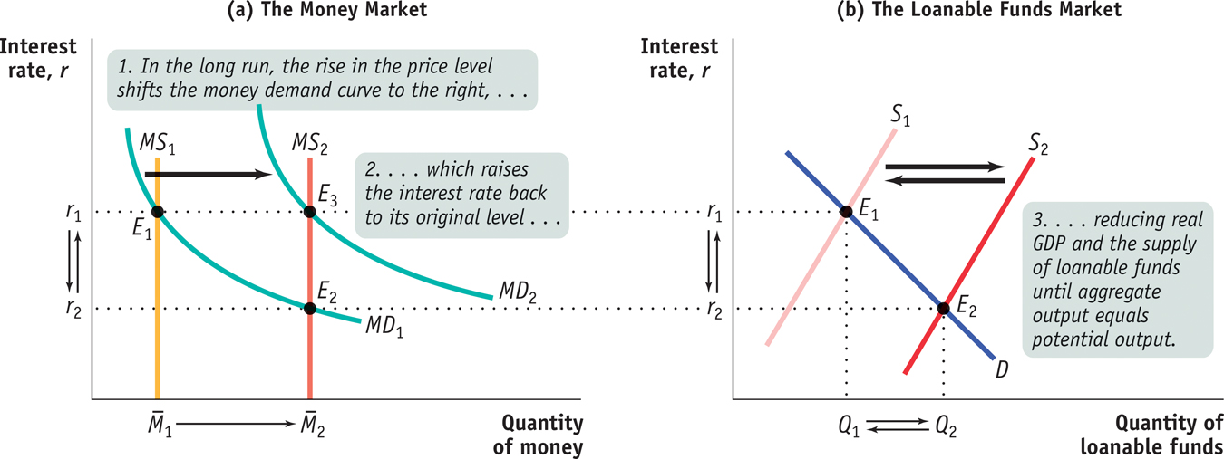
The Long-run Determination of the Interest Rate
Section 5 | Module 29

Slide 21
Graph these…
The Chair of the Federal Reserve testifies before Congress that he/she expects the health of the economy to significantly improve in coming months.
Households fear an imminent recession and begin to cut back on discretionary purchases.

Slide 22
Graph these…
The Federal government announces another annual budget surplus.
The flow of foreign financial capital into American financial markets begins to decrease.
Congress uses expansionary fiscal policy but does not change the tax rates.

Slide 23
Practice
At a rate of 5%, investors want to borrow $100 million from the loanable funds market and savers want to provide $125 million to the loanable funds market. We would expect: A. the interest rate to fall as there is currently a shortage of loanable funds. B. the interest rate to rise as there is currently a surplus of loanable funds.
C. The interest rate to rise as there is currently a shortage of loanable funds. D. the interest rate to fall as there is currently a surplus of loanable funds. E. the interest rate to remain the same as the loanable funds market is in equilibrium.

Slide 24
Practice
Assuming an equilibrium of 6% interest and $100 quantity, which of the following might produce a new equilibrium interest rate of 8% and a new equilibrium quantity of loanable funds of $150? A. Consumers have decreased consumption as a fraction of disposable income.
B. Businesses have become more optimistic about the return on investment spending.
C. The federal government has a budget surplus rather than a budget deficit. D. There has been an increase in capital inflows from other nations. E. Forecasts for future corporate profits are gloomier than expected.

Slide 25
Vocab
Medium of exchange, store of value, measure of value, M1, M2, M3, checkable deposits, demand deposits, time deposits, legal tender, asset demand, transaction demand, balace sheet, T account, fractional reserve banking system, required reserves, excess reserves, actual reserves, federal funds rate, prime interest rate, discount rate, open-market operations, monetary multiplier, nominal interest rate, FDIC, velocity of money

Slide 26
Summary
The hypothetical loanable funds market shows how loans from savers are allocated among borrowers with investment spending projects.
In equilibrium, only those projects with a rate of return greater than or equal to the equilibrium interest rate will be funded.
Government budget deficits can raise the interest rate and can lead to crowding out of investment spending.
Changes in perceived business opportunities and in government borrowing shift the demand curve for loanable funds; changes in private savings and capital inflows shift the supply curve.
Section 5 | Module 29

Slide 27
Summary
Because neither borrowers nor lenders can know the future inflation rate, loans specify a nominal interest rate rather than a real interest rate.
For a given expected future inflation rate, shifts of the demand and supply curves of loanable funds result in changes in the underlying real interest rate, leading to changes in the nominal interest rate.
According to the Fisher effect, an increase in expected future inflation raises the nominal interest rate one-to-one so that the expected real interest rate remains unchanged.
Section 5 | Module 29

