Slide 1
Interpret measures of long-run economic growth
Describe how real GDP has changed over time
Explain how real GDP varies across countries
Identify the sources of long-run economic growth
Explain how productivity is driven by physical capital, human capital, and technological progress
What You Will Learn in this Module
Section 7 | Module 37

Slide 2
Comparing Economies Across Time and Space
The key statistic used to track economic growth is real GDP per capita.
Real GDP per capita is real GDP divided by population size.
Section 7 | Module 37

Slide 3
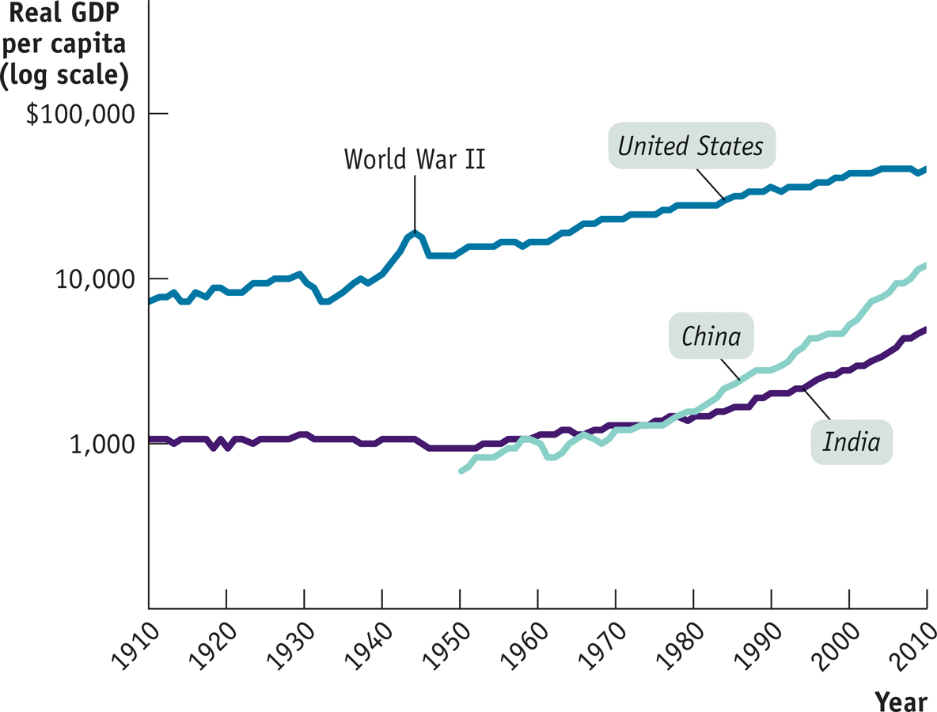
Comparing Economies Across Time and Space
Section 7 | Module 37
Notes:
Figure Caption: Figure 37.1: Economic Growth in the United States, India, and China over the Past Century
Real GDP per capita from 1907 to 2007, measured in 1990 dollars, is shown for the United States, India, and China. Equal percent changes in real GDP per capita are drawn the same size. India and China currently have a much higher growth rate than the United States. However, China has only just attained the standard of living achieved in the United States in 1907, while India is still poorer than the United States was in 1907.
Source: Angus Maddison, Statistics on World Population, GDP, and Per Capita GDP, 1–2006AD, http://www.ggdc.net/maddison; International Monetary Fund

Slide 4
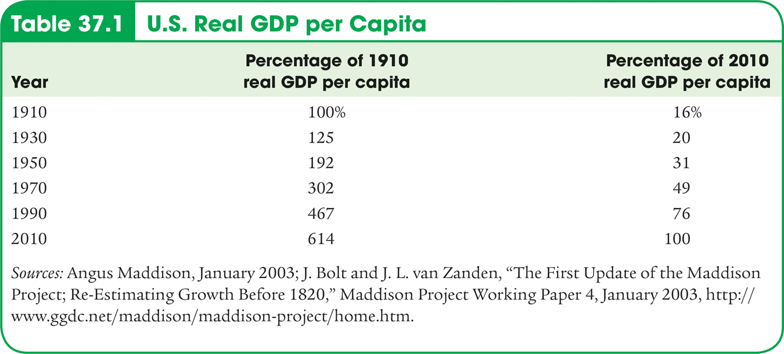
Real GDP per Capita
Section 7 | Module 37
Notes:
Table 37.1: U.S. Real GDP per Capita Percentage
Source: Angus Maddison, Statistics on World Population, GDP, and Per Capita GDP, 1–2006AD, http://www.ggdc.net/maddison; Bureau of Economic Analysis

Slide 5
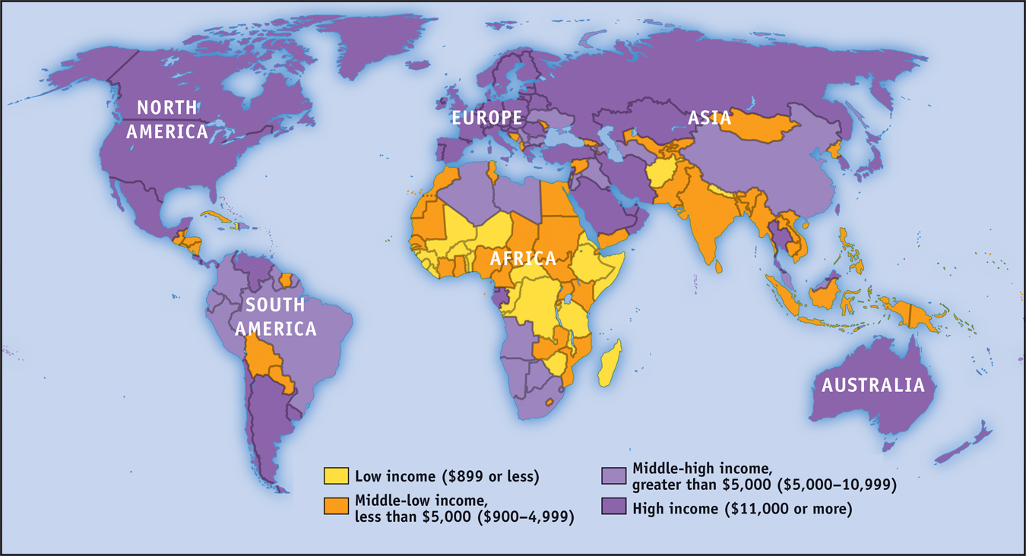
Income Around the World, 2013
Section 7 | Module 37
Notes:
Figure Caption: Figure 37.2: Incomes Around the World, 2008
Although the countries of Europe and North America—along with a few in the Pacific—have high incomes, much of the world is still very poor. Today, more than 50% of the world’s population lives in countries with a lower standard of living than the United States had a century ago.
Source: International Monetary Fund

Slide 6
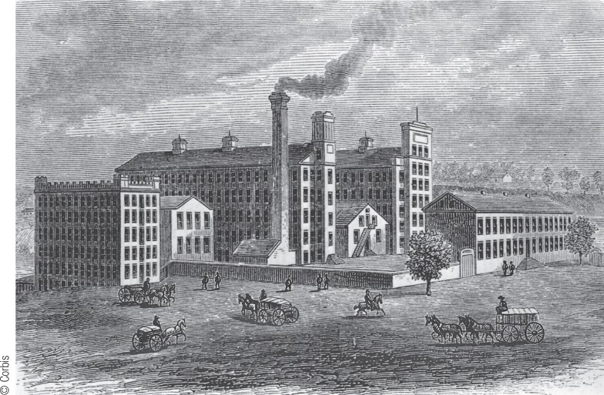
Growth Rates
How did the United States manage to produce more than seven times more per person in 2010 than in 1910?
A little bit at a time.
Long-run economic growth is normally a gradual process, in which real GDP per capita grows at most a few percent per year.
From 1910 to 2010, real GDP per capita in the United States increased an average of 2.1% each year.
Section 7 | Module 37

Slide 7
Growth Rates
The Rule of 70 tells us that the time it takes a variable that grows gradually over time to double is approximately 70 divided by that variable’s annual growth rate.
Number of years for variable to double =
70
Annual growth rate of variable
Section 7 | Module 37

Slide 8
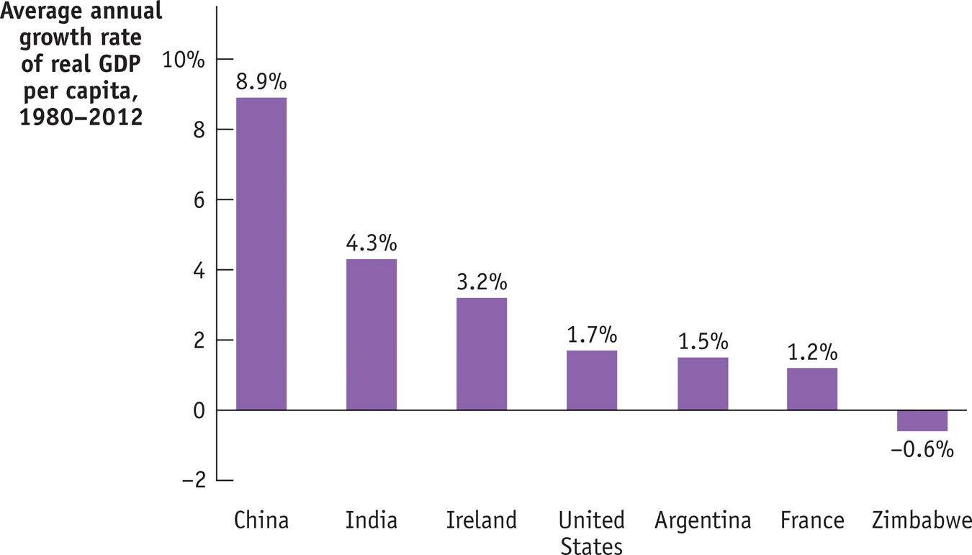
Growth Rates
70
Annual growth rate of variable
Section 7 | Module 37
Notes:
Figure Caption: Figure 37.3: Comparing Recent Growth Rates
Here the average annual rate of growth of real GDP per capita from 1980 to 2008 is shown for selected countries. China and, to a lesser extent, India and Ireland have achieved impressive growth. The United States and France have had moderate growth. Despite having once been considered an economically advanced country, Argentina has had sluggish growth. Still others, such as Zimbabwe, have slid backward.
Source: International Monetary Fund

Slide 9
F Y I
India Takes Off
India achieved independence from Great Britain in 1947, becoming the world’s most populous democracy—a status it has maintained to this day.
In India, real GDP per capita has grown at an average rate of 3% a year, tripling between 1980 and 2013.
What went right in India after 1980? Many economists point to policy reforms. A series of reforms opened the economy to international trade and freed up domestic competition.
Section 7 | Module 37

Slide 10
The Sources of Long-Run Growth
Labor productivity, often referred to simply as productivity, is output per worker.
Physical capital consists of human-made resources such as buildings and machines.
Human capital is the improvement in labor created by the education and knowledge embodied in the workforce.
Technology is the technical means for the production of goods and services.
Section 7 | Module 37

Slide 11
F Y I
The Wal-Mart Effect
After 20 years of being sluggish, U.S. productivity growth accelerated sharply (grew at a much faster rate) in the late 1990s.
What caused that acceleration?
According to McKinsey, the major source of productivity improvement after 1995 was a surge in output per worker in retailing.
Stores were selling much more merchandise per worker.
Wal-Mart has been a pioneer in using modern technology (for example, computers) to improve productivity.
Everyday improvements.
Section 7 | Module 37

Slide 12
Summary
Growth is measured as changes in real GDP per capita in order to eliminate the effects of changes in the price level and changes in population size.
According to the Rule of 70, the number of years it takes for real GDP per capita to double is equal to 70 divided by the annual growth rate of real GDP per capita.
The key to long-run economic growth is rising labor productivity, or just productivity, which is output per worker.
Increases in productivity arise from increases in physical capital per worker and human capital per worker as well as advances in technology.
Section 7 | Module 37

