Slide 1
Describe how the Federal Reserve implements monetary policy moving the interest rate to affect aggregate output
Explain why monetary policy is the main tool for stabilizing the economy
What You Will Learn in this Module
Section 6 | Module 31

Slide 2
Monetary Policy and the Interest Rate
An increase or decreasing the money supply, the Federal Reserve can set the interest rate.
In practice, the Federal Open Market Committee sets a target federal funds rate.
The Open Market Desk then adjusts the money supply through open-market operations.
The Open Market Desk is facilitated at the New York Fed
Section 6 | Module 31

Slide 3
The Effect of an Increase in the Money Supply
on the Interest Rate
Interest
rate, r
An increase
in the money
supply . . .
MS
1
MS
2
. . . leads to
a fall in the
interest rate.
r
E
1
1
E
2
r
2
MD
M
M
Quantity of money
1
2
Section 6 | Module 31

Slide 4
Setting the Federal Funds Rate
Pushing the Interest Rate Down to the Target Rate
Interest
rate, r
The target federal funds rate is the Federal Reserve’s desired federal funds rate.
An open-market
purchase . . .
MS
1
MS
2
. . . drives the interest rate down.
r
E
1
1
r
E
2
T
MD
M
1
M
2
Quantity of money
Section 6 | Module 31

Slide 5
Setting the Federal Funds Rate
Pushing the Interest Rate Up to the Target Rate
Interest
rate, r
An open-market
sale . . .
MS
2
MS
1
. . . drives the interest rate up.
r
E
T
2
r
E
1
1
MD
M
2
M
1
Quantity of money
Section 6 | Module 31

Slide 6
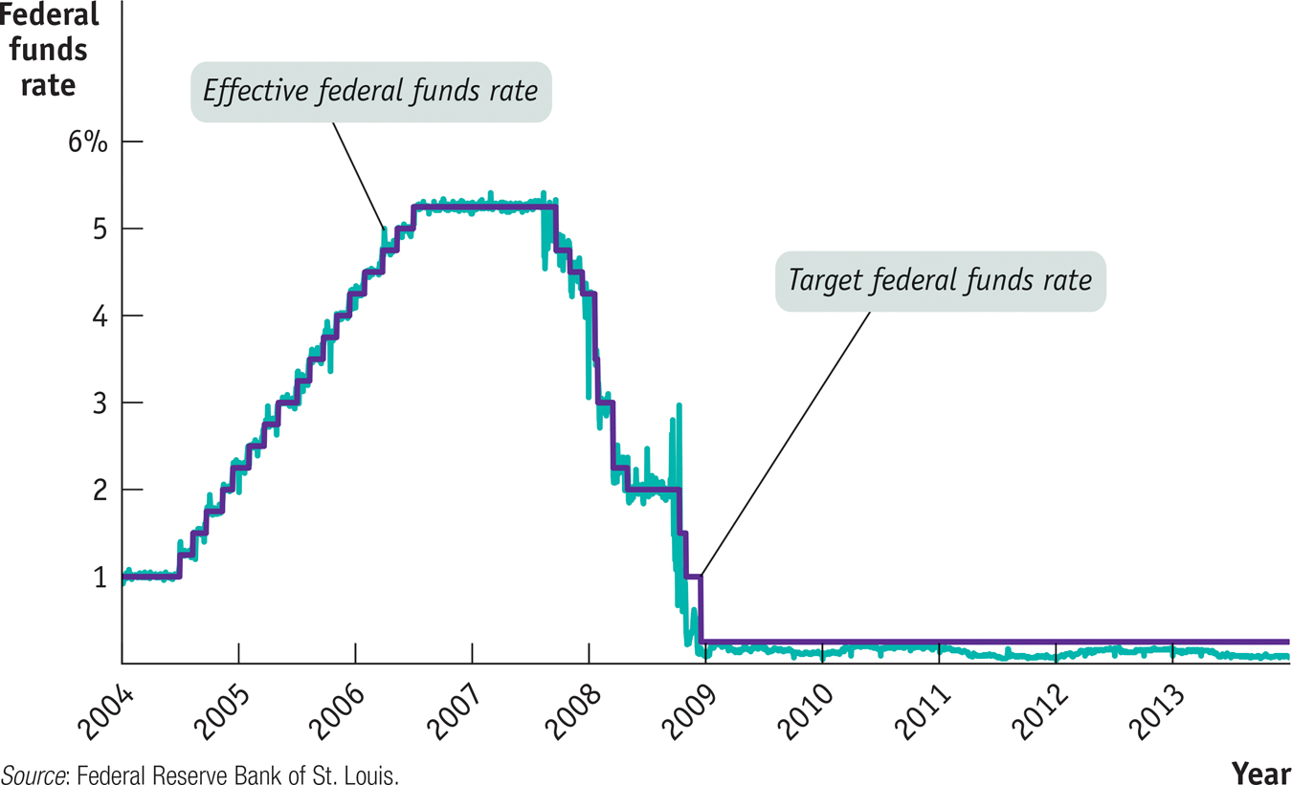
F Y I
The Fed Reverses Course
On August 7, 2007, the Federal Open Market Committee decided to make no change in its interest rate policy.
On September 18, the Fed cut the target federal funds rate “to help forestall some of the adverse effects on the broader economy that might otherwise arise from the disruptions in financial markets.”
This was a reversal of previous policy. Previously the Fed had generally been raising rates, not reducing them, out of concern that inflation might become a problem.
Starting in September 2007, fighting the financial crisis took priority.
Section 6 | Module 31

Slide 7
Monetary Policy and Aggregate Demand
Expansionary monetary policy is monetary policy that increases aggregate demand.
Contractionary monetary policy is monetary policy that reduces aggregate demand.
Section 6 | Module 31

Slide 8
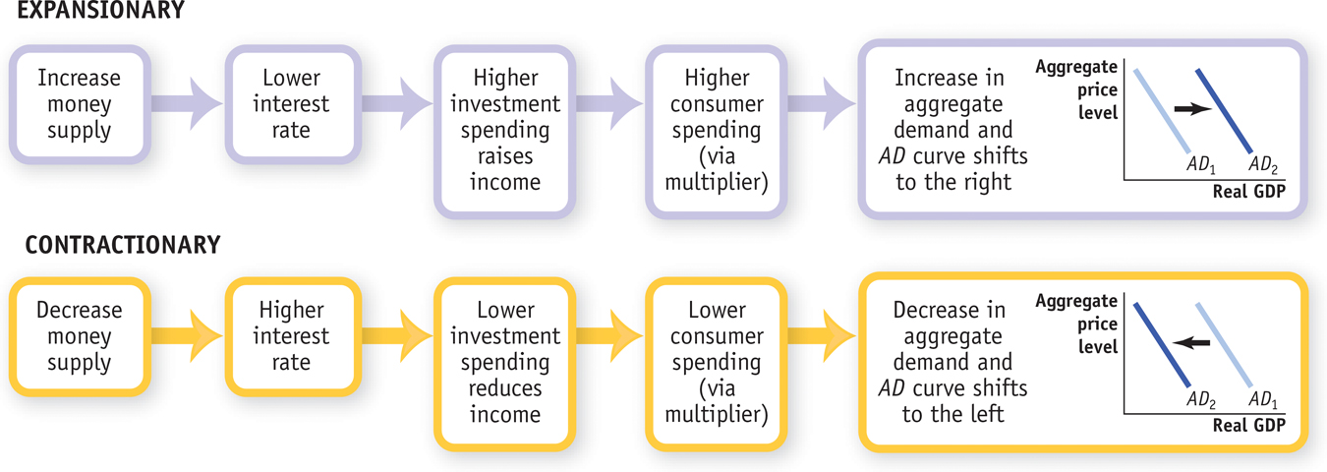
Expansionary and Contractionary Monetary Policy
Section 6 | Module 31

Slide 9
Monetary Policy and Aggregate Demand
(a) Expansionary Monetary Policy
(b) Contractionary Monetary Policy
Aggregate price level
Aggregate price level
AD
1
AD
2
AD
3
AD
1
Real GDP
Real GDP
Section 6 | Module 31

Slide 10
Monetary Policy in Practice
Policy makers try to fight recessions, but they also try to ensure price stability.
The Taylor rule for monetary policy is a rule for setting the federal funds rate that takes into account both the inflation rate and the output gap.
Monetary policy is the main tool of stabilization policy.
Federal funds rate = 1+(1.5 x inflation rate) + (0.5 x output gap)
Section 6 | Module 31

Slide 11
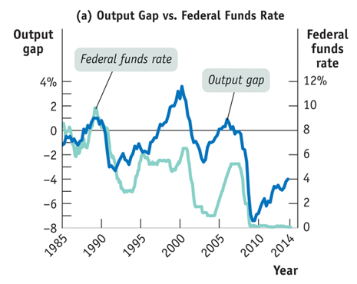
Tracking Monetary Policy
Section 6 | Module 31

Slide 12
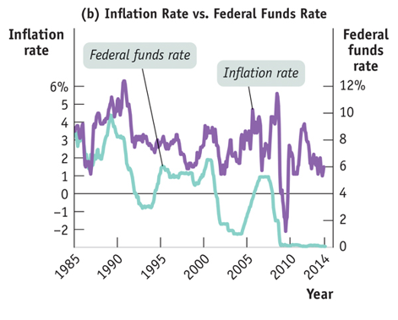
Tracking Monetary Policy
Section 6 | Module 31

Slide 13
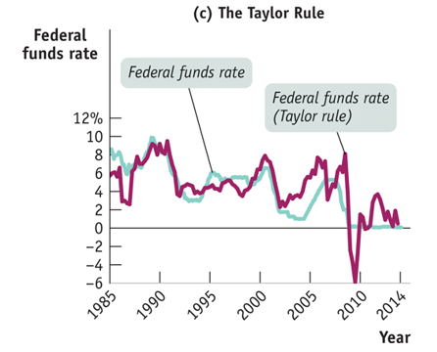
Tracking Monetary Policy
Section 6 | Module 31

Slide 14
Inflation Targeting
Inflation targeting occurs when the central bank sets an explicit target for the inflation rate and sets monetary policy in order to hit that target.
Section 6 | Module 31

Slide 15
F Y I
What the Fed Wants, the Fed Gets
Contractionary monetary policy is sometimes used to eliminate inflation that has become embedded in the economy.
In this case, the Fed needs to create a recessionary gap.
In four out of the five cases that Christina Romer and David Romer examined, the decision to contract the economy was followed, after a modest lag, by a rise in the unemployment rate.
On average, they found that the unemployment rate rises by 2 percentage points after the Fed decides that unemployment needs to go up.
Section 6 | Module 31

Slide 16
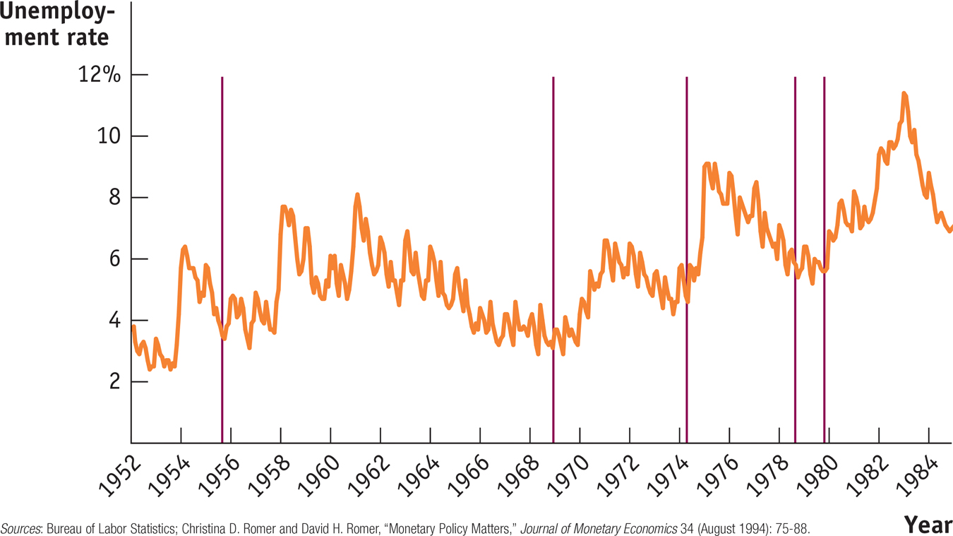
F Y I
What the Fed Wants, the Fed Gets
Section 6 | Module 31

Slide 17
Summary
Expansionary monetary policy reduces the interest rate by increasing the money supply. This increases investment spending and consumer spending, which in turn increases aggregate demand and real GDP in the short run.
Contractionary monetary policy raises the interest rate by reducing the money supply. This reduces investment spending and consumer spending, which in turn reduces aggregate demand and real GDP in the short run.
The Federal Reserve and other central banks try to stabilize the economy, limiting fluctuations of actual output around potential output, while also keeping inflation low but positive.
Section 6 | Module 31

Slide 18
Summary
Under the Taylor rule for monetary policy, the target interest rate rises when there is inflation, or a positive output gap, or both; the target interest rate falls when inflation is low or negative, or when the output gap is negative, or both.
Some central banks engage in inflation targeting, which is a forward-looking policy rule.
Because monetary policy is subject to fewer implementation lags than fiscal policy, it is the preferred policy tool for stabilizing the economy.
Section 6 | Module 31

