Slide 1
Identify the effects of an inappropriate monetary policy
Explain the concept of monetary neutrality and its relationship to the long-term economic effects of monetary policy
What You Will Learn in this Module
Section 6 | Module 32

Slide 2
Money, Output, and Prices
Because of its expansionary and contractionary effects, monetary policy is generally the policy tool of choice to help stabilize the economy.
The economy is self-correcting in the long run: a demand shock has only a temporary effect on aggregate output.
Section 6 | Module 32

Slide 3
The Short-Run and Long-Run Effects of an Increase in the Money Supply
Aggregate
price level
An increase in the
money supply reduces
the interest rate and
increases aggregate
demand . . .
L
R
AS
S
R
AS
2
S
R
AS
1
E
3
P
3
. . . but the eventual
rise in nominal wages
leads to a fall in
short-run aggregate
supply and aggregate
output falls back to
potential output.
P
2
E
2
P
1
AD
E
1
2
AD
1
Y
1
Y
2
Real GDP
Potential output
Section 6 | Module 32

Slide 4
Monetary Neutrality
In the long run, changes in the money supply affect the aggregate price level but not real GDP or the interest rate.
In fact, there is monetary neutrality: changes in the money supply have no real effect on the economy. So monetary policy is ineffectual in the long run.
Section 6 | Module 32

Slide 5
The Long-Run Determination of the Interest Rate
Interest
rate, r
An increase in the money
supply lowers the interest
rate in the short run . . .
MS
1
MS
2
. . . but in the long run higher
prices lead to greater money
demand, raising the interest
rate to its original level.
E
1
E
r
1
3
E
2
r
2
MD
MD
2
1
M
1
M
2
Quantity of money
Section 6 | Module 32

Slide 6
F Y I
International Evidence of Monetary Neutrality
All of the major central banks try to keep the aggregate price level roughly stable.
However, if we look at a longer period and a wider group of countries, we see large differences in the growth of the money supply. Between 1970 and the present, the money supply rose only a few percent per year in some countries.
The figure on the next slide shows the annual percentage increases in the money supply and average annual increases in the aggregate price.
The scatter of points clearly lies close to a 45-degree line, showing a more or less proportional relationship between money and the aggregate price level.
The data support the concept of monetary neutrality in the long run.
Section 6 | Module 32

Slide 7
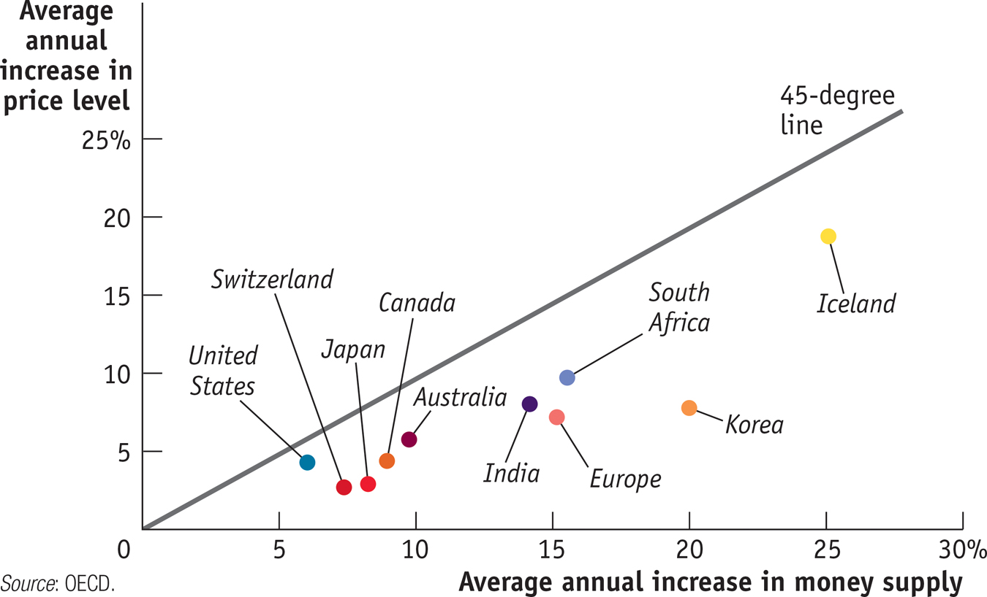
F Y I
International Evidence of Monetary Neutrality
Section 6 | Module 32

Slide 8
Summary
In the long run, changes in the money supply affect the aggregate price level but not real GDP or the interest rate.
Data show that the concept of monetary neutrality holds: changes in the money supply have no real effect on the economy in the long run.
Section 6 | Module 32

