Slide 1



Describe the multiplier process by which initial changes in spending lead to further changes in spending
Use the consumption function to show how current disposable income affects consumer spending
Explain how expected future income and aggregate wealth affect consumer spending
Identify the determinants of investment spending
Explain why investment spending is considered a leading indicator of the future state of the economy
What You Will Learn in this Module
Section 4 | Module 16

Slide 2

The Multiplier: An Informal Introduction
The marginal propensity to consume, or MPC, is the increase in consumer spending when disposable income rises by $1.
The marginal propensity to save, or MPS, is the increase in household savings when disposable income rises by $1.
Section 4 | Module 16

Slide 3

The Multiplier: An Informal Introduction
Increase in investment spending = $100 billion
  + Second-round increase in consumer spending
  = MPC × $100 billion
  + Third-round increase in consumer spending
  = MPC² × $100 billion
  + Fourth-round increase in consumer spending
  = MPC³ × $100 billion
• • • • • • • • • • • •
Total increase in real GDP
= (1 + MPC + MPC2 + MPC3 + . . .) × $100 billion
Section 4 | Module 16

Slide 4
The Multiplier: An Informal Introduction
The $100 billion increase in investment spending sets off a chain reaction in the economy.
The net result of this chain reaction is that a $100 billion increase in investment spending leads to a change in real GDP that is a multiple of the size of that initial change in spending.
How large is this multiple?
Section 4 | Module 16

Slide 5
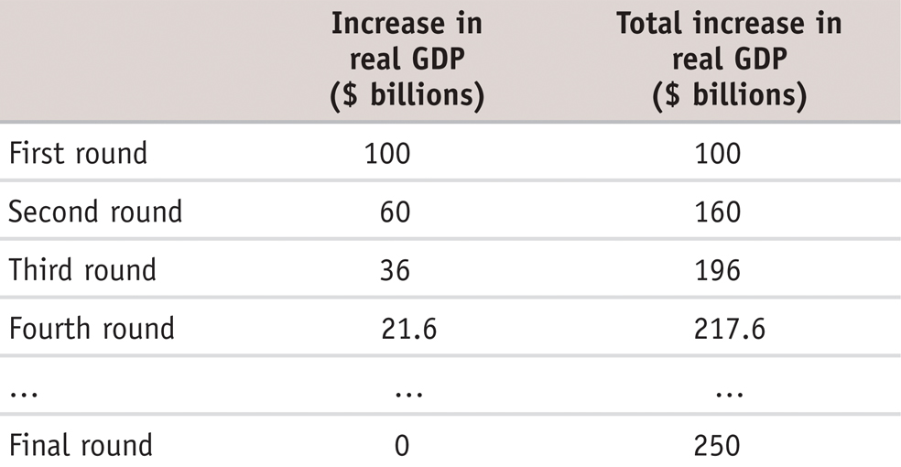
The Multiplier: Numerical Example
Rounds of Increases of Real GDP When MPC = 0.6
Section 4 | Module 16

Slide 6
The Multiplier: Numerical Example
In the end, real GDP rises by $250 billion as a consequence of the initial $100 billion rise in investment spending:
1/(1 − 0.6) × $100 billion
= 2.5 × $100 billion
= $250 billion
Section 4 | Module 16

Slide 7
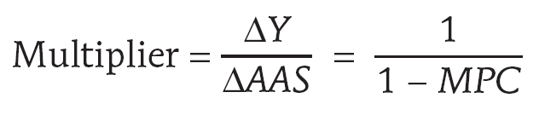
The Multiplier: An Informal Introduction
An autonomous change in aggregate spending is an initial change in the desired level of spending by firms, households, or government at a given level of real GDP.
The multiplier is the ratio of the total change in real GDP caused by an autonomous change in aggregate spending to the size of that autonomous change.
Section 4 | Module 16

Slide 8
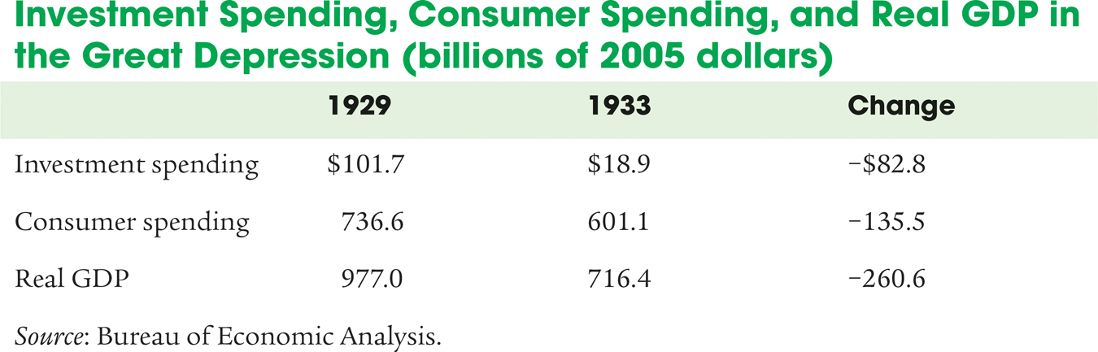
F Y I
The Multiplier and the Great Depression
The concept of the multiplier was originally devised by economists trying to understand the Great Depression. Most economists believe that the slump from 1929 to 1933 was driven by a collapse in investment spending.
But as the economy shrank, consumer spending also fell sharply, multiplying the effect on real GDP.
In the modern U.S. economy,
taxes are much higher than in
1929, and so is government
spending.
Why does this matter?
Because taxes and some government programs act as automatic stabilizers, reducing the size of the multiplier.
Section 4 | Module 16

Slide 9

Consumer Spending
The consumption function is an equation showing how an individual household’s consumer spending varies with the household’s current disposable income.
Autonomous Consumer Spending is the amount of money a household would spend if it had no disposable income
Section 4 | Module 16

Slide 10
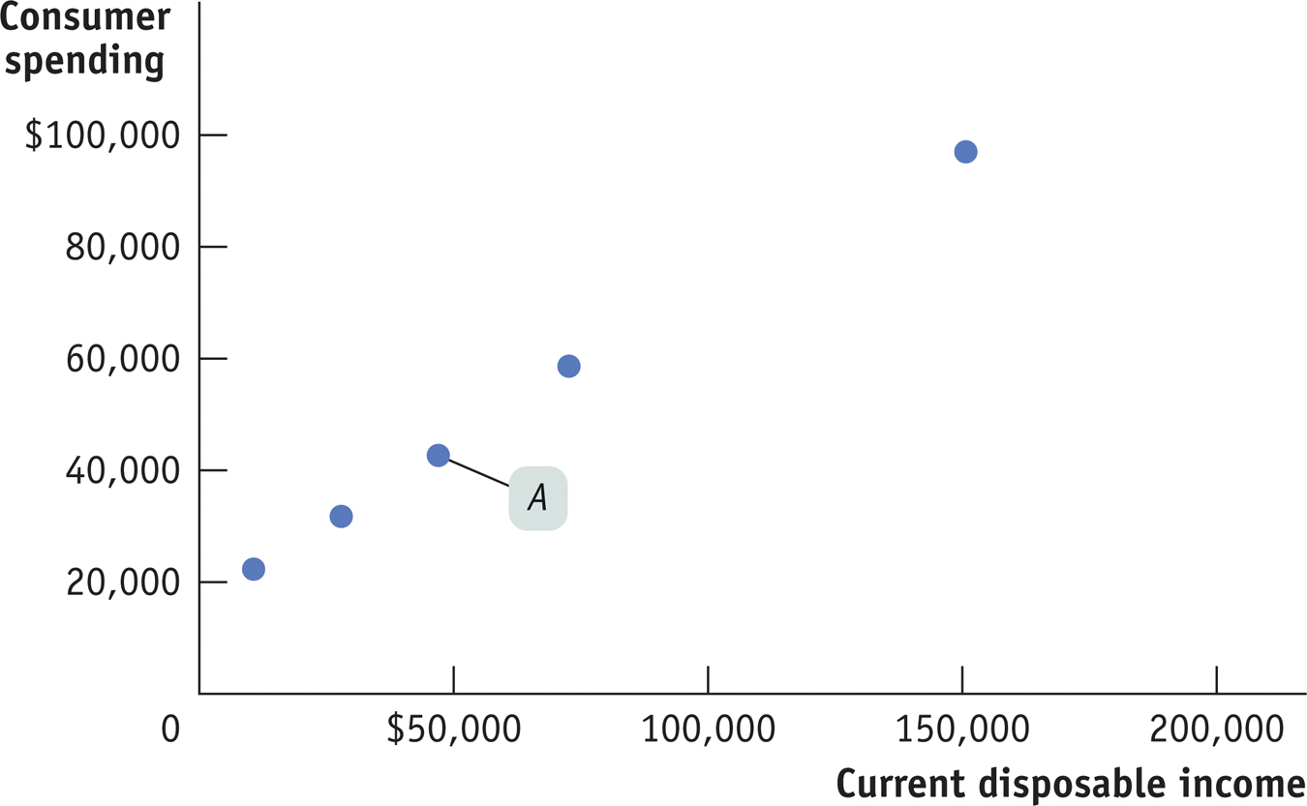
Disposable Income and Consumer Spending
Current Disposable Income and Consumer Spending for U.S. Households in 2012
Section 4 | Module 16

Slide 11
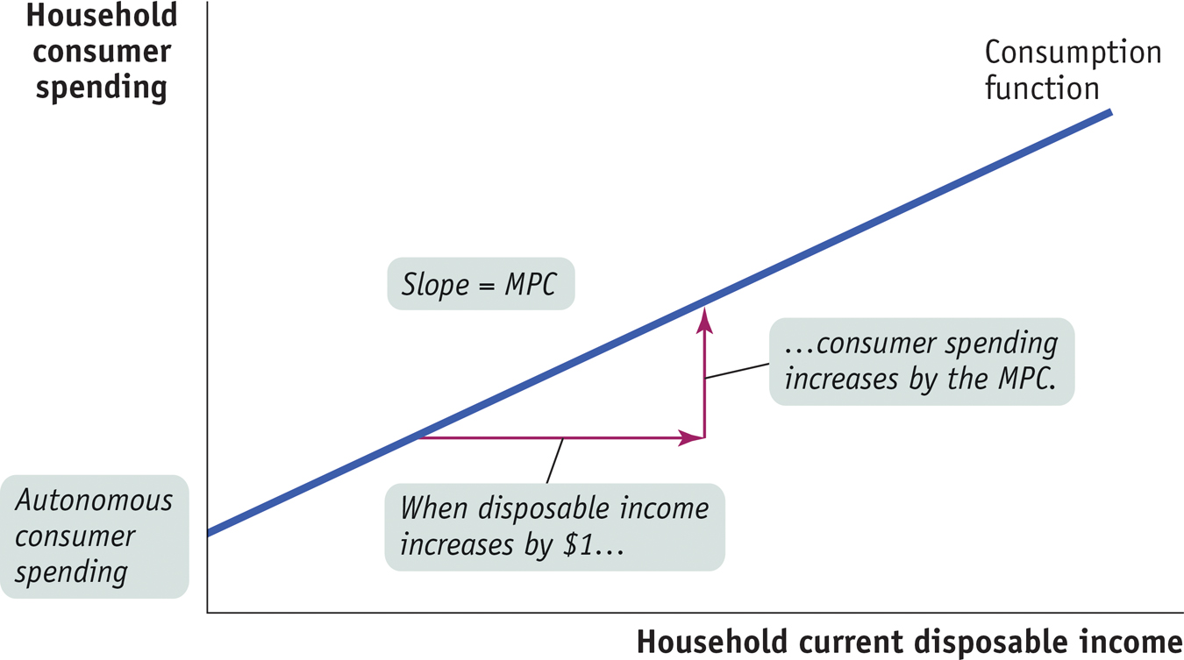
The Consumption Function
Section 4 | Module 16

Slide 12
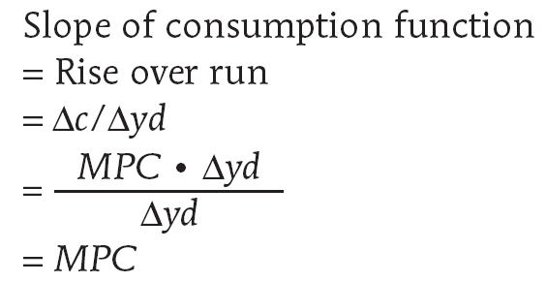
The Consumption Function
Deriving the Slope of the Consumption Function
Section 4 | Module 16

Slide 13
The Consumption Function
For American households, the best estimate of the average household’s autonomous consumer spending is $17,484
Section 4 | Module 16

Slide 14
Shifts of the Aggregate Consumption Function
The aggregate consumption function is the relationship for the economy as a whole between aggregate current disposable income and aggregate consumer spending.
Section 4 | Module 16

Slide 15
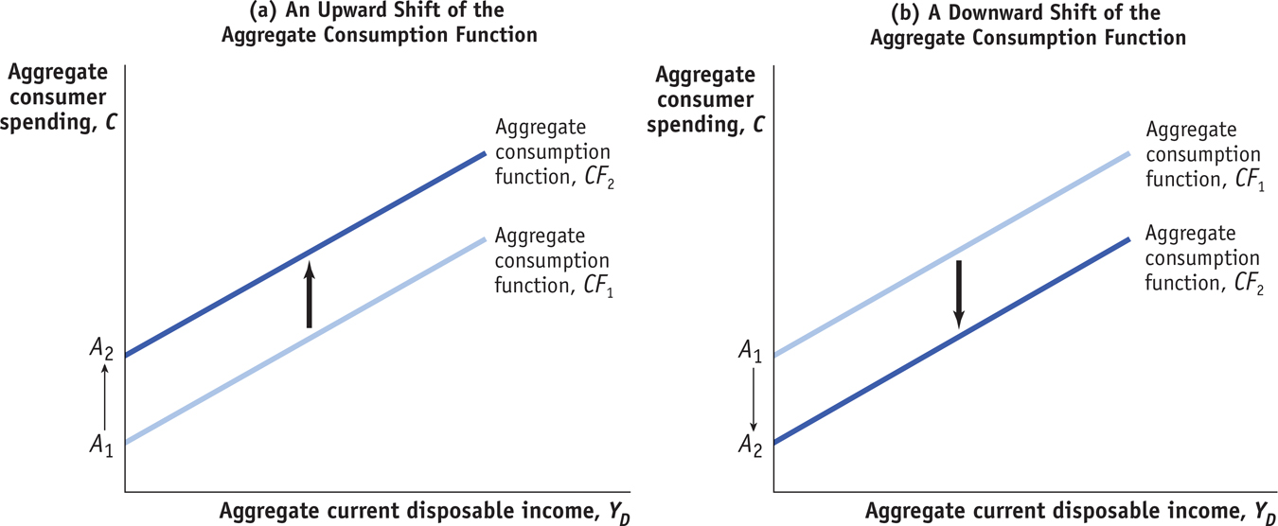
Shifts of the Aggregate Consumption Function
The aggregate consumption function shifts in response to changes in expected future disposable income and changes in aggregate wealth.
Section 4 | Module 16

Slide 16
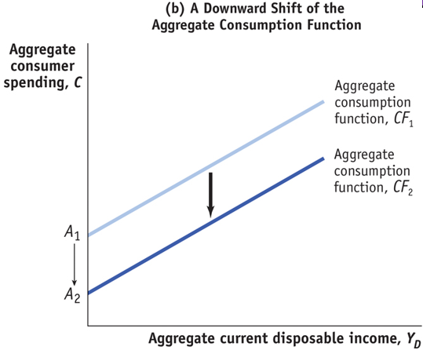
Shifts of the Aggregate Consumption Function
Section 4 | Module 16

Slide 17
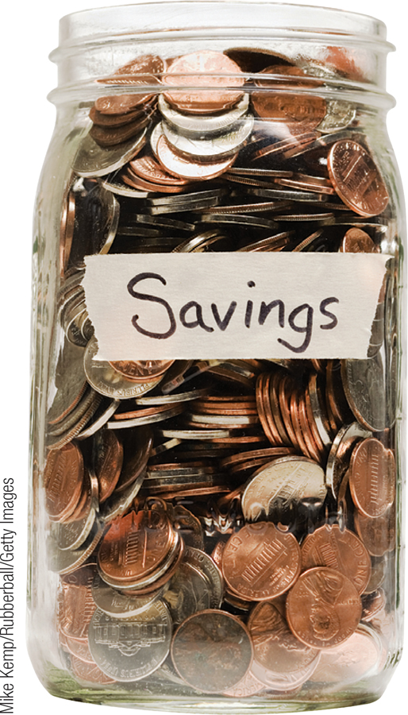
Investment Spending
Plan
Planned investment spending is the investment spending that businesses plan to undertake during a given period.
It depends negatively on:
  interest rate
  existing production capacity
and positively on:
  expected future real GDP
Section 4 | Module 16

Slide 18
Expected Future Real GDP, Production Capacity, and Investment Spending
Expected future sales has a positive effect on investment spending.
The current level of productive capacity has a negative effect on investment spending.
Therefore, firms will be most likely to undertake high levels of investment when they expect sales to grow rapidly.
This growth of sales will take up any excess capacity and encourage investment.
Section 4 | Module 16

Slide 19
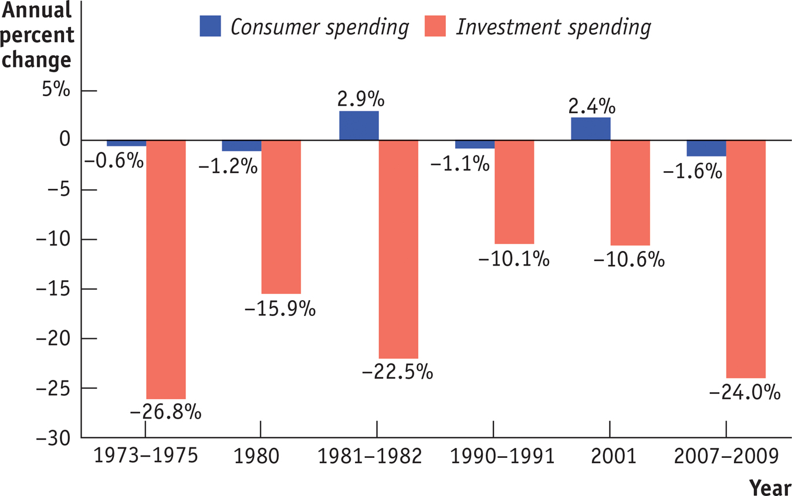
Fluctuations in Investment Spending and Consumer Spending
Section 4 | Module 16

Slide 20

Inventories and Unplanned Investment Spending
Inventories are stocks of goods held to satisfy future sales.
Inventory investment is the value of the change in total inventories held in the economy during a given period.
Unplanned inventory investment occurs when actual sales are more or less than businesses expected, leading to unplanned changes in inventories.
Section 4 | Module 16

Slide 21

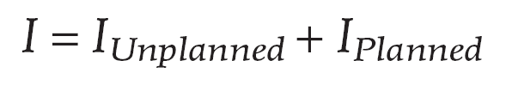
Inventories and Unplanned Investment Spending
Actual investment spending is the sum of planned investment spending and unplanned inventory investment.
Section 4 | Module 16

Slide 22
F Y I
Interest Rates and the U.S. Housing Boom
The Fed cut mortgage rates in response to the 2001 recession and continued cutting them into 2003 out of concern that
the economy’s recovery was too weak to generate sustained job growth.
The low interest rates led to a large increase in residential investment spending, reflected in a surge of housing starts.
By 2006, it was clear that the U.S. housing market was experiencing a bubble: people were buying housing based on unrealistic expectations about future price increases.
When the bubble burst, housing—and the U.S. economy—took a fall.
Section 4 | Module 16

Slide 23
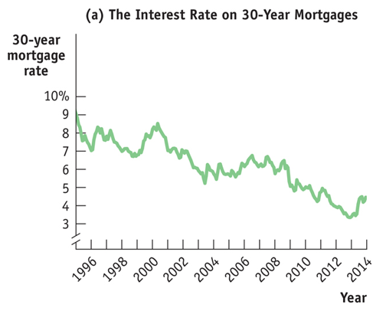
F Y I
Interest Rates and the U.S. Housing Boom
Section 4 | Module 16

Slide 24
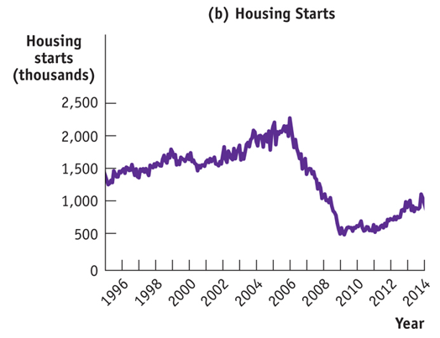
F Y I
Interest Rates and the U.S. Housing Boom
Section 4 | Module 16

Slide 25
Summary
An autonomous change in aggregate spending leads to a chain reaction in which the total change in real GDP is equal to the multiplier times the initial change in aggregate spending.
The size of the multiplier, 1/(1 − MPC), depends on the marginal propensity to consume, MPC, the fraction of an additional dollar of disposable income spent on consumption.
The consumption function shows how an individual household’s consumer spending is determined by its current disposable income.
The aggregate consumption function shows the relationship for the entire economy.
Section 4 | Module 16

Slide 26
Summary
Planned investment spending depends negatively on the interest rate and on existing production capacity;
it depends positively on expected future real GDP.
Firms hold inventories of goods so that they can satisfy consumer demand quickly.
Inventory investment is positive when firms add to their inventories, negative when they reduce them.
Unplanned inventory investment occurs because actual sales are higher or lower than expected.
Actual investment spending is the sum of planned investment spending and unplanned inventory investment.
Section 4 | Module 16

Slide 27
Suppose investment spending increases by $50 billion, and as a result the equilibrium income increases by $200 billion. The value of the MPC is:
0.8.
0.4.
0.75.
4.
E. 0.5.
If the size of MPS is decreasing, it will:
A. make the multiplier smaller.
B. make the multiplier larger.
C. not affect the value of the multiplier.
D. decrease the interest rate.
E. cause the MPC to also decrease.
Which of the following will shift the aggregate consumption function upward?
A. Current disposable income rises.
B. Consumer expectations turn more pessimistic about the future.
C. The stock market is strong and wealth is rising.
D. Current disposable income falls.
E. Interest rates begin to increase.

