Slide 1
The Natural Rate of Unemployment
Workers who spend time looking for employment are engaged in job search.
Frictional unemployment is unemployment due to the time workers spend in job search.
Structural unemployment is unemployment that results when there are more people seeking jobs in a labor market than there are jobs available at the current wage.
Section 3 | Module 13

Slide 2
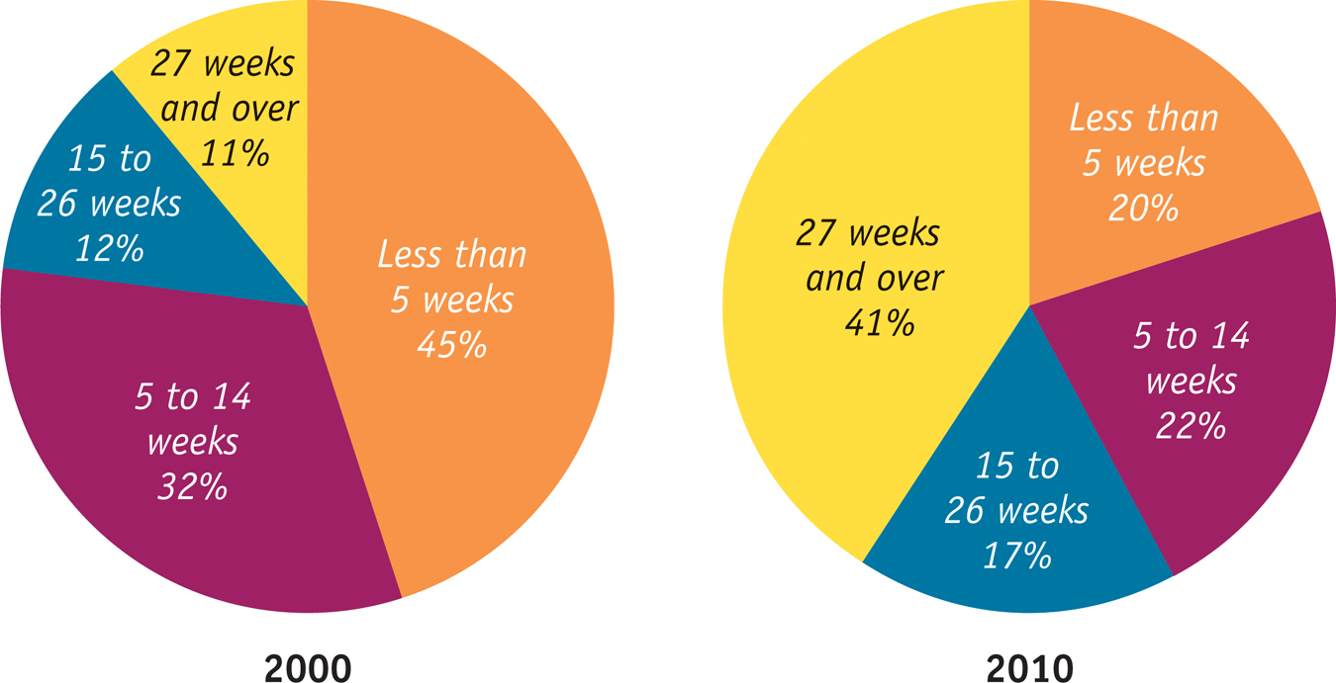
The Nature of Unemployment
Distribution of the Unemployed by Duration of Unemployment 2000 and 2010
Section 3 | Module 13

Slide 3
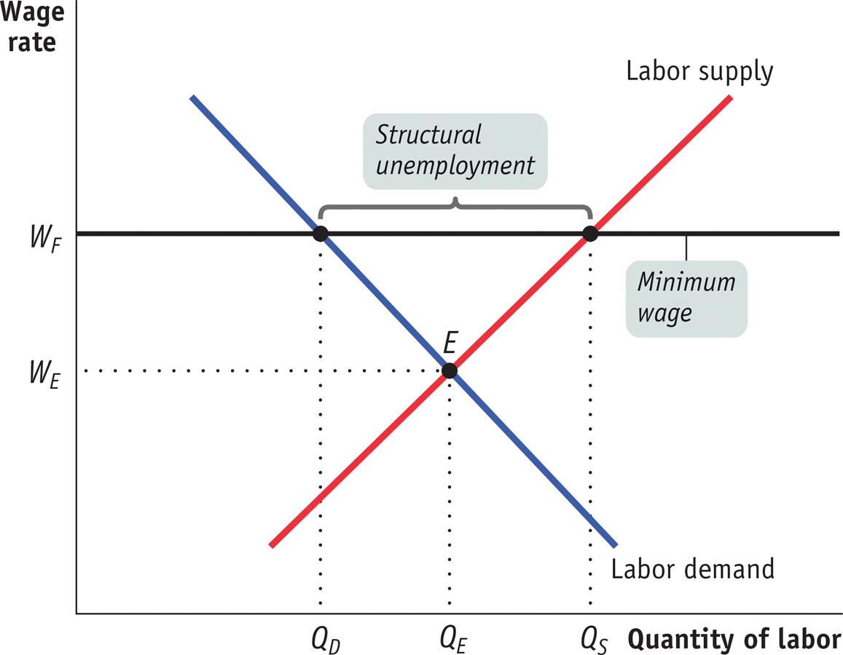
Structural Unemployment
The Effect of a Minimum Wage on the Labor Market
Section 3 | Module 13

Slide 4
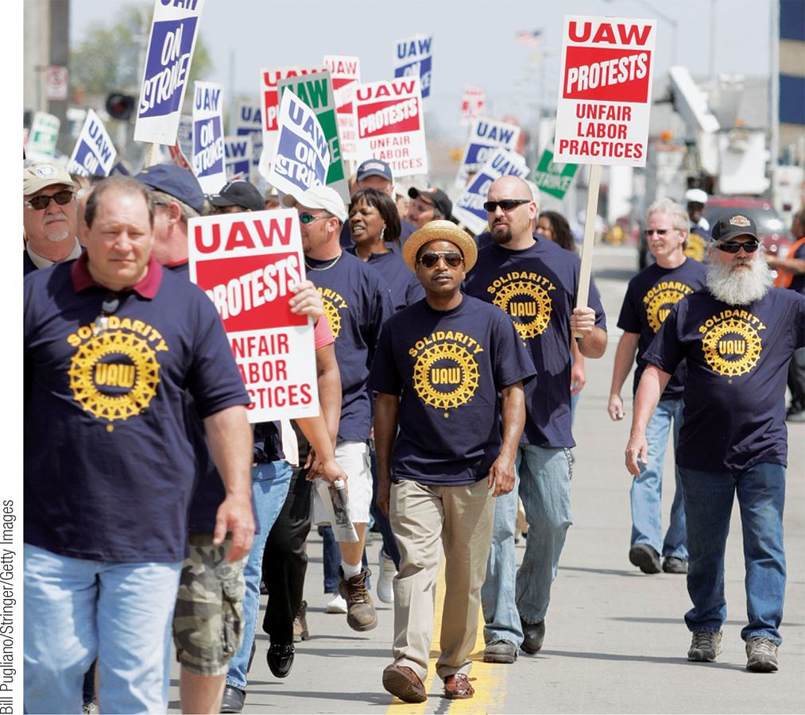
Structural Unemployment
Minimum wages - a government-mandated floor on the price of labor. In the U.S., the national minimum wage in 2009 was $7.25 an hour.
Unions - by bargaining for all a firm’s workers collectively (collective bargaining), unions can often win higher wages from employers than the market would have otherwise provided when workers bargained individually.
Section 3 | Module 13

Slide 5
Structural Unemployment
Efficiency wages - wages that employers set above the equilibrium wage rate as an incentive for better performance.
Side effects of government policies - public policies designed to help workers who lose their jobs; these policies can lead to structural unemployment as an unintended side effect.
Section 3 | Module 13

Slide 6
The Natural Rate of Unemployment
The natural rate of unemployment is the normal unemployment rate around which the actual unemployment rate fluctuates.
The natural rate of unemployment is the unemployment rate that arises from the effects of frictional plus structural unemployment.
Cyclical unemployment is a deviation in the actual rate of unemployment from the natural rate.
Section 3 | Module 13

Slide 7
The Natural Rate of Unemployment
Natural unemployment = Frictional unemployment + Structural unemployment
Actual unemployment = Natural unemployment + Cyclical unemployment
Section 3 | Module 13

Slide 8
Changes in the Natural Rate of Unemployment
Estimates of the natural rate of unemployment show that the U.S. natural rate rises and falls over time.
The factors that affect the natural rate of unemployment include:
Changes in labor force characteristics
Changes in labor market institutions
Changes in government policy
Section 3 | Module 13

Slide 9
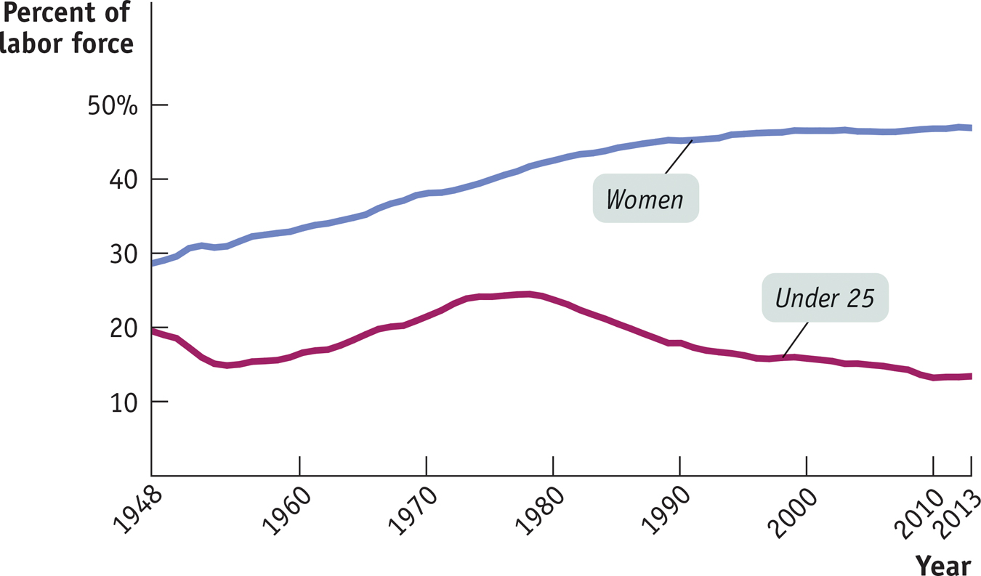
Changes in the Natural Rate of Unemployment
The Changing Makeup of the U.S.
Labor Force, 1948–2013
Section 3 | Module 13

Slide 10
1. Last week Stephanie quit her job as a copywriter at an advertising agency. She has spent the last few days browsing the help-wanted ads, but hasn't found anything that matches her skills. Stephanie is best classified as:
^{A. Structurally unemployed.}
^{B. Frictionally unemployed.}
^{C. a discouraged worker.}
^{D. out of the labor force.}
^{E. Cyclically unemployed.}
2. Which pair of policies is likely to have the effect of reducing the natural rate of unemployment?
A. Job training and employment subsidies.
B. High minimum wages and generous unemployment benefits.
C. Job training and higher minimum wages.
D. Employment subsidies and policies designed to strengthen labor unions.
E. High minimum wages and policies designed to strengthen labor unions.
3. If the actual unemployment rate is 7% and the cyclical unemployment rate is 2%, then the natural rate of unemployment is:
A. 2%. B. 5%. C. 7%. D. 9%. E. 3.5%.

Slide 11
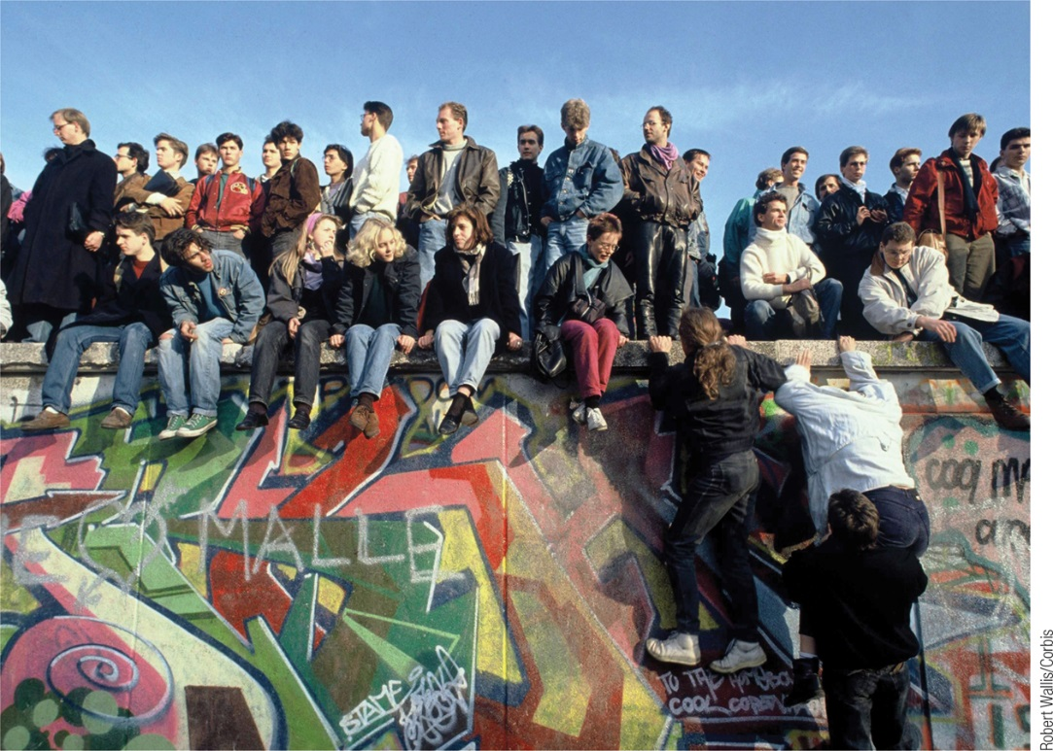
F Y I
Structural Unemployment in Eastern Germany
After reunification, employment in East Germany plunged. The economy of the former East Germany has remained persistently depressed, with an unemployment rate of more than 16% in 2008.
East Germany found itself suffering from severe structural unemployment.
It became clear that workers in East Germany were much less productive than their cousins in the west.
The result has been a persistently large mismatch between the number of workers demanded and the number of those seeking jobs.
Section 3 | Module 13

Slide 12
Summary
Job creation and destruction lead to job search and frictional unemployment.
A variety of factors such as minimum wages, unions, efficiency wages, and government policies designed to help laid-off workers result in a situation in which there is a surplus of labor at the market wage rate, creating structural unemployment.
The natural rate of unemployment, the sum of frictional and structural employment, is well above zero, even when jobs are plentiful.
Cyclical unemployment is the deviation of the actual rate of unemployment from the natural rate.
The natural rate of unemployment changes over time.
Section 3 | Module 13

