Slide 1
Use the Phillips curve to show the nature of the short-run trade-off between inflation and unemployment
Explain why there is no long-run trade-off between inflation and unemployment
Discuss why expansionary policies are limited due to the effects of expected inflation
Explain why even moderate levels of inflation can be hard to end
Identify the problems with deflation that lead policy makers to prefer a low but positive inflation rate
What You Will Learn in this Module
Section 6 | Module 34

Slide 2
Short-run Phillips Curve
The short-run Phillips curve is the negative short-run relationship between the unemployment rate and the inflation rate.
Section 6 | Module 34

Slide 3
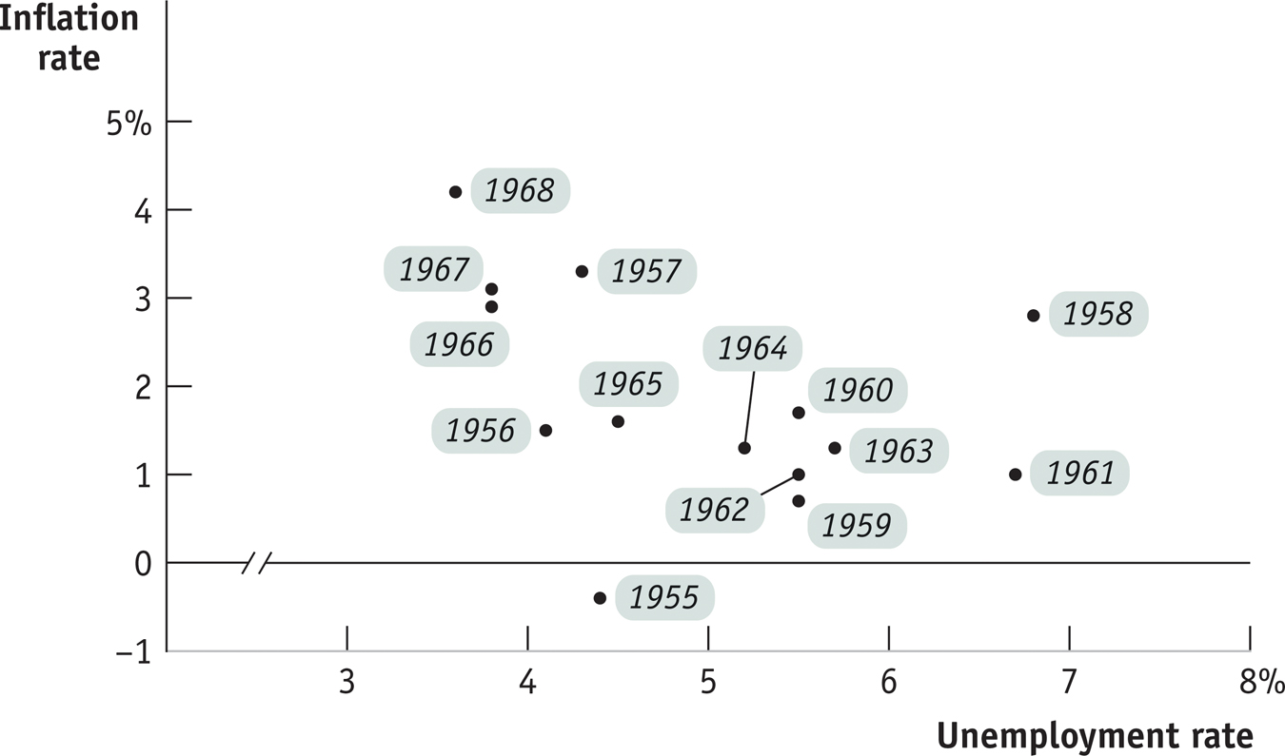
Unemployment and Inflation, 1955-1968
Section 6 | Module 34

Slide 4
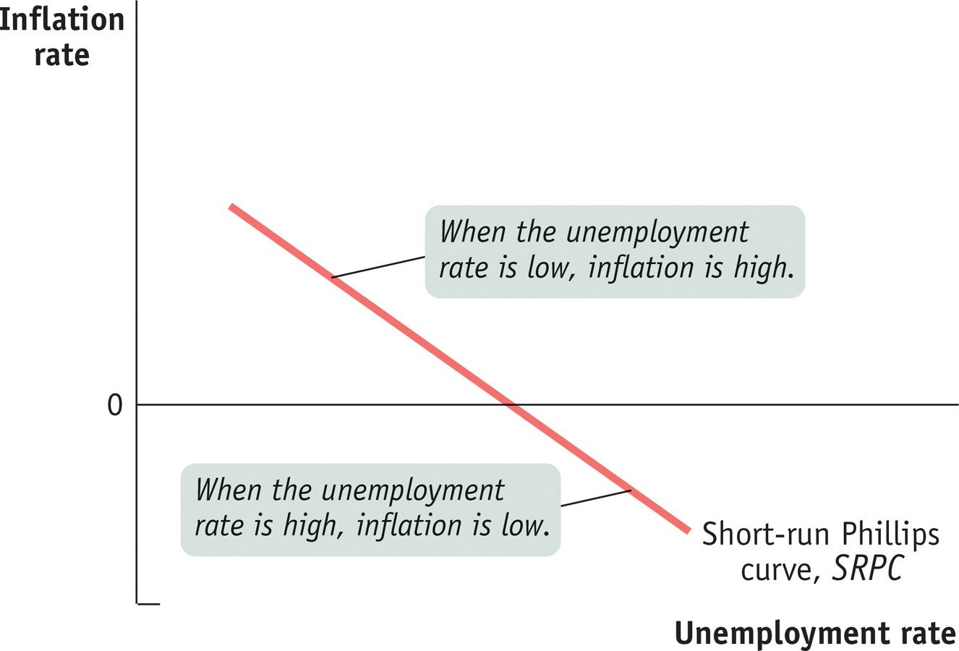
The Short-Run Phillips Curve
Section 6 | Module 34

Slide 5
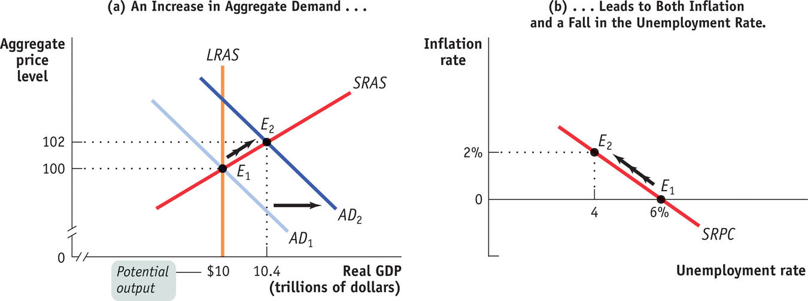
The AD-AS Model and the Short-Run Phillips Curve
Section 6 | Module 34

Slide 6
The Short-Run Phillips Curve and Supply Shocks
Inflation rate
A negative supply
shock shifts
SRPC up.
0
SRPC
1
Unemployment
rate
SRPC
0
A positive supply
shock shifts
SRPC down.
SRPC
2
Section 6 | Module 34

Slide 7
Inflation Expectations and the Short-Run Phillips Curve
The expected rate of inflation is the rate that employers and workers expect in the near future.
Expectations about future inflation directly affect the present inflation rate.
Higher expected inflation causes workers to desire higher wages, an increase in expected inflation shifts the short-run Phillips curve.
Section 6 | Module 34

Slide 8
Expected Inflation and the Short-Run Phillips Curve
Inflation
rate
6%
5
4
SRPC shifts up by the
amount of the increase
in expected inflation.
3
2
1
SRPC
2
0
3
4
5
6
7
8%
–1
Unemployment
rate
–2
SRPC
0
–3
Section 6 | Module 34

Slide 9
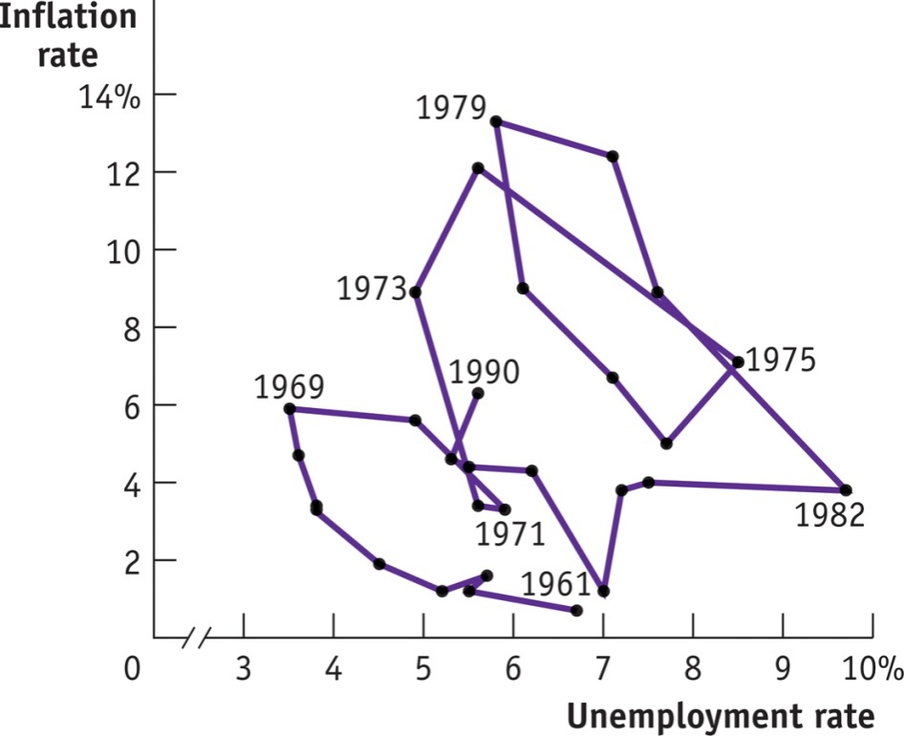
F Y I
From the Scary Seventies to the Nifty Nineties
After 1969, the relationship between unemployment and inflation seems to fall apart in the data, with high unemployment and high inflation, also known as stagflation, in the 1970s and early 1980s.
In the 1990s, the economy experienced low
unemployment and inflation.
The reason: a series of negative supply
shocks in the 1970s and positive supply
shocks in the 1990s.
Section 6 | Module 34

Slide 10
Inflation and Unemployment in the Long Run
The long-run Phillips curve shows the relationship between unemployment and inflation after expectations of inflation have had time to adjust to experience.
To avoid accelerating inflation over time, the unemployment rate must be high enough that the actual rate of inflation matches the expected rate of inflation.
The nonaccelerating inflation rate of unemployment, or NAIRU, is the unemployment rate at which inflation does not change over time.
Section 6 | Module 34

Slide 11
The NAIRU and the Long-Run Phillips Curve
Inflation
rate
8%
7
6
C
5
B
E
4
4
3
A
E
2
2
SRPC
4
1
E
0
SRPC
2
0
3
4
5
6
7
8%
Unemployment
rate
–1
–2
Nonaccelerating inflation
rate of unemployment, NAIRU
SRPC
0
–3
Section 6 | Module 34

Slide 12
The Natural Rate of Unemployment, Revisited
The natural rate of unemployment is the portion of the unemployment rate unaffected by the swings of the business cycle.
The level of unemployment the economy “needs” in order to avoid accelerating inflation is equal to the natural rate of unemployment.
Economists estimate the natural rate of unemployment by looking for evidence about the NAIRU from the behavior of the inflation rate and the unemployment rate over the course of the business cycle.
Section 6 | Module 34

Slide 13
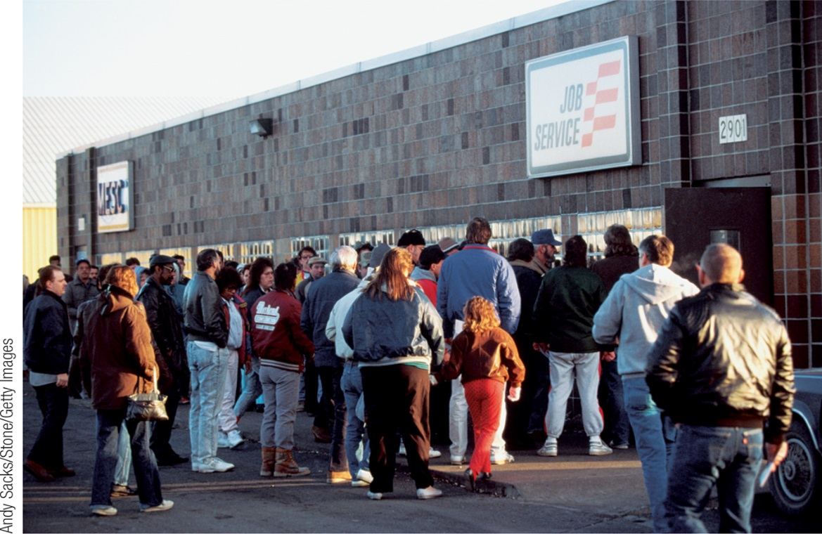
Cost of Disinflation
Once inflation has become embedded in expectations, getting inflation back down can be difficult because disinflation can be very costly.
This requires high levels of unemployment and the sacrifice of large amounts of aggregate output.
However, policy makers in the United States and other wealthy countries were willing to pay that price of bringing down the high inflation of the 1970s.
Section 6 | Module 34

Slide 14
Practice
Set up a correctly labeled PC graph. Then, show and explain what happens to the SRPC. Assume natural rate of unemployment is 5%.
Government spending increases
Price of crude oil and most sources of energy decreases
Inflation expectations rise from 3% to 6%
The Fed increases interest rates with contractionary monetary policy
Inflation expectations fall from 5% to 2%
The government increases income taxes
Tornados hit the nation! Destroying manufacturing ability
Consumer confidence falls amid news of political squabbling

Slide 15
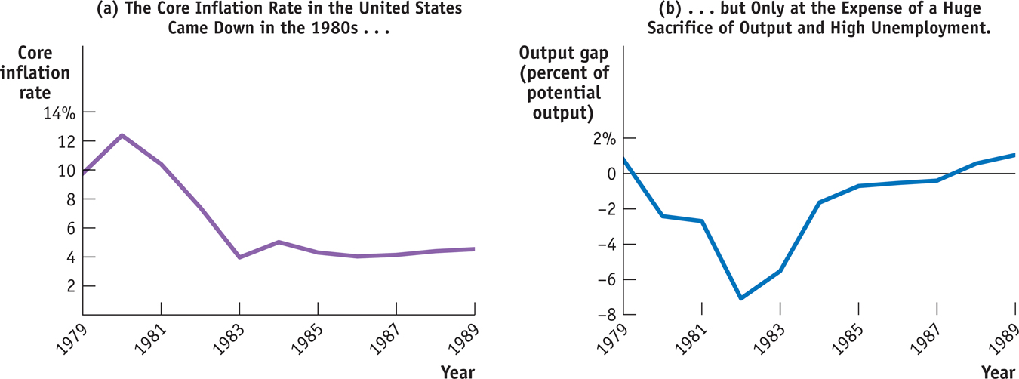
F Y I
The Great Disinflation of the 1980s
Section 6 | Module 34

Slide 16
Deflation
Debt deflation is the reduction in aggregate demand arising from the increase in the real burden of outstanding debt caused by deflation.
Effects of Expected Deflation:
There is a zero bound on the nominal interest rate: it cannot go below zero.
Monetary policy can’t be used because nominal interest rates cannot fall below the zero bound.
This liquidity trap can occur whenever there is a sharp reduction in demand for loanable funds.
A liquidity trap is when monetary policy is unable to stimulate an economy because nominal interest rates are up against the zero bound.
Section 6 | Module 34

Slide 17
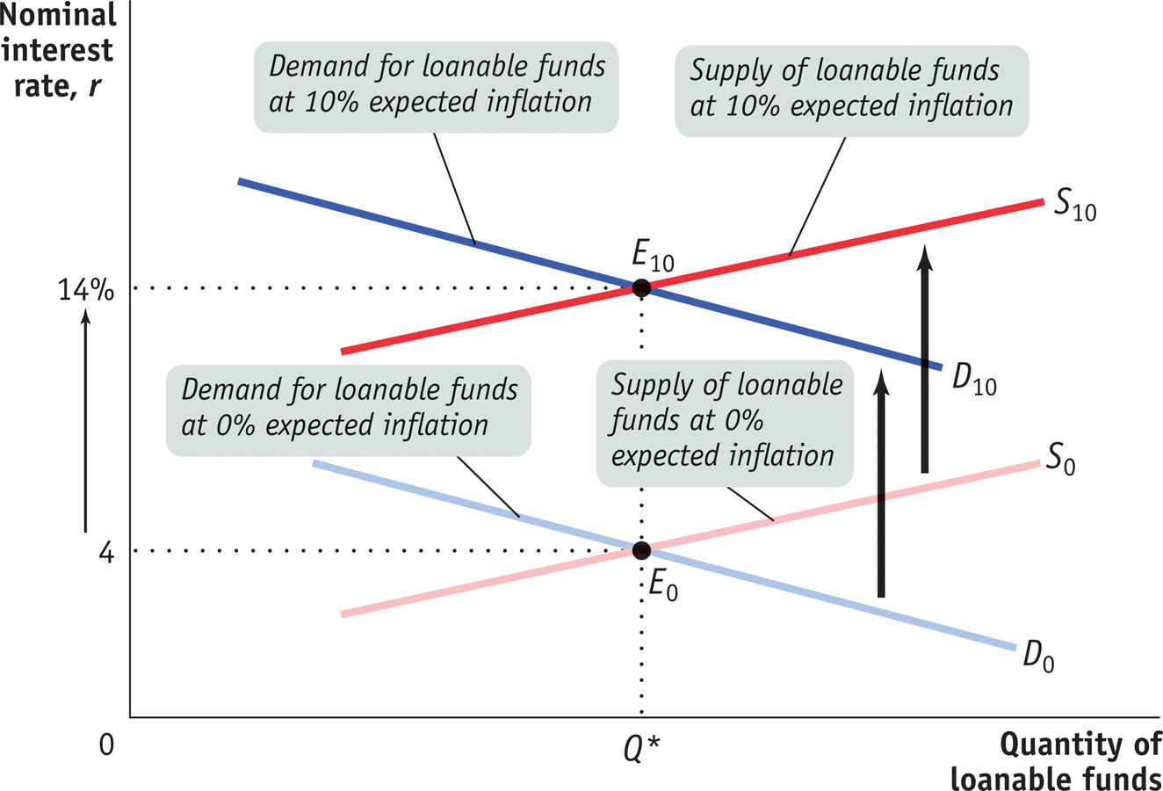
The Fisher Effect
Section 6 | Module 34

Slide 18
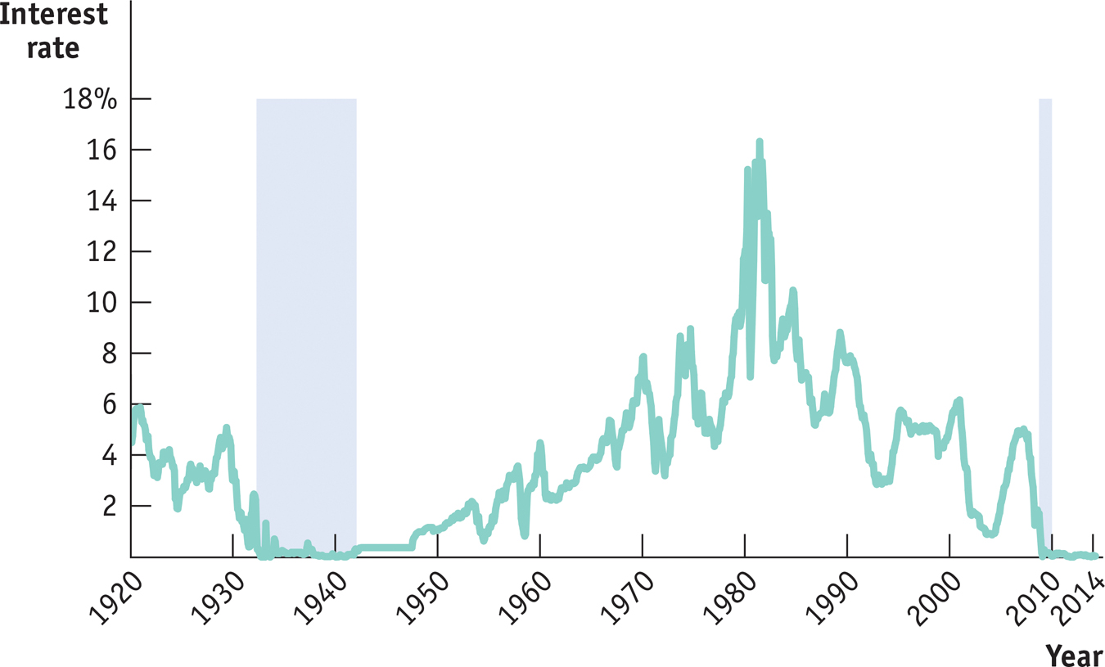
The Zero Bound in U.S. History
Section 6 | Module 34

Slide 19
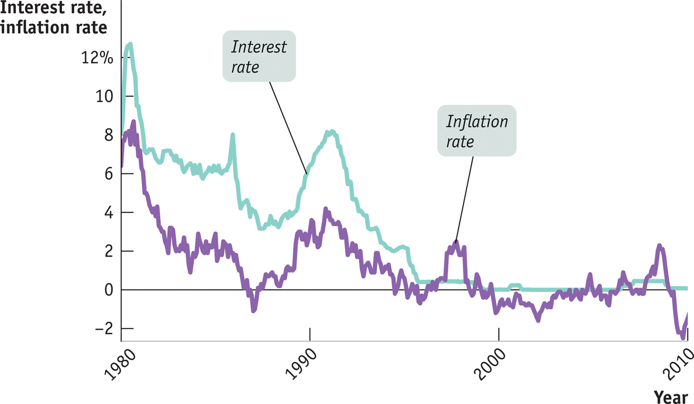
Japan’s Lost Decade
Section 6 | Module 34

Slide 20
Summary
At a given point in time, there is a downward-sloping relationship between unemployment and inflation known as the short-run Phillips curve. This curve is shifted by changes in the expected rate of inflation.
The long-run Phillips curve, which shows the relationship between unemployment and inflation once expectations have had time to adjust, is vertical. It defines the non-accelerating inflation rate of unemployment, or NAIRU, which is equal to the natural rate of unemployment.
Once inflation has become embedded in expectations, getting inflation back down can be difficult since disinflation can be very costly.
Section 6 | Module 34

Slide 21
Summary
Deflation can lead to debt deflation, in which a rising real burden of outstanding debt intensifies an economic downturn.
Interest rates are more likely to run up against the zero bound in an economy experiencing deflation. When this happens, the economy enters a liquidity trap, rendering conventional monetary policy ineffective.
Section 6 | Module 34

