Slide 1
Explain what a price index is and how it is calculated
Calculate the inflation rate using the values of a price index
Describe the importance of the consumer price index and other price indexes
What You Will Learn in this Module
Section 3 | Module 15

Slide 2
Price Indexes and the Aggregate Price Level
The aggregate price level is a measure of the overall level of prices in the economy.
To measure the aggregate price level, economists calculate the cost of purchasing a market basket.
A price index is the ratio of the current cost of that market basket to the cost in a base year, multiplied by 100.
Section 3 | Module 15

Slide 3
Calculating the Cost of a Market Basket
Calculating GDP and Real GDP in a Simple Economy
Section 3 | Module 15

Slide 4
Inflation Rate, CPI, and other Indexes
The inflation rate is the yearly percentage change in a price index, typically based upon Consumer Price Index, or CPI, the most common measure of the aggregate price level.
The CPI measures the cost of the market basket of a typical urban American family.
Section 3 | Module 15

Slide 5
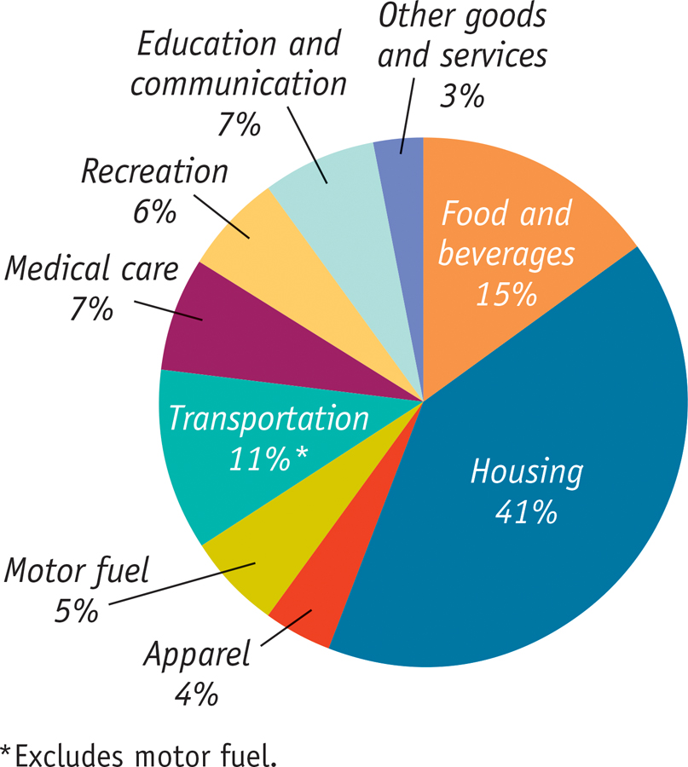
The Makeup of the Consumer Price Index in 2012
Section 3 | Module 15

Slide 6
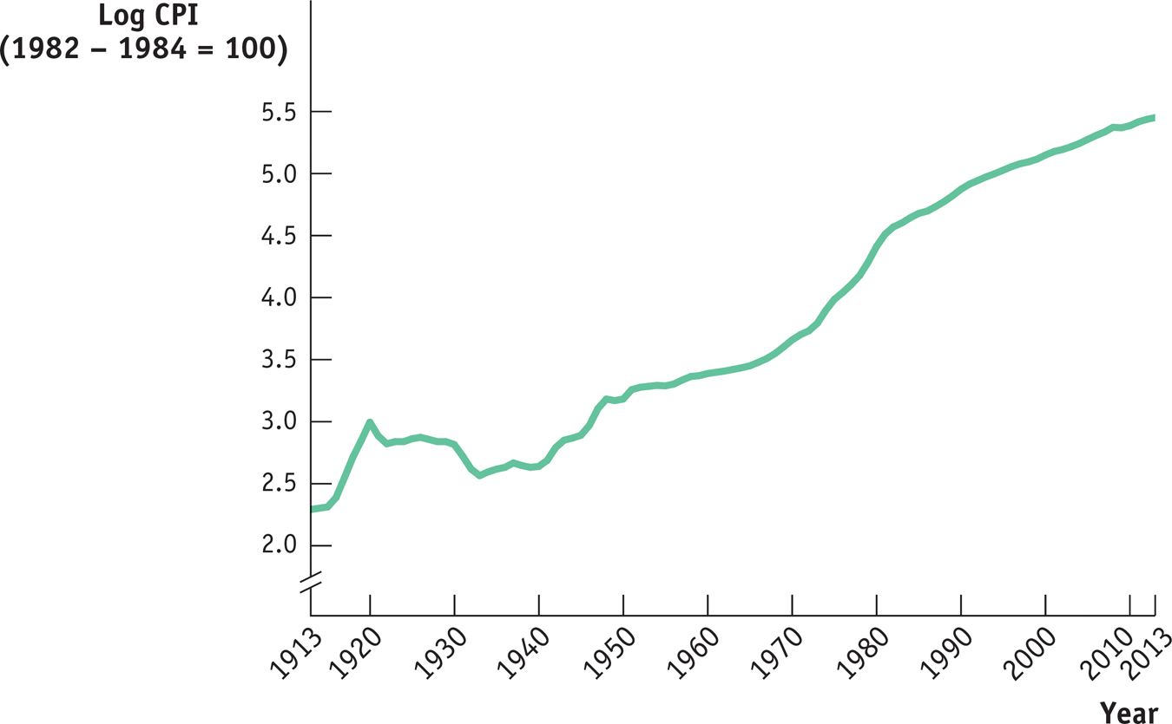
The CPI, 1913 – 2013
Section 3 | Module 15

Slide 7
Other Price Measures
A similar index to CPI for goods purchased by firms is the producer price index.
Economists also use the GDP deflator, which measures the price level by calculating the ratio of nominal to real GDP.
The GDP deflator for a given year is 100 times the ratio of nominal GDP to real GDP in that year.
Section 3 | Module 15

Slide 8
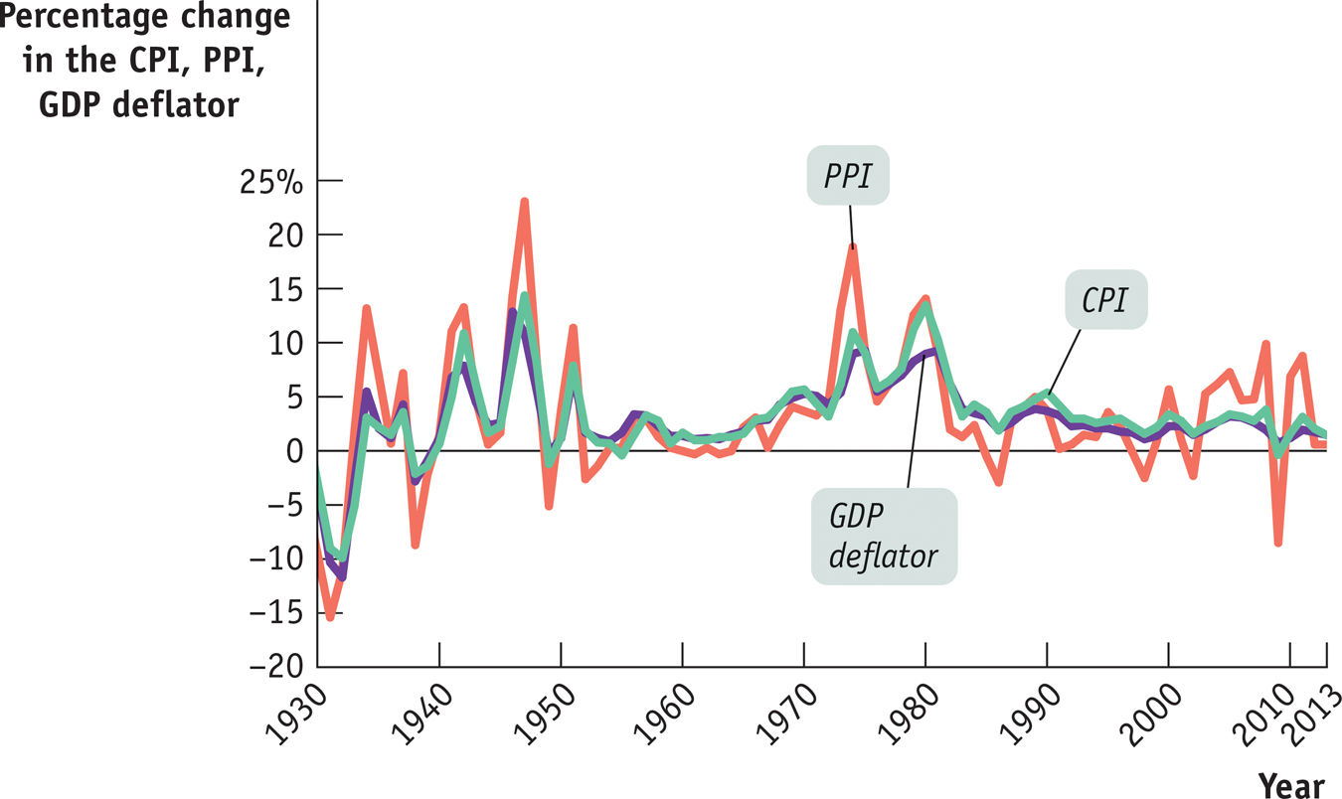
The CPI, the PPI, and the GDP Deflator
Section 3 | Module 15

Slide 9
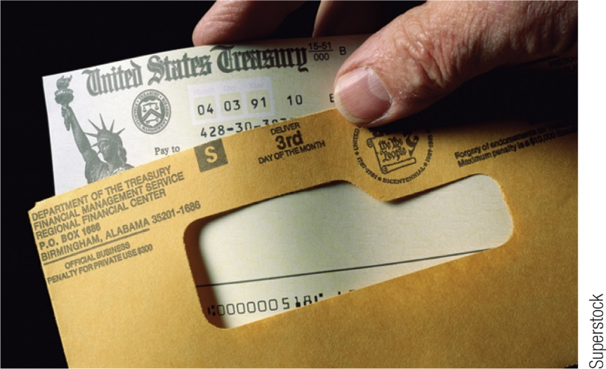
F Y I
Indexing to the CPI
The CPI has a direct and immediate impact on millions of Americans.
Many payments are tied, or “indexed,” to the CPI.
Today, 48 million people receive checks from Social Security. In addition, all Social Security payments are adjusted each year to offset any increase in consumer prices over the previous year.
The CPI is used to calculate the official estimate of the inflation rate used to adjust these payments yearly.
Section 3 | Module 15

Slide 10
Summary
To measure the aggregate price level, economists calculate the cost of purchasing a market basket.
A price index is the ratio of the current cost of that market basket to the cost in a selected base year, multiplied by 100.
The inflation rate is the yearly percent change in a price index, typically based on the consumer price index the most common measure of the aggregate price level.
A similar index for goods and services purchased by firms is the producer price index. Finally, economists also use the GDP deflator, which measures the price level by calculating the ratio of nominal to real GDP times 100.
Section 3 | Module 15

Slide 11
Circular Flow
GDP – Real vs Nominal
GDP and Inflation

