Slide 1
Illustrate changes in productivity using an aggregate production function
Discuss how growth has varied among several important regions of the world and explain why the convergence hypothesis applies to economically advanced countries
What You Will Learn in this Module
Section 7 | Module 38

Slide 2
Accounting for Growth: The Aggregate Production Function
The aggregate production function is a hypothetical function that shows how productivity (real GDP per worker) depends on the quantities of physical capital per worker and human capital per worker as well as the state of technology.
Section 7 | Module 38

Slide 3
Accounting for Growth: The Aggregate Production Function
A recent example of an aggregate production function applied to real data comes from a comparative study of Chinese and Indian economic growth by the economists Barry Bosworth and Susan Collins of the Brookings Institution.
They used the following aggregate production function:
Section 7 | Module 38

Slide 4
Accounting for Growth: The Aggregate Production Function
Using this function, they tried to explain why China grew faster than India between 1978 and 2004.
They found that about half the difference was due to China’s higher levels of investment spending, which raised its level of physical capital per worker.
The other half was due to faster Chinese technological progress.
Section 7 | Module 38

Slide 5
Accounting for Growth: The Aggregate Production Function
An aggregate production function exhibits diminishing returns to physical capital when, holding the amount of human capital and the state of technology fixed, each successive increase in the amount of physical capital leads to a smaller increase in productivity.
Section 7 | Module 38

Slide 6
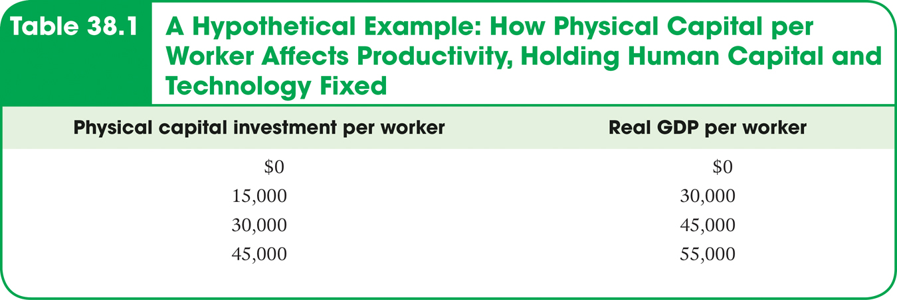
Accounting for Growth: The Aggregate Production Function
Section 7 | Module 38

Slide 7
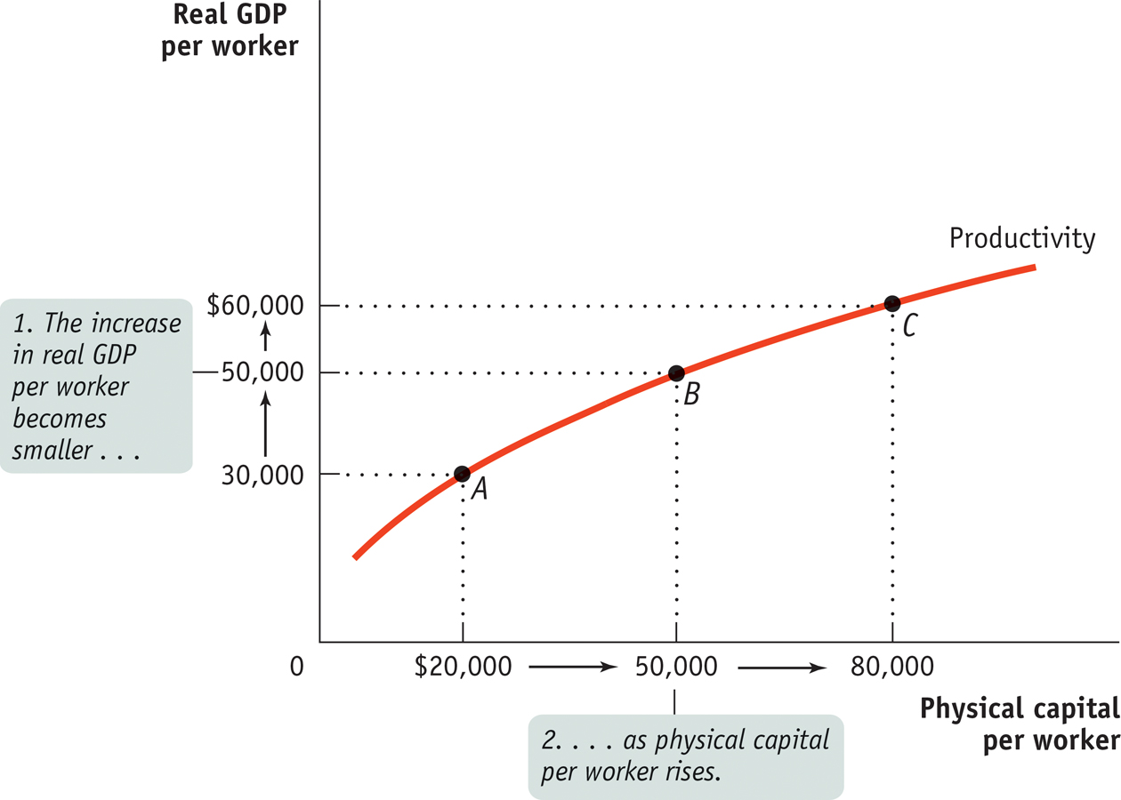
Physical Capital and Productivity
Section 7 | Module 38
Notes:
Figure Caption: Figure 38.1: Physical Capital and Productivity
Other things equal, a greater quantity of physical capital per worker leads to higher real GDP per worker but is subject to diminishing returns: each successive addition to physical capital per worker produces a smaller increase in productivity. Starting at point A, with $20,000 in physical capital per worker, a $30,000 increase in physical capital per worker leads to an increase of $20,000 in real GDP per worker. At point B, with $50,000 in physical capital per worker, a $30,000 increase in physical capital per worker leads to an increase of only $10,000 in real GDP per worker.

Slide 8
Accounting for Growth: The Aggregate Production Function
Growth accounting estimates the contribution of each major factor in the aggregate production function to economic growth.
The amount of physical capital per worker grows 3% a year.
According to estimates of the aggregate production function, each 1% rise in physical capital per worker, holding human capital and technology constant, raises output per worker by 1⁄3 of 1%, or 0.33%.
Total factor productivity is the amount of output that can be achieved with a given amount of factor inputs.
Section 7 | Module 38

Slide 9
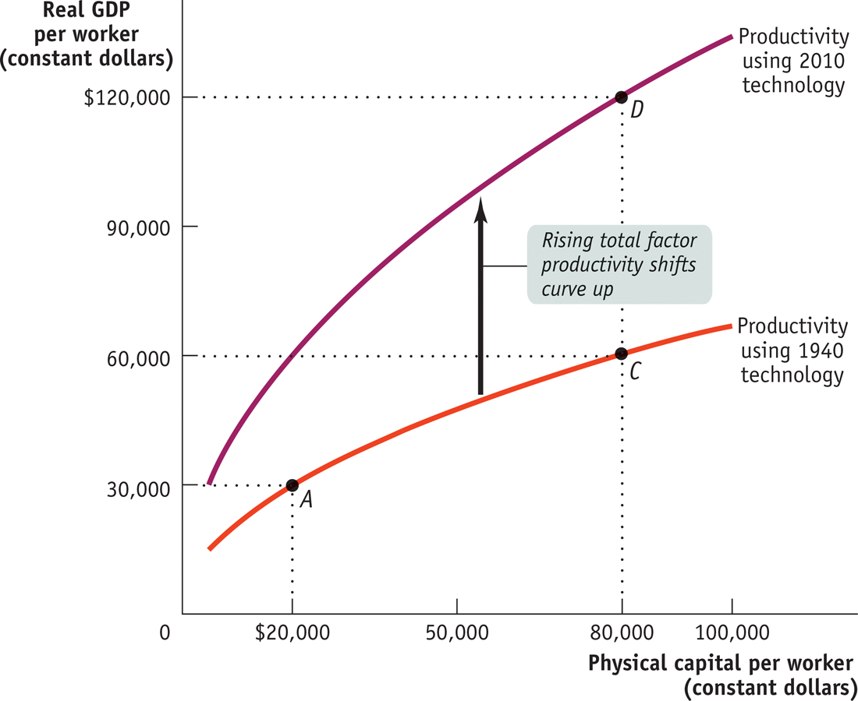
Technological Progress and Productivity Growth
Section 7 | Module 38
Notes:
Figure Caption: Figure 38.2: Technological Progress and Productivity Growth
Technological progress shifts the productivity curve upward. Here we hold human capital per worker fixed. We assume that the lower curve (the same curve as in Figure 25-4) reflects technology in 1937 and the upper curve reflects technology in 2007. Holding technology and human capital fixed, quadrupling physical capital per worker from $20,000 to$80,000 leads to a doubling of real GDP per worker, from $30,000 to $60,000. This is shown by the movement from point A to point C, reflecting an approximately 1% per year rise in real GDP per worker. In reality, technological progress shifted the productivity curve upward and the actual rise in real GDP per worker is shown by the movement from point A to point D. Real GDP per worker grew 2% per year, leading to a quadrupling during the period. The extra 1% in growth of real GDP per worker is due to higher total factor productivity.

Slide 10
What about Natural Resources?
In the modern world, natural resources are a much less important determinant of productivity than human or physical capital for the great majority of countries.
For example, some nations with very high real GDP per capita, such as Japan, have very few natural resources. Some resource-rich nations, such as Nigeria (which has sizable oil deposits), are very poor.
Section 7 | Module 38

Slide 11
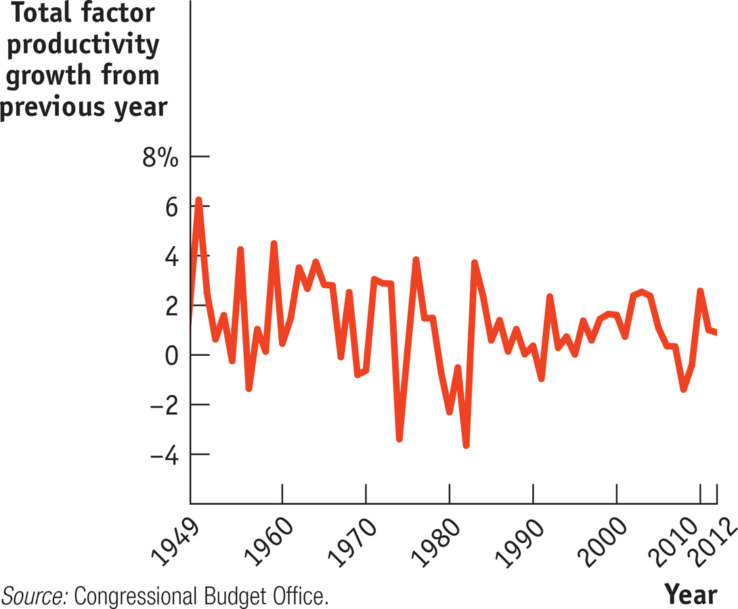
F Y I
The Information Technology Paradox
Many economists were puzzled by the slowdown in the U.S. growth rate of labor productivity.
There was a fall from an average annual growth rate of 3% in the late 1960s to slightly less than 1% in the mid-1980s.
This was surprising given that there appeared to be rapid progress in technology.
Section 7 | Module 38

Slide 12
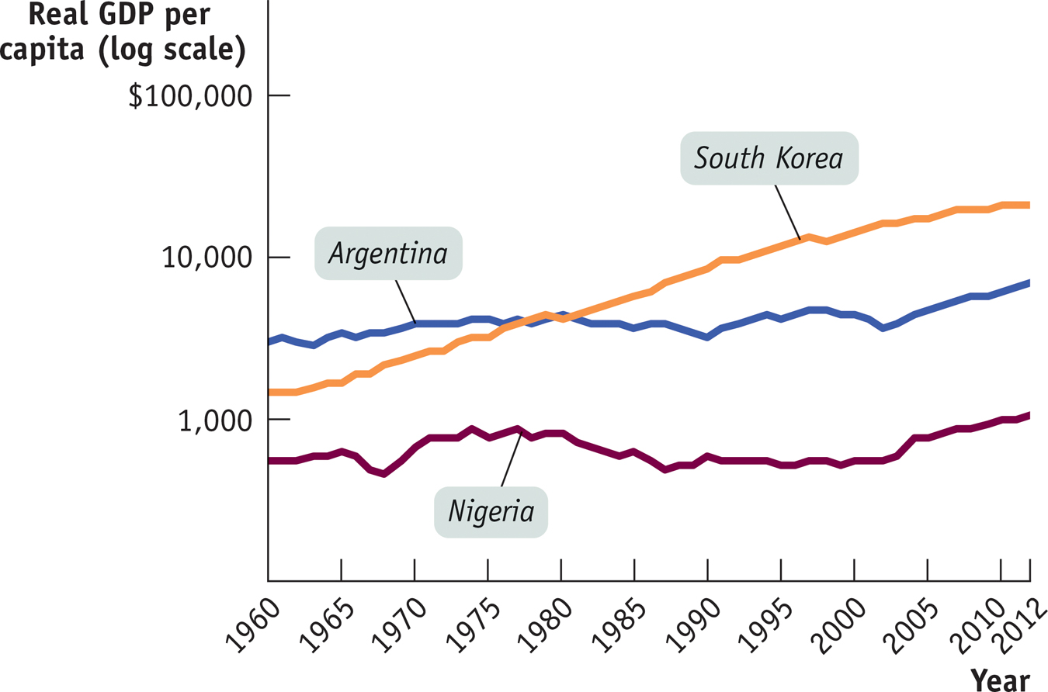
Success, Disappointment, & Failure
Section 7 | Module 38
Notes:
Figure Caption: Figure 38.3 Success and Disappointment
Real GDP per capita from 1960 to 2008, measured in 2000 dollars, is shown for Argentina, South Korea, and Nigeria, using a logarithmic scale. South Korea and some other East Asian countries have been highly successful at achieving economic growth. Argentina, like much of Latin America, has had several setbacks, slowing its growth. Nigeria’s standard of living in 2007 was only barely higher than it had been in 1960, an experience shared by many African countries.
Source: World Bank

Slide 13
Success, Disappointment, & Failure
The world economy contains examples of success and failure in the effort to achieve long-run economic growth.
East Asian economies have done many things right and achieved very high growth rates.
In Latin America, where some important conditions are lacking, growth has generally been disappointing.
In Africa, real GDP per capita has declined for several decades (there are some signs of progress now).
Section 7 | Module 38

Slide 14
Success, Disappointment, & Failure
The growth rates of economically advanced countries have converged, but not the growth rates of countries across the world.
This has led economists to believe that the convergence hypothesis fits the data only when factors that affect growth (i.e. education, infrastructure, and favorable policies and institutions) are held equal across countries.
Section 7 | Module 38

Slide 15
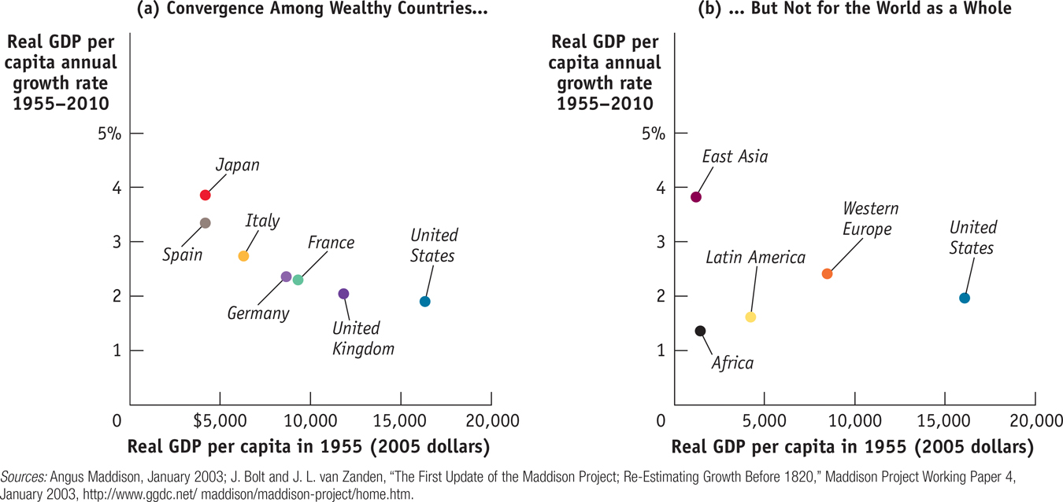
F Y I
Are Economies Converging?
Section 7 | Module 38
Notes:
Figure Caption: Do Economies Converge?
Data on today’s wealthy economies (measured in 2000 dollars) seem to support the convergence hypothesis. In panel (a) we see that among wealthy countries, those that had low levels of real GDP per capita in 1955 have had high growth rates since then, and vice versa. But for the world as a whole, there has been little sign of convergence. Panel (b) shows real GDP per capita in 1955 (also measured in 2000 dollars) and subsequent growth rates in major world regions. Poorer regions did not consistently have higher growth rates than richer regions: poor Africa turned in the worst performance, and relatively wealthy Europe grew faster than Latin America.
Source: Angus Maddison, Statistics on World Population, GDP, and Per Capita GDP, 1–2006AD, http://www.ggdc.net/maddison.

Slide 16
Success, Disappointment, & Failure
East Asia’s spectacular growth was generated by high savings and investment spending rates, emphasis on education, and adoption of technological advances from other countries.
Poor education, political instability, and irresponsible government policies are major factors in the slow growth of Latin America.
In sub-Saharan Africa, severe instability, war, and poor infrastructure— particularly affecting public health—have resulted in a catastrophic failure of growth.
Section 7 | Module 38

Slide 17
Summary
The aggregate production function shows how real GDP per worker depends on these three factors.
Other things equal, there are diminishing returns to physical capital: holding human capital per worker and technology fixed, each successive addition to physical capital per worker yields a smaller increase in productivity than the one before.
Growth accounting, which estimates the contribution of each factor to a country’s economic growth, has shown that rising total factor productivity is key to long-run growth. It is usually interpreted as the effect of technological progress.
The world economy contains examples of success and failure in the effort to achieve long-run economic growth.
Section 7 | Module 38

Slide 18
Summary
East Asian economies have done many things right and achieved very high growth rates.
In Latin America, where some important conditions are lacking, growth has generally been disappointing.
When the overall level of prices is going down, the economy is experiencing deflation.
In Africa, real GDP per capita has declined for several decades, although there are recent signs of progress.
Economists to believe that the convergence hypothesis fits the data only when factors that affect growth, such as education, infrastructure, and favorable policies and institutions, are held equal across countries.
Section 7 | Module 38

