Slide 1
What You Will Learn in this Module
Differentiate between real GDP and nominal GDP
Explain why real GDP is the appropriate measure of real economic activity
Section 3 | Module 11

Slide 2
Today’s Agenda
Real vs Nominal GDP
How to calculate
Practice

Slide 3
Real GDP: A Measure of Aggregate Output
The most important use of GDP is as a measure of the size of the economy.
To measure the economy’s growth with accuracy, we need a measure of aggregate output.
The aggregate output is the total quantity of final goods and services the economy produces.
Section 3 | Module 11

Slide 4
Real GDP: A Measure of Aggregate Output
Real GDP is the total value of the final goods and services produced in the economy during a given year, calculated using the prices of a selected base year.
Nominal GDP is the value of all final goods and services produced in the economy during a given year, calculated using the prices current in the year in which the output is produced.
Section 3 | Module 11

Slide 5
Calculating Real GDP
Calculating GDP and Real GDP in a Simple Economy
 | Year 1 | Year 2
Quantity of apples (billions) | 2,000 | 2,200
Price of apple | $0.25 | $0.30
Quantity of oranges (billions) | 1,000 | 1,200
Price of orange | $0.50 | $0.70
GDP (billions of dollars) | $1,000 | $1,500
Real GDP (billions of year 1 dollars) | $1,000 | $1,150
Section 3 | Module 11

Slide 6
Calculating Real GDP
Except in the base year, real GDP is not the same as nominal GDP, output valued at current prices.
Chained dollars is the method of calculating changes in real GDP using the average between the growth rate calculated using an early base year and the growth rate calculated using a late base year.
Section 3 | Module 11

Slide 7
Calculating Real GDP
Nominal versus Real GDP in 2001, 2005, and 2009
Nominal versus Real GDP in 2000, 2005, and 2013
 | Nominal GDP (billions of current dollars) | Real GDP (billions of 2005 dollars)
2000 | $9,951.5 | $11,286
2005 | 12,683 | 12,638
2013 | 16,803 | 14,504
Section 3 | Module 11

Slide 8
What Real GDP Doesn’t Measure
A country can have a higher GDP simply by having a higher population.
GDP per capita is a measure of average GDP per person, but is not by itself an appropriate policy goal.
Real GDP does not include many of the things that contribute to happiness.
Section 3 | Module 11

Slide 9
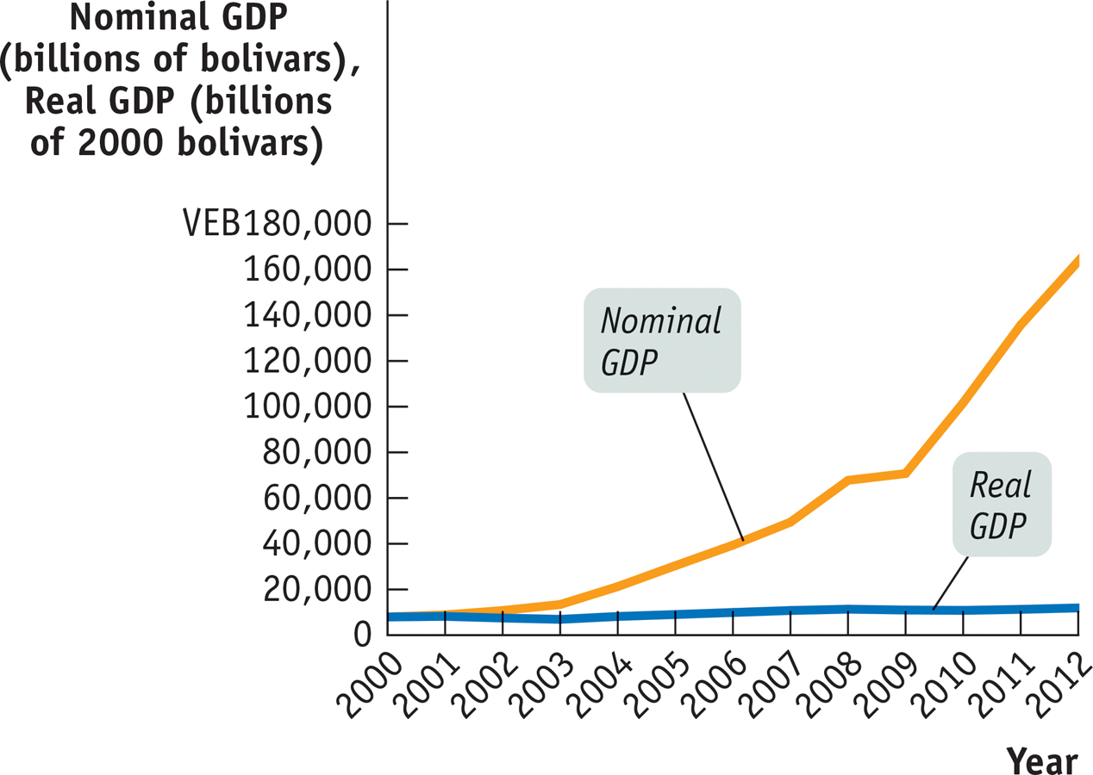
F Y I
Miracle in Venezuela?
The South American nation of Venezuela has a had one of the world’s fastest-growing nominal GDPs.
But, Venezuela has had very high inflation.
Section 3 | Module 11

Slide 10
1. Real GDP is nominal GDP adjusted for:
^{A. double counting.}
^{B. changes in prices.}
^{C. population.}
^{D. imports.}
^{E. interest rates.}
2. If the price level in the economy and the nominal wages both doubled, then the real wages would:
A. Also Double B.Increase by 50%
C. Decrease by 20% D. Decrease by 50%
^{E. Remain unchanged}

Slide 11
Summary
Real GDP is the value of the final goods and services produced calculated using the prices of a selected base year.
Except in the base year, real GDP is not the same as nominal GDP, the value of aggregate output calculated using current prices.
Analysis of the growth rate of aggregate output must use real GDP. Real GDP per capita is a measure of average aggregate output per person but is not in itself an appropriate policy goal.
Section 3 | Module 11

