Slide 1
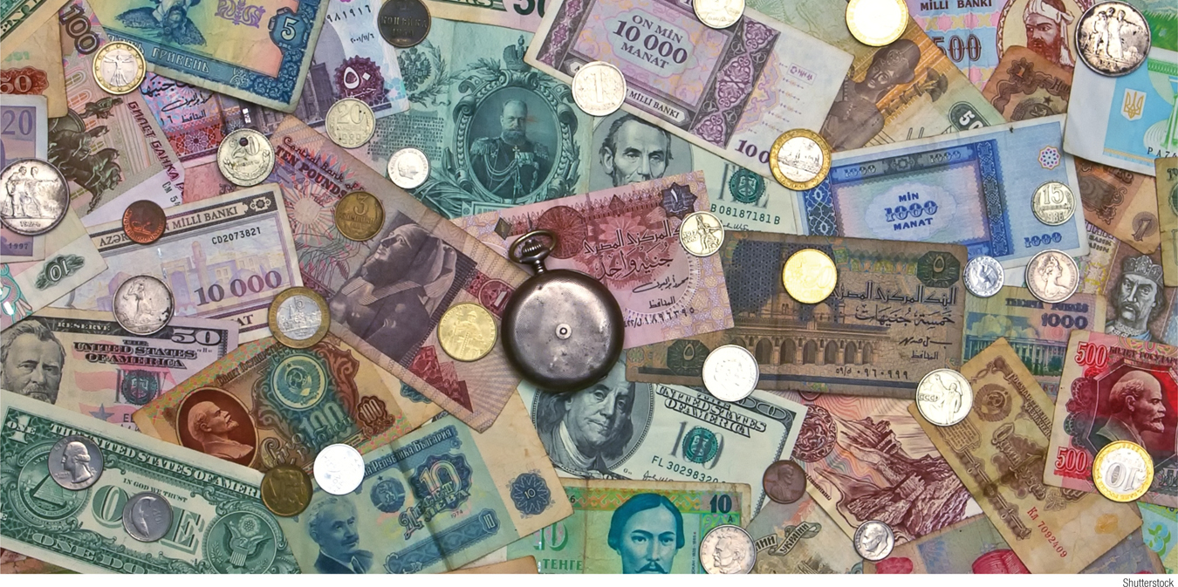
Identify the functions of money
Explain the various roles money plays and the many forms it takes in the economy
Describe how the amount of money in the economy is measured
What You Will Learn in this Module
Section 5 | Module 23

Slide 2
The Meaning of Money
Money is any financial asset that can easily be used to purchase goods and services.
Currency in circulation is cash held by the public.
Checkable bank deposits are bank accounts on which people can write checks.
The money supply is the total value of financial assets in the economy that are considered money.
Section 5 | Module 23

Slide 3
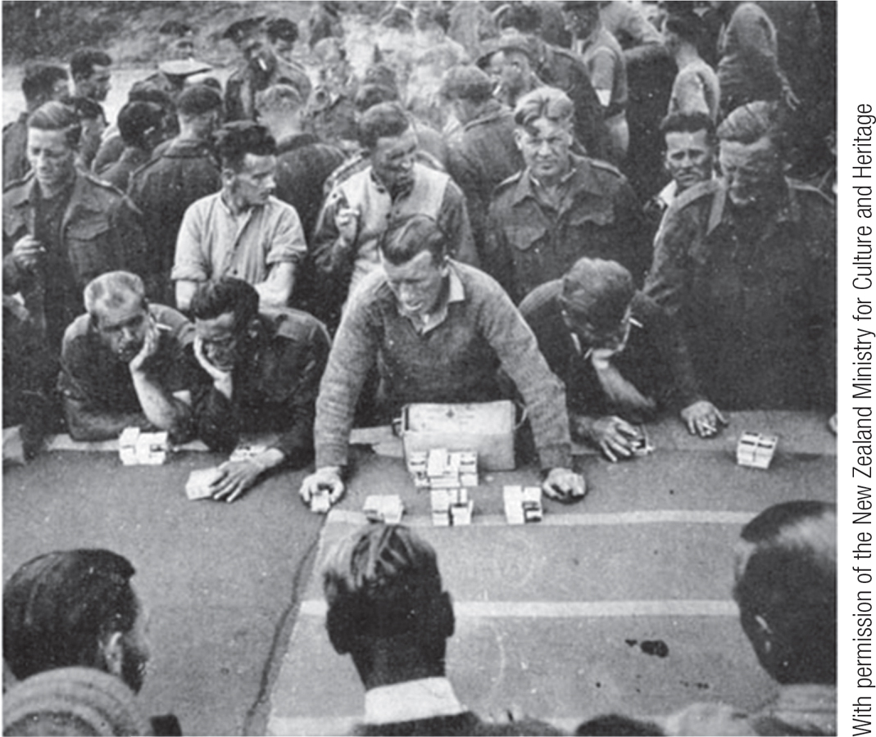
Roles of Money
A medium of exchange is an asset that individuals acquire for the purpose of trading rather than for their own consumption.
A store of value is a means of holding purchasing power over time.
A unit of account is a measure used to set prices and make economic calculations.
Section 5 | Module 23

Slide 4
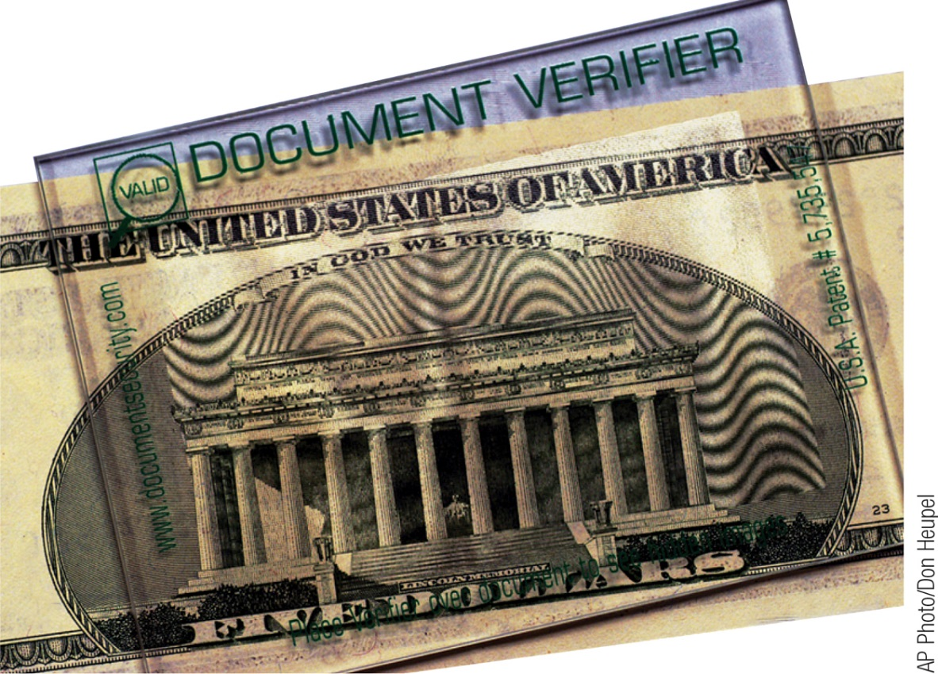
Types of Money
Commodity money is a good used as a medium of exchange that has other uses.
A commodity-backed money is a medium of exchange with no intrinsic value whose ultimate value is guaranteed by a promise that it can be converted into valuable goods.
Fiat money is a medium of exchange whose value derives entirely from its official status as a means of payment.
Section 5 | Module 23

Slide 5
F Y I
The History of the Dollar
In the early days of European settlement, the colonies that would become the United States used commodity money, partly consisting of gold and silver coins minted in Europe. Later in American history, commodity-backed paper money came into widespread use.
In 1933, when President Franklin D. Roosevelt broke the link between dollars and gold, his own federal budget declared ominously, “This will be the end of Western civilization.” It wasn’t. The link between the dollar and gold was restored a few years later, then dropped again—seemingly for good—in August 1971.
Despite the warnings of doom, the U.S. dollar is still the world’s most widely used currency.
Section 5 | Module 23

Slide 6
Measuring the Money Supply
A monetary aggregate is an overall measure of the money supply.
Near-moneys are financial assets that can’t be directly used as a medium of exchange but can readily be converted into cash or checkable bank deposits.
Section 5 | Module 23

Slide 7
Measuring the Money Supply
The Federal Reserve calculates the size of two monetary aggregates, overall measures of the money supply.
M1: contains only money in circulation, traveler’s checks, and checkable bank deposits (valued at $1,676.4 billion)
M2: contains M1 and near moneys, financial assets that aren’t directly usable as a medium of exchange but can be easily exchanged (valued at $8,462.9 billion)
Section 5 | Module 23

Slide 8
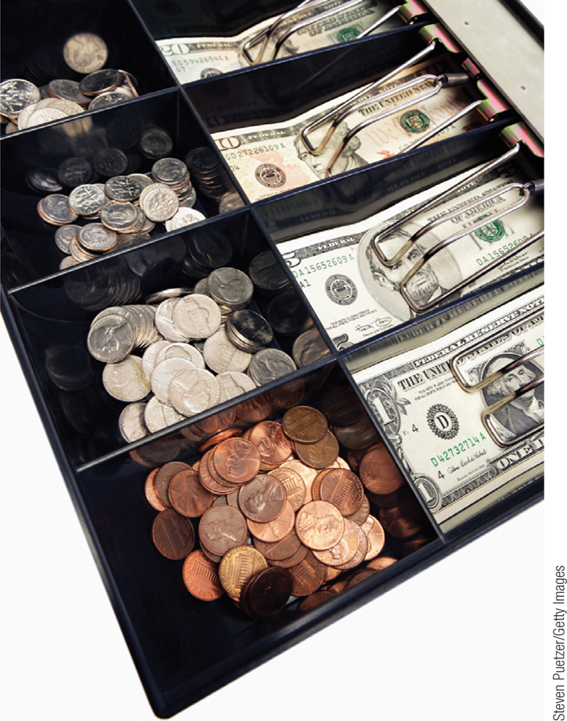
F Y I
What’s with All the Currency?
There is $1,159 billion of currency in circulation. So where is all that cash? Part of the answer is that it isn’t in individuals’ wallets: it’s in cash registers.
Economists also believe that cash plays an important role in transactions that people want to keep hidden. Small businesses and the self-employed sometimes prefer to be paid in cash so they can avoid paying taxes by hiding income from the Internal Revenue Service.
The most important reason for those huge currency holdings, however, is foreign use of dollars. The Federal Reserve estimates that 60% of U.S. currency is actually held outside the United States.
Section 5 | Module 23

Slide 9
Summary
Money is any asset that can easily be used to purchase goods and services.
Currency in circulation and checkable bank deposits are both considered part of the money supply.
Money plays three roles: it is a medium of exchange used for transactions, a store of value that holds purchasing power over time, and a unit of account in which prices are stated.
Over time, commodity money, which consists of goods possessing value aside from their role as money, such as gold and silver coins, was replaced by commodity-backed money, such as paper currency backed by gold. Today the dollar is pure fiat money, whose value derives solely from its official role.
Section 5 | Module 23

Slide 10
Summary
M1 is the narrowest monetary aggregate, containing only currency in circulation, traveler’s checks, and checkable bank deposits.
M2 includes a wider range of assets called near-moneys, mainly other forms of bank deposits, that can easily be converted into checkable bank deposits.
Section 5 | Module 23

