Slide 1
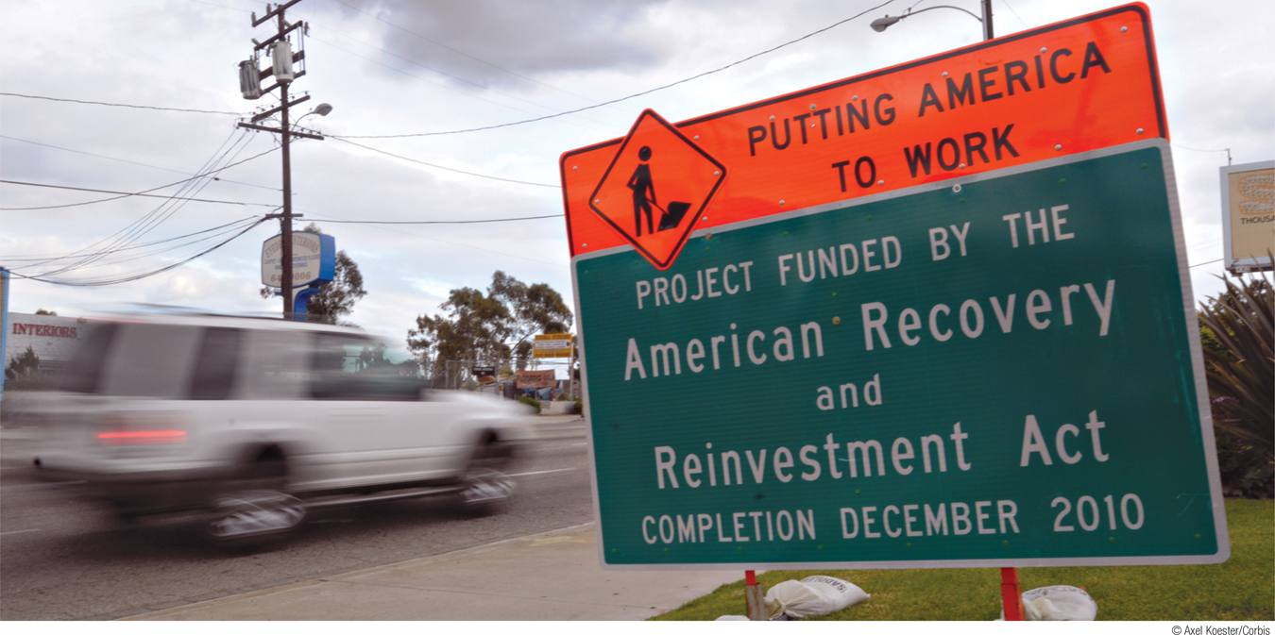
What You Will Learn in this Module
Explain why fiscal policy has a multiplier effect
Describe how automatic stabilizers influence the multiplier effect
Section 4 | Module 21

Slide 2
Today’s Agenda
Thursday’s Test
Austrian vs Chicago school
AD/AS practice
Gov’t intervention and automatic stabilizers

Slide 3
Chicago School
John Maynard Keynes
If in a recessionary or inflationary period of the business cycle, use fiscal and monetary policy to ”correct” the market
Rely upon gov spending to influence AD and push consumer confidence back up
(Small amounts of) Inflation is OK. Deficits are fine. Growth is king

Slide 4
Austrian School
F.A. Hayek
Fiscal and monetary policy to correct market inefficiencies is, long term, a bad idea.
Using gov’t spending to manipulate AD is like an addictive drug
Let the market determine interest rates! Booms are CAUSED by manipulating interest rates, recessions are merely a way to cull out the poor performers in a market
Austrian vs Chicago school Rap Battle

Slide 5
Front: Increase AS
Back: Increase AD
Windows: Decrease AD
Door: Decrease AS
1. Congress increases taxes on the rich.
2. Congress cuts taxes on the middle class.
3. Oil prices fall amid rumors of a new discovery in Alaska.
4. Productivity increases.
5. Productivity falls for the third quarter in a row.
6. Congress decreases unemployment benefits.
7. Baby boomers retire in greater numbers.
8. Wages rise due to labor union contracts.
9. Producers and consumers are pessimistic about the future.
10. Producers and consumers are optimistic about the future.

Slide 6
Front: Increase AS Back: Increase AD Windows: Decrease AD Door: Decrease AS
11. More people are graduating from college with a 4 year degree or a technical degree.
12. More people are dropping out of school.
13. Commodity prices drop.
14. Commodity prices increase.
15. Congress raises taxes on businesses.
16. Congress lowers taxes on businesses.
17. Exports rise to an all-time high.
18. Imports rise to an all-time high.
19. Congress increases spending on health care.
20. Congress decreases spending on the space program.

Slide 7
Automatic Stabilizers
Unemployment Benefits, government transfers (social security, SNAP benefits, etc)
When a Demand shock occurs…
What happens to unemployment?
What happens to PL?
What happens to wages?

Slide 8
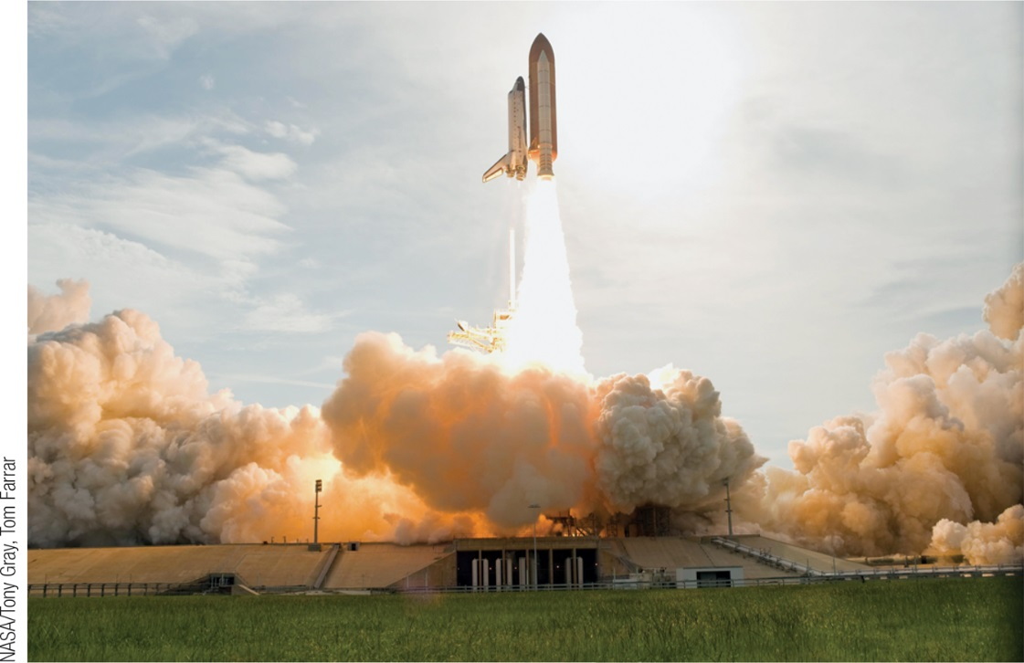
Using the Multiplier to Estimate
the Influence of Government Policy
Fiscal policy has a multiplier effect on the economy.
Fiscal policy can take the form of changes in taxes, transfers, and government spending.
Expansionary fiscal policy leads to an increase in real GDP larger than the initial rise in aggregate spending caused by the policy.
Conversely, contractionary fiscal policy leads to a fall in real GDP larger than the initial reduction in aggregate spending caused by the policy.
Section 4 | Module 21

Slide 9
Using the Multiplier to Estimate the Influence of Government Policy
The multiplier on changes in government purchases is 1/(1 − MPC).
Section 4 | Module 21

Slide 10
Multiplier Effects of Changes in Taxes and Government Transfers
Example: The government hands out $50 billion in the form of tax cuts.
There is no direct effect on aggregate demand by government purchases of goods and services; GDP goes up only because households spend some of that $50 billion.
How much will they spend?
MPC × $50 billion. For example, if MPC = 0.6, the first-round increase in consumer spending will be $30 billion (0.6 × $50 billion = $30 billion).
This initial rise in consumer spending will lead to a series of subsequent rounds in which real GDP, disposable income, and consumer spending rise further.
Section 4 | Module 21

Slide 11
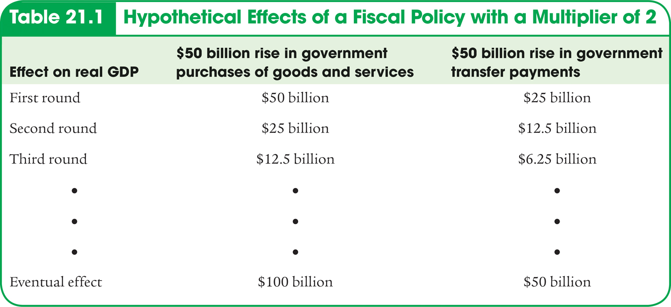
Multiplier Effects of Changes in Government Transfers and Taxes
Section 4 | Module 21

Slide 12
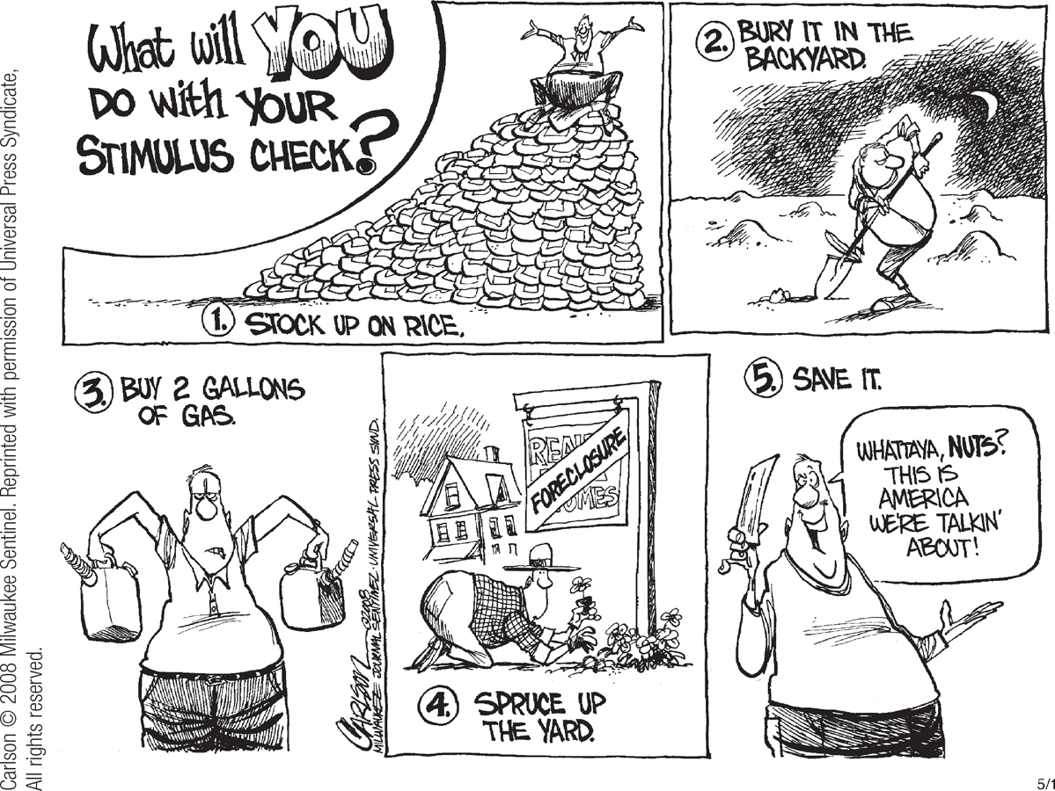
Multiplier Effects of Changes
in Government Transfers and Taxes
The multiplier on changes in taxes or transfers, MPC/(1 − MPC), because part of any change in taxes or transfers is absorbed by savings.
The results from changes in taxes are complicated by the fact that governments rarely impose lump sum taxes.
Changes in government purchases have a more powerful effect on the economy than equal-sized changes in taxes or transfers.
Section 4 | Module 21

Slide 13
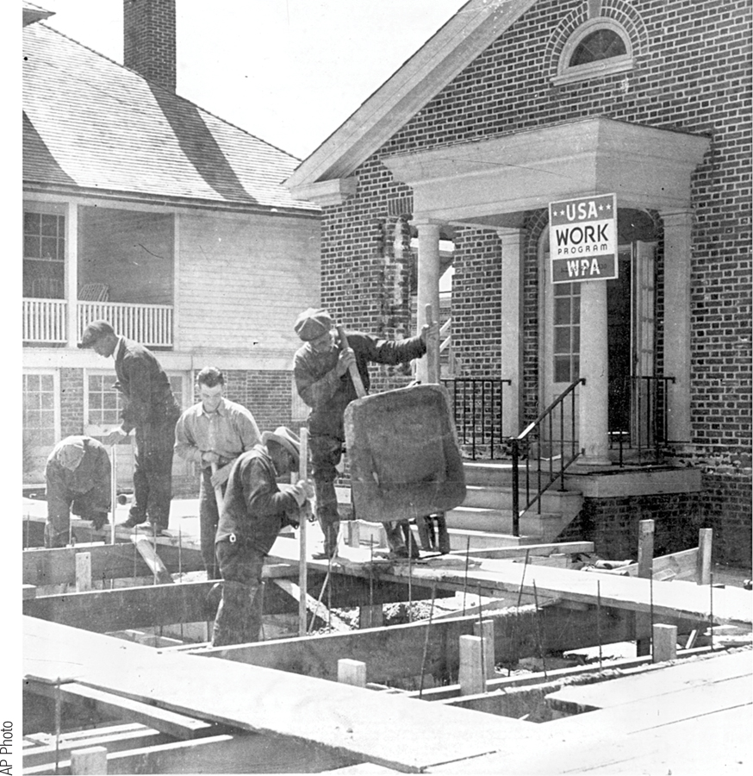
How Taxes Affect the Multiplier
Rules governing taxes and some transfers act as automatic stabilizers, reducing the size of the multiplier and automatically reducing the size of fluctuations in the business cycle.
In contrast, discretionary fiscal policy arises from deliberate actions by policy makers rather than from the business cycle.
Section 4 | Module 21

Slide 14
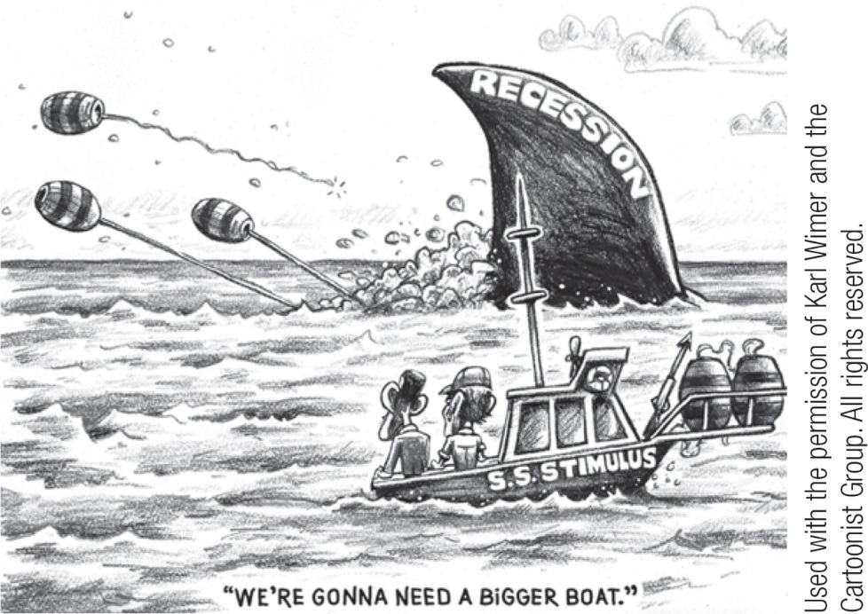
F Y I
About That Stimulus Package . . .
The U.S. economy needed a fiscal stimulus. There was, however, sharp partisan disagreement about what form that stimulus should take.
Republicans favored tax cuts on general political principles. Democrats preferred transfer payments, especially increased unemployment benefits and expanded food stamp aid.
The eventual compromise gave most taxpayers a flat $600 rebate, $1,200 for married couples.
Many economists believed that only a fraction of the rebate checks would actually be spent, so that the eventual multiplier would be fairly low.
Section 4 | Module 21

Slide 15
Summary
Fiscal policy has a multiplier effect on the economy, the size of which depends upon the fiscal policy.
Except in the case of lump-sum taxes, taxes reduce the size of the multiplier. Expansionary fiscal policy leads to an increase in real GDP, while contractionary fiscal policy leads to a reduction in real GDP.
Because part of any change in taxes or transfers is absorbed by savings in the first round of spending, changes in government purchases of goods and services have a more powerful effect on the economy than equal-size changes in taxes or transfers.
Section 4 | Module 21

Slide 16
Summary
Rules governing taxes—with the exception of lump-sum taxes—and some transfers act as automatic stabilizers, reducing the size of the multiplier and automatically reducing the size of fluctuations in the business cycle.
Discretionary fiscal policy arises from deliberate actions by policy makers rather than from the business cycle.
Section 4 | Module 21

