Slide 1
Illustrate the relationship between the demand for money and the interest rate with a graph
Explain why the liquidity preference model determines the interest rate in the short run
What You Will Learn in this Module
Section 5 | Module 28

Slide 2
The Demand for Money
The Opportunity Cost of Holding Money
The decision process to hold money is the same process as the decision to purchase goods: is the benefit of holding money greater than the cost of holding money?
The interest rate reflects the opportunity cost of holding money.
Short-term interest rates are the interest rates on financial assets that mature within six months or less.
Long-term interest rates are interest rates on financial assets that mature a number of years in the future.
Section 5 | Module 28

Slide 3
The Monetary Role of Banks
Section 5 | Module 28

Slide 4
The Demand for Money
Section 5 | Module 28

Slide 5
F Y I
Long-term Interest Rates
Long-term interest rates don’t necessarily move with short-term interest rates.
If investors expect short-term interest rates to rise, investors may buy short-term bonds even if long-term bonds offer a higher interest rate.
In practice, long-term interest rates reflect the average expectation in the market about what’s going to happen to short-term rates in the future.
Section 5 | Module 28

Slide 6
The Money Demand Curve
Interest rate, r
The money demand curve shows the relationship between the quantity of money demanded and the interest rate.
Money demand curve, MD
Quantity of money
Section 5 | Module 28

Slide 7
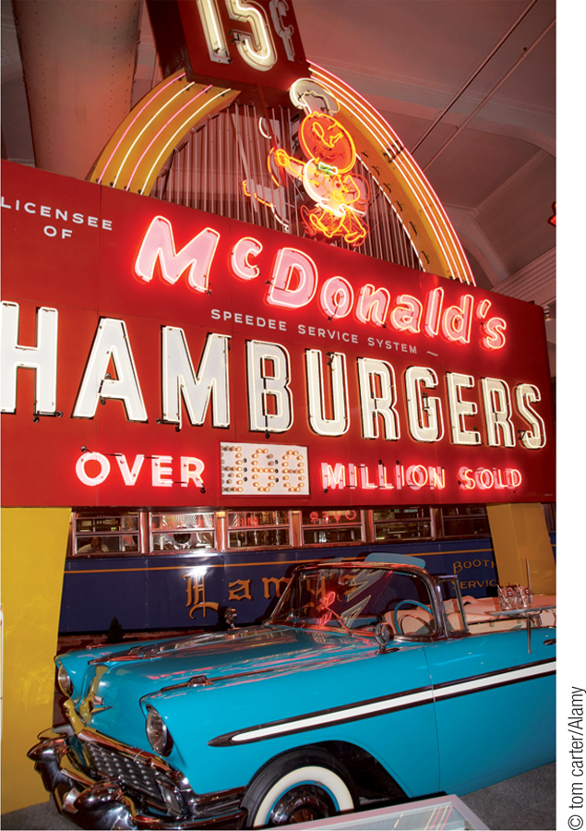
Shifts of the Real Money Demand Curve
Factors that shift the real money demand curve:
Changes in aggregate price level
Changes in real GDP
Changes in technology
Changes in institutions
Section 5 | Module 28

Slide 8
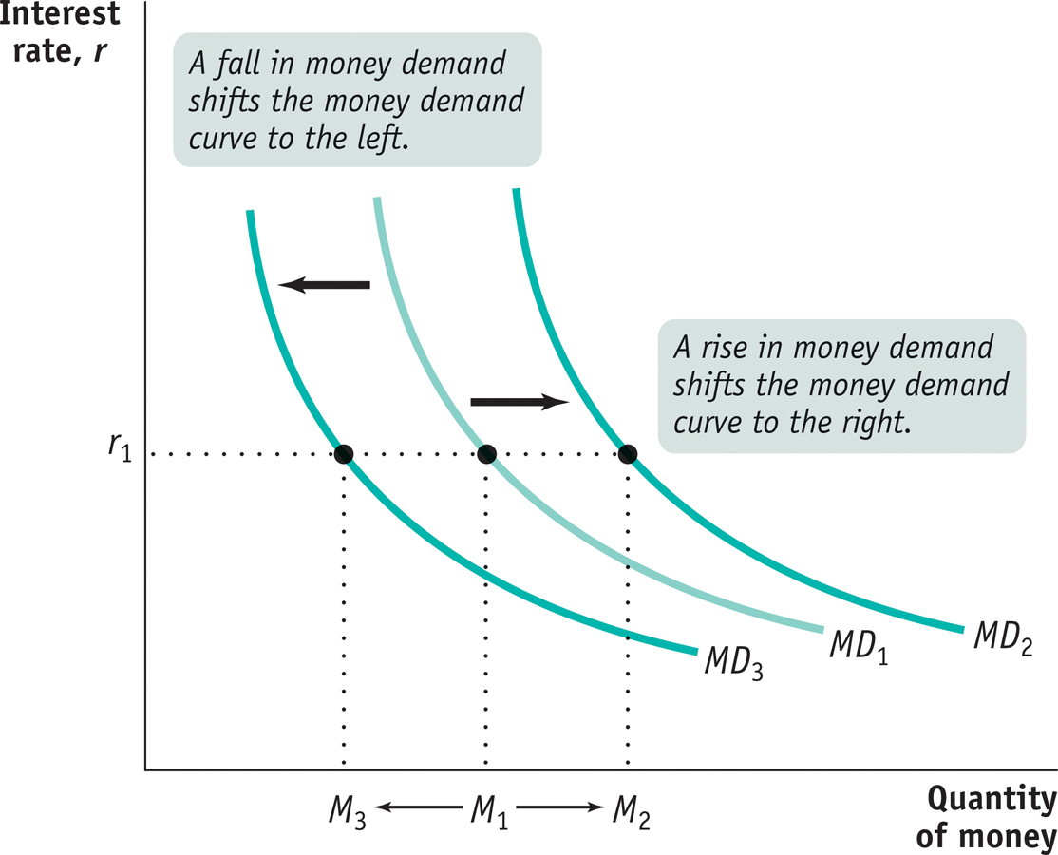
Increases and Decreases in the Demand for Money
Section 5 | Module 28

Slide 9
Money and Interest Rates
According to the liquidity preference model of the interest rate, the interest rate is determined by the supply and demand for money.
The money supply curve shows how the nominal quantity of money supplied varies with the interest rate.
Section 5 | Module 28

Slide 10
Equilibrium in the Money Market
Interest
rate, r
Money supply
curve, MS
r
H
H
Equilibrium
Equilibrium interest rate
r
E
E
L
r
L
MD
M
H
M
M
L
Quantity of money
Money supply
chosen by the Fed
Section 5 | Module 28

Slide 11
Two Models of the Interest Rate
This module has developed the liquidity preference model of the interest rate.
This model is consistent with another model known as the loanable funds model of the interest rate, developed in Module 29.
Section 5 | Module 28

Slide 12
Practice
If a checking account has an interest rate of 1% and a government Treasury bill has an interest rate of 3%, the opportunity cost of holding cash in your wallet is: A. zero. B. 0.02%.
C. 1%.
D. 2%.
E. 3%.
The demand for money is negatively related to _______ and positively related to ______. A. the interest rate; real GDP B. the interest rate; unemployment C. real GDP; the interest rate
D. real GDP; the money supply E. the inflation rate; the interest rate
An increase in the demand for money would result from:
A. a decrease in nominal GDP. B. A decrease in real GDP. C. A decrease in the price level.
D. an increase in the price level. E. an increase in the unemployment rate.

Slide 13
Summary
The money demand curve arises from a trade-off between the opportunity cost of holding money and the liquidity that money provides.
The opportunity cost of holding money depends on short-term interest rates, not long-term interest rates.
Changes in the aggregate price level, real GDP, technology, and institutions shift the money demand curve.
According to the liquidity preference model of the interest rate, the interest rate is determined in the money market by the money demand curve and the money supply curve.
Section 5 | Module 28

