Slide 1

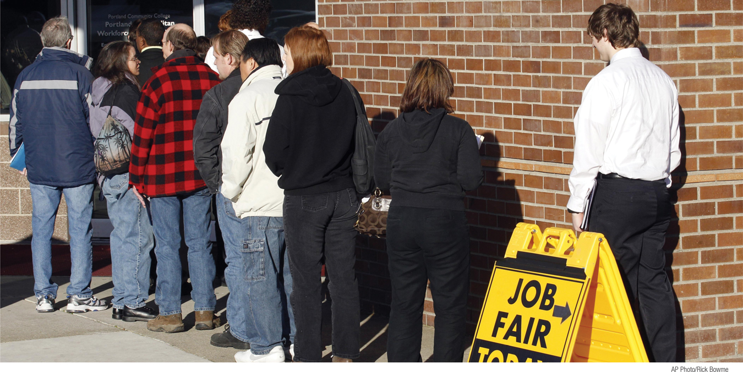

What You Will Learn in this Module
Explain how unemployment is measured
Calculate the unemployment rate
Summarize the significance of the unemployment rate for the economy
Explain the relationship between the unemployment rate and economic growth
Section 3 | Module 12

Slide 2


Unemployment Rate
Employment is the number of people currently employed in the economy, either full time or part time.
Unemployment is the number of people who are actively looking for work but aren’t currently employed.
The labor force is equal to the sum of employment and unemployment.
Section 3 | Module 12

Slide 3
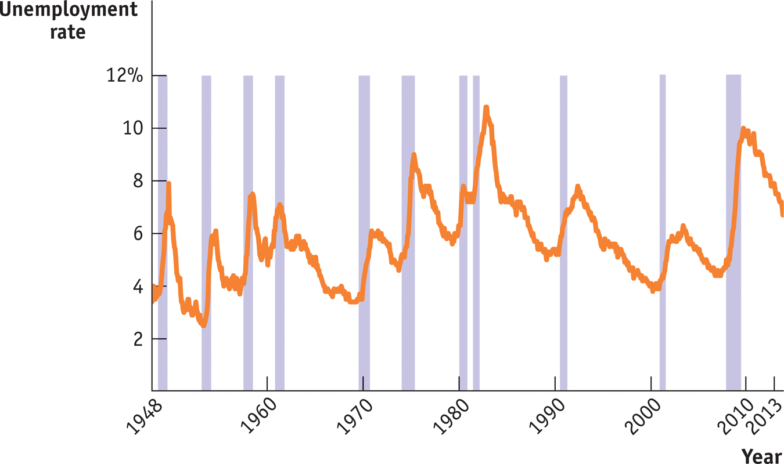
The U.S. Unemployment Rate, 1948-2013
Section 3 | Module 12

Slide 4
Unemployment Rate
The labor force participation rate is the percentage of the population aged 16 or older that is in the labor force.
The unemployment rate is the percentage of the total number of people in the labor force who are unemployed.
Section 3 | Module 12

Slide 5
The Significance of the Unemployment Rate
The unemployment rate can overstate the true level of unemployment while people who are easily employed look for the right job.
Section 3 | Module 12

Slide 6
The Significance of the Unemployment Rate
The unemployment rate can be understated by not including.
  Discouraged workers are nonworking people who are capable of working but have given up looking for a job given the state of the job market.
  Marginally attached workers would like to be employed and have looked for a job in the recent past but are not currently looking for work.
  Underemployment is the number of people who work part time because they cannot find full-time jobs.
Section 3 | Module 12

Slide 7
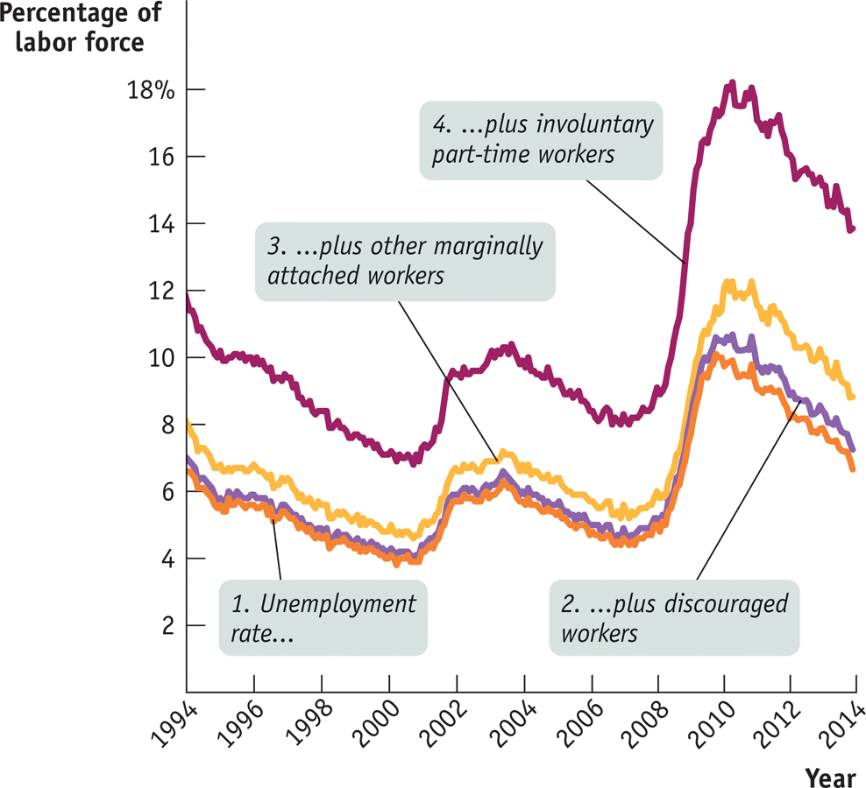
The Significance of the Unemployment Rate
Alternative Measures of Unemployment, 1994–2013
Section 3 | Module 12

Slide 8
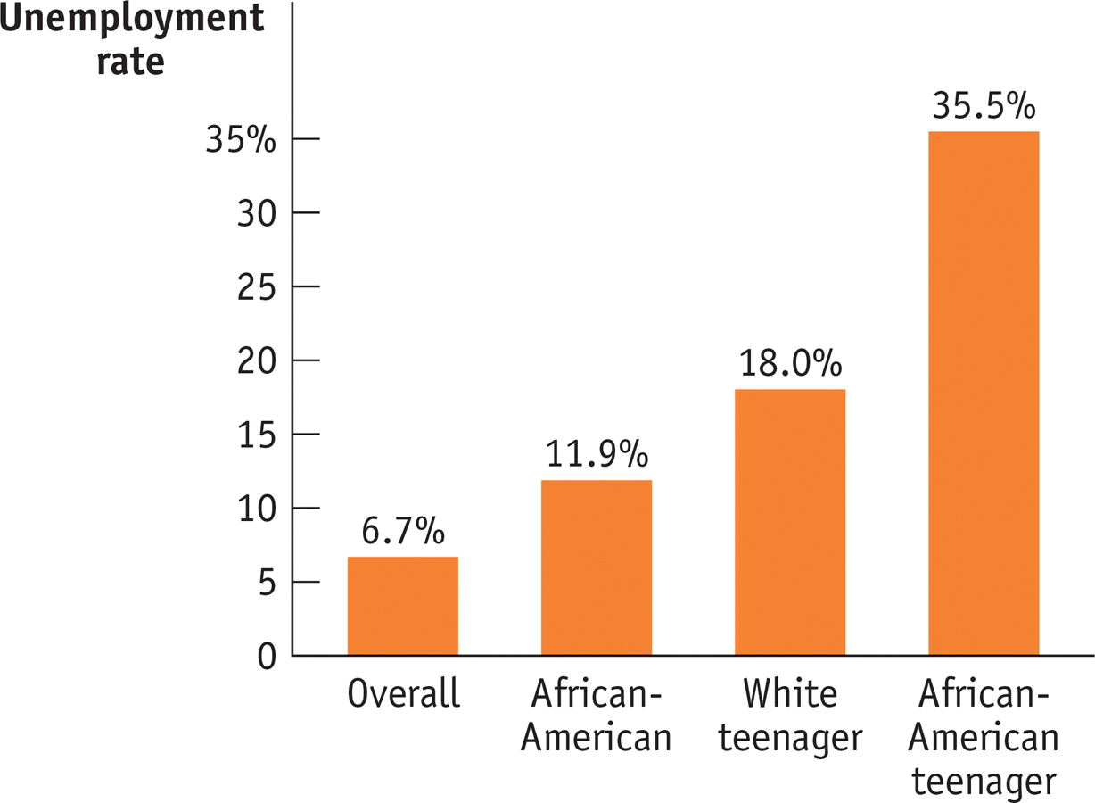
The Significance of the Unemployment Rate
Unemployment Rates of Different Groups, 2013
Section 3 | Module 12

Slide 9
Growth and Unemployment
During every recession in the last 30 years, the unemployment rate rose.
During periods of expansion, the unemployment rate usually falls, however, not always.
Section 3 | Module 12

Slide 10
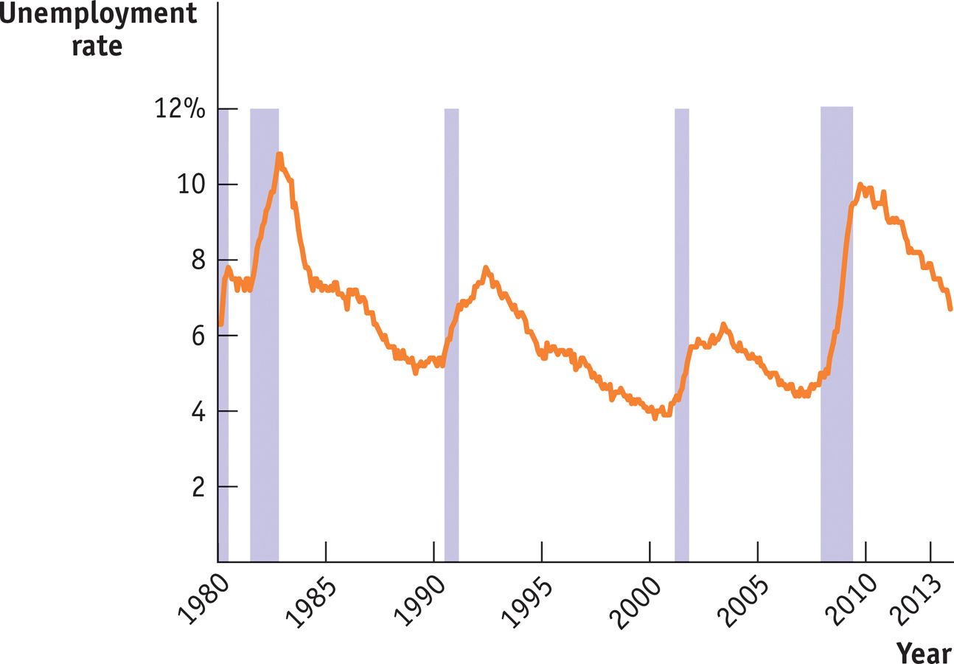
Unemployment Rate
Unemployment and Recessions, 1980-2013
Section 3 | Module 12

Slide 11
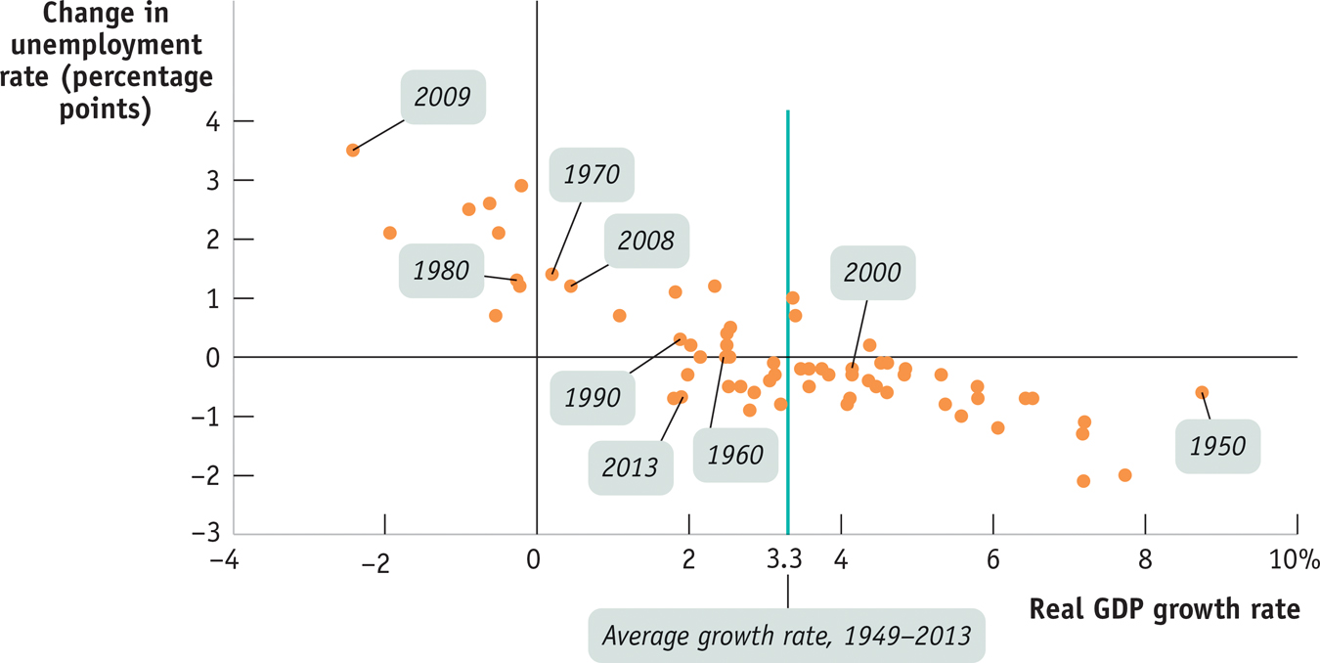
Unemployment Rate
Growth and Changes in Unemployment, 1949-2013
Section 3 | Module 12

Slide 12
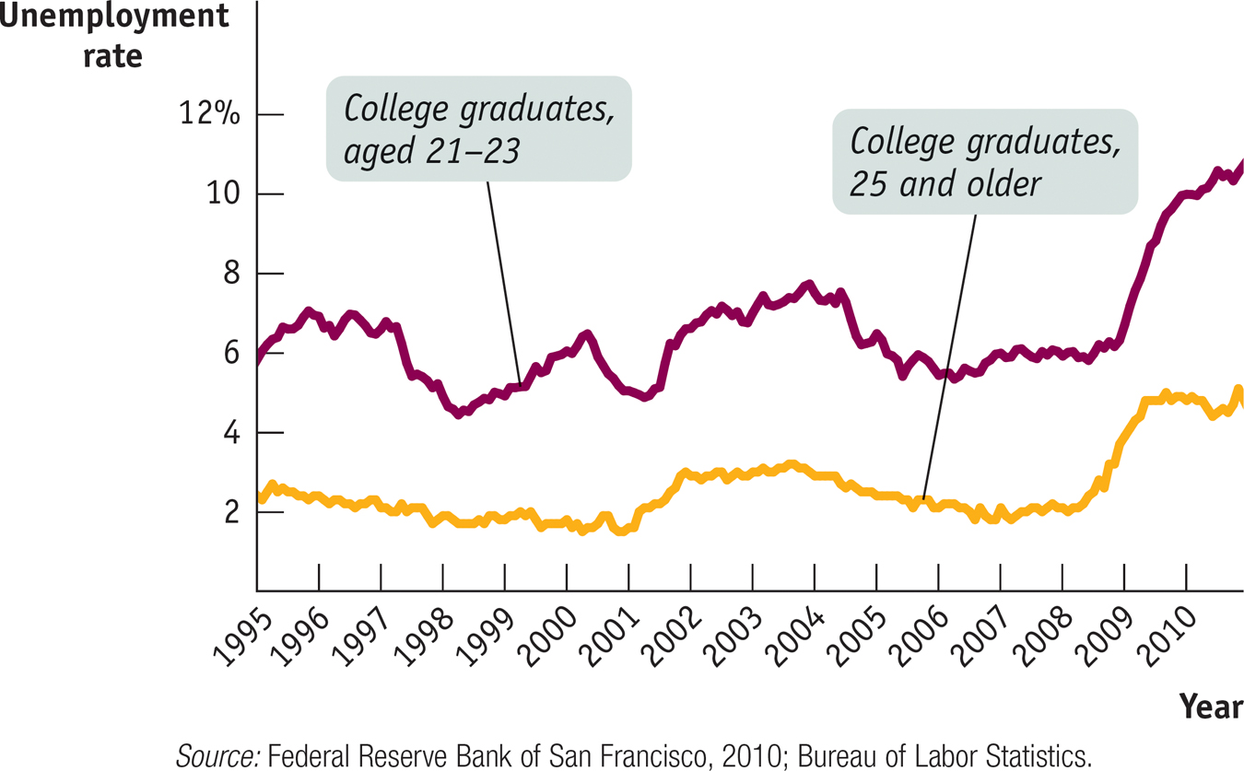
F Y I
Failure to Launch
Section 3 | Module 12

Slide 13
Practice
Appledale has 32,000 full-time residents including 4,000 residents either retired or are too young to work. Of the total, 15,000 residents are employed full time while 8,000 work part time. The town has 2,000 residents not currently working but looking for work. The remaining residents have given up looking for work.
What is the size of Appledale’s work force?
What is Appledale’s employmet rate?
What is Appledale’s unemployment rate?
What percentage of the population are discourages workers?
Suppose a new factory opens that hires 1,000 workers, half of those hired had previously given up finding work
What is the new size of the labor force? New employment rate? New unemployment rate? % of population considered discouraged workers?

Slide 14
1. If a country has a working-age population of 200 million, 135 million people with jobs, and 15 million people unemployed and seeking employment, then its labor force is:
^{A. 335 million.}
^{B. 200 million.}
^{C. 155 million.}
^{D. 150 million.}
^{E. 135 million.}
2. Donna was laid off by her employer at the beginning of 2014. She looked for a job for three months, but could not find anything suitable. She then decided to volunteer for a soup kitchen. Donna is considered to be
^{A. unemployed.}
^{B. underemployed.}
^{C. a discouraged worker.}
^{D. a part time worker.}
^{E. employed.}
3. In general, economic expansions are characterized by:
A. increasing rates of unemployment.
B. decreasing rates of unemployment.
^{C. Decreasing employment.}
D. unchanged rates of employment.
E. unchanged rates of unemployment.

Slide 15
Summary
Employment is the number of people employed.
Unemployment is the number of people unemployed and actively looking for work.
The sum of employment and unemployment is equal to the labor force.
The labor force participation rate is the percentage of the population age 16 or older that is in the labor force.
The unemployment rate can overstate because it counts as unemployed those who are continuing to search for a job despite having been offered one.
The unemployment rate can understate because it ignores frustrated workers, such as discouraged workers, marginally attached workers, and the underemployed.
Section 3 | Module 12

